Slide 1
Workforce development as outreach for surveyors
Esra Tekdal Yilmaz,
Frank Derby, Elizabeth Hughes, Jane Ashton

Slide 2
Earth Conservancy
A nonprofit organization
founded in 1992 to
address the impacts of past coal mining operations in Luzerne County, Pennsylvania.
Operations center on the former holdings of the Blue Coal Corporation, which total nearly 16,500 acres.

Slide 3
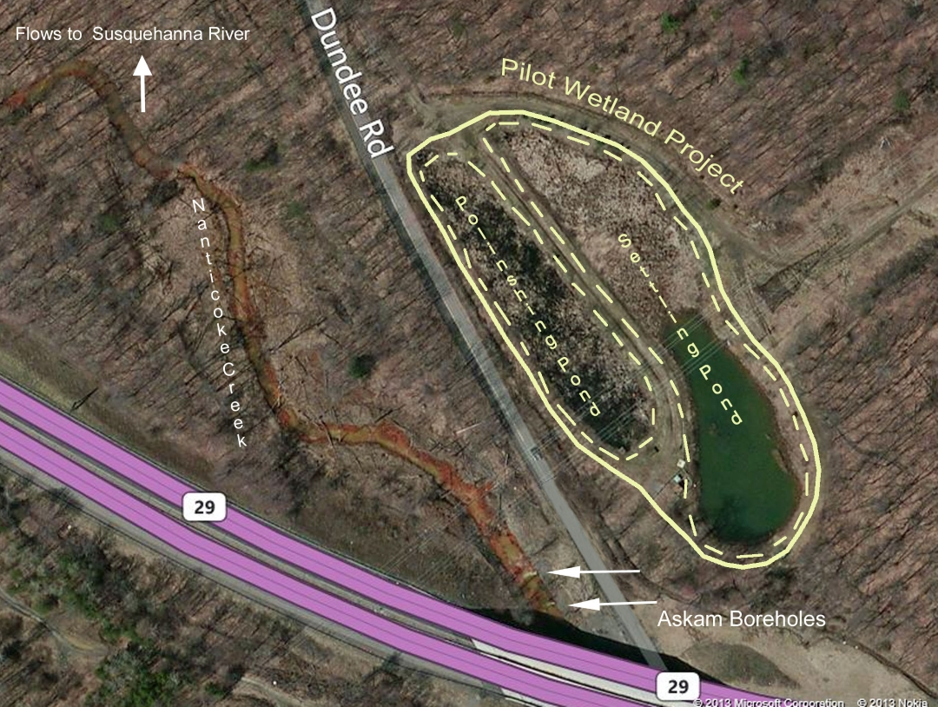
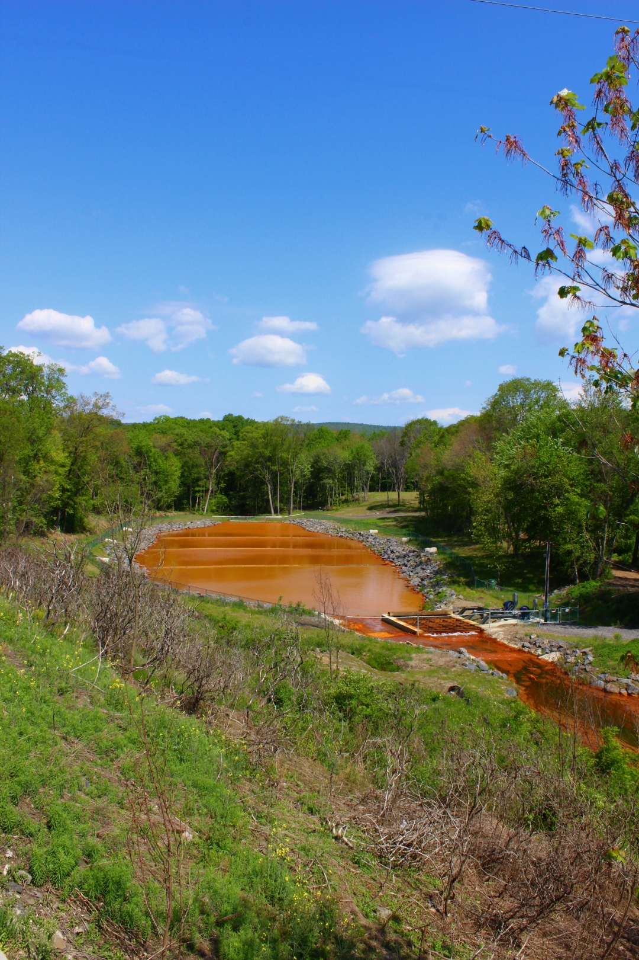
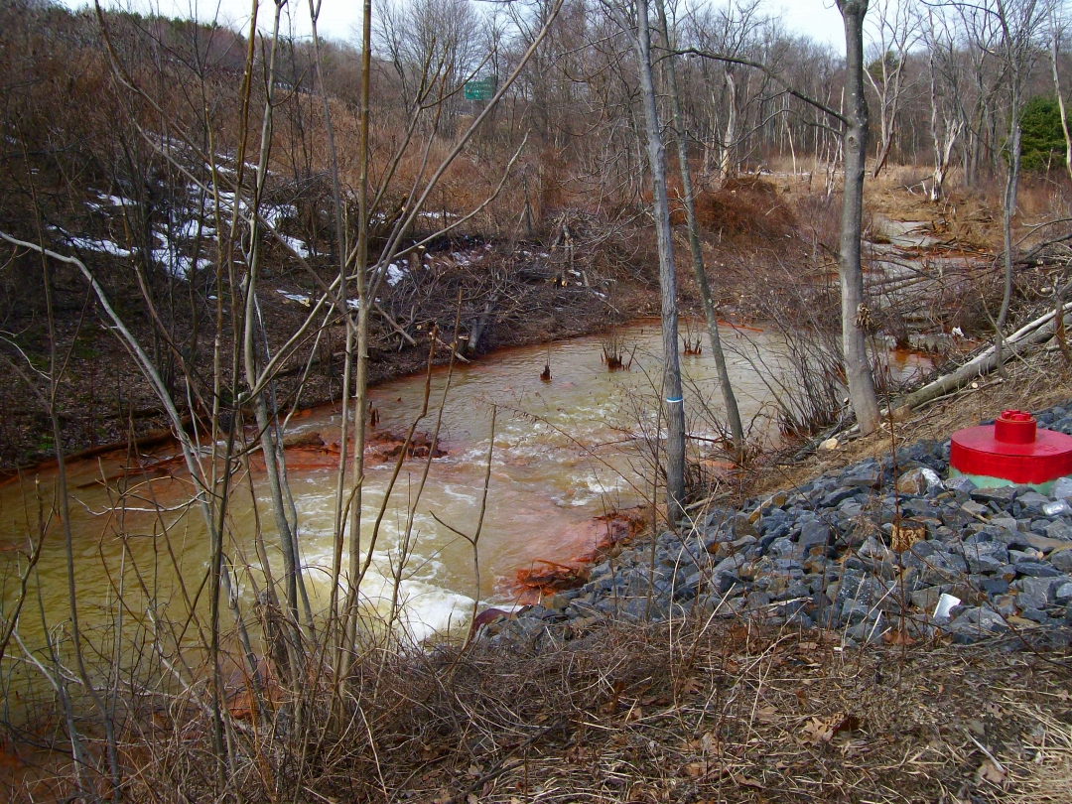
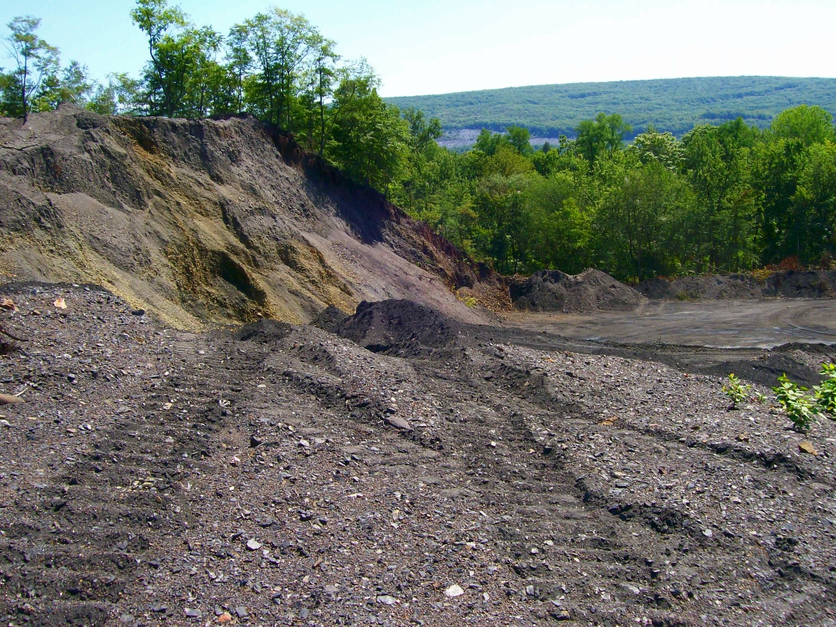
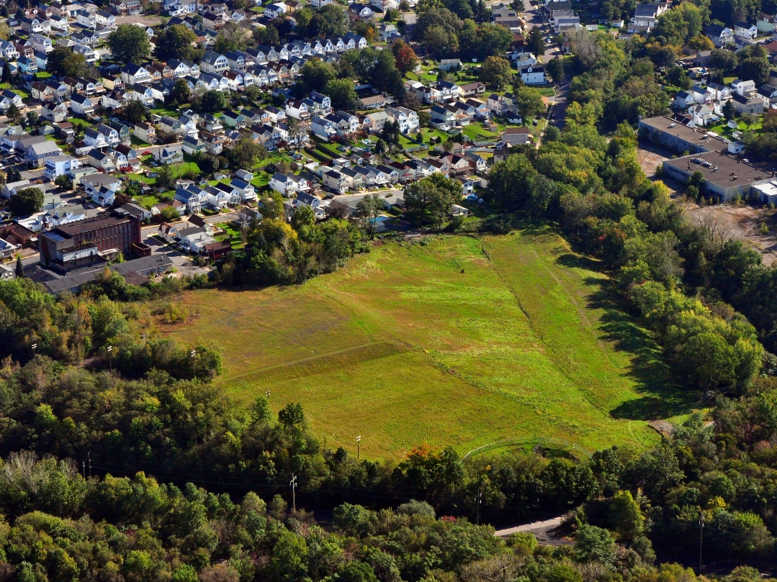
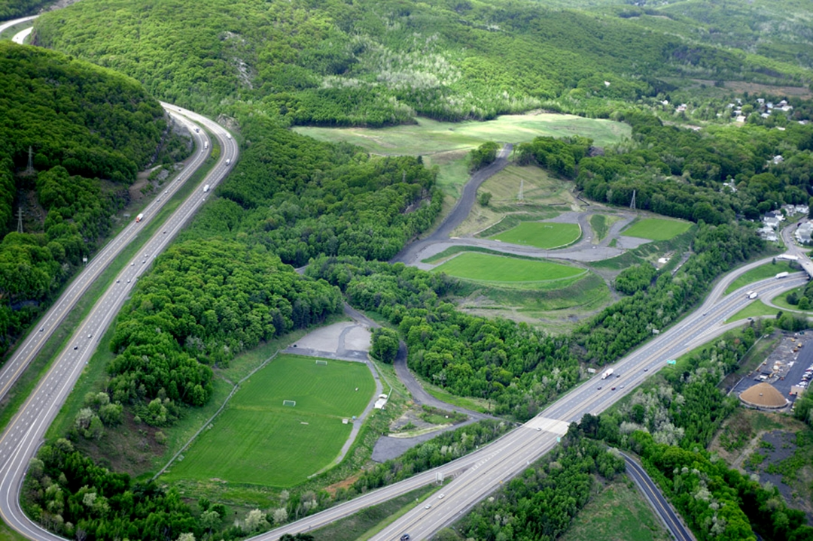
Environmental problems

Slide 4
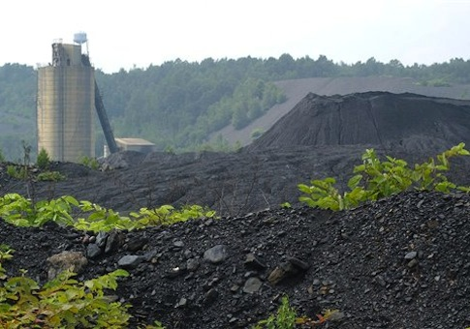
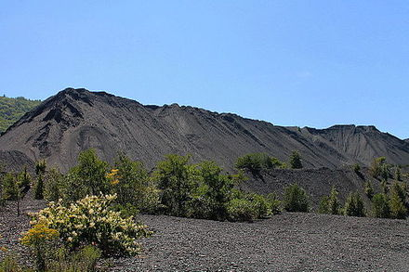
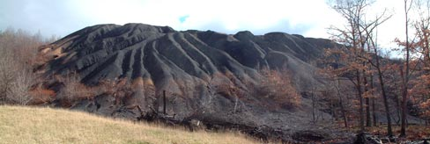
The environmental problem

Slide 5
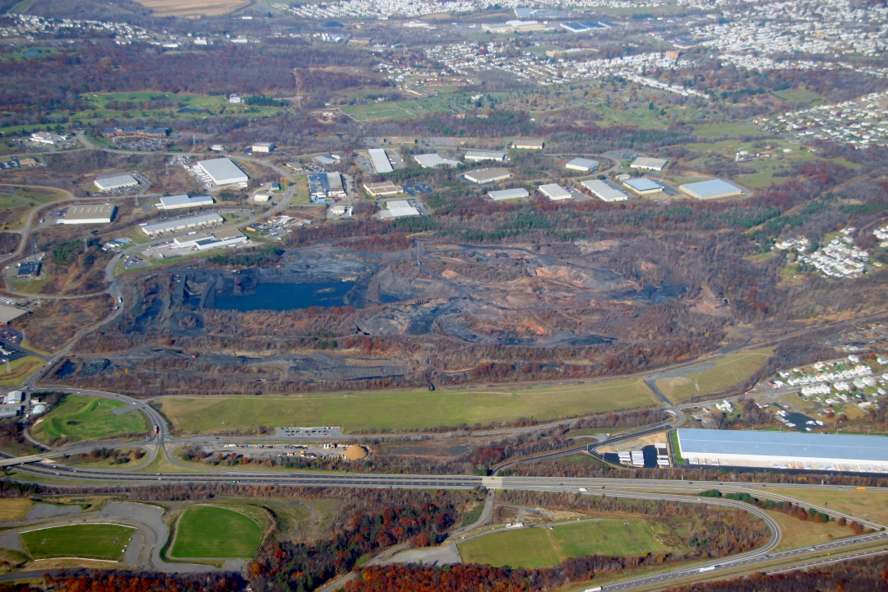
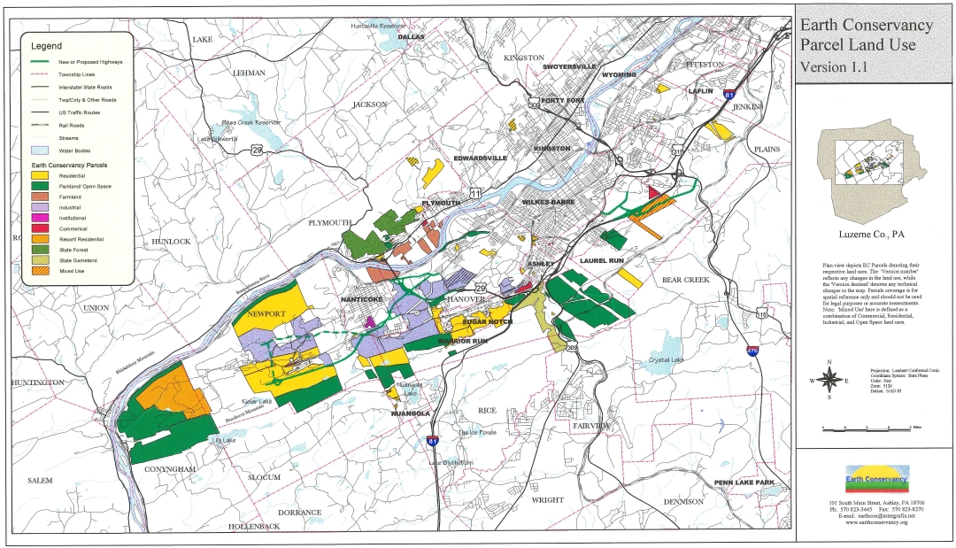
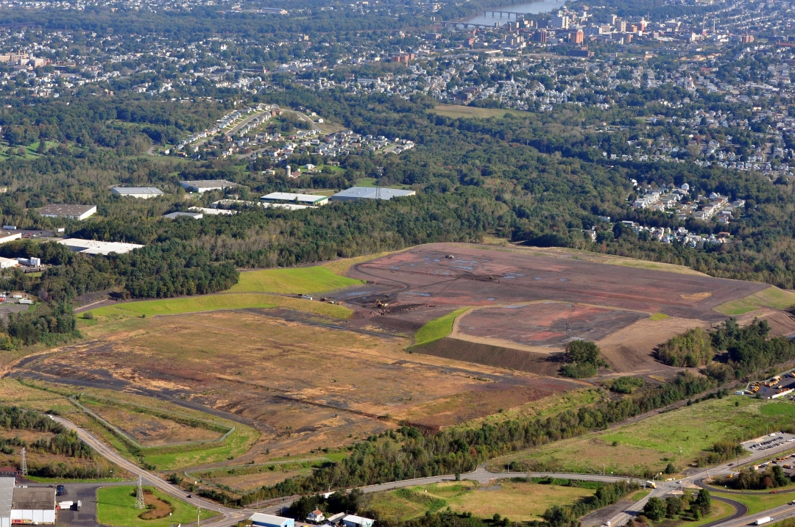
The solution

Slide 6
The Environmental Workforce Training Program?
EPA Grant of $200,000 (in 2017)
To support Environmental Protection Agency’s Environmental Workforce Development and
Environmental Workforce Development Job Training (EWDJT) program
To implement a new job training program for local unemployed and underemployed residents, including veterans, in the Scranton–Wilkes‑Barre–Hazleton metro area.
Another way the Earth Conservancy can help encourage revitalization in our region.

Slide 7
The Problem
Although the mines closed decades ago, northeastern Pennsylvania is still dealing with environmental and economic challenges from the demise of the anthracite mining industry.
The EWT program was designed to address environmental and economic revitalization.
Developing abandoned mines , brown fields, and impacts of acid rain
Environmental Workforce development focusing on land surveying, and developing skills in technologies required in the reclamation and remediation process.

Slide 8











partners
Strong partnerships are the cornerstone of the EWT program, chief among them are:
Penn State Wilkes‑Barre’s Surveying Engineering department
Penn State Wilkes-Barre Office of Continuing Education.
Luzerne/Schuylkill Workforce Investment Board,
Lackawanna County Workforce Development Board,
Pocono County Workforce Development Board,
The Northern Tier Regional Planning & Development Commission,
Pennsylvania CareerLink®,
The Employment Opportunity & Training Center (EOTC),
The Eastern Pennsylvania Coalition for Abandoned Mine Reclamation (EPCAMR).
Many local engineering firms also contributed to the grant proposal, offering program comments and agreeing to participate in coursework and interviewing of program graduates.

Slide 9
The Curriculum
The EWT program provides a comprehensive and realistic curriculum to participants seeking to enter an environmentally oriented career in the Wyoming Valley. The curriculum, designed by a team at Penn State Wilkes‑Barre, consists of 205 contact hours over the course of four months. Tuition is underwritten by a grant from the U.S. Environmental Protection Agency (EPA) — a $4,289/person. Courses include:
Introduction to Brownfields
OSHA 40-Hour HAZWOPER Training
AutoCAD, Level I
Surveying Field Assistant
Basic Land Surveying Techniques
GIS for Resource Conservation
OSHA 10-Hour Safety Training
First Aid/CPR/AED

Slide 10
The Curriculum

Slide 11
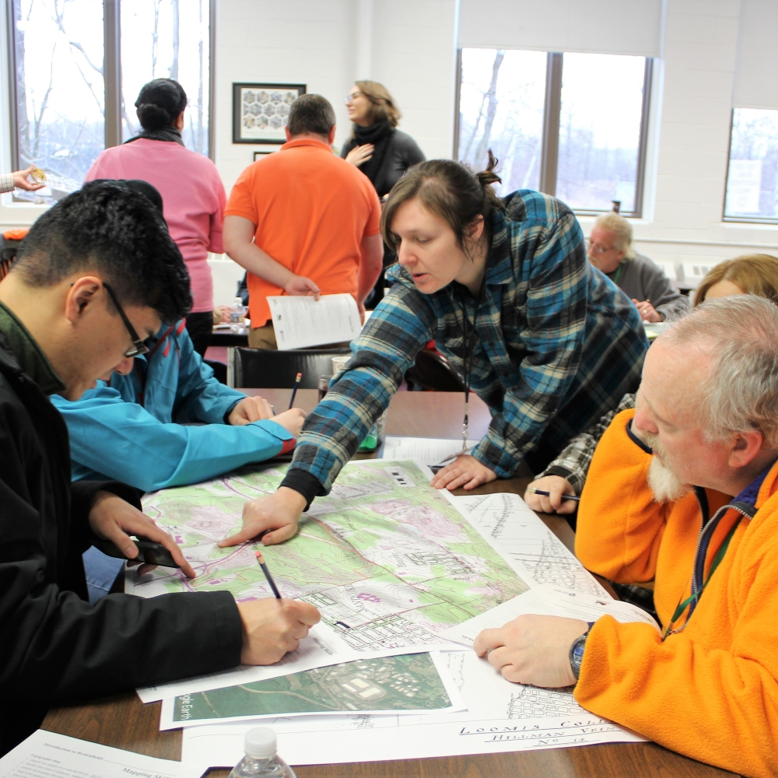
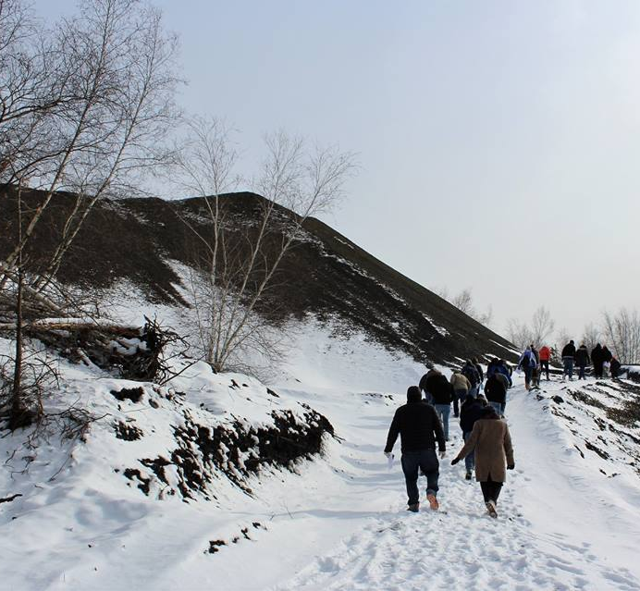
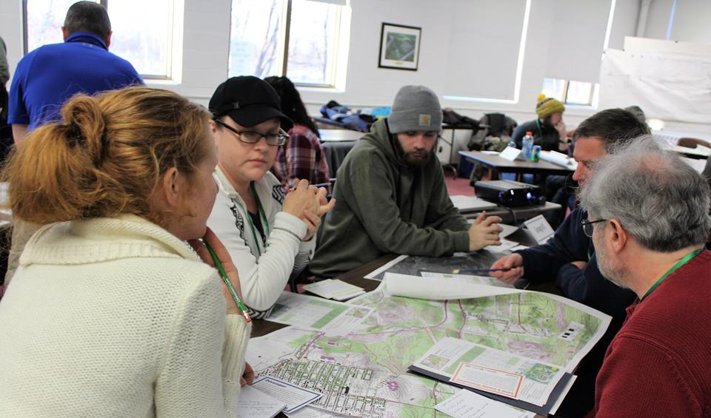
Introduction to Brownfields

Slide 12
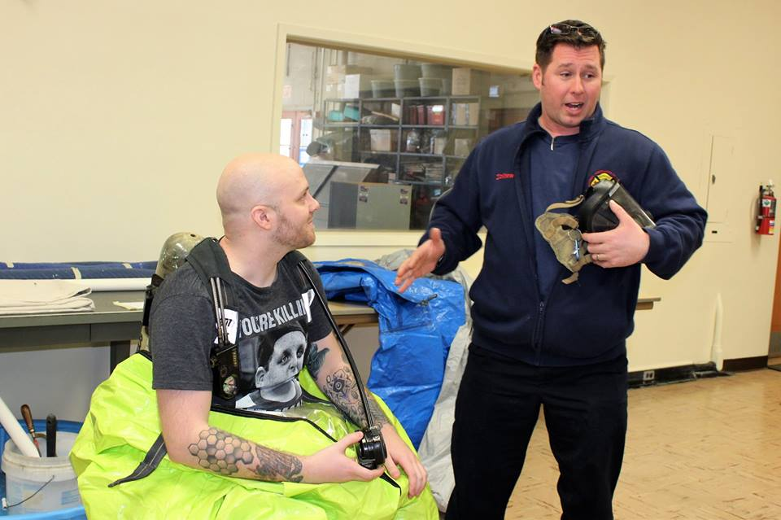
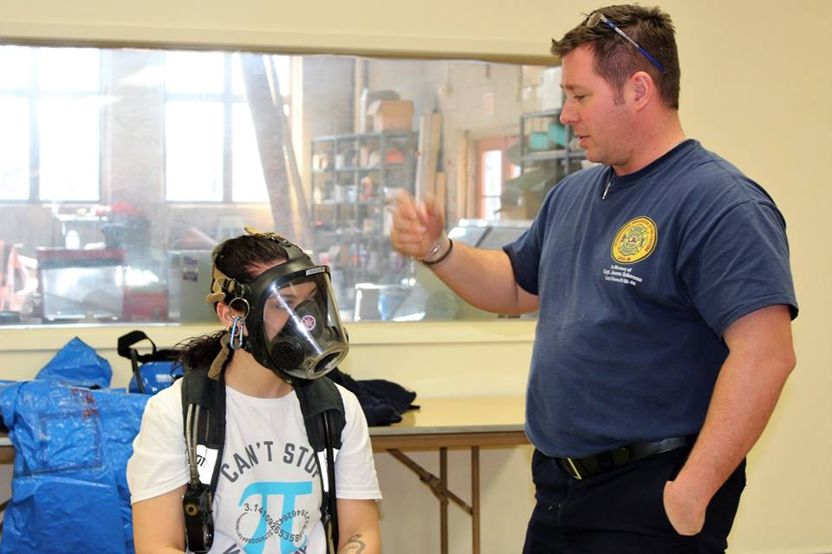
OSHA OSHA 40-Hour HAZWOPER Training

Slide 13
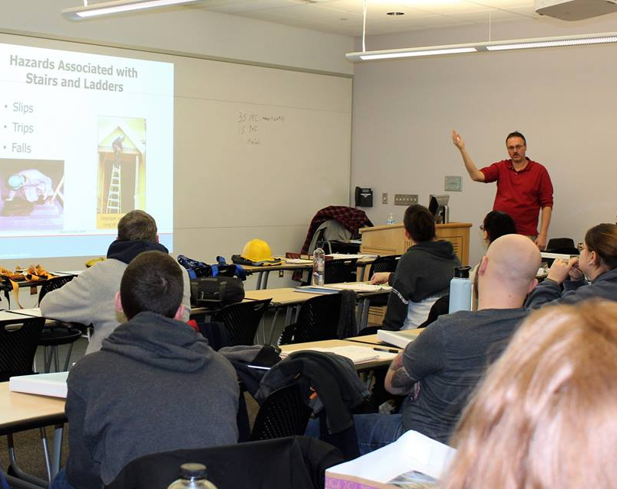
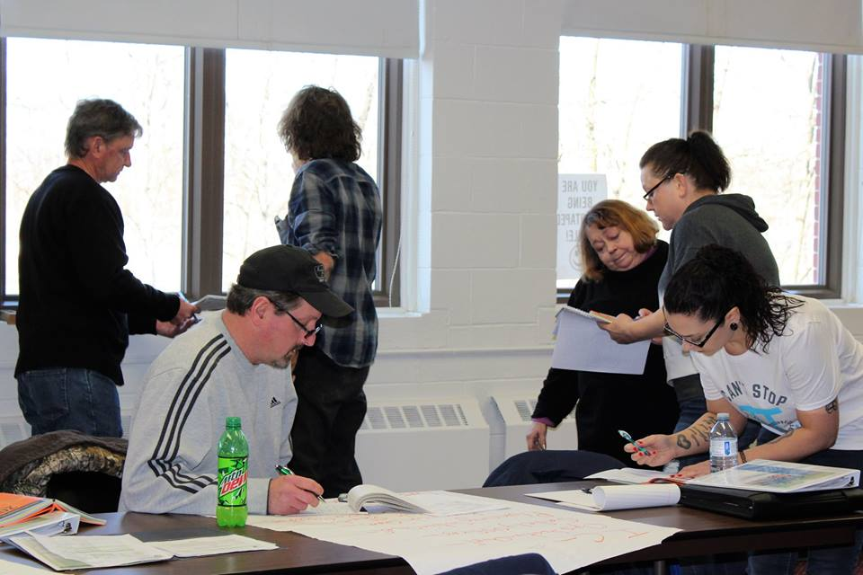
OSHA 10-Hour Safety Training

Slide 14
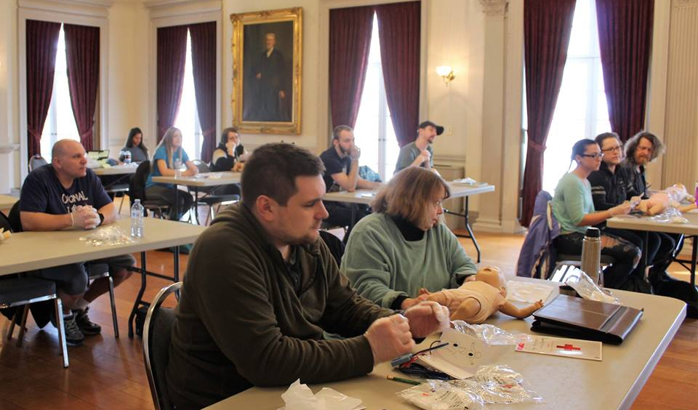
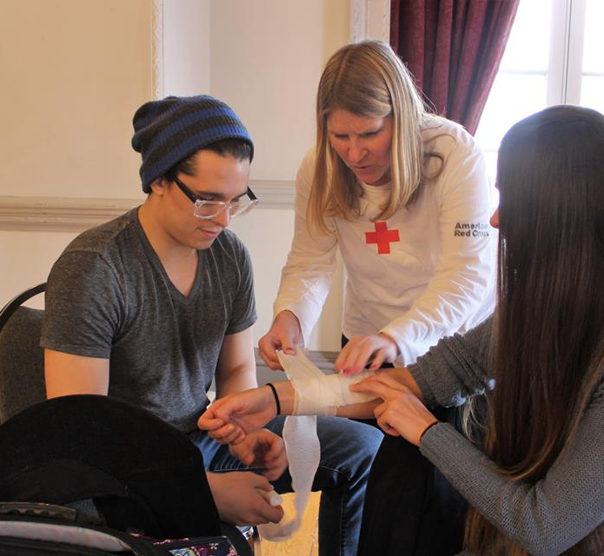
First Aid/CPR/AED

Slide 15
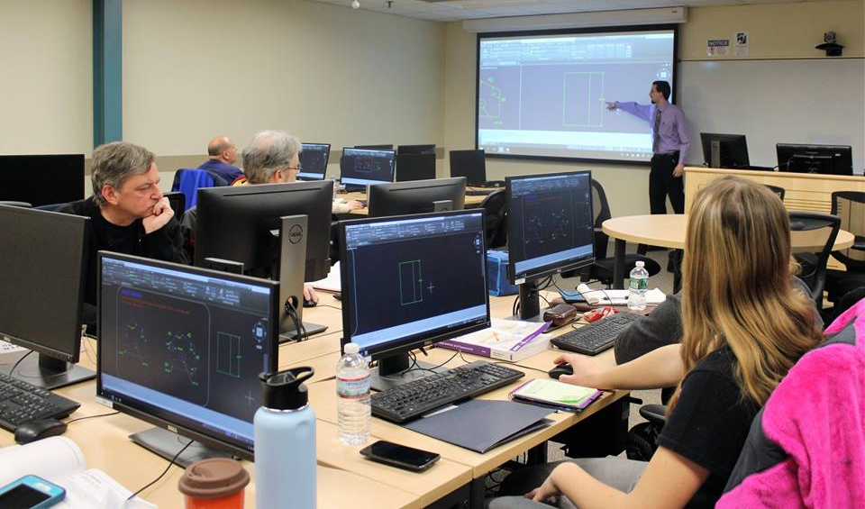
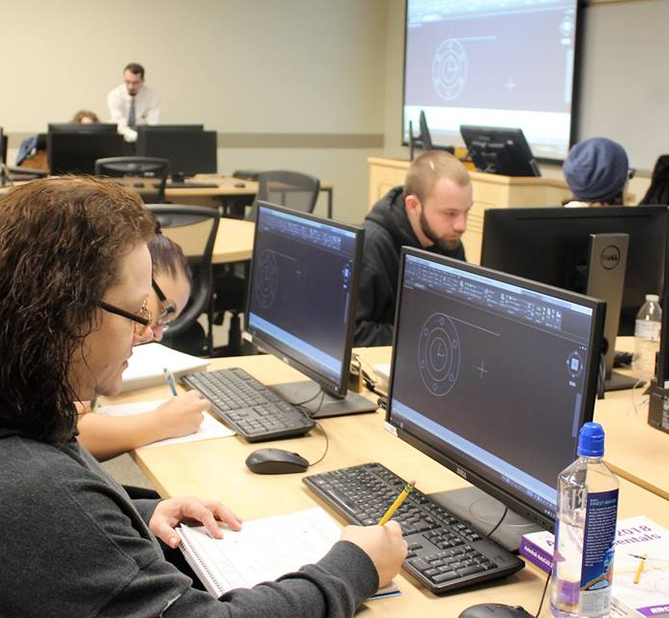
AutoCAD

Slide 16
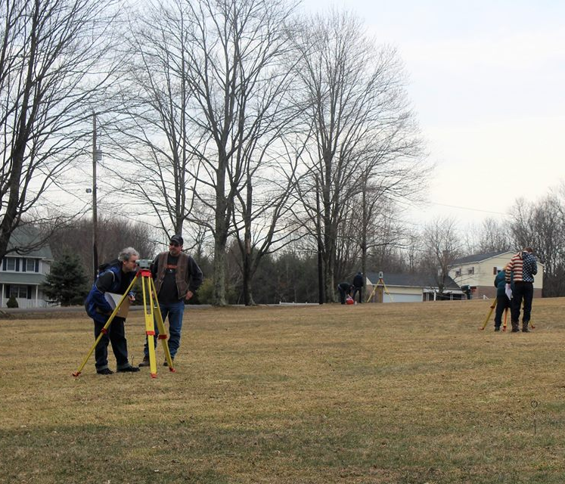
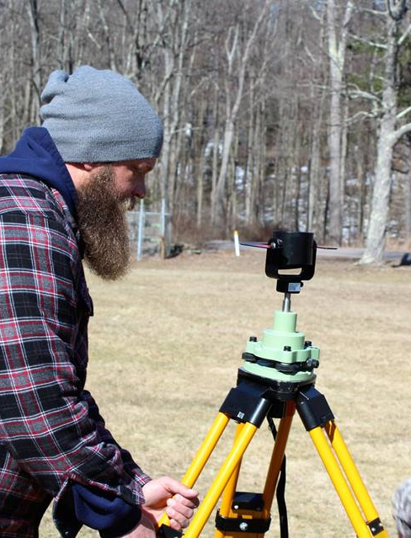
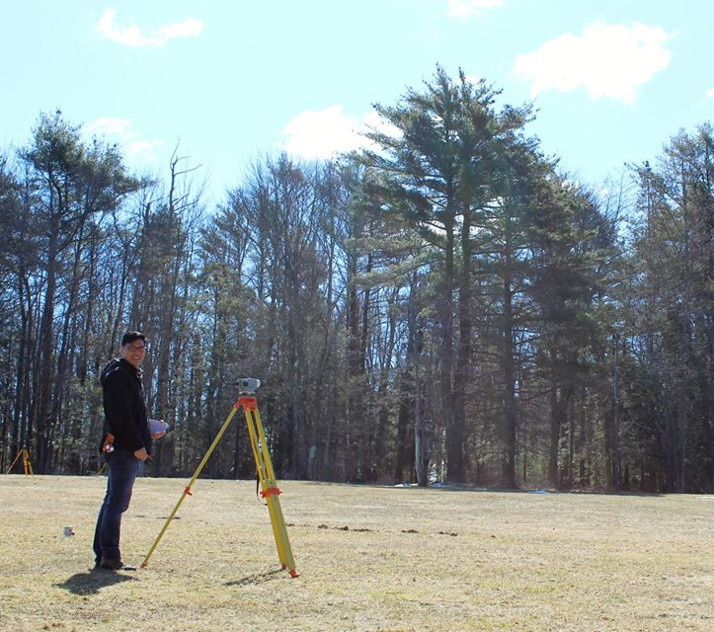
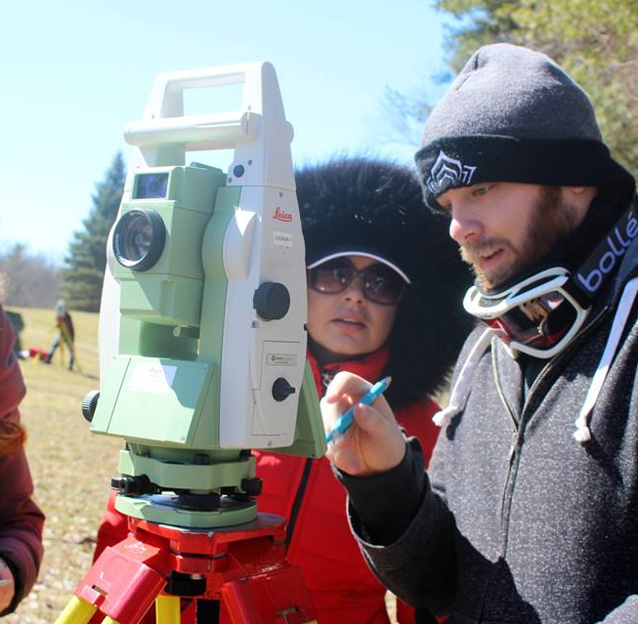
Surveying Field Assistant

Slide 17
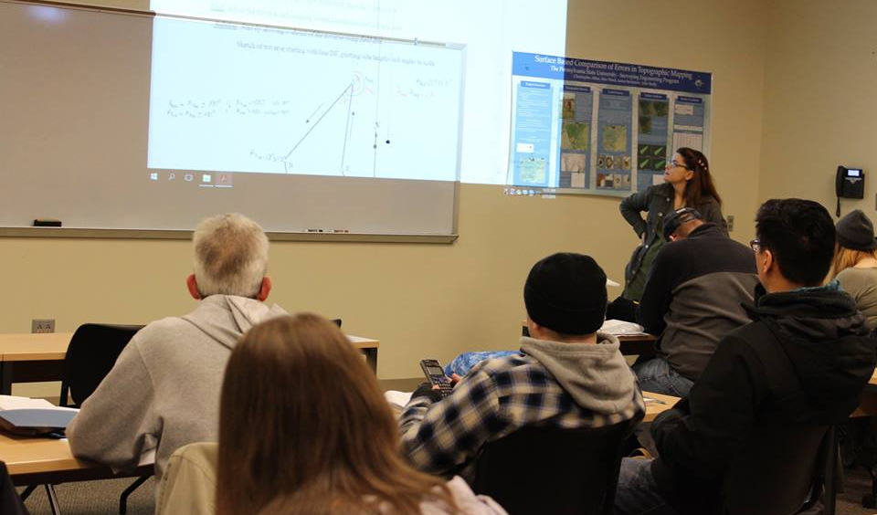

Basic Land Surveying Techniques

Slide 18
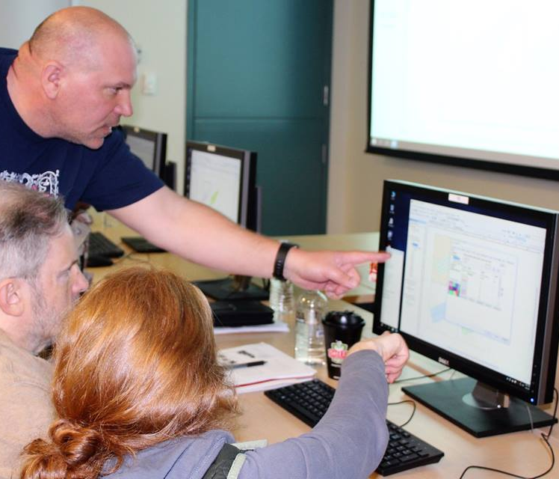
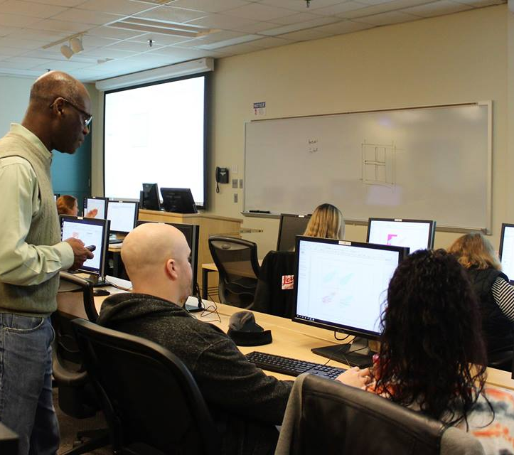
GIS for Resource Conservation

Slide 19
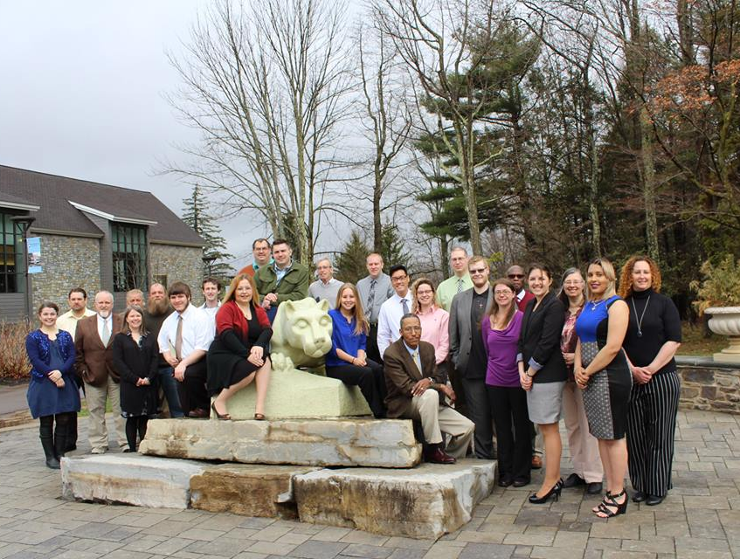

The Results
Upon graduation, participants will have skills and certifications that can lead to exciting careers in engineering, construction, remediation, environmental cleanup, and more. The Earth Conservancy and its partners will work with graduates to help find employment opportunities. Graduates leave the EWT program with
20.5 hours of continuing education units from the Pennsylvania State University
3 federal certifications (HAZWOPER 40, OSHA 10, First Aid)
professional résumé and cover letter
letter of recommendation

Slide 20
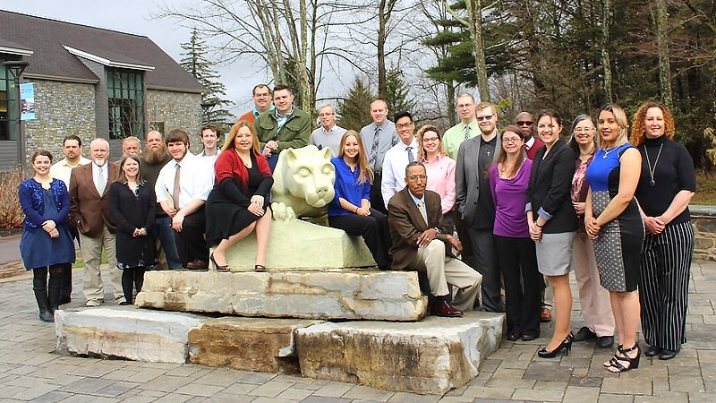

Slide 21
the Results
The End
Participants will be tracked for a whoe year and employment support wil be provided dutring that period
So far the first cohort of 23 participants have achieved 100% employment.
The second cohort of 21 participants completed the program in May and they are being tracked. It is anticipated that they also will achieve 100% job placement.

