Slide 1
Leveraging non-Traditional Educational Opportunities
in support of the
2014 NSPS Education Policy Statement
presented by:
A. Richard Vannozzi, MS, PLS
School of Engineering Technology
University of Maine
Orono, Maine
anthony.vannozzi@maine.edu
Surveying and Geomatics Educators Society Conference
Nicholls State University, Thibodaux, LA
August 5, 2019
© A.R. Vannozzi 2019

Slide 2
The 2014 NSPS Education Policy Statement:
“The official position of the National Society of Professional Surveyors shall be that a Bachelor’s Degree in Surveying, Surveying Engineering, or Surveying Engineering Technology be the minimum educational requirement for licensure as a Land Surveyor in all jurisdictions.”
© A.R. Vannozzi 2019

Slide 3
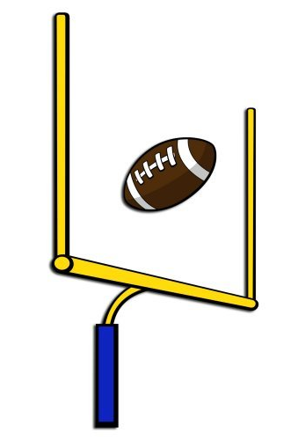
Major Factors driving the realization of the Policy:
Regional Approach White Paper (1974);
Technological Advances (1970’s to date);
Body of Knowledge Publication (2011);
NSPS 100% Membership Program (2014).
© A.R. Vannozzi 2019

Slide 4
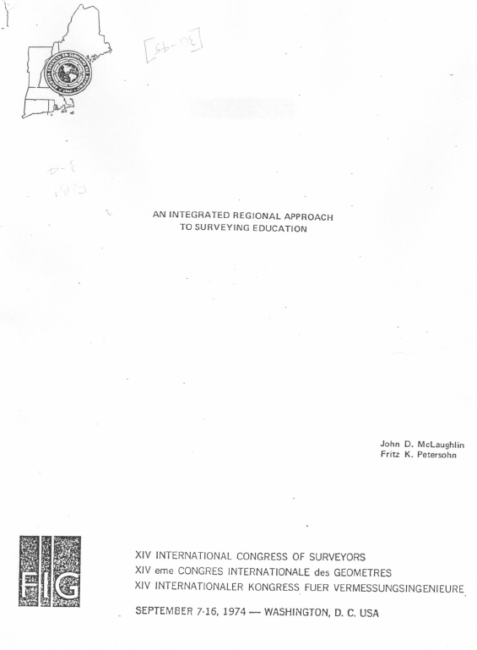
Regional Approach White Paper (1974):
Provided the framework for creating regional BS/MS/PhD programs;
Described a local/state focused system of AS programs to feed into these regional programs.
© A.R. Vannozzi 2019

Slide 5
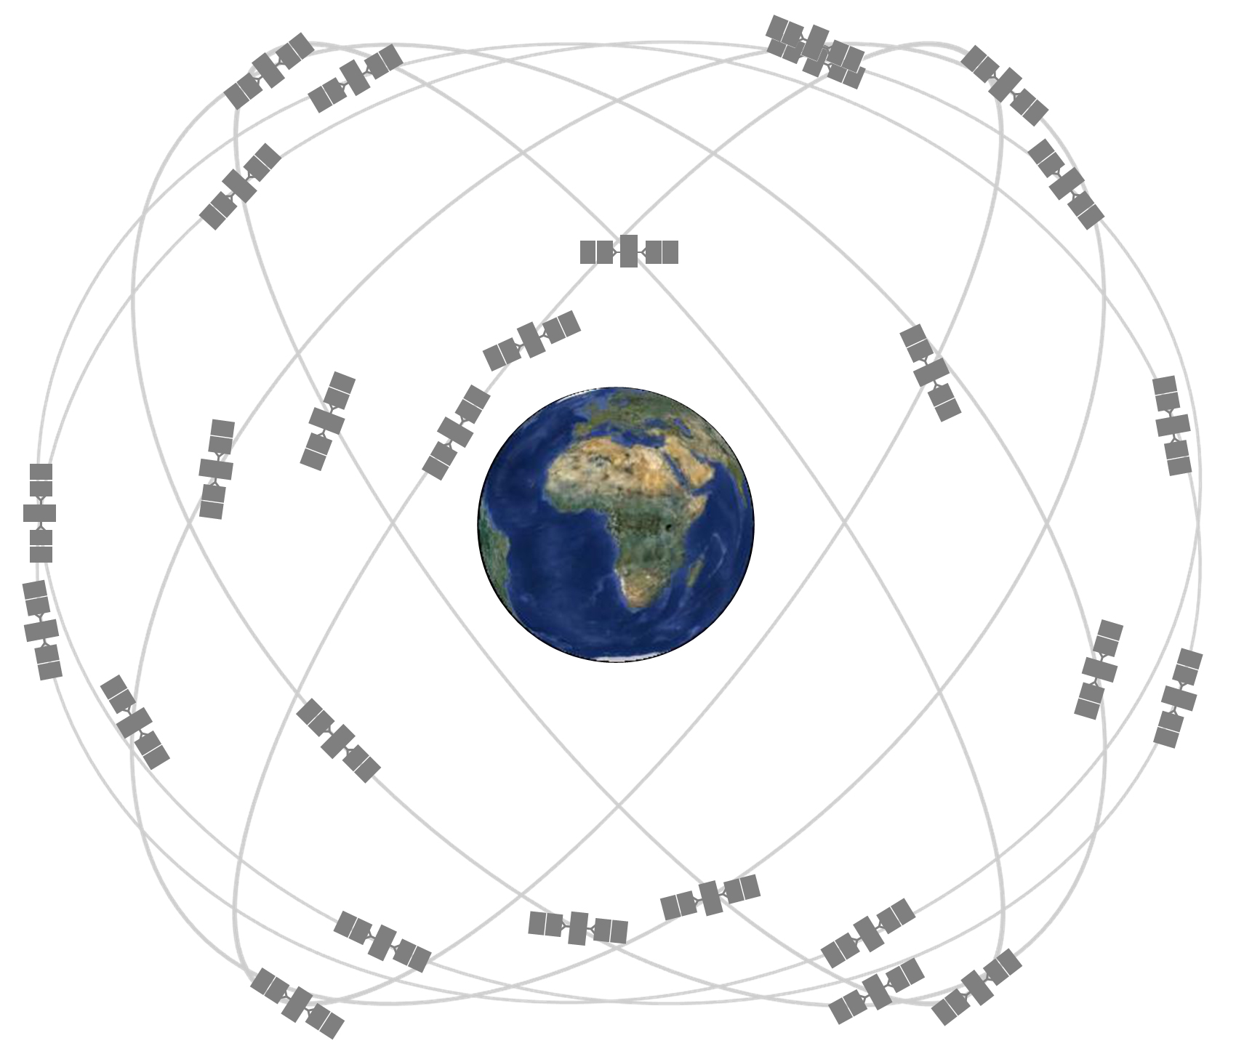
Technological Advances (1970’s to date):
Pace of new technology adoption in practice outstrips historic apprenticeship/mentor education licensure model:
Licensees unable to adequately provide education to mentees since they lacked knowledge themselves;
Need for theoretical knowledge to support practice- based decision process increased;
Simply put: The earth is no longer flat.
https://www.gps.gov/systems/gps/space/
© A.R. Vannozzi 2019

Slide 6
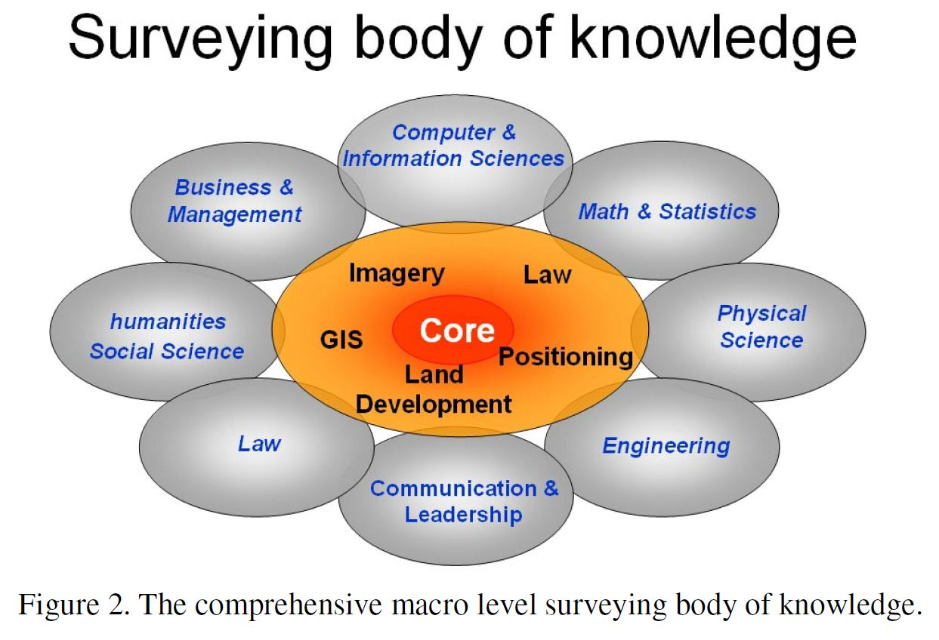
Body of Knowledge Publication (2011):
Articulated the basis for Surveying as a separate and distinct profession:
Defined the breadth and depth of knowledge necessary to competently practice;
Inescapably evident that the knowledge (quantity and quality) necessary for competent practice requires a bachelor’s degree in the discipline.
© A.R. Vannozzi 2019

Slide 7
NSPS 100% Membership Program:
Realization that creating an educated profession was a national issue and required national leadership:
Larger, more engaged, Board of Directors;
Focused roll in providing support for local/state initiatives.
© A.R. Vannozzi 2019

Slide 8
Major factors hampering the realization of the Policy:
General lack of public awareness of surveying as a career/education choice;
Introduction to profession remains technician experience;
Limited access to formal surveying education until recently.
© A.R. Vannozzi 2019

Slide 9
General public awareness of surveying
as a career/education choice:
Get Kids into Survey
https://www.elaineball.co.uk/campaigns/
© A.R. Vannozzi 2019

Slide 10
General public awareness of surveying
as a career/education choice:
American School Counselor’s Association
https://www.ascaconferences.org/
© A.R. Vannozzi 2019

Slide 11
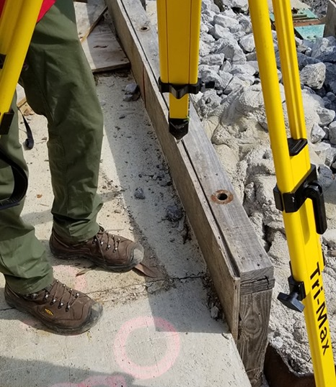
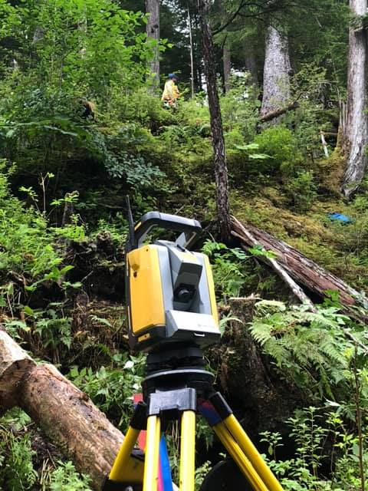
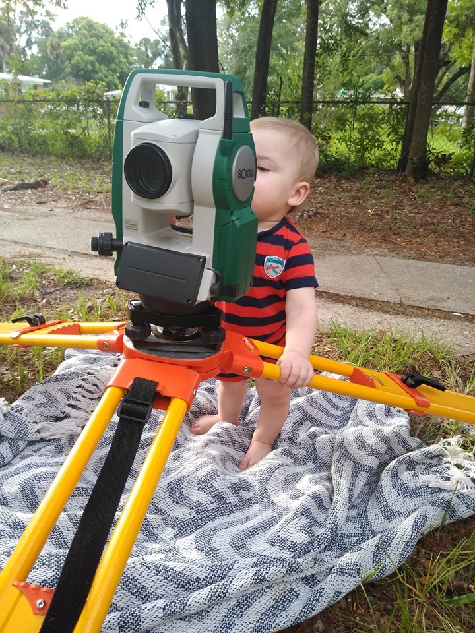
Introduction to profession remains technician experience:
Note: Photographs found on “The Field Crew” Facebook page.
© A.R. Vannozzi 2019

Slide 12
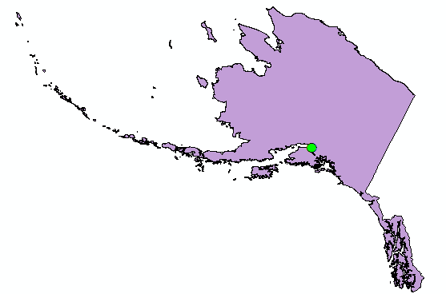
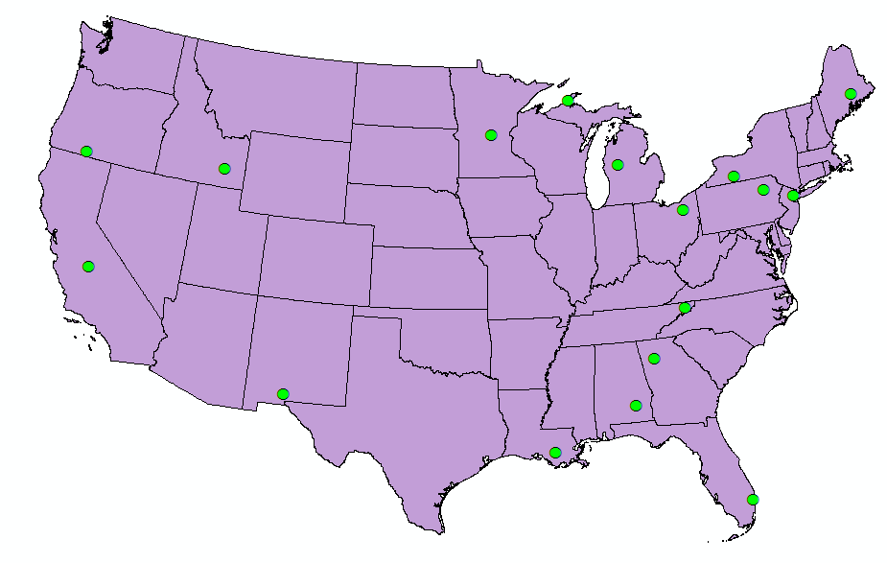
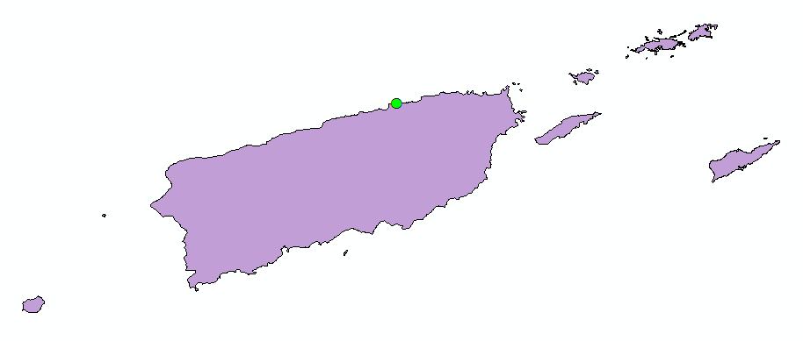
Access to surveying education:
2017 ABET Identified “Surveying” or “Geomatics” Baccalaureate Programs (n=19) Note: 2019: (n=20)
Note: Above graphics from “Surveying Minors in Civil Engineering Degree Programs: Fresh Look at an Old Model” presented by this author at SAGES conference, 2017.
© A.R. Vannozzi 2019

Slide 13
Reality Check: Outreach
General public awareness of surveying as a career/education will take years to bear fruit (Increased enrollments);
These outreach efforts are critical;
Bring in young future practitioners (greater exposure = more diverse pool of future professionals);
Change public image of surveying.
© A.R. Vannozzi 2019

Slide 14
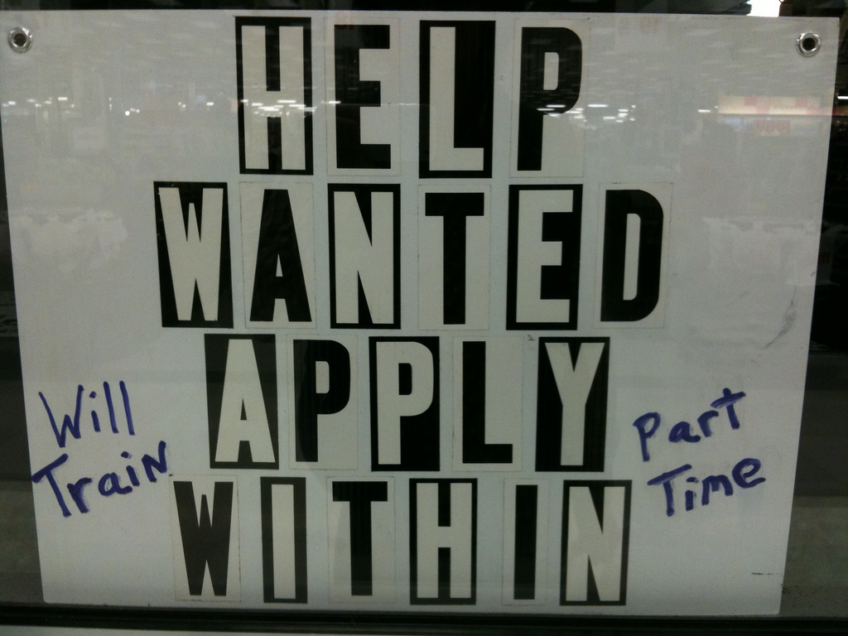
Reality Check: Today’s Entry Level Personnel
Current economic growth is emphasizing that the introduction to the profession remains technician experience;
Without education there is little or no career advancement (Technician or Professional).
© A.R. Vannozzi 2019

Slide 15
Reality Check: Access
Limited growth in the number of traditional programs;
Nearly all traditional programs have experienced viability-threatening events;
Mixed progress on program stability factors;
Low enrollments (For STEM disciplines)
High equipment costs
Difficulty attracting qualified instructors
Retirement continuity
Endowed faculty positions
Research funding scarce
© A.R. Vannozzi 2019

Slide 16
NSPS: Promoted Education Models
Existing “bricks and mortar” baccalaureate programs;
Associate degree completers conversion to baccalaureate studies;
Certificate programs;
Surveying minors in Civil Eng programs (coupled with a Masters degree);
On-line baccalaureate degree programs.
© A.R. Vannozzi 2019

Slide 17
Existing “bricks and mortar” baccalaureate programs
Pros:
Open for discovery by widest population
who are “looking” for a career (High Schoolers).
Singular focus
Challenges:
Awareness
© A.R. Vannozzi 2019

Slide 18
Associate degree completers conversion to baccalaureate studies often with geographic move
Pros:
Demonstrated academic success
Less demand for faculty (transfer credit)
Challenges:
Often requires geographic move
© A.R. Vannozzi 2019

Slide 19
Certificate programs
Pros:
Viable option in states without 4-year surveying degree requirements
Viable option for those with non-surveying baccalaureate
Precursor to an On-line Masters degree
Challenges:
Availability of equipment and instructors if not coupled with other related programs
© A.R. Vannozzi 2019

Slide 20
Surveying minors in Civil Engineering programs
Pros:
Viable option in states without 4-year surveying degree requirements
Precursor to an On-line Masters degree
Challenges:
Availability of equipment and instructors if not coupled with other related programs
© A.R. Vannozzi 2019

Slide 21
On-line baccalaureate degree programs
Pros:
No geographic constraints
National access problem is solved
Challenges:
Revised pedagogical approaches need to be accepted
ABET outcomes need to be carefully accounted for
Relevant to licensed practice and NCEES expectations
© A.R. Vannozzi 2019

Slide 22
NSPS Education Policy:
What is and what it is not
Long-range policy requiring patience;
Recognition that every jurisdiction is not on the same timeline;
Policy supports ALL efforts to increase the education requirements for licensure;
Models recognized and communicated through the NSPS Education Committee;
Identify a problem – Choose a model – One size does not fit all.
© A.R. Vannozzi 2019

Slide 23
Leveraging non-Traditional Educational Opportunities
in support of the
2014 NSPS Education Policy Statement
Questions?
presented by:
A. Richard Vannozzi, MS, PLS
School of Engineering Technology
University of Maine
Orono, Maine
anthony.vannozzi@maine.edu
© A.R. Vannozzi 2019

