Slide 1


USING A gis Platform to develop a boundary survey plat compliance training/checking tool
“2019 Surveying and Geomatics Educators Society Conference” (SaGES)
August 5, 2019, Thibodaux, LA
By: Roger C. Purcell, Ph.D., P.E., R.L.S.,
Assist. Professor Georgia Southern university

Slide 2

Presentation Author:
Roger C. Purcell
Before coming to Georgia Southern University in Fall 2015, I taught at Middle Georgia State University in the Surveying-Geomatics Program and RETP engineering courses for 14 years.
Twenty-Seven years of experience in Surveying and Civil Engineering.
Licensed as a Professional Engineer and a Registered Land Surveyor in Georgia.
Bachelors, Masters and Doctoral Degree in Civil Engineering from Georgia Tech. (Minor in Geographical Information Systems.)

Slide 3
Outline
Overview
Case Study: List of Georgia Laws and Technical Standards
Comparison of Regulation Coverage of Surrounding States
Future Influences
Developing a boundary survey plat compliance training/checking tool
Future Work: Completion of Framework
Questions/Comments

Slide 4

Overview (1)
Land Surveyors are besieged as they prepare all types of Survey Plats by:
  an ever increasing number of
    Laws
    Board Rules,
    Regulations
    and Ordinances.

Slide 5

Overview (2)
Training new surveyors about these regulations and the associated compliance points is very intensive.
Training leaves much to be desired when only using a Checklist based on a limited interpretation of these regulations.

Slide 6

Overview (3)
Thus, the idea of using ESRI’s ArcMap in an effort to illustrate the application of the regulations/compliance points on a training plat in terms of
  applicability,
  graphical impact
  and geospatial location.
A link to the appropriate document was developed for each compliance point.
This training application is intended to make use of ArcGIS’ robust Topology Tools.

Slide 7
CASE Study: A list of Georgia Laws and Technical Standards (1)
Georgia Plat Act (2012 Revisions)
  Purpose:
  To amend Code Section 15-6-67, relating to recordation of maps and plats, and specifications

Slide 8
Plat Act – w/2012 Revisions
UID | Name | Paragraph Reference | Description | Link
PA1 | Caption: Title or Name | O.C.G.A. 15-6-67(b)(1)(B)(2) | Example: Survey for Jim Jones | Link to Document
PA2 | Caption: Location/Subdivision | O.C.G.A. 15-6-67(b)(1)(B)(2)(A) | Location of the property by Descriptors | Link to Document
PA3 | Caption: Dates-Plat Preparation & Field Survey | O.C.G.A. 15-6-67(b)(1)(B)(2)(B) | Dates: Dates of Plat Preparation & Field Survey | Link to Document
PA4 | Caption: Scale-Stated & Graphically | O.C.G.A. 15-6-67(b)(1)(B)(2)(C) | Drawing Scales (Plat): Stated (ex. 1” = 100”) & Graphical (Linear scale is shown.) | Link to Document
PA5 | Caption: Surveyor Location Information (or County Surveyor) | O.C.G.A. 15-6-67(b)(1)(B)(2)(D) | Surveyor Name & Contact information, (Alt. County Surveyor Statement if appropriate) | Link to Document
PA6 | Surveyor Signature: Across Seal in contrasting color | O.C.G.A. 15-6-67(b)(1)(B)(2)(E) | Surveyor’s signature in contrasting ink across the seal. | Link to Document
PA7 | Size Check | O.C.G.A. 15-6-67(b)(1)(B)(3) | Plat size check: Not < 8 -½”X11” and ≤ 24” X 36” | Link to Document
PA8 | Planning Commission Check required or No PCC required | O.C.G.A. 15-6-67(b)(1)(B)(3)(d) | Planning Commission Approval required for recording (or exempt based on Lack of certain improved conditions) | Link to Document

Slide 9
CASE Study: A list of Georgia Laws and Technical Standards (2)
Chapter 180-7 TECHNICAL STANDARDS FOR PROPERTY SURVEYS (2016)
Rule 180-7-.01 Preamble:
In order to assure the public that proper and adequate surveys, maps, plats and writings are executed in connection with property, for whatever purpose, Technical Standards are hereby established. These standards establish the minimum degrees of accuracy, completeness and/or quality in the several areas of concern in order to be considered acceptable.

Slide 10
Technical Standards Revs - 2008 (1)
UID | Name | Paragraph Reference | Description | Link
TS1 | Caption: Title or Name | R 180-7-.07 (b) 1 | Example: Survey for Jim Jones | Document Link
TS2 | Caption: Location/Subdivision | R 180-7-.07 (b) 2 | Location of the property by Descriptors | Document Link
TS3A | Caption: Dates-Plat Preparation & Subsequent Revisions | R 180-7-.07 (b) 3 | Dates: Dates of Plat Preparation | Document Link
TS3B | Caption: Dates-Plat Preparation & Subsequent Revisions | R 180-7-.07 (b) 3 | Dates: Dates of Plat Revisions | Document Link
TS4 | Caption: Date(s) of Field Survey | R 180-7-.07 (b) 4 | Dates: Dates of Field Survey | Document Link
TS5A | Caption: Scale-Stated & Graphically | R 180-7-.07 (b) 5 | Drawing Scales (Plat): Stated (ex. 1” = 100”) | Document Link
TS5B | Caption: Scale-Stated & Graphically | R 180-7-.07 (b) 5 | Drawing Scales (Plat): Linear scale is shown. | Document Link
TS6 | Caption: Surveyor Location Information (or County Surveyor) | R 180-7-.07 (b) 6 | Surveyor Name & Contact information, (Alt. County Surveyor Statement if appropriate) | Document Link
TS7 | Surveyor Signature: Original Signature across Seal in contrasting color | R 180-7-.07 (b) 7 | Surveyor’s signature in contrasting ink across the seal. | Document Link

Slide 11
Technical Standards RevS - 2008 (2)
TS8 | Size Check | R 180-7-.07 (c) | Plat size check: Will allow reduction to 24” X 36” if legible when scanned at 200 dpi. | Document Link
TS9 | Point of Reference | R 180-7-.07 (d) 1 | Point of reference to a point on boundary required. Can be on the boundary itself. | Document Link
TS10A | Bearings & Distances on Property Lines | R 180-7-.07 (d) 2 | Direction & distance must be shown on all property lines. | Document Link
TS10B | Area of Parcels | R 180-7-.07 (d) 2 | Area of parcels must be expressed in acres or square feet. | Document Link
TS11 | Closure of Field Survey | R 180-7-.07 (d) 3 | Closure of Field Survey shown as the ration of one foot to the distance traveled in which a one foot error would occur. | Document Link
TS12 | Plat Closure | R 180-7-.07 (d) 4 | Statement: “This map or plat has been calculated for closure and is found to be accurate within one foot in ____ feet.” | Document Link
TS13 | Easements or Rights–of-Way | R 180-7-.07 (d) 5 | Easements or Rights–of-Way adjacent or crossing the property-show width. | Document Link

Slide 12
Technical Standards Revs - 2008 (3)
TS14A | Apparent Encroachments | R 180-7-.07 (d) 6 | Show encroachments or apparent encroachments. | Document Link
TS14B | Evidence of human burials or cemeteries | R 180-7-.07 (d) 6 | Show apparent/existing graves and cemeteries. | Document Link
TS15 | Horizontal Curves | R 180-7-.07 (d) 7 | Show radius, arc length, chord bearing & distance of regular curves. | Document Link
TS16 | Land lot lines, land district lines, section lines and municipal boundaries | R 180-7-.07 (d) 8 | Land lot lines, land district lines, section lines and municipal boundaries (city, county and state) intersecting or adjacent | Document Link
TS17 | Description of corner markers and markers | R 180-7-.07 (d) 9 | Show the description of corner markers and markers (materials, dimensions, set, found or replaced). | Document Link
TS18A | Arrow for Principal meridian: Type | R 180-7-.07 (d) 10 | Show arrow for Principal meridian: Type-magnetic, astronomic, record or grid. | Document Link
TS18B | Line of Survey: oriented with Record Bearing | R 180-7-.07 (d) 10 | Show which line is oriented with Record Bearing. | Document Link
TS19A | Linear Distances: Horizontal Distances | R 180-7-.07 (d) 11 a | Indicate on plat that distances shown are horizontal distances. | Document Link

Slide 13
Technical Standards Revs - 2008 (4)
TS19B | Linear Distances: Distinguish Types | R 180-7-.07 (d) 11 b | Linear Distances: Distinguish Types if necessary: Ground distances vs. Grid distances with grid scale factor, elevation scale factor and combined factor. | Document Link
TS19C | Linear Distances: US Survey Foot | R 180-7-.07 (d) 11 c | Feet unit utilized will be US Survey Feet (39.37 inches = 1 meter). | Document Link
TS20 | Angular Directions: Units & nomenclature | R 180-7-.07 (d) 12 | Angular Directions: Units (DDMMSS) & nomenclature NW, SE, etc. Ex. N23D22M15SE. | Document Link
TS21 | Equipment used: Distance & angles | R 180-7-.07 (d) 13 | Indicate the equipment used: Distance & angles or GPS use R 180-7-.09. | Document Link
TS22 | Adjacent Property Owner Information | R 180-7-.07 (d) 14 | Adjacent Property Owner Information: Per: R 180-7-.02 (1) (a) Name, Deed book, page, record description, recorded plats other documents or surveys. If the adjoiner is S/D, use S/D name, phase, lot and recording information. Show lot lines & lot numbers. | Document Link
TS23 | Water Boundaries | R 180-7-.07 (d) 15 | Show water boundaries in sufficient detail for parcel being surveyed and adjoiner. | Document Link

Slide 14
Technical Standards Revs - 2008 (5)
TS24 | Evidence of Possession | R 180-7-.07 (d) 16 | Evidence of Possession: Show any and all evidence of possession relative to property lines. Overlaps & gores. R 180-7-.02. | Document Link
TS25 | Features requested by client | R 180-7-.07 (d) 17 | Show requests of client, mortgagors & insurers as long as their standards are not lower than those required by R 180-7-.07. | Document Link
TS26 | Type of Survey | R 180-7-.07 (d) 18 | Show type of survey: Retracement, Subdivision, Cut out from parent tract, Disputed area, Easement Survey or Other Survey. | Document Link
TS27 | Surveyor Certification | R 180-7-.07 (d) 19 | Surveyors Certification of Conformity with Technical Standards and Plat Act | Document Link

Slide 15
Technical Standards Revs - 2008 (6)
TS28 | Surveying with GPS | R 180-7-.09 a | State what portion or all of Survey performed by using GPS. | Document Link
TS29 | Type of GPS Equipment | R 180-7-.09 b | State the type of GPS Equipment used: manufacturer, model & dual or single frequency. | Document Link
TS30 | Type of GPS Survey | R 180-7-.09 c | Type of GPS Survey performed. Static, Real-time Kinematic, Network, or adjusted Real-time Kinematic. | Document Link
TS31 | Precision of GPS Survey | R 180-7-.09 d | Disclose precision of GPS survey: Relative Positional Accuracy, Vector Closure or other mathematical expression. | Document Link

Slide 16
CASE Study: A list of Georgia Laws and Technical Standards (3)
House Bill 76 (Enacted 2017) (Georgia Plat Act Revisions)
  Purpose:
  To amend Title 15 of the Official Code of Georgia Annotated, relating to courts, so as to
    change certain requirements and certifications for certain maps, plats, and plans presented for filing with the clerk of superior court;
    to provide for definitions;
    to change certain provisions relating to the information and certifications to be provided by land surveyors on certain documents;
    to provide for applicability;
    to provide a short title;
    to provide for related matters;
    to provide an effective date;
    to repeal conflicting laws;
    and for other purposes.

Slide 17
Georgia House Bill 76 (1)
UID | Name | Line Reference | Description | Link
HB1 | County of Property | HB1004 L33 | Show county where property lies. | Document Link
HB2 | City, Town, Municipality or Village | HB1004 L41-42 | Show City, Town, Municipality or Village where the property lies. | Document Link
HB3 | Names of all Owners of Property | HB1004 L43 | Show names of all Owners of the Property. | Document Link
HB4 | Indicate: Subdivision Plat, Condominium Plat, or Condominium Site Plan, Plot Plan or Floor plan | HB1004 L44-45 | Indicate: Subdivision Plat, Condominium Plat, or Condominium Site Plan, Plot Plan or Floor plan. | Document Link
HB5 | Name of Subdivision | HB1004 L46 | Indicate the name of Subdivision. | Document Link
HB6 | Name of Condominium | HB1004 L47-48 | Indicate the name of the Condominium. | Document Link
HB7 | Units, pods, blocks, lots or other | HB1004 L49-50 | Indicate the units, pods, blocks, lots or other sub-designation for S/D or Condo. | Document Link
HB8 | Name(s) of Developer | HB1004 L51-52 | Indicate the name(s) of Developer. | Document Link

Slide 18
Georgia House Bill 76 (2)
HB9 | Land Districts & Land Lots | HB1004 L53 | Indicate Land Districts & Land Lots. | Document Link
HB10 | Date of Preparation/Revision | HB1004 L54 | Date of Preparation/Revision(s). | Document Link
HB11 | Location & License Information for Surveyor | HB1004 L55-56 | Indicate Contact, Location & License Information for Surveyor: Name, Address, Telephone number, license or registration number. | Document Link
HB12 | Page Numbers | HB1004 L57-58 | Show page numbers where plat exceeds one page. | Document Link
HB13 | Certification Box | HB1004 L59-79 | Show required surveyor certification. | Document Link
HB14 | Filing box | HB1004 L82-84 | Show filing box. (not less than 3 sq. inches in upper-left corner) | Document Link
HB15 | Planning Commission Approvals | HB1004 L118-152 | Comply with Planning Commission Requirements. | Document Link

Slide 19
Comparison of Regulation Coverage of Surrounding States
State | Tech Stds. and/or Plat Act | Title Research Required | Measure Horiz. Stds. | Meas. Vertical Stds. | Monument Requirements | Coords | Map/ Plat Reqs. | Technical Methods | GPS Reqs.
Georgia | X | X | X | X | X | X | X | X | X
Florida | X | X | X | X | X | X | X | X | X
Alabama | X | X | X | X | X | X | X | X | X
North Carolina | X | X | X | X | X | X | X | X | X
South Carolina | X | X | X | X | X | X | X | X | X
Tennessee | X | X | X | X | X | X | X | X | X

Slide 20
Future Impacts (1)
Future Impacts to Surveying in Georgia:
  Vertical Measurement by GPS:
    As GPS solutions get more and more accurate, we are hearing that in the very near future, we will be using GPS to establish Elevation. The National Geodetic Survey (NGS) has been working diligently on Height Modernization and with the idea of a new Datum (Ellipsoid) in the not too distant future, our use of physical benchmarks may diminish. NGS may eventually eliminate their support for Benchmarks and associated data sheets.

Slide 21
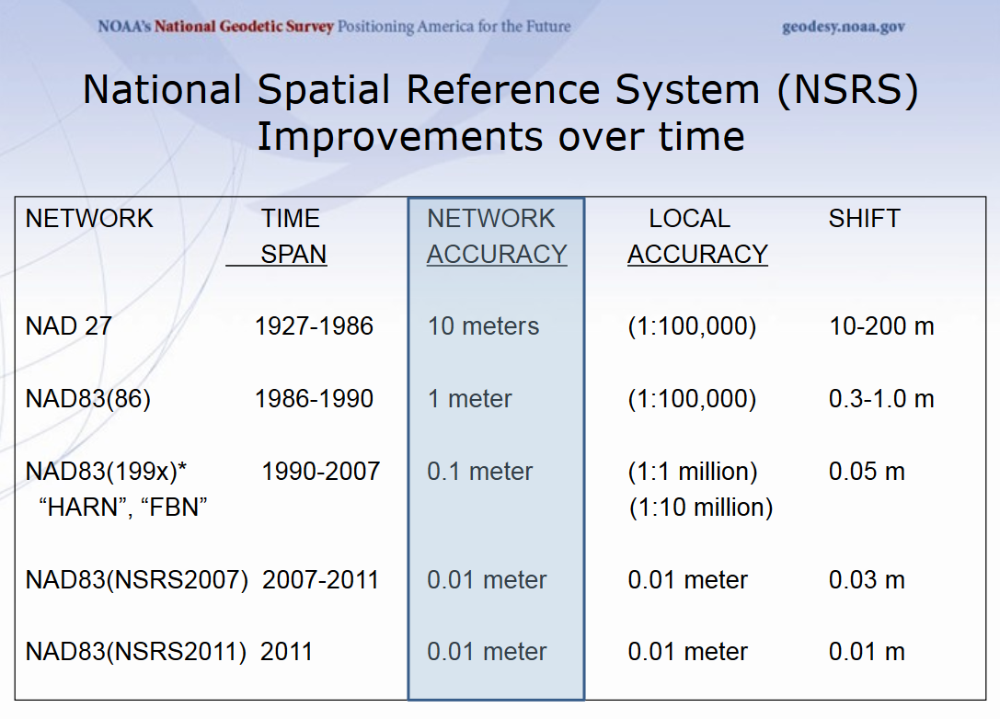
Future Impacts (2)

Slide 22

FUTURE IMPACTS (3)
NGS Ten Year Plan:
Goal 1: Support the users of the NSRS
Goal 2: Modernize and Improve the NSRS
Replace NAVD 88 with a GPS geoid datum
Replace NAD 83 with a geocentric GPS based datum
Implement New Datums in 2022
http://www.ngs.noaa.gov/web/news/Ten_Year_Plan_2013-2023.pdf

Slide 23
developing a boundary survey plat compliance training/checking tool (1)
Step 1
Step 2
Import CAD File into ArcGIS Desktop.
(Simplify and/or modify prior to importing.)
Step 3
Assign Compliance point locations.
(Populate Compliance point attribute table.)
Plat Selection for Training Tool
(Maximize number of Compliance Applications.)
Step 4
Establish point identification information for hovering over point.
(Test to see information selected.)
Step 5
Test all Compliance points for accuracy.
(Location and attribute table)
Step 6
Training: Have trainee confirm the location of all compliance points.
(Calculate number of correct answers versus number of points.)

Slide 24
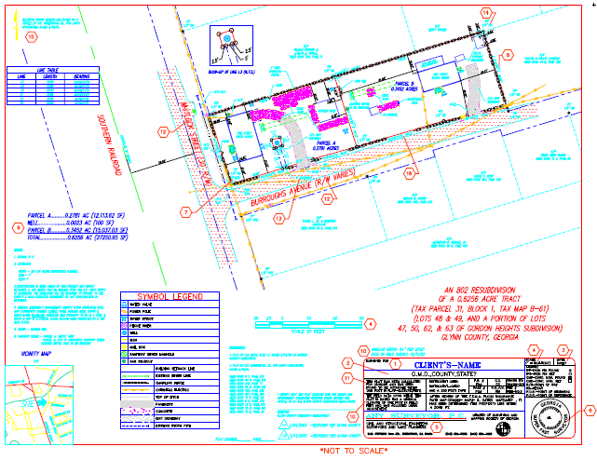
developing a boundary survey plat compliance training/checking tool (2)

Slide 25
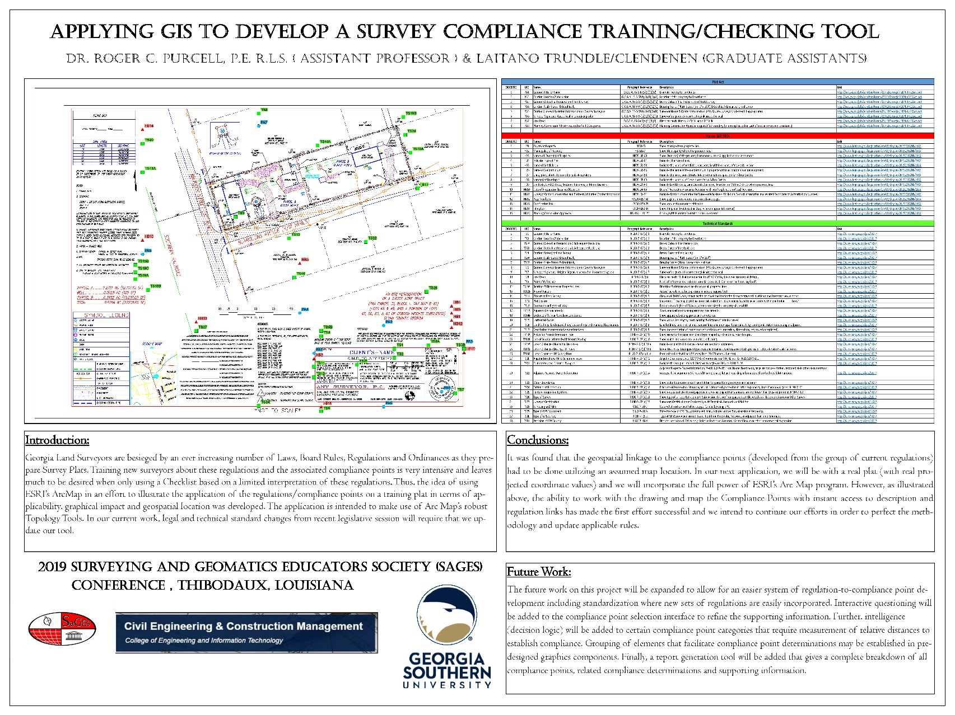
developing a boundary survey plat compliance training/checking tool (4)

Slide 26

Future Work: Completion of Framework (1)
This project will be expanded to allow for an easier system of regulation-to-compliance point development including standardization where new sets of regulations are easily incorporated.

Slide 27

Future Work: Completion of Framework (2)
Interactive questioning will be added to the compliance point selection interface to refine the supporting information.

Slide 28

Future Work: Completion of Framework (3)
Further, intelligence (decision logic) will be added to certain compliance point categories that require measurement of relative distances to establish compliance.

Slide 29
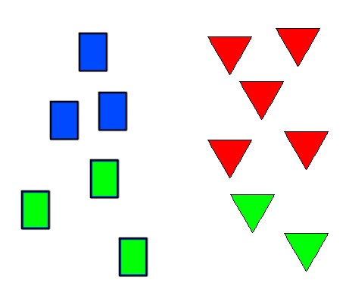
Future Work: Completion of Framework (4)
Grouping of elements that facilitate compliance point determinations may be established in predesigned graphics components.

Slide 30

Future Work: Completion of Framework (5)
Finally, a report generation tool will be added that gives a complete breakdown of all compliance points, related compliance determinations and supporting information.

Slide 31
Any Questions???
Any Comments???
Thank you!!!

