Slide 1
Rigorous Error Propagation for Topographic Displacements Derived from Image Correlation
Preston Hartzell, Jennifer Telling
University of Houston
Notes:
Note Jenn’s role in introducing me to PIV

Slide 2


About me – Preston Hartzell
Based in Houston, TX
Academic
  BS Surveying, Penn State - Wilkes-Barre, 2004
  PhD Geosensing Systems Eng. & Sciences, University of Houston, 2016
Professional
  6+ years with an Engineering, Land Planning & Surveying firm
  Licensed in a few states
  Now with University of Houston as an Assistant Research Professor
Research
  Single photon radiometry, surf zone wave characteristics, lidar sensor geometric calibration, spatial change detection, error propagation

Slide 3
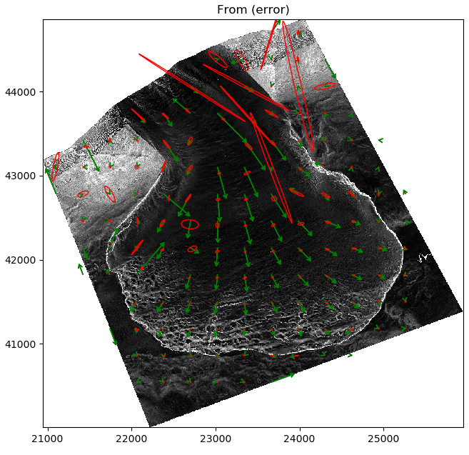
Overview
Topic
  General: Automated measurement of ground motion from images, often Digital Elevation Models (DEMs)
  Focus: Estimating uncertainty in the measured ground motion
Outline
  Motivation
  Review of Image Correlation
  Error Propagation
  Status & Conclusions
Glacier Motion and Estimated Uncertainties
(Canada Glacier, Taylor Valley, Antarctica)

Slide 4
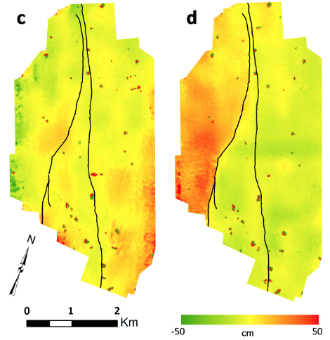
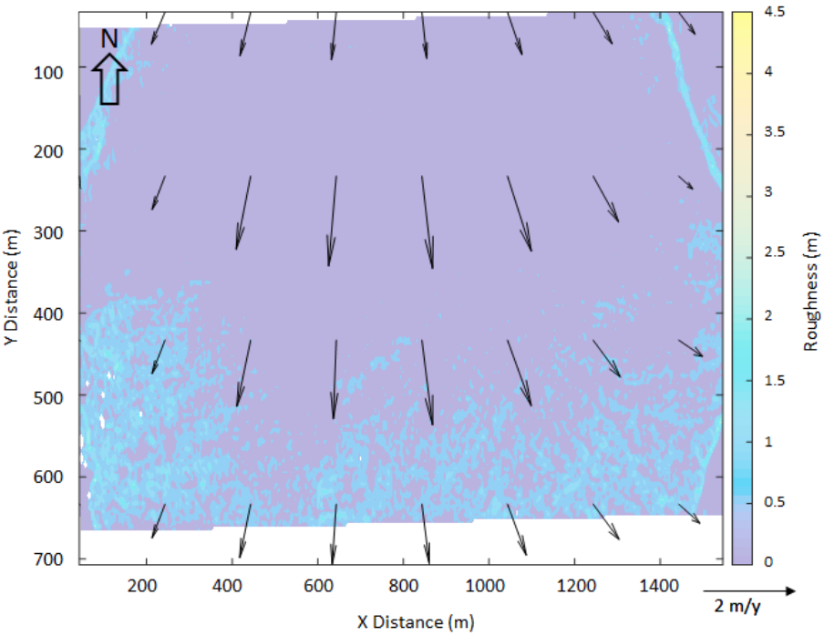
Motivation
Image correlation is commonly used in the Geosciences for measuring horizontal displacement
East/West
Motion
North/South
Motion
Glacier Motion (Telling et al., 2017)
Earthquake Motion (Ekhtari et al., 2017)

Slide 5
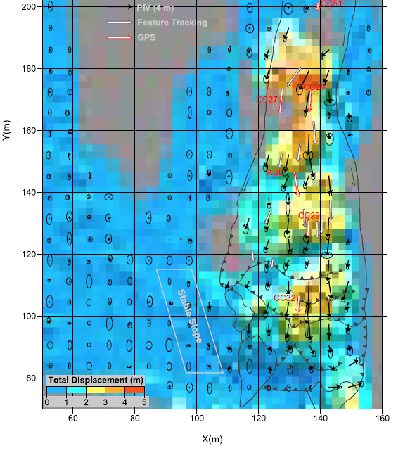
Motivation
Per vector uncertainty estimation = rare
Per vector uncertainty propagation = not practiced
→ What can we accomplish with GLOPOV?
Landslide Motion (Aryal et al., 2011)
Notes:
- Geoscience Remote Sensing Community is just beginning to take systematic, automated, rigorous uncertainty estimates seriously.
- We can bring our knowledge and abilities in this area to this (quite large) audience.

Slide 6
Image Correlation
Correlation
A measure of the degree of similarity
  Size, shape, brightness
Useful for automatically finding similar data
  When masked by noise
  When cumbersome to identify manually
We are interested in 2D correlation of digital imagery
  Specifically, the cross-correlation between temporally spaced images, or DEMs.

Slide 7



Image Correlation
2D Digital Image Correlation
  Multiply two images, pixel by pixel
  Sum the multiples
  → If the images are the same (shown above): Auto-Correlation
  → If using different images: Cross-Correlation
Image 1
Image 2
$$Σ$$
$$×$$
$$=$$
Correlation Value

Slide 8
Image Correlation
To find a smaller region (template) within a larger image (search area):
Slide the template over the search area, pixel by pixel
Compute the cross-correlation at each location and store in matrix
The maximum correlation value indicates the location of the most likely match
For sub-pixel estimation, fit a Gaussian or parabola to the pixels around each peak
Search Area
Correlation Matrix
Template
The center pixel is maximum, indicating the Template is located in the center of the Search area.
store
compute

Slide 9

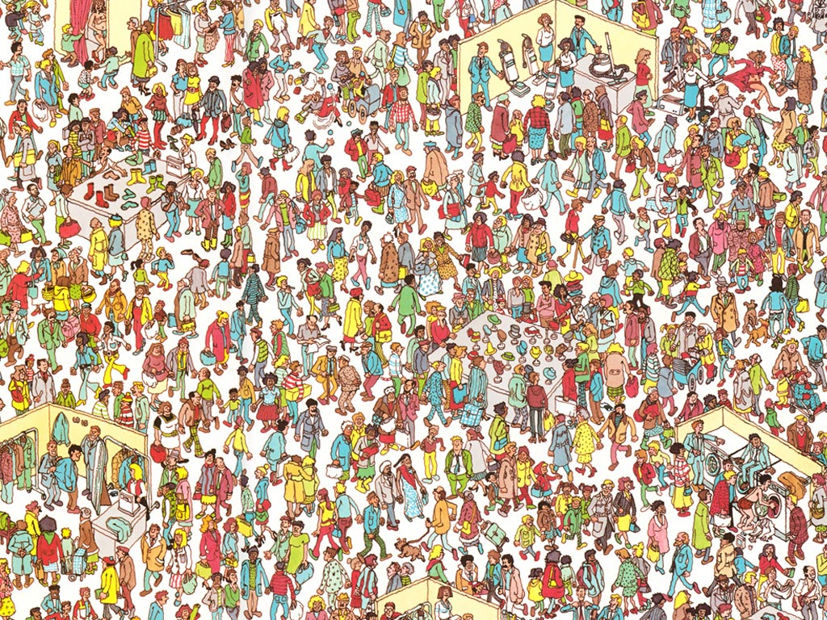
Image Correlation

Slide 10
Image Correlation
Slide Waldo, pixel by pixel, over the search area, and compute the correlation
Store the correlation solutions in a matrix (image)
Notes:
In reality, image is converted to grayscale

Slide 11
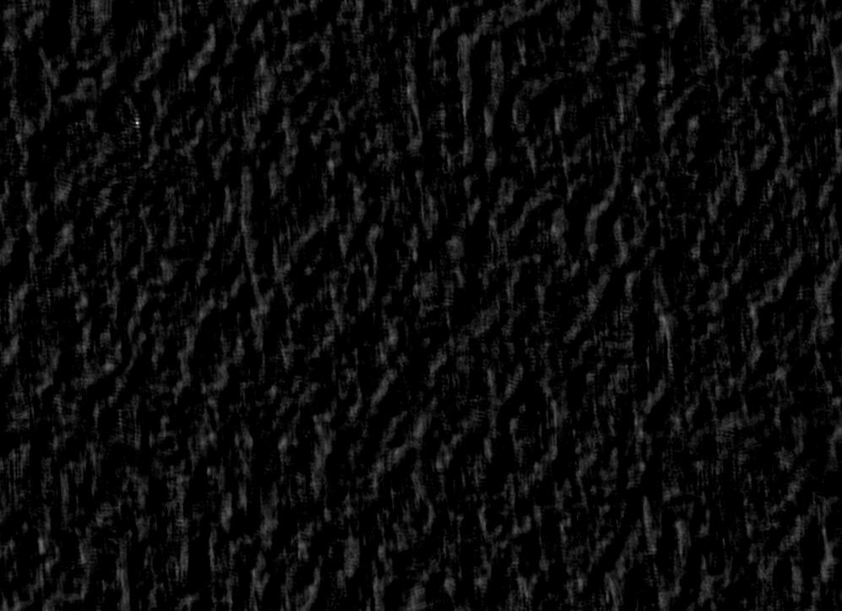
Image Correlation
Correlation Matrix/Image/Plane
Search Area

Slide 12
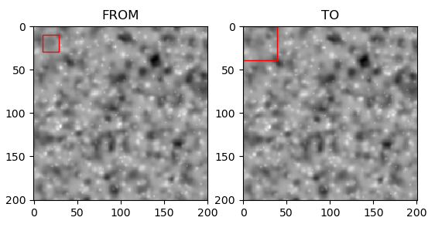
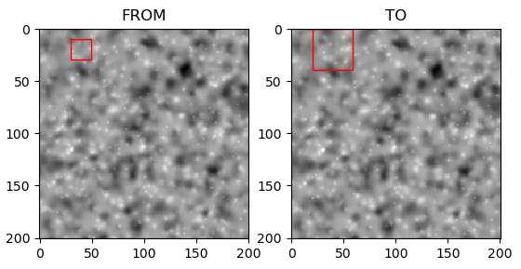
Image Correlation
For measuring motion at multiple locations:
Extract a small template from one image and a larger search area from a second image.
Slide the template over the search area, computing the correlation at each location.
Identify the correlation peak and store the displacement vector (i.e., the motion).
Step a defined number of pixels horizontally or vertically and repeat the above.
Template #1
Search #1
Template #2
Search #2
step

Slide 13
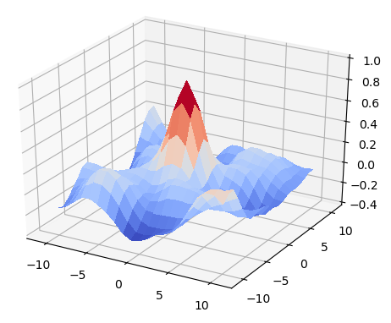
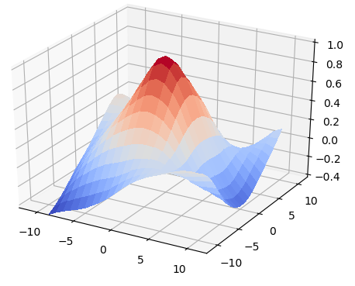
Image Correlation
Note: A relatively sharp peak in the correlation matrix:
  Indicates well defined features
  Implies lower uncertainty
→ How does Error Propagation capture this?
Relatively Stronger Solution
Relatively Weaker Solution

Slide 14
Image Correlation
Sub-pixel estimation of the correlation matrix peak location:
Cut profiles through the correlation peak in the X and Y directions
Fit a Gaussian (or other) function to the profiles and find the peak
  3-pixel profile in X direction
  3-pixel profile in Y direction
→ This is where the Error Propagation captures the strength of the solution.

Slide 15
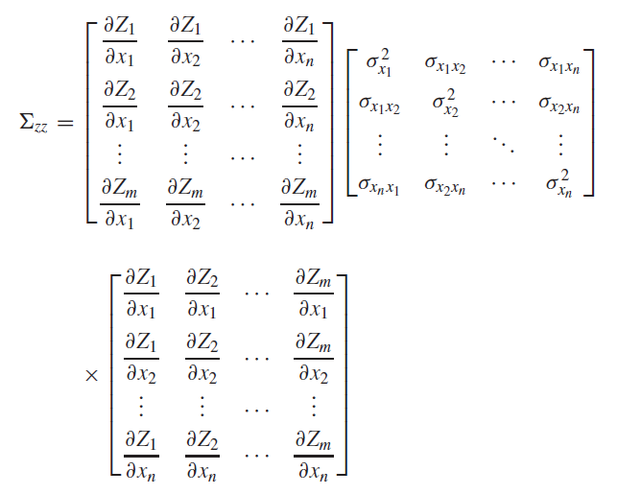
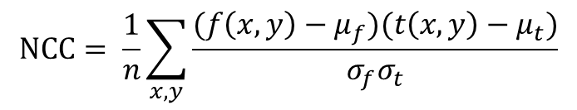

Propagating Uncertainty
Apply the General Law of Propagation of Variance (GLOPOV):
Propagate DEM uncertainties through the correlation equation:
Propagate the correlation matrix uncertainties into the sub-pixel peak estimation.
$$Σ_{zz}=JΣ_{xx}J^{T}$$
$$NCC= \frac{1}{n}\sum_{x,y}{\frac{(f\left(x,y\right)−μ_{f})(t\left(x,y\right)−μ_{t})}{σ_{f}σ_{t}}}$$
Notes:
For Step 1: each column is a pixel in the template or search area; each row is the NCC equation for one of the 9 pixels of a square centered on the correlation peak

Slide 16
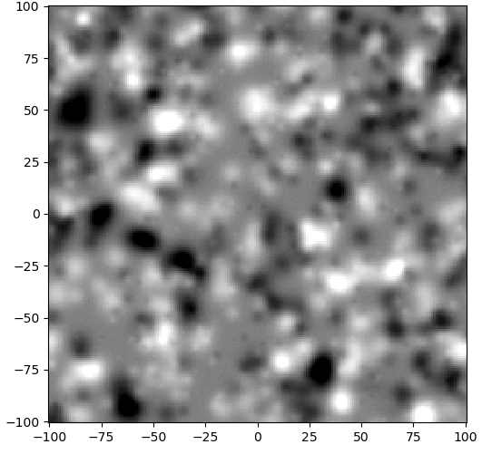
Propagating Uncertainty
Test DEM: Sample a grid from a known surface
Synthetic surface of overlapping Gaussians
Add random noise of known magnitude (σ = 0.1 )

Slide 17
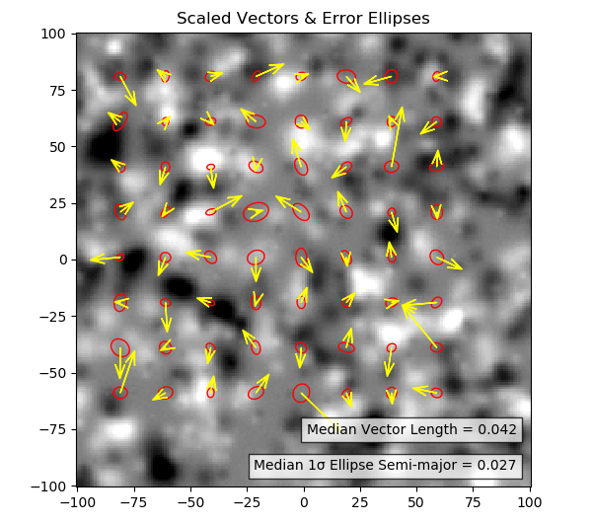
Propagating Uncertainty
Test 1: Use identical grids, but with unique random noise application
Compute displacements and propagate the known error (σ = 0.1 for each pixel)
Propagated error should bound the computed displacements ~68% of the time
20 pixel window, 10 pixel step
Result:
X bounded = 41%
Y bounded = 38%
Magnitude bounded = 27%
Too Low!
Notes:
PIV run at 20 pixel template, 10 pixel step, generating 256 solutions. Results shown are limited to 20 pixel step solutions for clarity.

Slide 18
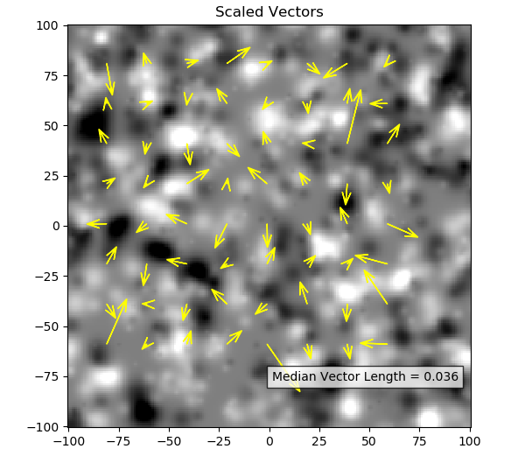
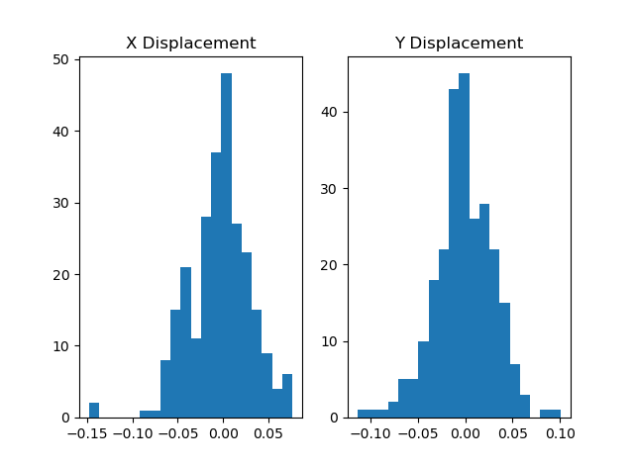
Propagating Uncertainty
Test 2: Let’s back up and run just correlation (no error prop) on identical images with no noise
All displacements should equal zero
σ=0.034
σ=0.031

Slide 19
Propagating Uncertainty
The problem is sub-pixel peak Bias
The peak is not really Gaussian in shape
Bias characteristics:
  Random in magnitude and direction
  Magnitude primarily a function of template size
→ Estimate bias variance in X and Y
→ Add to propagated X and Y variances

Slide 20
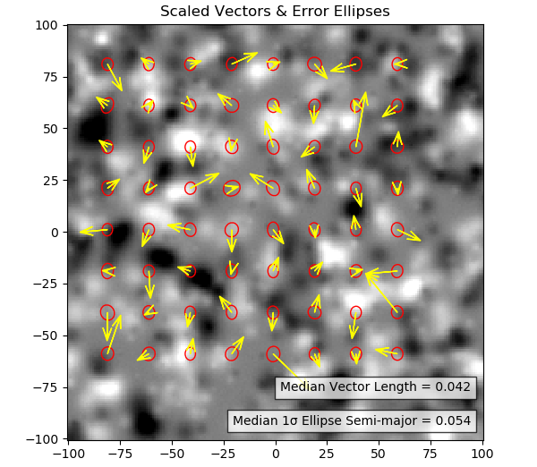
Propagating Uncertainty
Test 1 (Re-Do): Use identical grids, but with unique random noise application
Compute displacements and propagate the known error (σ = 0.1 for each pixel)
Propagated error should bound the computed displacements ~68% of the time
This time we include the bias variance
Result:
X bounded = 67%
Y bounded = 66%
Magnitude bounded = 69%

Slide 21
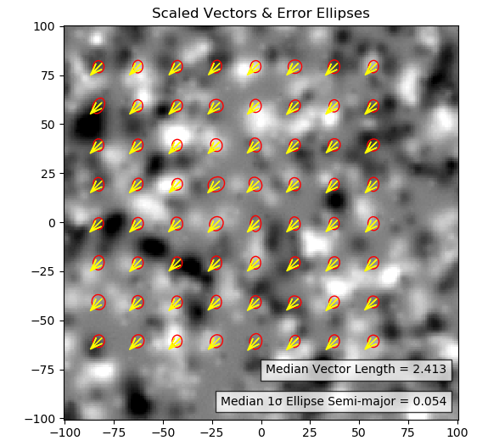
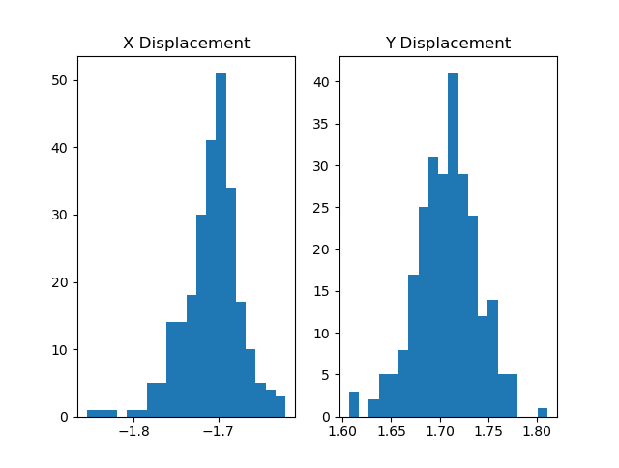
Propagating Uncertainty
Test 3: Constant Shift in X & Y of 1.7 pixels
Check if errors in computed displacements are bounded by propagated error ~68% of the time
Result:
X bounded = 74%
Y bounded = 74%
Magnitude bounded = 77%

Slide 22
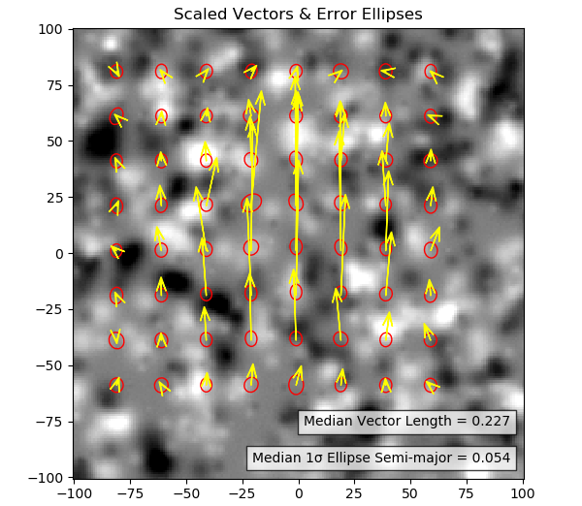
Propagating Uncertainty
Test 4: Deformation in Y
Large, Gaussian deformed applied to the synthetic surface in the Y direction only
Check if errors in computed displacements are bounded by propagated error ~68% of the time
Result:
X bounded = 54%
Y bounded = 49%
Magnitude bounded = 48%
→ Multiple pass with deforming search windows?
Too Low. Ugh.
Notes:
Using a smaller window (10 pixel), which is subject to less deformation within the search window, improves the bounding results to X = 52%, Y = 60%, and M = 58%
Using a larger window (30 pixel), which is subject to more deformation within the search window, degrades the bounding results to X = 42%, Y = 28%, and M = 19%

Slide 23
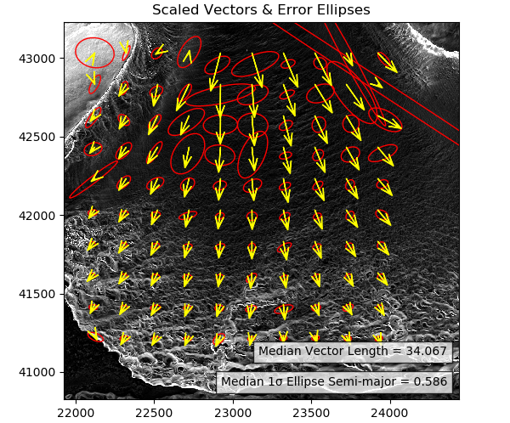
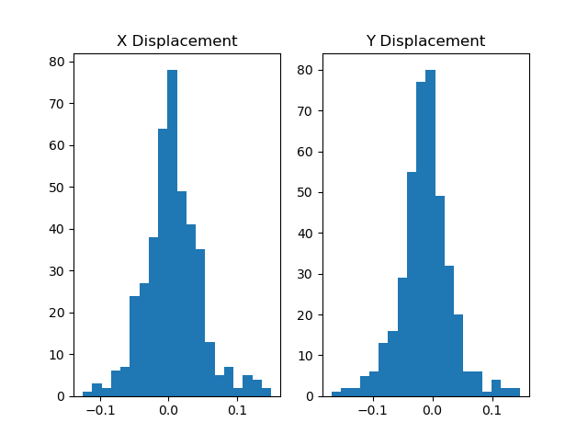
Propagating Uncertainty
Real Data Example:
Canada Glacier
Northing (m)
Sub-Pixel Bias Histograms
Easting (m)
Notes:
DEM uncertainties are standard deviation of points in each cell (5 meter cells) – not correct

Slide 24
Python Project
GPIV: Geospatial PIV
bitbucket.org/pjh172/gpiv
A Command Line Interface (CLI) tool
Absolute disaster right now
  Things blew up during conference prep (but for the better)
  Check back near the end of the year
Why share?
  Transparency: Can your work be replicated? (wikipedia.org/wiki/Replication_crisis)
  Practicality: If your work is relevant, make it available for use.
Notes:
According to a 2016 poll of 1,500 scientists reported in the journal Nature, 70% of them had failed to reproduce at least one other scientist's experiment (50% had failed to reproduce one of their own experiments). In 2009, 2% of scientists admitted to falsifying studies at least once and 14% admitted to personally knowing someone who did.

Slide 25
Conclusions
→ Two components: Bias and DEM uncertainties
  Global bias error estimation… Rigorous Error Propagation?
→ Systematic uncertainty underestimation in deformation areas
  Clue = Smaller search windows produce better results
→ More validation needed
  Introduce areas with low feature density in synthetic data
  Test on real data with valid DEM uncertainties (Kriging?)
→ Aiming for a functional Python tool by end of year
  Not inclusive of an automated, valid DEM error estimator

Slide 26
Closing Thought on Uncertainty
Only a few know, how much one must know to know how little one knows.
- Werner Heisenberg

Slide 27
References
J. Telling, C. Glennie, A.G. Fountain, D.C. Finnegan, Analyzing Glacier Surface Motion Using LiDAR Data, Remote Sensing, 2017.
N. Ekhtari, C. Glennie, High-Resolution Mapping of Near-Field Deformation With Airborne Earth Observation Data, a Comparison Study, IEEE Transactions on Geoscience and Remote Sensing, 2018.
A. Aryal, B.A. Brooks, M.E. Reid, G.W. Bawden, G.R. Pawlak, Displacement fields from point cloud data: Application of particle imaging velocimetry to landslide geodesy, Journal of Geophysical Research, 2012.

