Slide 1
Visual Traverse: an open Source Python Program to assess, post-process, and visualize Polygon Data
Yanli Zhang, Matthew McBroom, Brian P. Oswald, Warren Conway and Daniel R. Unger
Arthur Temple College of Forestry and Agriculture
Stephen F. Austin State University

Slide 2
Outline
Visual Traverse
Traverse
Python
Visual Traverse

Slide 3
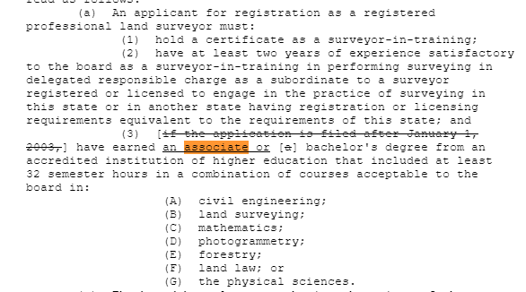
Texas HB 1523 Bill
Effective on 9.1.2019

Slide 4
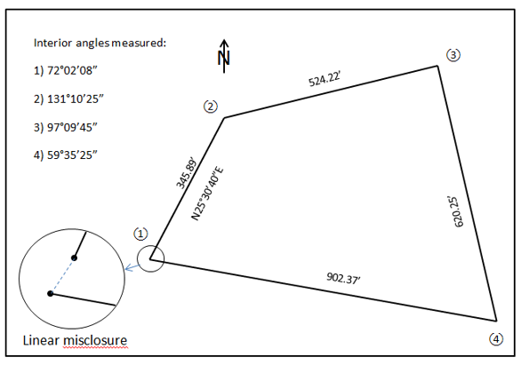
Traverse
misclosure

Slide 5
Traverse computation
Different methods
Compass rule
Least square
Different software
Calson Survey
AutoCAD
…

Slide 6
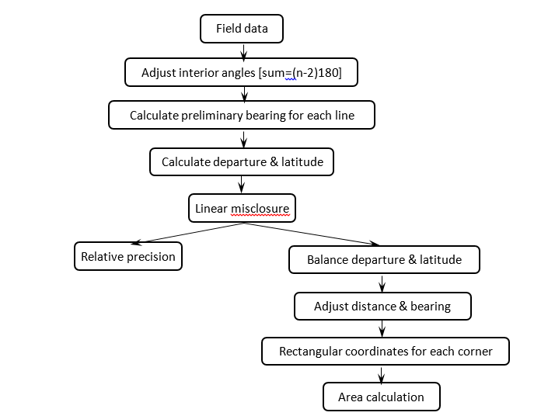
Compass rule

Slide 7
Traverse computation
Teaching challenge
First land survey class

Slide 8
Outline
Visual Traverse
Traverse
Python
Visual Traverse

Slide 9
Python
Python is open source
Free to use, even for commercial products.
Python is cross platform
It runs on Windows, Linux/unix, Mac OS X and have been ported to the Java and .NET virtual machines.

Slide 10
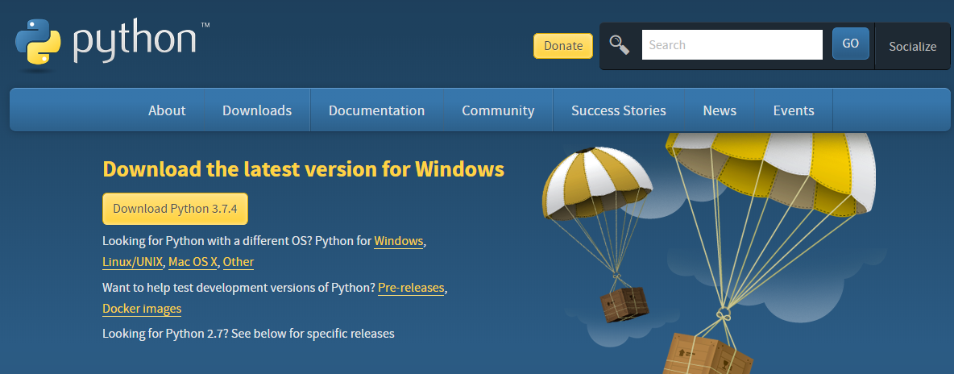
Python
3.7 and 2.7 versions

Slide 11
Python application
Web and internet development
Scientific computing
Education
Desktop GUI (graphical user interface) design
Software development
E-commerce system
https://www.python.org/about/apps/

Slide 12
Python and GIS
It is integrated into ArcGIS Desktop
All ArcGIS Desktop applications include an embedded scripting language called Python. Many areas of ArcGIS—particularly geoprocessing—are accessible through simplified Python application programming interfaces (APIs), making it easy to author and automate common tasks. Python scripts are easily shared and can be produced without an external development environment. There are a variety of public domain Python modules focused on areas such as science, engineering, and mathematics.

Slide 13
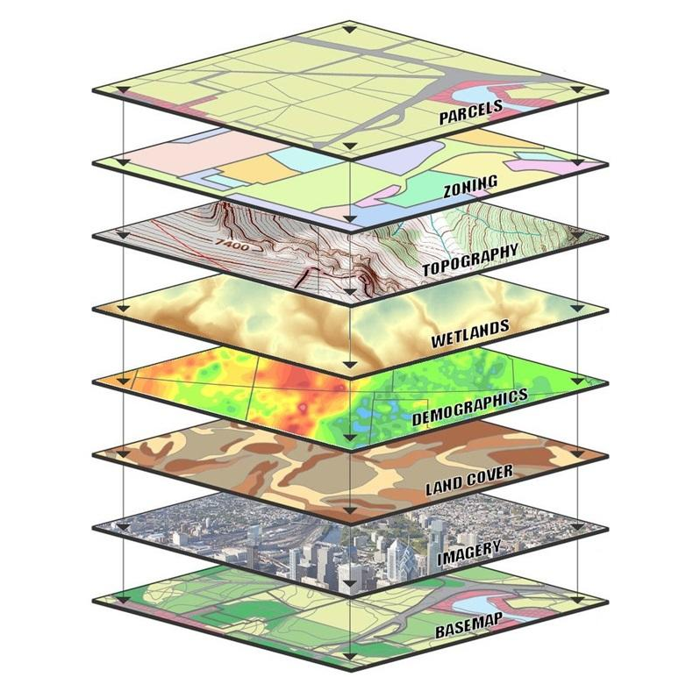
GIS and land survey
Two complementary disciplines
https://www.usgs.gov/media/images/gis-data-layers-visualization

Slide 14
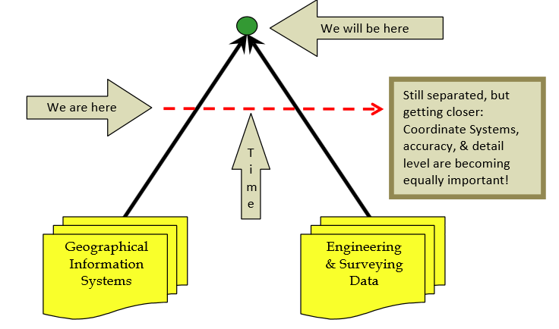
GIS and land survey
ftp://ftp.odot.state.or.us/ORGN/Documents/ocrs_handbook_user_guide.pdf

Slide 15
Outline
Visual Traverse
Traverse
Python
Visual Traverse

Slide 16
Virtual Traverse
Open source code
For programmers
Exe file available
For non-programmers

Slide 17
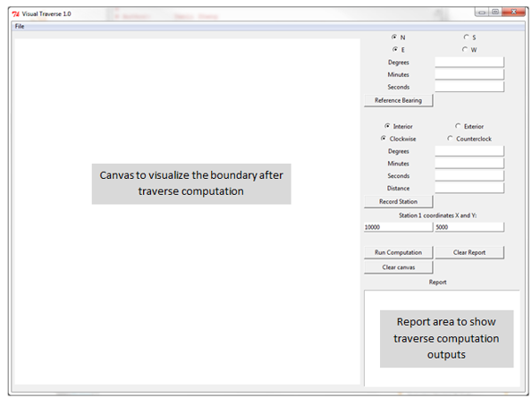
Virtual traverse

Slide 18
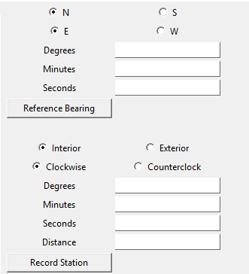
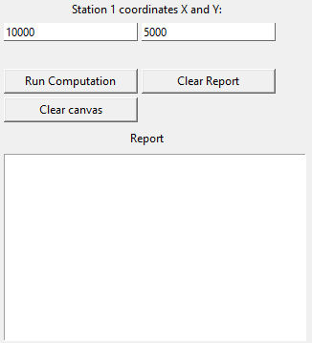
Virtual traverse
Thorough consideration for polygon

Slide 19
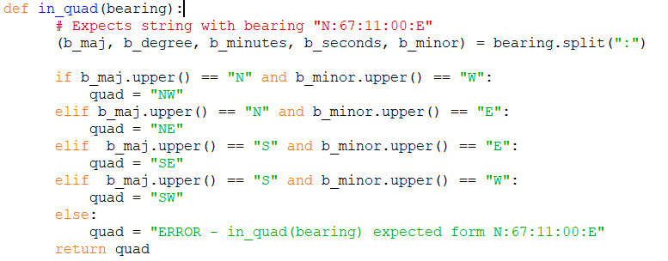
Python code
Code example

Slide 20
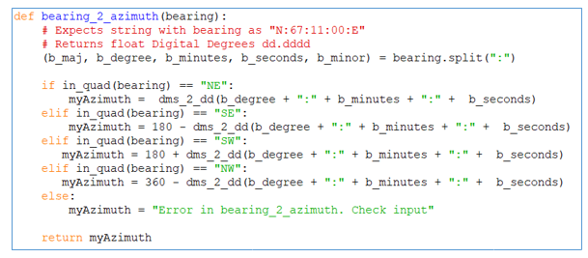
Python code
Code example

Slide 21
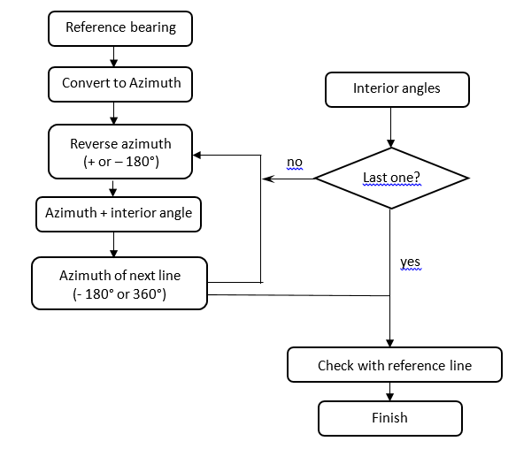
Azimuth

Slide 22
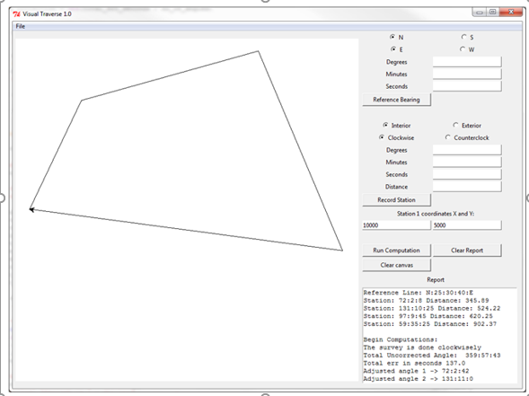
Output

Slide 23
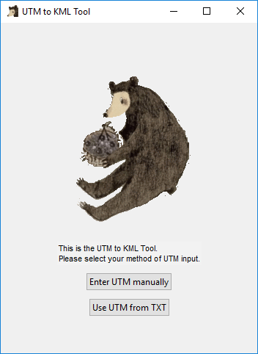
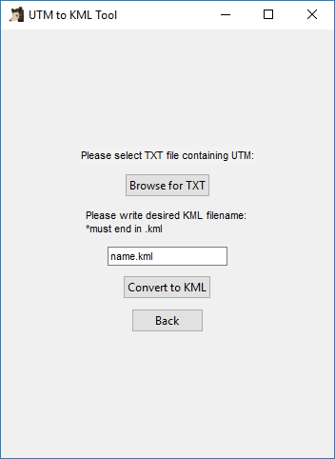
UTM to KML

Slide 24
Future
Open source
Community effort

Slide 25
zhangy2@sfasu.edu
Yanli Zhang, Matthew McBroom, Brian P. Oswald, Warren Conway and Daniel R. Unger
Arthur Temple College of Forestry and Agriculture
Stephen F. Austin State University

