Slide 1
A Student Centered, Active Learning Approach to the Delivery of a Visiting Professional Lecture Series
A. Richard Vannozzi, MS, PLS
School of Engineering Technology, University of Maine, Orono, Maine
anthony.vannozzi@maine.edu
Leonard Anderson, Ph.D., C.P.C.
Department of Civil Engineering, Wentworth Institute of Technology, Boston, Massachusetts
andersonl@wit.edu
Surveying and Geomatics Educators Society Conference
Nicholls State University, Thibodaux, LA
August 8, 2019
*Previously Presented at the ASEE Zone 1 Conference, Buffalo, NY, April 2019

Slide 2
The 2019 C.E. Senior Year Curriculum

Slide 3
WIT’s Capstone Design Experience
Two Course Sequence
CIVE4000 (Spring Semester)
CIVE5500 (Summer Semester)
1 Hour Lecture per Week and Two Three-Hour Labs (Studio) Sessions per Week
Incorporates all of the civil engineering curriculum in a comprehensive intra-disciplinary civil project that includes communication, teamwork and engineering design

Slide 4
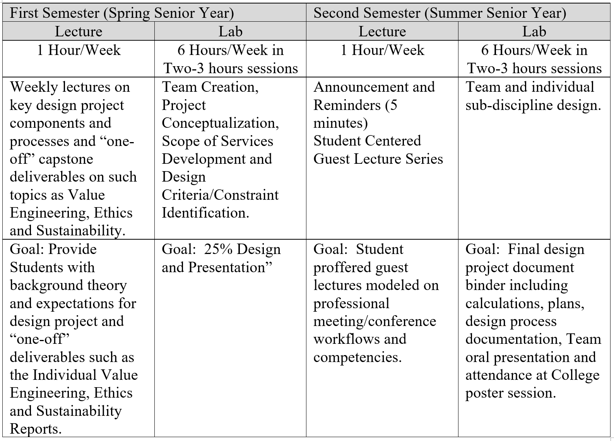
Generalized Components of the Wentworth Capstone Experience

Slide 5
Second Semester Lecture History
Initial used for course lecturing, project instruction, and guest speakers supplied by the Faculty;
Three years ago, the occasional faculty-generated guest lectures morphed into students inviting guests for some of the weeks;
In 2018 it was decided to formalize the second semester lecture into a singular focus on a student-centered lecture series modeled on the elements of professional conference/meeting planning.

Slide 6
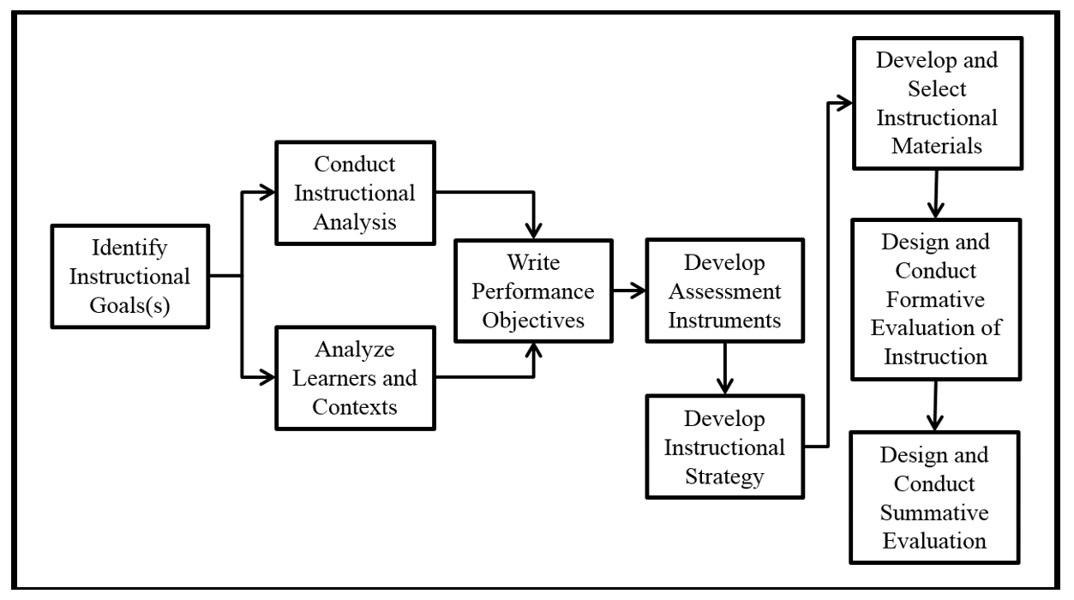
Adaption of the Dick & Carey Instructional Design Model Developed by the Authors and that Provides the Framework of the Student-Centered Lecture Series Curriculum

Slide 7
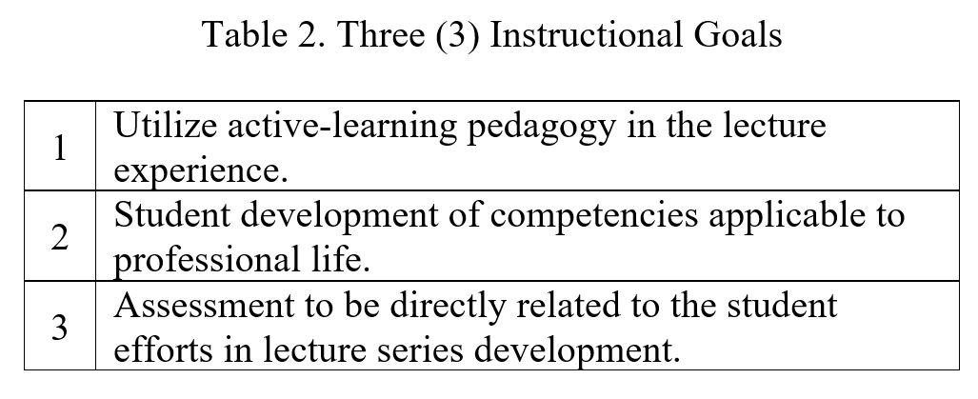
Identification of the Instructional Goals

Slide 8
Analyze Learners and Contexts
Homogeneous Cohort;
Majority are Seniors in their last semester of their BSCE degree;
Two Co-op experiences;
Will be employed in the field of Civil Engineering.

Slide 9
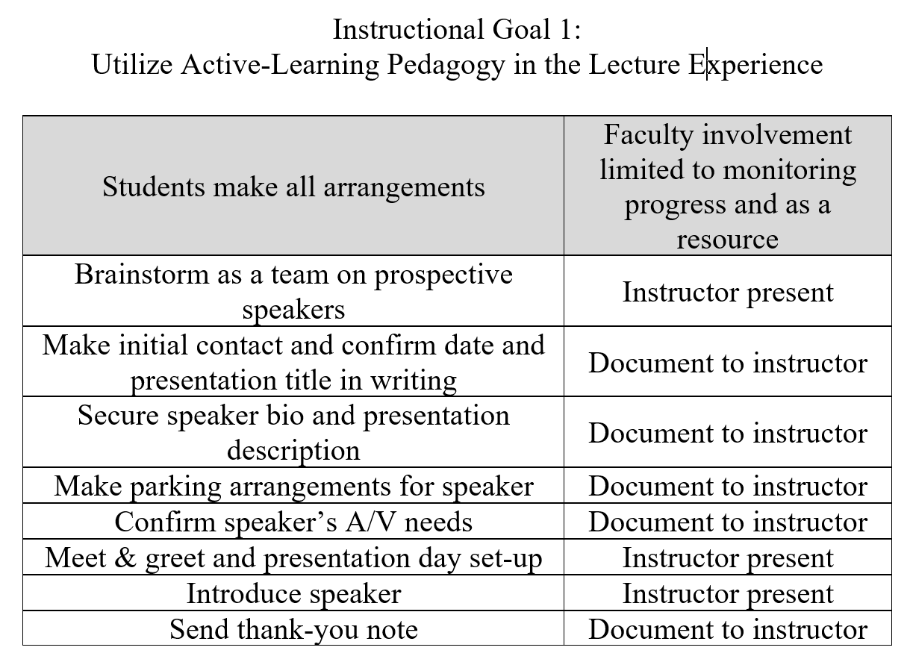
Conduct Instructional Analysis

Slide 10
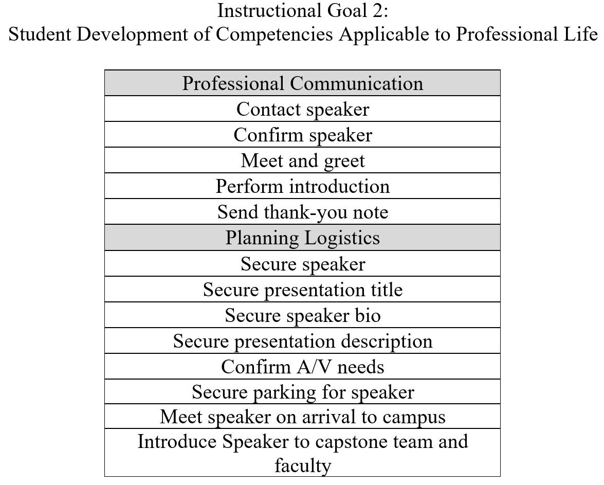
Conduct Instructional Analysis

Slide 11
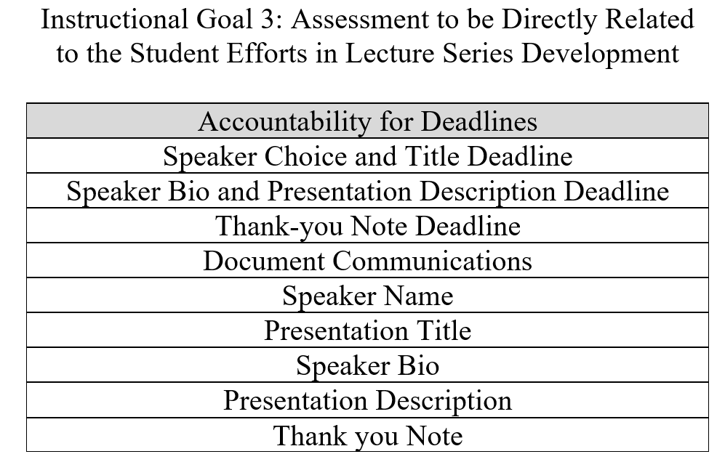
Conduct Instructional Analysis

Slide 12
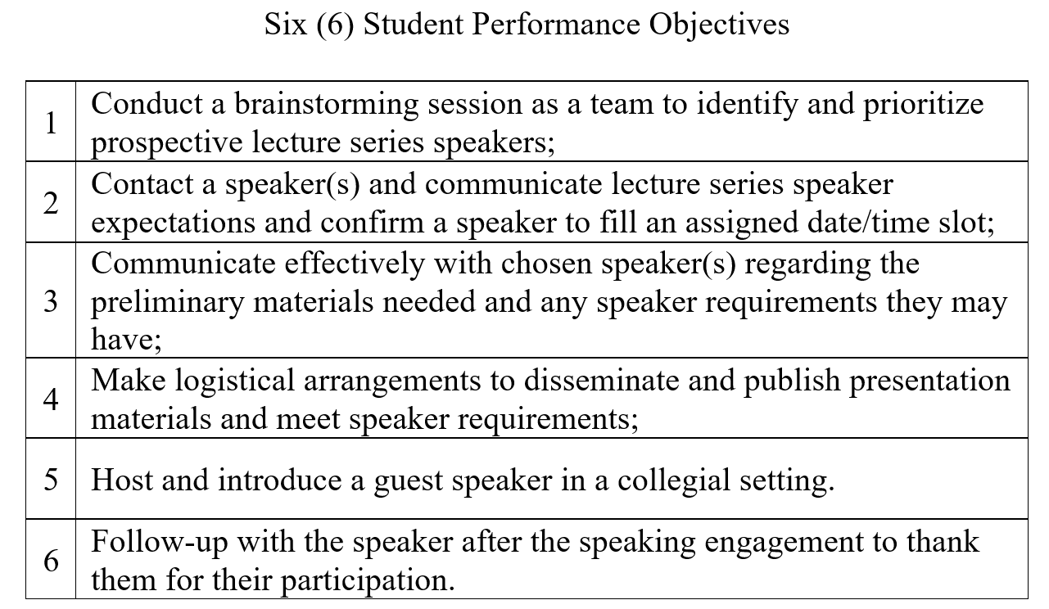
Write Performance Objectives

Slide 13
Write Performance Objectives

Slide 14
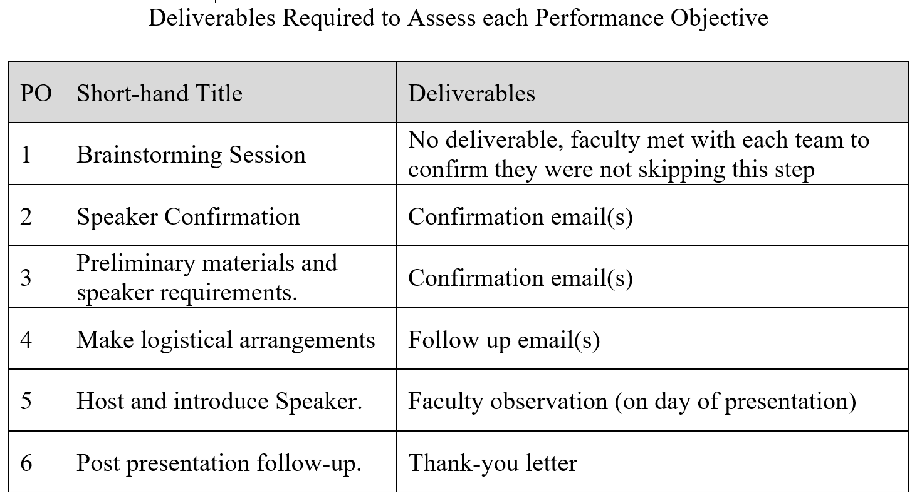
Develop Assessment Instruments

Slide 15
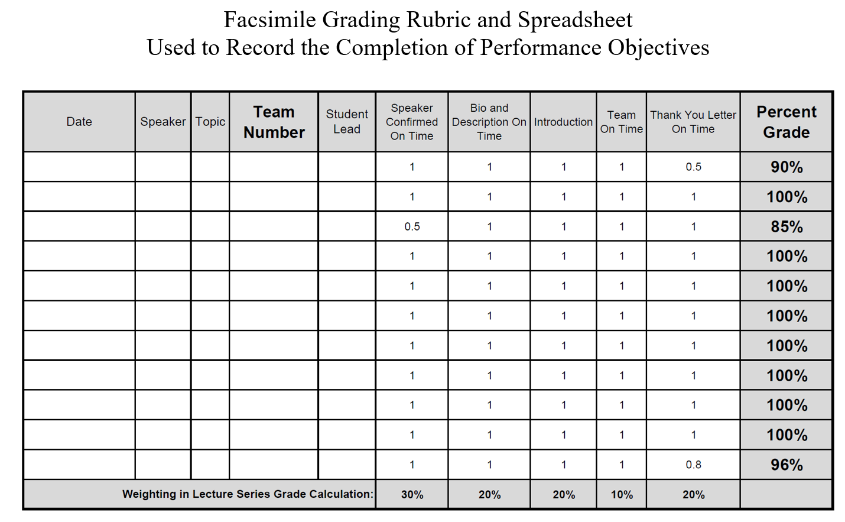
Develop Assessment Instruments

Slide 16
Develop Instructional Strategy
The following four (4) guidelines were adhered to in preparing the student instructions:
Because the planning and orchestrating of this lecture series spanned two semesters it was determined that student expectations should be in writing;
Rather than give the students one handout for the entire lecture series, it was felt that it would be best to give them two handouts, one relative to the responsibilities for each semester;

Slide 17
Develop Instructional Strategy
The following four (4) guidelines were adhered to in preparing the student instructions (Continued)
Instructions would focus on outcomes (Performance Objectives) and would include little procedural detail;
Deadlines would be made very clear since this would mimic conference planning environments.

Slide 18
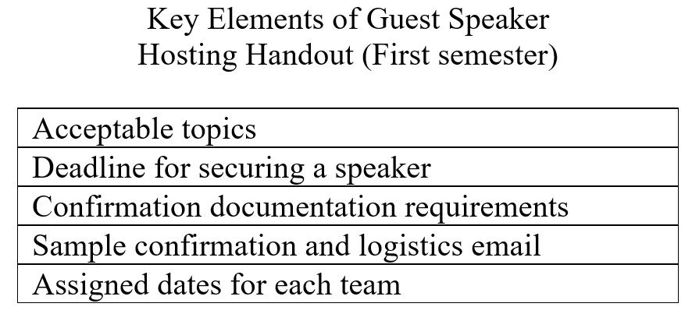
Develop Instructional Materials

Slide 19
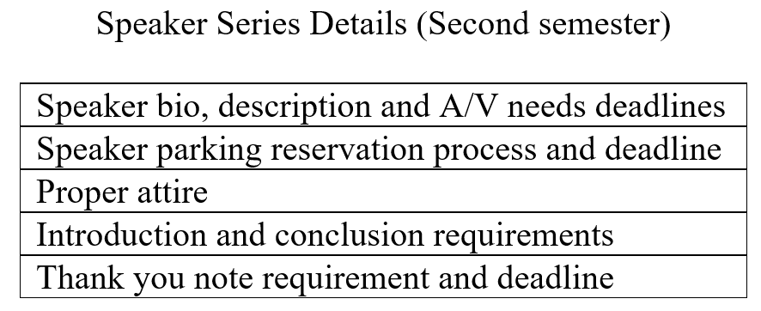
Develop Instructional Materials

Slide 20
Design and Conduct Formative Evaluation of Instruction
Drafts of the Instructional Materials (Handouts) were circulated to all capstone faculty with a solicitation for comments and suggestions
The comments and suggestions were then reviewed by the authors
Revisions were made based on the comments and suggestions
This process continued iteratively until consensus was reached

Slide 21
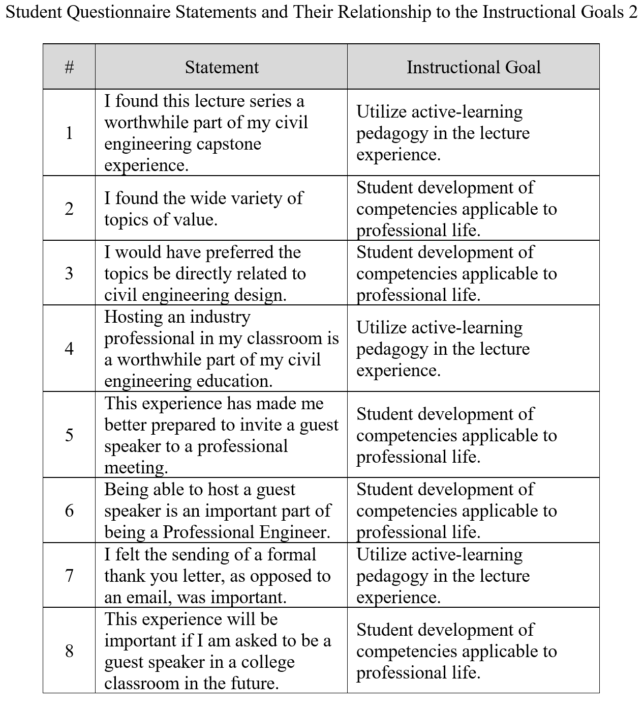
Design and Conduct Summative Evaluation

Slide 22
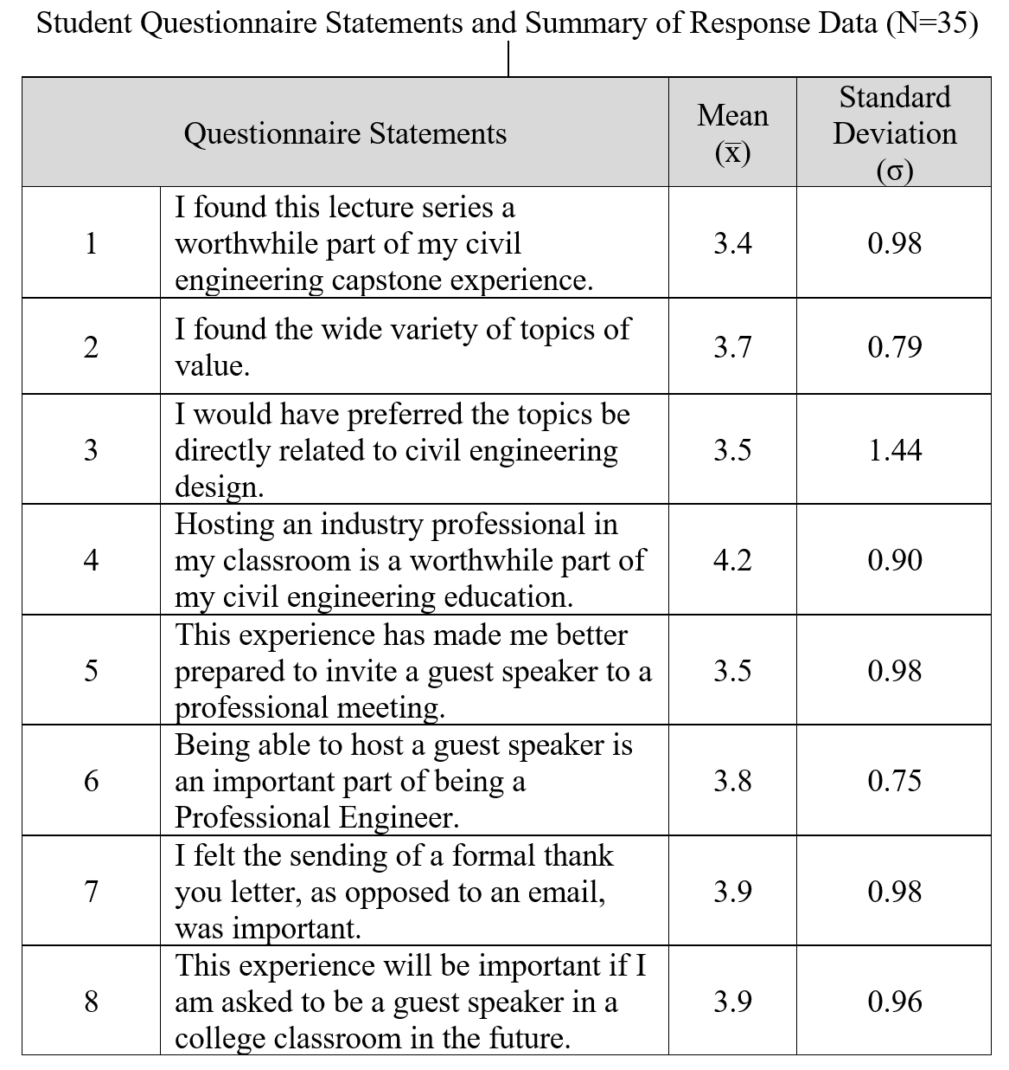
Summative Evaluation Results

Slide 23
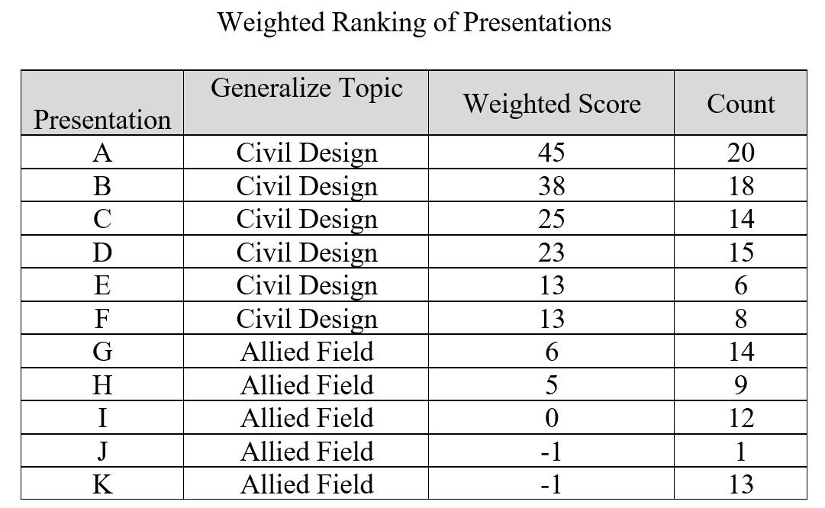
Summative Evaluation Results

Slide 24
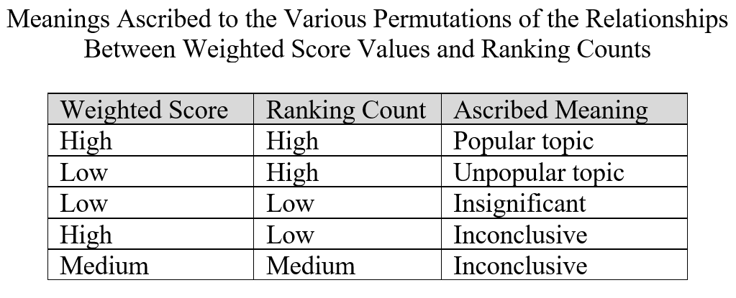
Analysis of Summative Evaluation

Slide 25
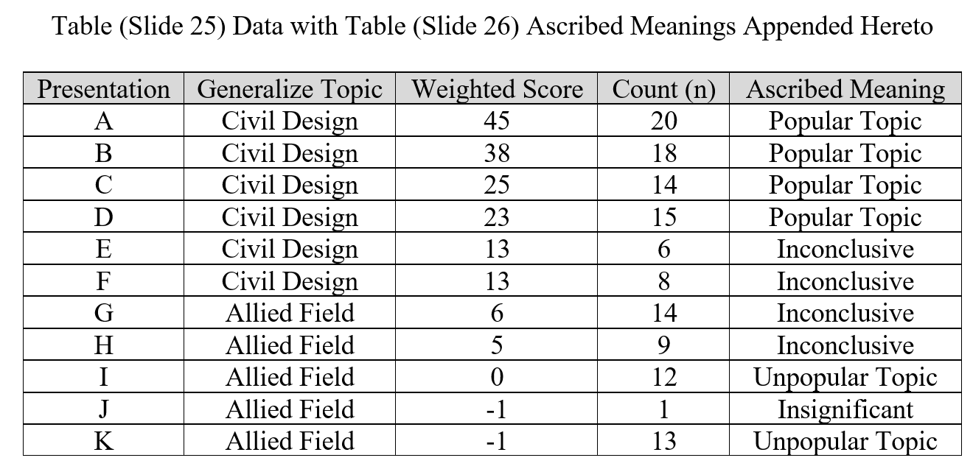
Analysis of Summative Evaluation
Slide 23 Data with Slide 24 Ascribed Meanings Appended Hereto

Slide 26
Conclusions
The Instructional Goals of: 1) Utilizing an active-learning pedagogy in the lecture series experience; 2) Student development of competencies applicable to professional life; and 3) Crafting an assessment directly related to the student efforts in lecture series development, were REACHED.

Slide 27
August 2019 - Update
Lecture Series Ended Yesterday 8/6/19;
Student Questionnaire Data Preliminarily Reviewed (n=48);
Instruction for 2019 included preference for design;
Students differentiated between design & construction this year.

Slide 28
References
Dick, W. and L. Carey and J.O. Carey. 2014. The Systematic Design of Instruction (8th ed.). Pearson.
Doolittle, P.E. Constructivism and Online Education. http://www.trainingshare.com/resources/doo2.htm, accessed on February 28, 2019.
Eckert, E. and Bell, A. 2005. Invisible Force: Farmers’ Mental Models and How They Influence Learning and Actions. Journal of Extension, Vol. 43, No. 3.
Kolb, D. A. 1984. Experiential Learning; Experience as the Source of Learning and Development. Upper Saddle River, NJ, Prentice Hall, Inc.
Markman, A. B. and Gentner, D. 2001. Thinking. Annual Review of Psychology, Vol 52, pg. 223-247.
Prince, M. 2004. Does Active Learning Work? A Review of the Research. Journal of Engineering Education 93 (3), pg. 223.

Slide 29
A Student Centered, Active Learning Approach to the Delivery of a Visiting Professional Lecture Series
Questions?
A. Richard Vannozzi, MS, PLS
School of Engineering Technology, University of Maine, Orono, Maine
anthony.vannozzi@maine.edu
Leonard Anderson, Ph.D., C.P.C.
Department of Civil Engineering, Wentworth Institute of Technology, Boston, Massachusetts
andersonl@wit.edu
*Previously Presented at the ASEE Zone 1 Conference, Buffalo, NY, April 2019

