Slide 1
Enhancing Surveying Engineering Education with Immersive Virtual Reality
Dimitrios Bolkas, dxb80@psu.edu Assistant Professor, Surveying Engineering
Jeffrey Chiampi, jdc308@psu.edu Lecturer, Computer Science and Mathematics
Undergraduate Research Assistants John Chapman Joe Fioti Vincent Pavill Eric Williams

Slide 2
Introductions
Dimitrios Bolkas, PhD
Assistant Professor of Surveying Engineering
5-year Engineering degree: Rural and Surveying Engineering, Aristotle University of Thessaloniki, Greece
Ph.D. in Geological Sciences and Geological Engineering, Queen’s University, Kingston, Canada
Research interests:
Laser scanning
Unmanned aerial systems
Earth monitoring applications
Geoid and gravity-field modeling
Virtual environments and virtual reality

Slide 3
Introductions
Jeffrey Chiampi, MBA, MSE
Lecturer of Computer Science and Mathematics
10 Years of industry experience before joining Penn State
Courses:
Computer Science (C++, Python, MATLAB, C#)
Game Development (Unity, Construct)
Research interests:
Virtual environments and virtual reality
User interface design
Engineering education

Slide 4
Outline
Motivation and Objectives
Background in virtual reality (VR)
Surveying Exercises and Integration with Physical Labs
Leveling Lab: Main Features
Assessment Plan
Conclusions

Slide 5
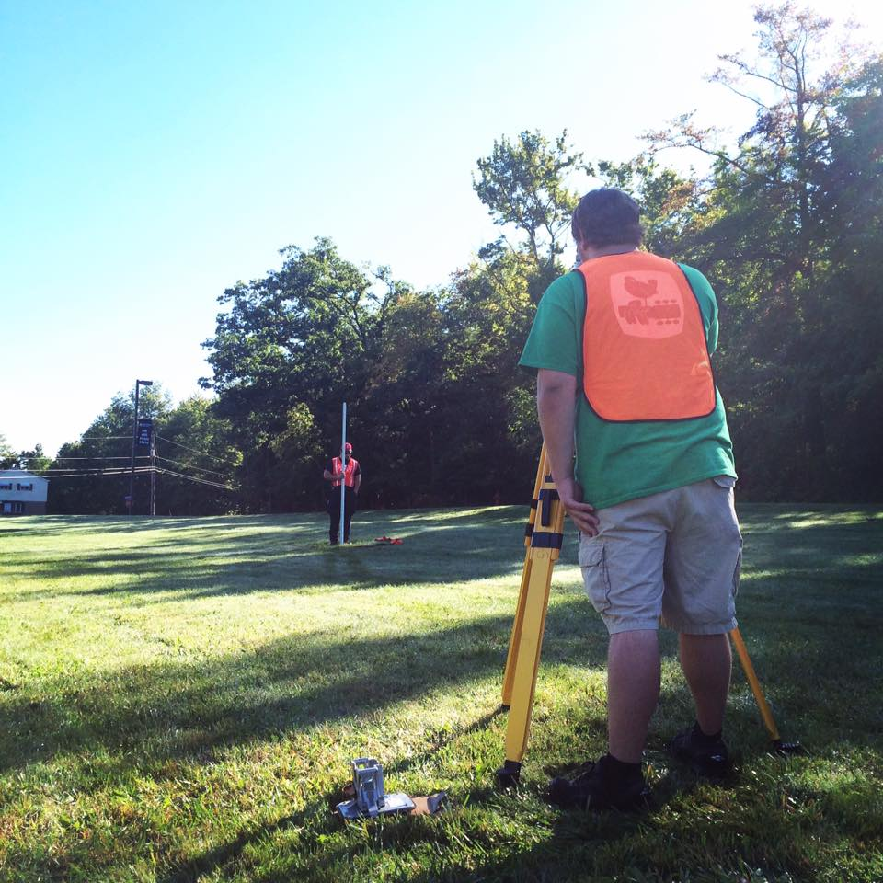
Motivation
Surveying requires extensive practice with instruments
However, students often spent limited time
Surveying takes place in many different terrains
Yet, we only train students around the campus
Weather!!
2-3 cancelled classes every semester
What about online/remote teaching?

Slide 6
Objectives
Create immersive virtual reality (VR) laboratories
Assess the effectiveness of VR laboratories
Explore the synergies between physical and virtual laboratories

Slide 7
Learning with VR
Virtual reality (Martín-Gutiérrez et al. 2017):
Ideal for creating game-based environments
Can improve academic performance, social and collaborative skills, psychomotor and cognitive skills
VR encourages students to be active learners, promotes decision-making, autonomous exploration, help in complex concepts, more interaction than conventional learning methods
In contrast, other studies show less learning (Makransky et al. 2017).
Constructivist approach of learning

Slide 8
Background in Surveying VR
Few studies used VR in surveying:
Dib et al. (2014) created a differential leveling lab in desktop-based VR
Found that improved declarative (know facts) and procedural (how to do things) knowledge
SimuSurvey and SimuSurvey X (Lu et al. 2007; Lu et al. 2009; Kang et al. 2010)
Simulated surveying instruments, their errors and their interaction
Aided student comprehension of instrument operation and systematic error behavior

Slide 9
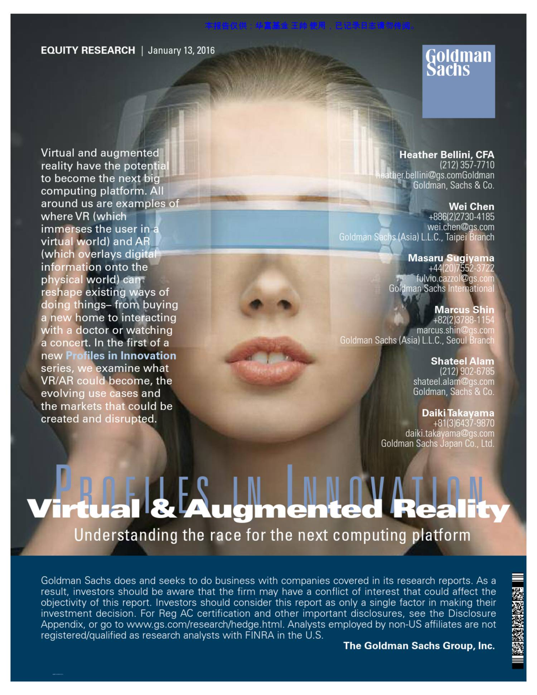
Additional Motivation
Goldman Sachs (2016 report): virtual reality technology has the potential to become the next big computing platform
We need to introduce virtual reality to engineering students
Visualization and manipulation of 3D spatial data in VR is here and becomes a trend (Jacobs 2017; Billingsley 2018)

Slide 10
Implementation Exercises
Establish vertical and horizontal control (leveling and traverse)
Total station data collection for topographic mapping
These exercises are major components of courses in first academic year of surveying students
Notes:
Leveling to establish elevations on control points, contour mapping
Traversing
In the future move to construction related projects

Slide 11
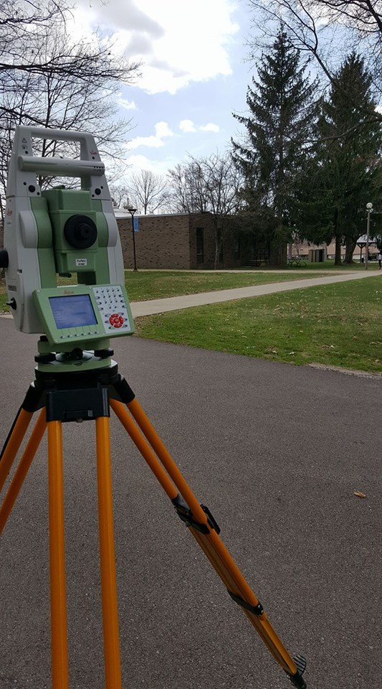
Integration with Physical Laboratories
Two methods of integration
Training students and prepare them for physical laboratory
Conduct VR laboratory in different surveying conditions (e.g., different location and terrain characteristics)
Notes:
And explain here that no matter how good I prepare them, they will still have questions, so it is better to have a vr lab to prepare them

Slide 12
Timeline
 | Year 1 |  | Year 2 |  | Year 3 |  | Year 4
 | Fall 2018 | Spring 2019 | Fall 2019 | Spring 2020 | Fall 2020 | Spring 2021 | Fall 2021 | Spring 2022
3D Data collection and processing | On campus data | On campus – processing | Off Campus data | Off campus – processing | Off campus – processing
Software | Development of version 1 | Development of version 1 | Version 1; development of version 2 | Version 2; | Revision on version 2 | Revision on version 2; inclusion of off campus exercises | Version 3
Implementation |  |  | Students use version 1 | Students use version 2 | Students use version 2 | Students use version 2 | Students use version 3 | Students use version 3
Version 1: includes leveling (on campus)
Version 2: includes traverse and leveling (on campus)
Version 3: includes traverse and leveling (off campus)

Slide 13
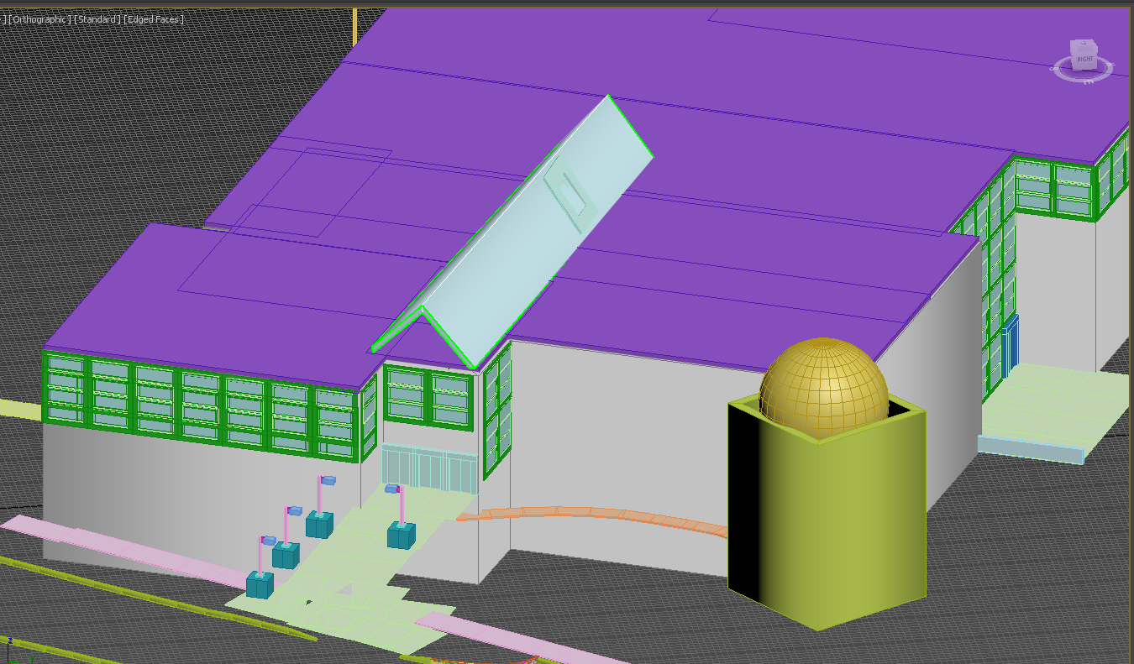
3D modeling
An integral part of immersive virtual reality is the environment
Utilize laser scanning and UAS mapping

Slide 14
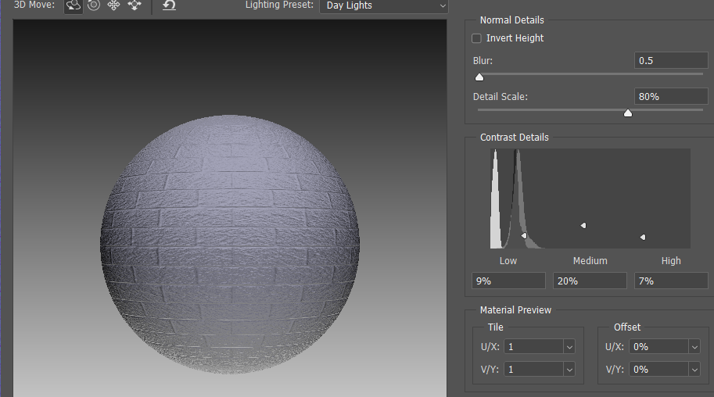
Texturing
Used close-up pictures to create textures in Photoshop

Slide 15
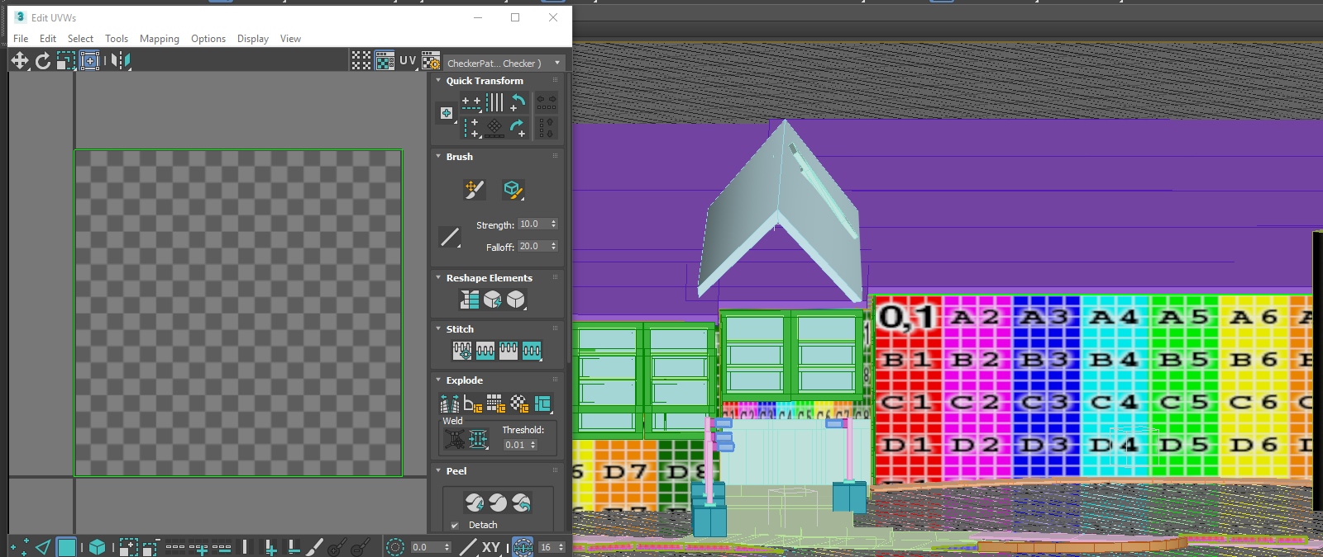
Applying Materials
UV unwrapping in Autodesk 3DS Max
Created Materials in Unity and applied textures

Slide 16
Virtual Environment

Slide 17
Virtual Environment

Slide 18
Virtual Environment

Slide 19
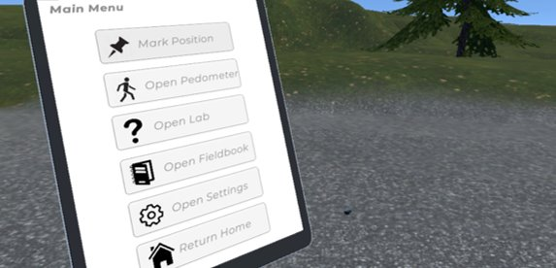
Leveling Lab
The student will be able to:
Pick up the rod and center it
Level the rod and adjust the height
Set the rod onto of a monument
Drop temporary points (rail spikes)
Use a pedometer to count paces

Slide 20
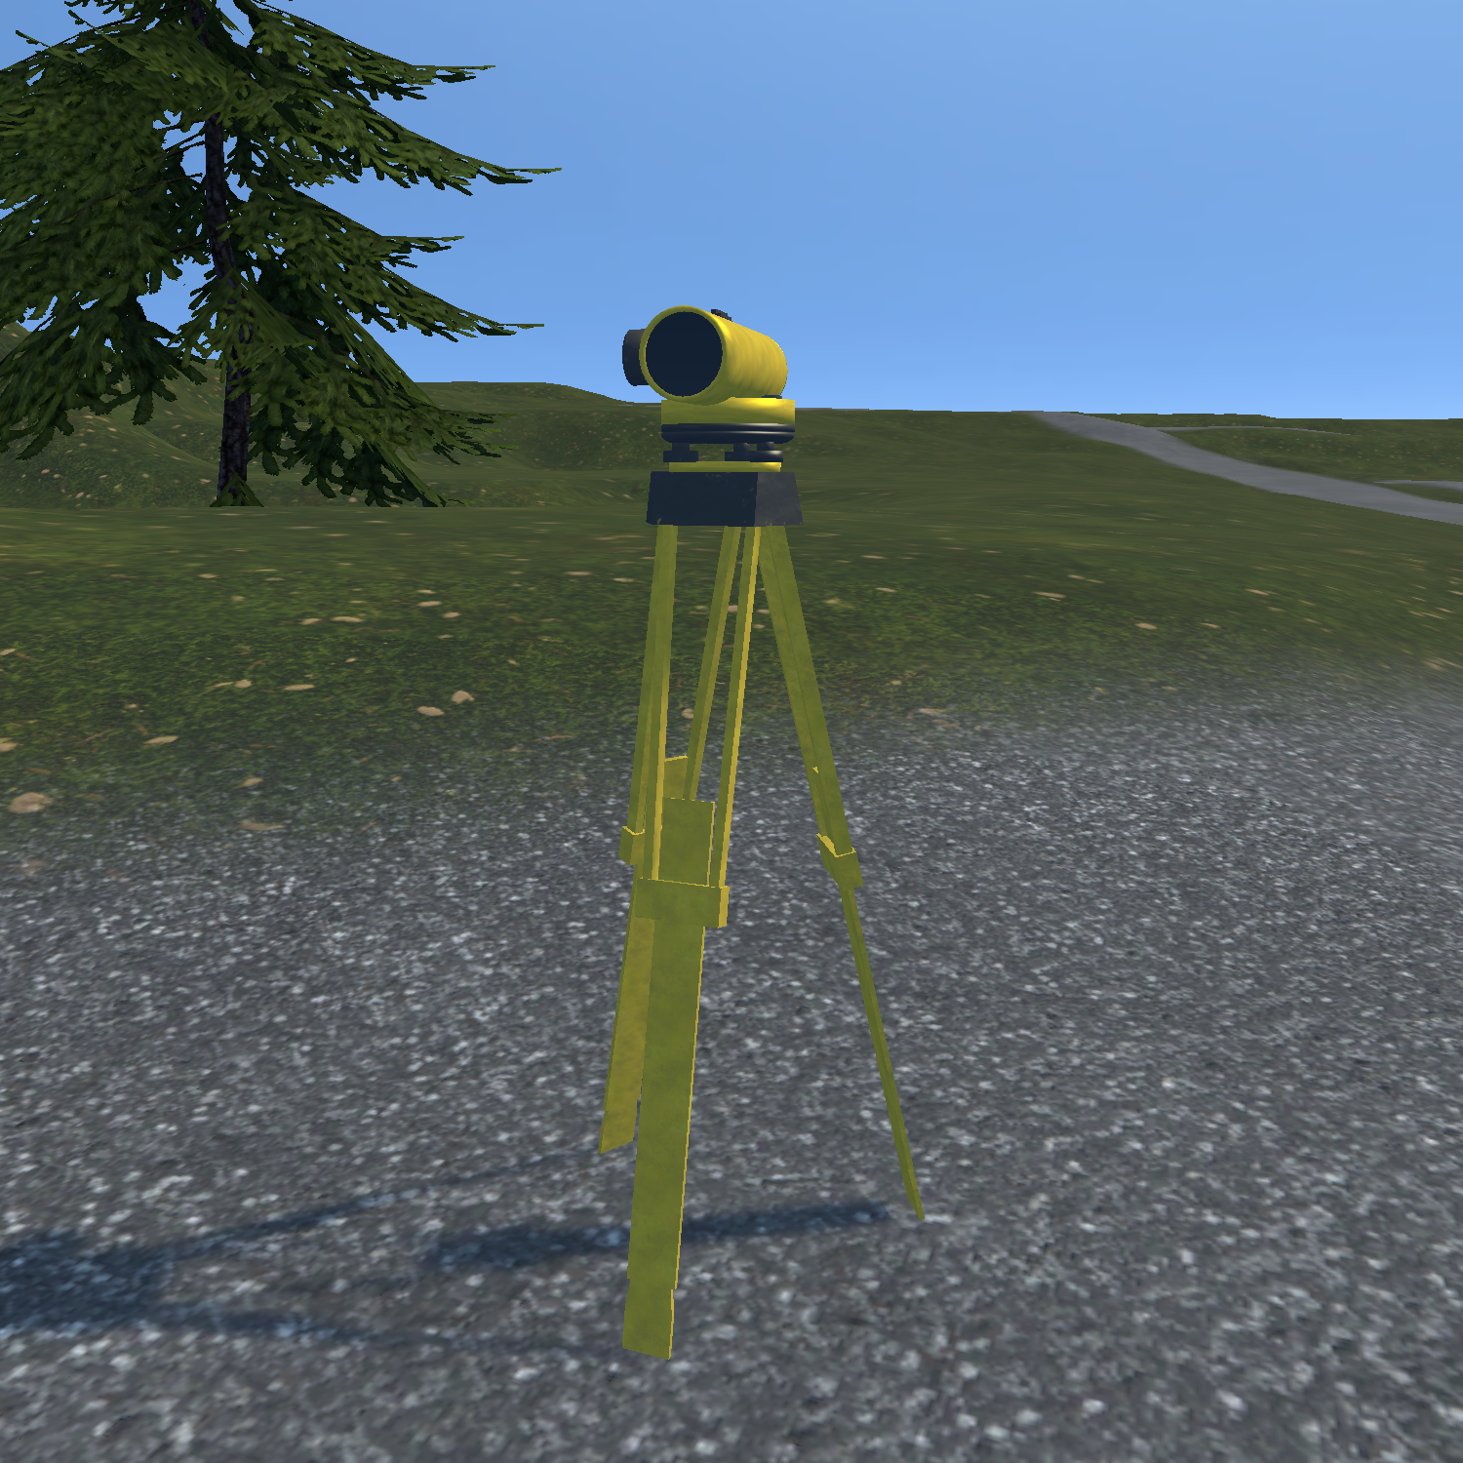
Leveling Lab (Cont.)
Pick the tripod and place it in any location
Select and adjust tripod legs
Select and adjust tribrach screws
Focus and rotate
Take a measurement

Slide 21
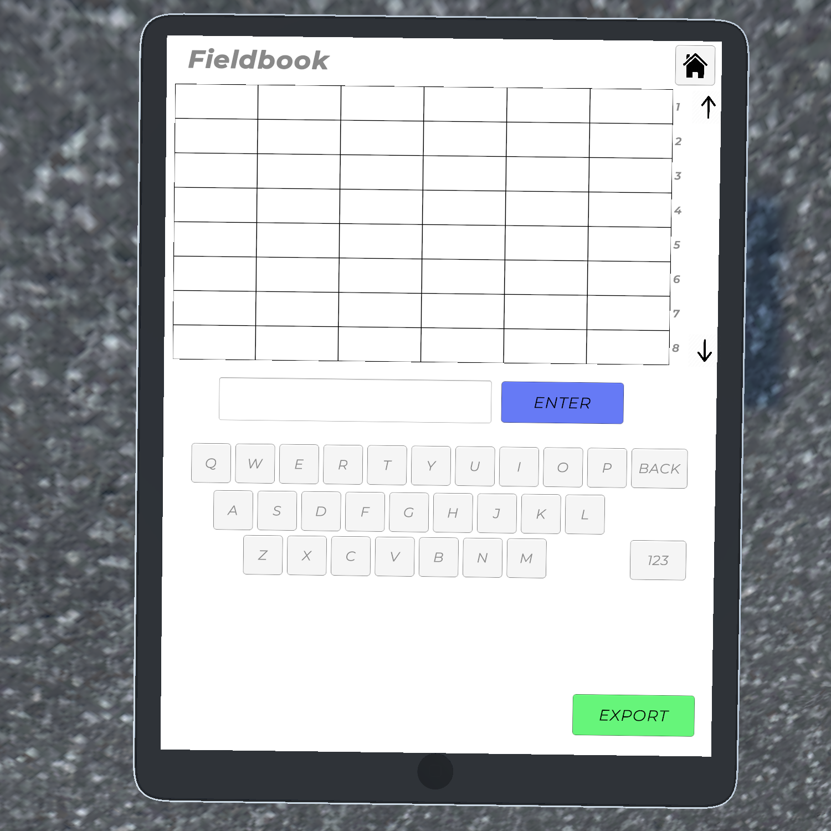
Leveling Lab (Cont.)
Open a virtual field book and record observations
Students will have to title each column and input observations
They can export a PDF with their measurements and snapshots of the telescope aimed at the rod for each observation

Slide 22
Future Features
Select two screws to adjust to mimic leveling
Snap the rod when close to the marker
Work with sensitivity of the bubble
Have a help screen for the peep sight
Add a map of user and location of tripod and markers

Slide 23
Assessment
Will determine whether VR labs increased student knowledge, skill, experience, and comprehension:
Pretests and Posttests (provides narrow snapshot of student learning)
Measure student understanding of theory, techniques, and procedures
Augment evaluation approach with reports of the VR labs.
Assess critical thinking based on their selected approach, comprehension based on whether they follow discussed procedures, and student skill and performance based on their achieved accuracy
Conduct summative anonymous surveys

Slide 24
Assessment (Cont.)
Surveys will have four categories:
Background
Students might have different levels of competency and experience with virtual reality technology and surveying, engineering vs. technology
General Pedagogy
Learning experience (e.g., VR gave me more incentive to learn, VR improved my learning experience, enhanced my knowledge and skills)
Surveying Pedagogy
Surveying knowledge (e.g., VR helped me prepare for surveying labs, VR helped increase skills with leveling, VR is useful to learn how to operate surveying instruments)
Technical Feedback
E.g., the level was easy to handle, I moved in the VR world with ease, touch controls where easy, I felt nausea during the VR lab
Notes:
Surveys will contain questions segmented in four categories (i) background, (ii) general pedagogy, (iii) surveying related pedagogy, (iv) technical feedback on virtual reality. Item (i) will focus on understanding the background of students, as students might have different levels of competency and experience with virtual reality technology and/or gaming. Furthermore, we will ask questions on their surveying background to determine how experienced they are with surveying practices and instruments. This is important as several students learn about the profession through working as field crew in surveying companies before they decide to earn in degree in surveying. In addition, students re-take courses due to failure in previous years, making them familiar with course content. Therefore, some students will be more experienced than others and we want to distinguish between novice and experienced students in terms of virtual technology and surveying. Item (ii) focuses on the pedagogy and learning experience of students, while item (iii) contains more specific questions in order to understand how virtual reality aids to enhance their surveying knowledge and skills. Finally, questions on item (iv) will focus on feedback on how we can improve the virtual reality software, user interaction, control handling, etc.

Slide 25
Additional Long-Term Questions
No available curricula or teaching materials to train surveying students with immersive VR
Questions:
Is immersive VR a viable solution for supplementing surveying laboratories and what are the learning outcomes?
How should VR laboratories be integrated with physical ones?
What is the contribution of VR in developing student’s skills and aiding student comprehension?
What assessment methods should be applied and developed for assessing student performance in VR laboratories?
What are the incentives to motivate other 2-year or 4-year surveying schools, as well as professionals to create and employ similar VR laboratories?

Slide 26
Conclusions
Virtual reality can be used to address challenges in surveying education
The leveling lab simulates the environment and instrument to a high level of fidelity
Two methods of integration of VR labs with physical ones
Future work:
Assessment of the VR labs
Expand the VR labs to different instruments, terrain, and tasks

Slide 27
Acknowledgements
Undergraduate Research Assistants:
This project is funded by:
The Schreyer Institute for Teaching Excellence
Engineering Technology and Commonwealth Engineering
Chancellor Endowment Funds
Penn State Wilkes-Barre Academic Affairs
Unity for providing the game development software license
John Chapman | Surveying Engineering
Joe Fioti | Computer Science
Vincent Pavil | Surveying Engineering
Eric Williams | Surveying Engineering
Malcolm Sciandra | Information Sciences and Technology
Courtney Snow | Business

Slide 28
References
Billingsley, S. (2018). Trimble Dimensions: Mixed reality, point-cloud to CAD processing, and some unexpected enthusiasm. SPAR 3D. On the Internet at https://www.spar3d.com/blogs/confessions-of-a-hired-gun/trimble-dimensions-mix-reality-point-cloud-to-cad-processing-and-some-unexpected-enthusiasm/ (Accessed May 10, 2019)
Dib, H., Adamo-Villani, N., & Garver, S. (2014). An interactive virtual environment for learning differential leveling: Development and initial findings. Advances in Engineering Education, 4(1), n1.
Jacobs, G. (2017). Three trends at SPAR International 2017. xyHt. On the Internet at https://www.xyht.com/lidarimaging/three-trends-at-spar-international-2017/ (Accessed September 1, 2018).
Kang, S. C., Chuang, S. K., Shiu, R. S., Chen, Y., & Hsieh, S. H. (2010). SimuSurvey X: an improved virtual surveying instrument running off a game engine. In Proceedings of the International Conference on Computing in Civil and Building Engineering
Lu, C. C., Kang, S. C., & Hsieh, S. H. (2007, June). SimuSurvey: a computer-based simulator for survey training. In Proceedings of CIB 24th W78 Conference Maribor 2007 &14th EG-ICE Workshop & 5th ITC@ EDU Workshop: Bringing ITC knowledge to work. Maribor, Slovenia (pp. 743-748).
Lu, C. C., Kang, S. C., Hsieh, S. H., & Shiu, R. S. (2009). Improvement of a computer-based surveyor-training tool using a user-centered approach. Advanced Engineering Informatics, 23(1), 81-92.
Martín-Gutiérrez, J., Mora, C. E., Añorbe-Díaz, B., & González-Marrero, A. (2017). Virtual technologies trends in education. EURASIA Journal of Mathematics Science and Technology Education, 13(2), 469-486.
Makransky, G., Terkildsen, T. S., & Mayer, R. E. (2017). Adding immersive virtual reality to a science lab simulation causes more presence but less learning. Learning and Instruction.

Slide 29
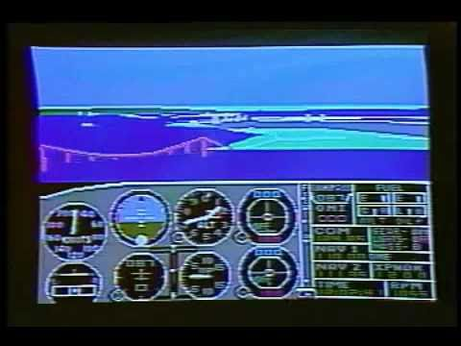
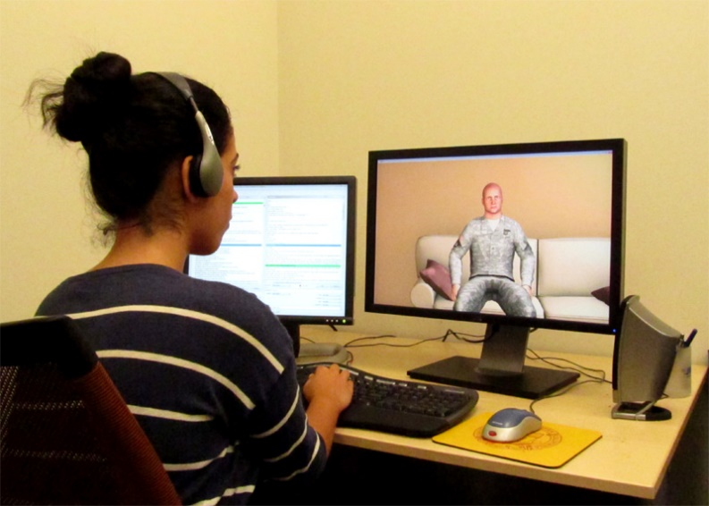
Virtual Reality (VR) Background
VR for education can be traced back to the 1980’s
Flight simulation
In higher education VR introduced in the 1990’s
High cost prohibited widespread use
Reduction of computer cost and VR hardware allowed rise of mostly desktop-based VR in 2000’s
Medicine, engineering, elementary education
https://www.youtube.com/watch?v=1H9BEyHmq_I
http://ict.usc.edu/wp-content/uploads/2012/03/virtual-patient-1.jpg

Slide 30
sUAS Data
Nadir and Oblique

Slide 31
Laser Scanning data

Slide 32
Desktop VR: Limitations
Students would prefer a camera at the eye level of the character
Challenges in instrument operation and changing view angles
Desktop-VR cannot mimic hand movement and real instrument operation
User needs to make use of several viewpoints to navigate around the virtual environment,
Unnatural and cumbersome, reducing realism
Lu et al. (2009)

Slide 33
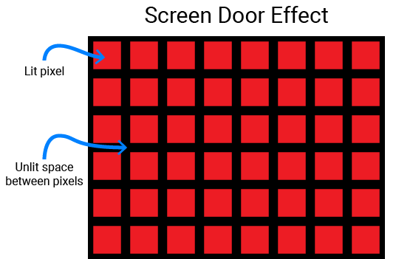
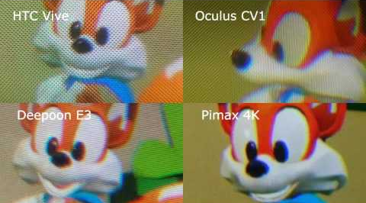
VR Problems
Mech like effect (visual gaps between pixels)
Reduces image quality
Distracts from immersive experience
Causes eyestrain and headaches
Eye fatigue
Motion Sickness
Most people adjust over time
Limit experience to 30 minutes
Freedom of movement (limited space)
Notes:
These can limit experience and immersion

Slide 34
Immersive VR: Advantages
Immersive VR:
Brings a sense of naturalism in navigation and movement
Increase their presence and immersion
Increases engagements with the virtual reality laboratories.

