Slide 1
Photogrammetry-based Bridge Dynamic Deformation Monitoring (PhoBD2M)
Dr. Yushin Ahn

Slide 2
Content
General statements
  Bridge health
  Existing studies
Test
Bridges & results

Slide 3
Bridge Inspection
Regular inspection in order to assess:
  Current Structural Condition
  Anticipate future problem
  Identify maintenance needed
By Qualified Inspectors
  Deck, superstructure and substructure

Slide 4
Bridge Inspection Cont.’
1/9 bridges considered to be structurally deficient
  Based on condition assessment and load ratings
  From Visual Inspection
  Inherently Subjective

Slide 5
Bridge monitoring studies
Drone
Total Station
LiDAR
Camera
Strain gage
Accelerometers
GPS
Remote sensing approach
(non-contact)
Conventional approach
Limitations in accuracy

Slide 6
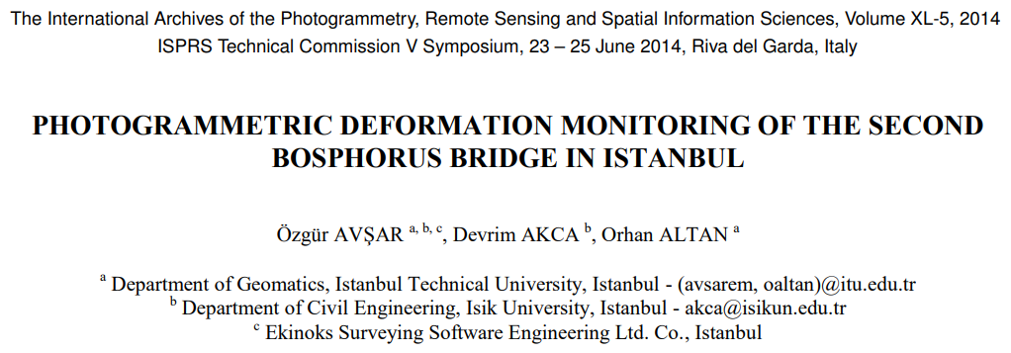
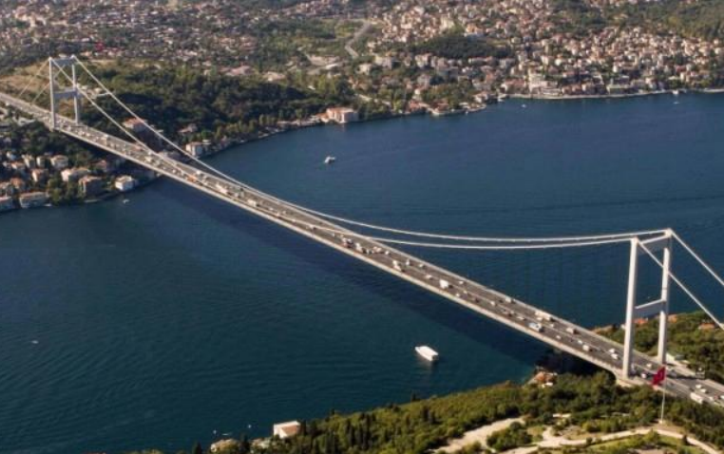
suspension bridge
Bridge length: 562m
Level rod readings compared to photogrammetric measurements from 122m away
2352x800 pixels, 12 fps
Maximum deflection: ~8 mm
Differences from photogrammetry, curvature, and level rod were within: 0.5 - 1.5 mm

Slide 7
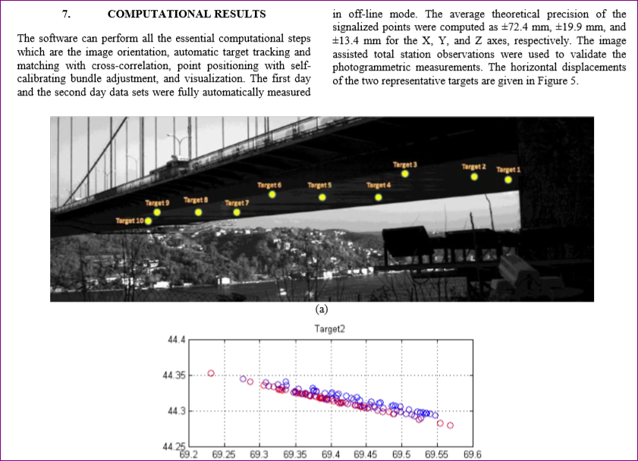
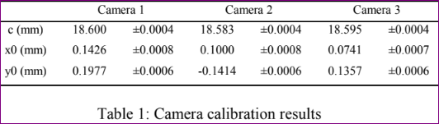
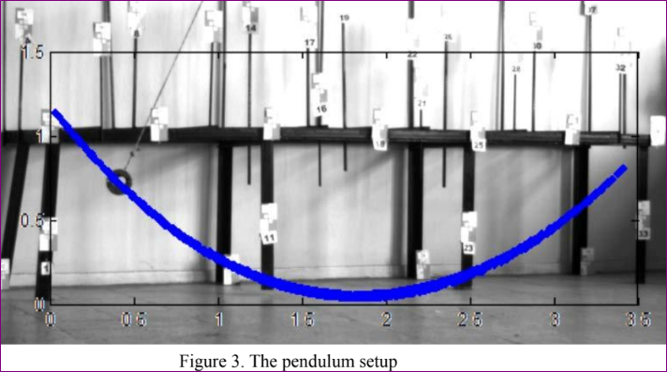
suspension bridge
Conclusion: Successful results. Further experiments will be performed monitor the entire bridge online.

Slide 8
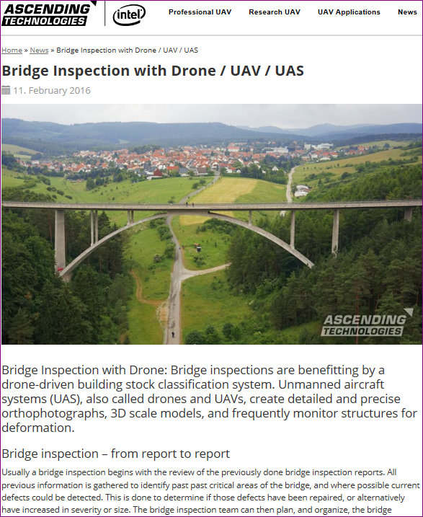
Drones
Bridge Inspection with Drone / UAV / UAS
By Ascending Technologies
Anna-Ebert Bridge, 220m long
UAV flew up to 5m close
Georeferenced 3D point cloud with 1.3 Billion points
High-quality orthophotos 1 mm/pixel resolution
True to scale 40 images in 4 minutes
Mesh with 101 Million polygons, accuracy: <0.5 mm
All 43 decorative elements captured on this bridge shows how accurate and sharp we can capture small details.
Notes:
http://www.asctec.de/en/bridge-inspection-per-drone-uav-uas/

Slide 9
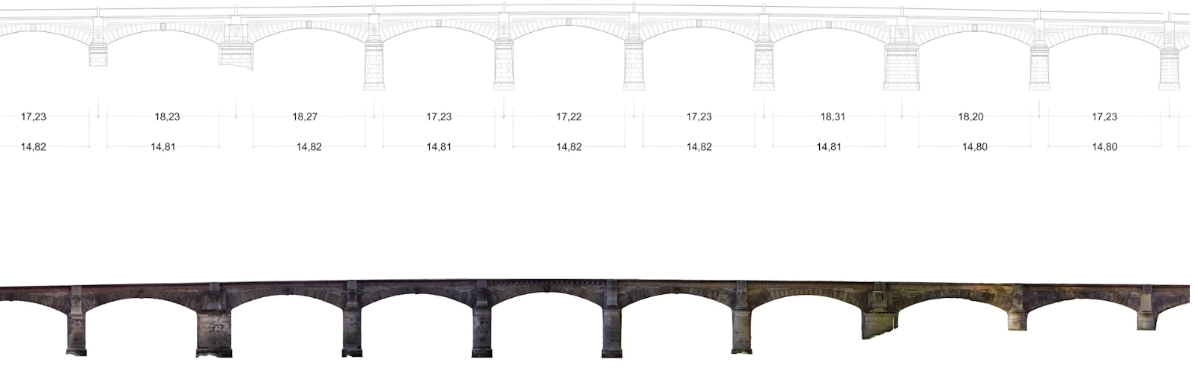

Drones...
Results: Construction plans for damage detection and frequent deformation monitoring

Slide 10
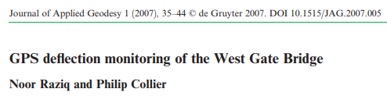
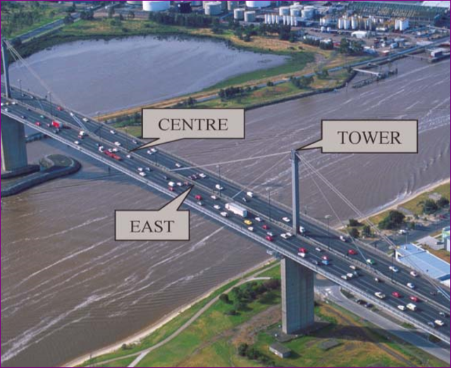
Global Positioning System
West Gate Bridge in Melbourne, Australia (length: 2,582.6 m)
3 GPS antenna
Bridge movement deflections detected by GPS laterally and longitudinally, measured in m/s.

Slide 11
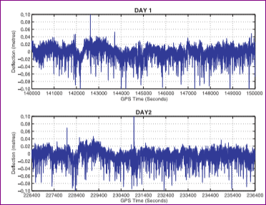
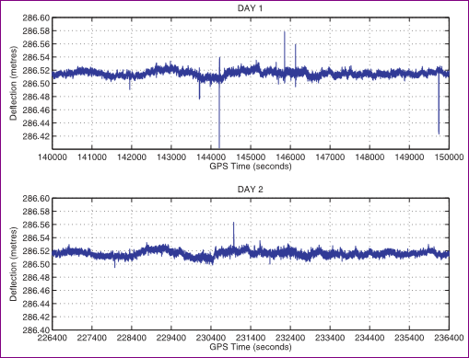
Global Positioning System
Vertical deflections: high frequency outliers
Results:
Conclusion: GPS successfully identified many of the dominant frequencies of bridge. However, amplitudes of these deflections go beyond GPS noise level.
Future work will focus on filtering modifications to alleviate the harshness of these vibrations
Horizontal deflections: low frequency outliers

Slide 12
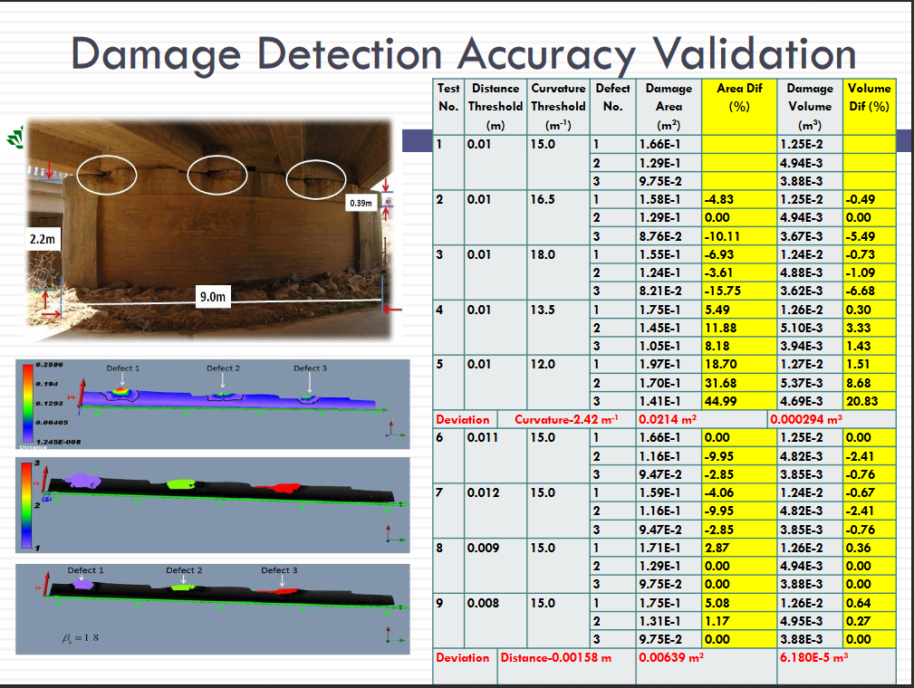
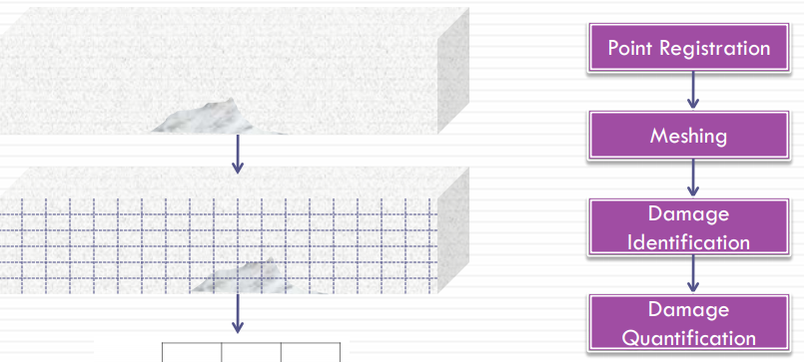
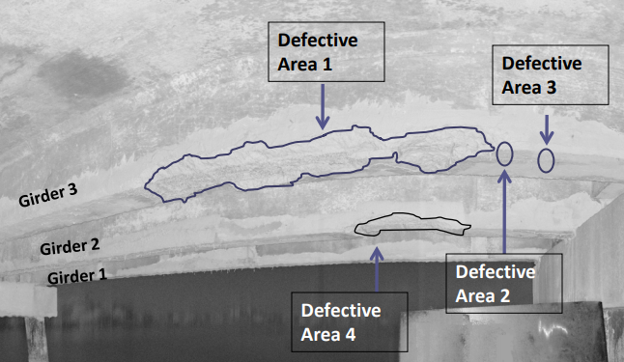
LiDAR
UNC, Charlotte: LiDAR Based Bridge Evaluation by Wanqiu Liu
Damage detection
screen shot

Slide 13
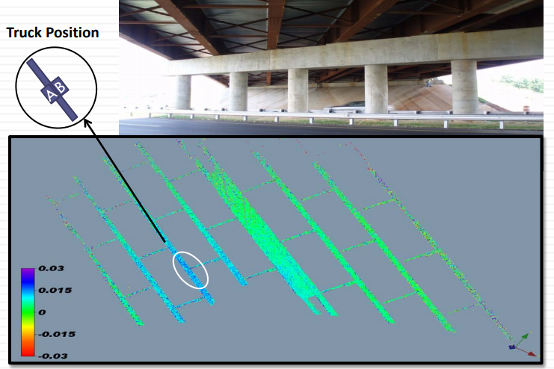
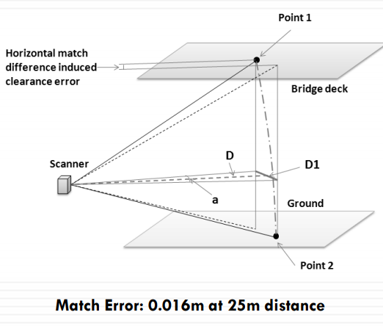
Lidar
Deflection measurement
Clearance measurement
Conclusion: Deflection of bridge yet no dymanic behavior of the bridge

Slide 14
What do they measure?
Dead Load Deflection
Live Load Deflection, Magnitude
Live Load Deflection, Frequency
Velocity and acceleration
of the bridge
Bridge structural health

Slide 15
Dead Load Deflection
Self Weight
Pre-stressed Concrete

Slide 16

Live Load (Traffic) Deflection
Vehicle Weight

Slide 17
Live Load (Traffic) Derived Vibration
Vehicle Weight

Slide 18
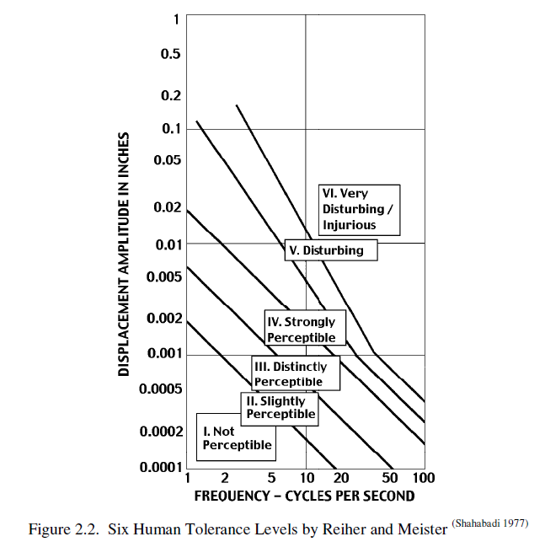
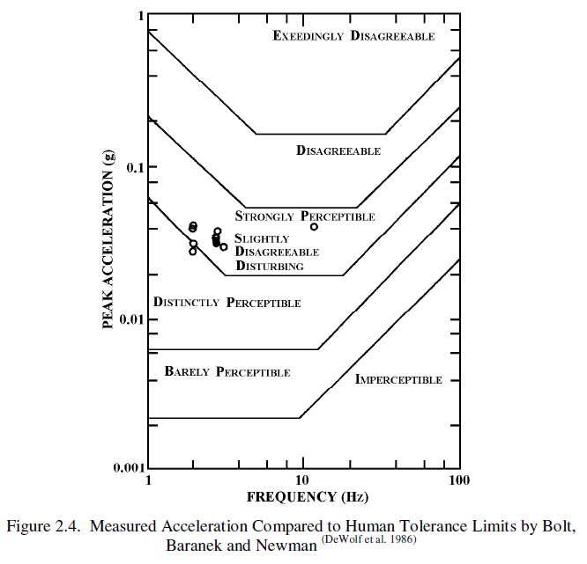
Structural health + serviceability
Pedestrians/Drivers perceive the bridge vibration

Slide 19
Project Objectives
Dead Load Deflection
Live Load Deflection, Magnitude
Live Load Deflection, Frequency
Safety and Serviceability
Velocity and acceleration

Slide 20
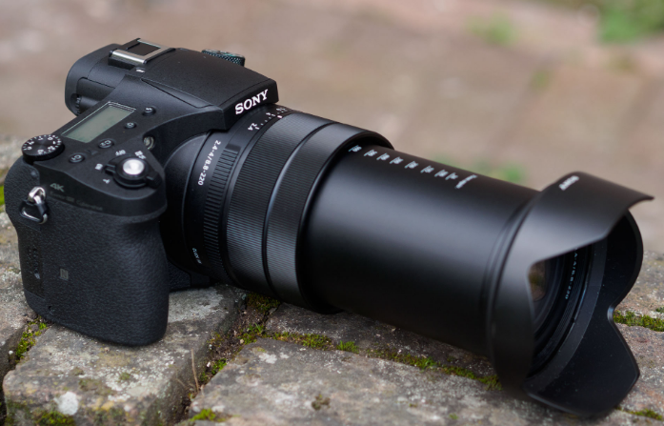
What do we use?
Sony Cyber-shot RX10 IV DSLR camera
Focal Zoom:
  24 to 600 mm
20 Megapixel
  5472 Χ 3648

Slide 21
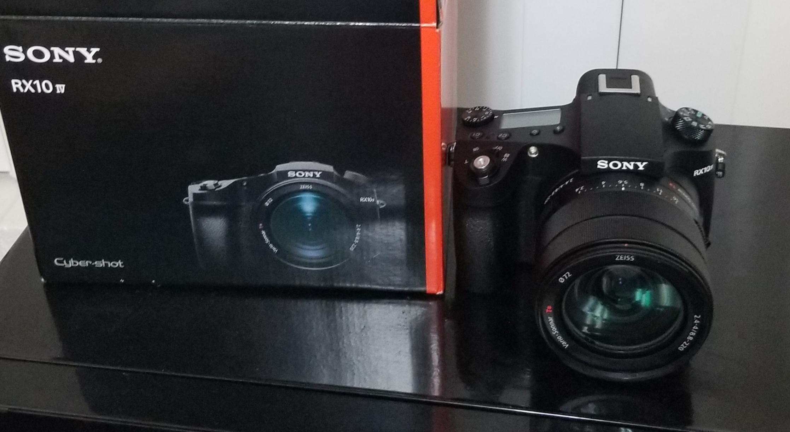
Digital camera with slow-motion video capabilities
Frames per Second
  Normal: 30-60 fps
  Slow motion: 240 fps
  Super Slow motion: 960 fps
24 frames per second continuous shooting , up to 249 frames
Picture resolution: 3647 Χ 5472
Video resolution : 2160 Χ 3840 (~30 fps)
1080 Χ 1920 (~960 fps)
How slow does this camera capture?

Slide 22
Camera specification
Specification | Content
Pixels | 21.1 Megapixels (5472 X 3648)
Sensor | 1” (13.2 X 8.8 mm) CMOS
Resolution | 3840 x 2160p: 30 fps, 25 fps, 24 fps 1920 x 1080p: 60 fps, 50 fps, 30 fps, 25 fps, 24 fps 1920 x 1080p: 240 fps, 480 fps, 960 fps 1920 x 1080p: 250 fps, 500 fps, 1000 fps
Zoom Lens | Effective focal length: 8.8 - 220 mm Equivalent focal length: 24 – 600 mm
Shutter speed | Mechanical: 4 – 1/2000 second Electronic: 4 – 1/32000 second

Slide 23
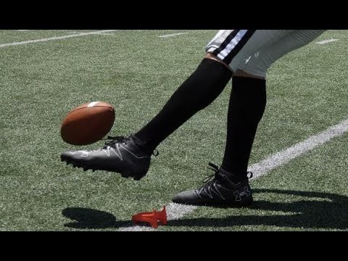

Slide 24
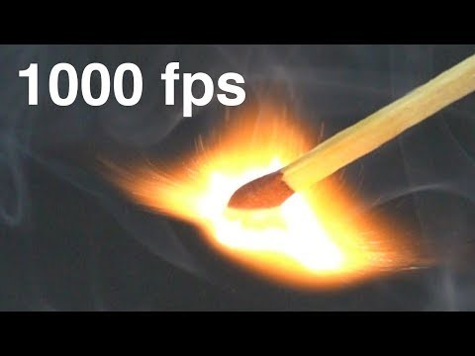

Slide 25
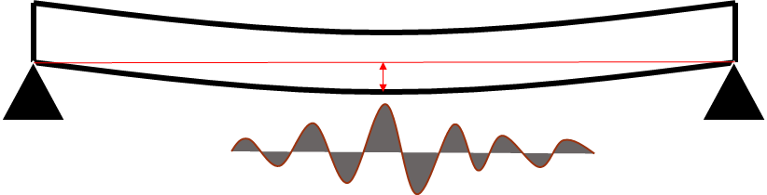
Back to the bridge
How much vibration are we talking about?
Magnitude
How many cycles per second
Can we measure this amount?

Slide 26
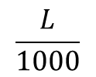
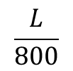
Live Load deflection (traffic & pedestrians) by American Association of state highway and transportation officials(AASHTO)
Bridge Span, L
$$\frac{L}{800}$$
Highway Bridge that carries no pedestrians
$$\frac{L}{1000}$$
Highway Bridge that carries pedestrians

Slide 27
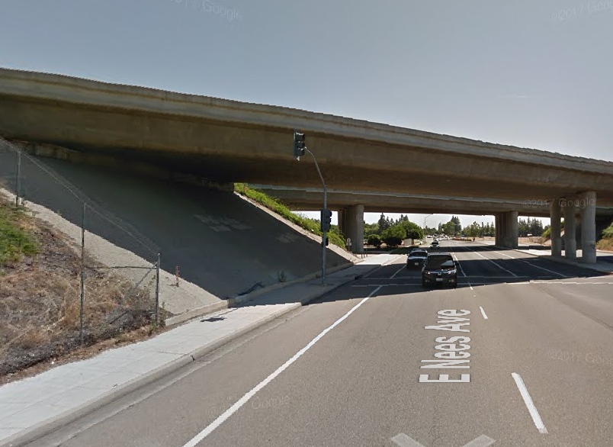
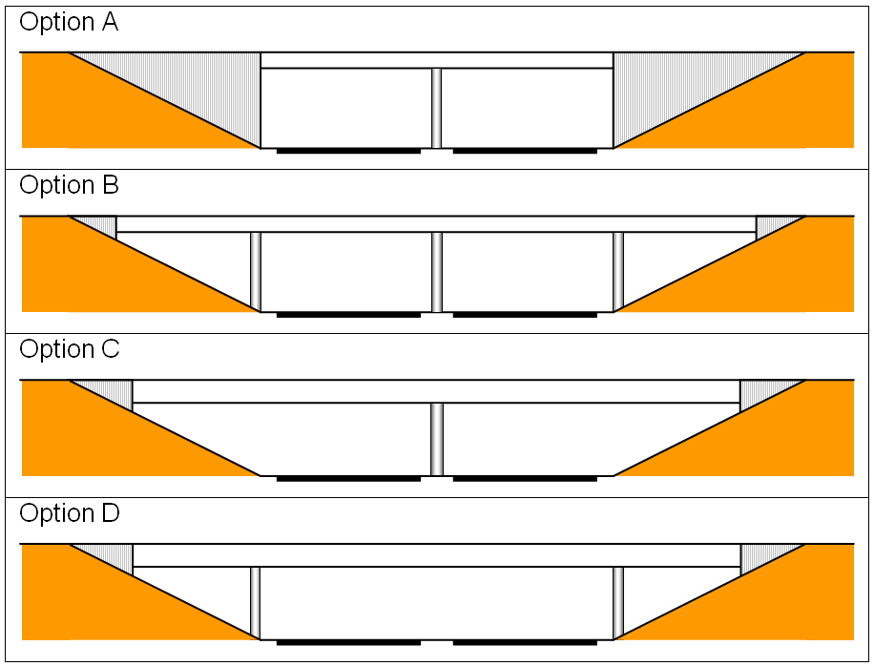
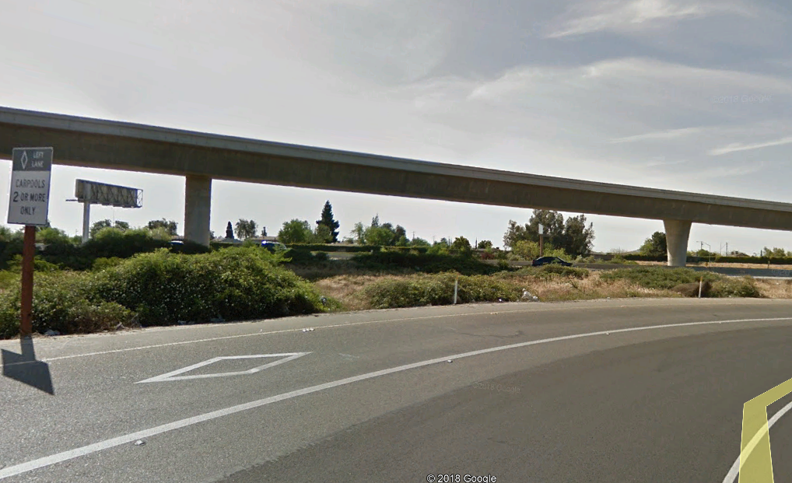
Short Span: 6-30 meters
Medium Span: 30-100 meters
Long span: 100 meters
https://www.steelconstruction.info/File:R11_Fig1.PNG

Slide 28
Short Span: 6-30 meters
Medium Span: 30-100 meters
Long span: 100 meters
Maximum Allowable Deflection:
Short Span: 6-30 meters (30 mm)
Medium Span: 30-100 meters (100 mm)
Long span: 100 meters
https://www.steelconstruction.info/File:R11_Fig1.PNG
Simply, 10 meters span: 10 mm

Slide 29
Study Objectives
Camera system as bridge monitoring sensor
Camera position
  Where do we put camera to shoot the bridge?
  Can we detect vibration and its vertical motion?

Slide 30
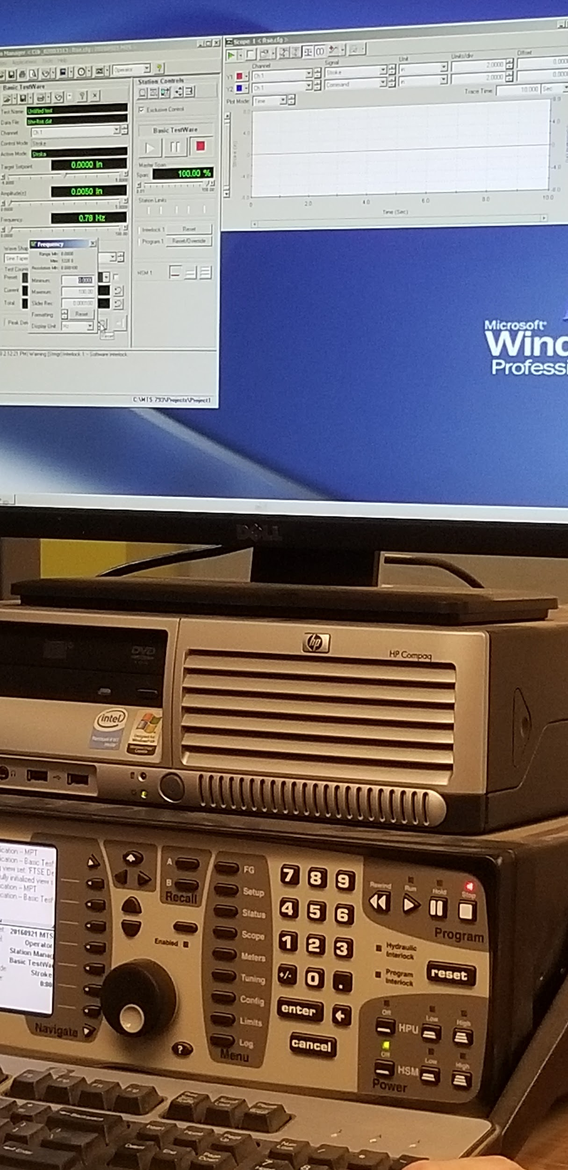
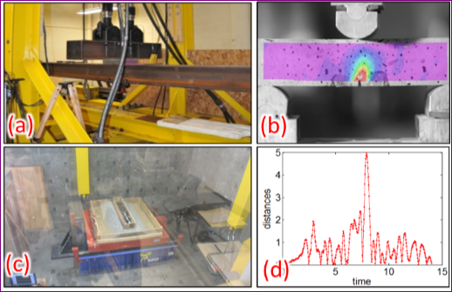
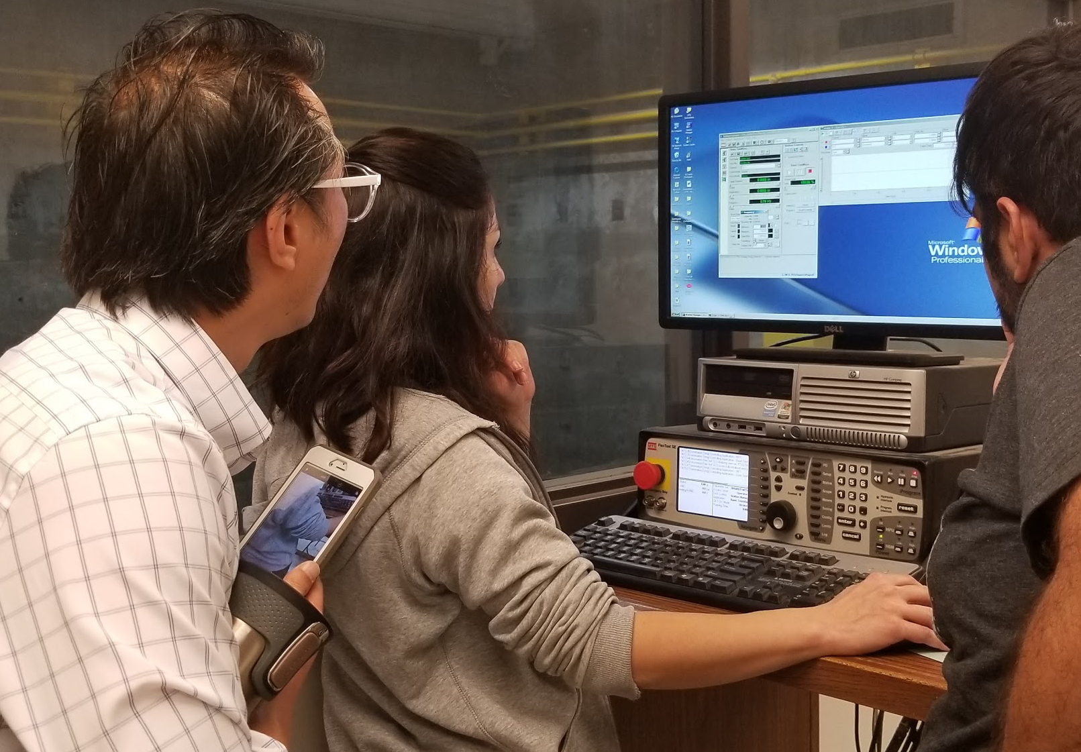
Tests with Shake Table
Civil does lots of material tests

Slide 31
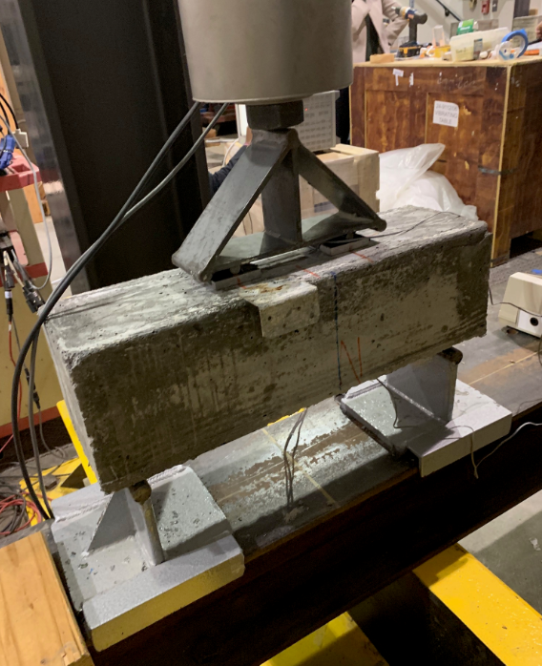
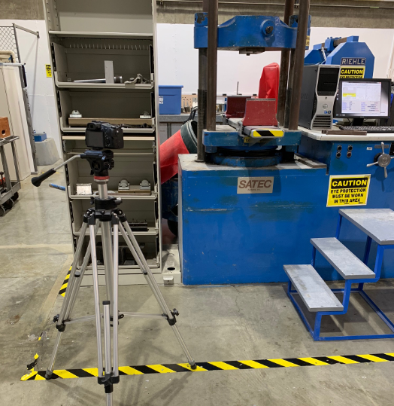
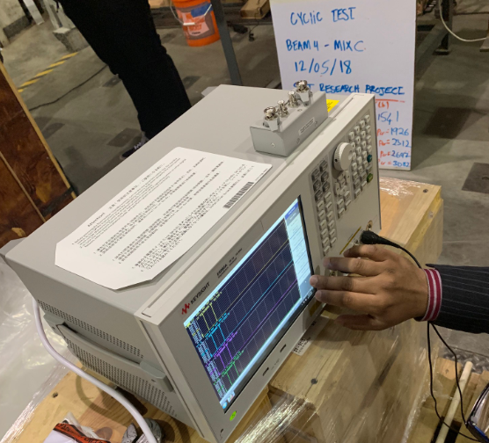
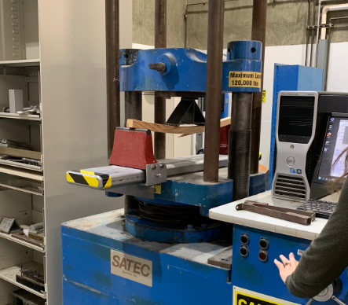

Slide 32
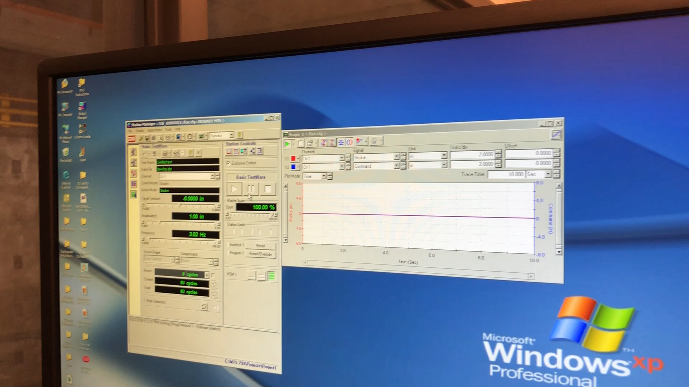
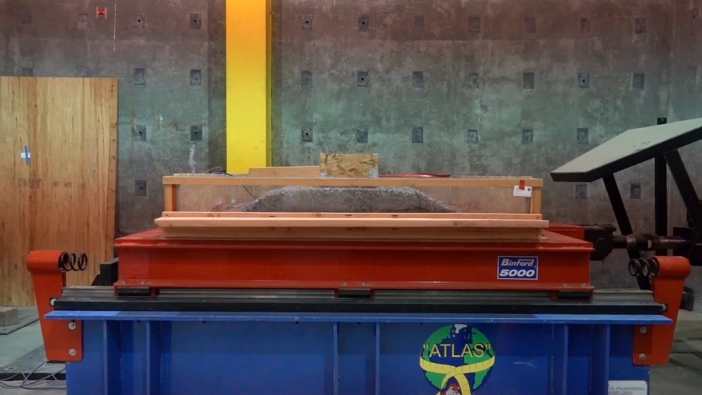
Shake table Video
Fresno State Shake Table Test
October 2, 2018
Video recorded by: V. Lazar
It mimics ground motion excitation

Slide 33
Specification | Content
Maximum Payload | 20 KIP
Dimensions | 7 ft X 8 ft
Frequency | 20-50 Hz
Maximum horizontal displacement | 5 inches on each side

Slide 34
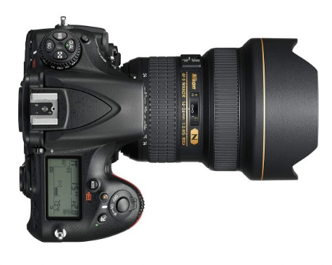
Camera Geometry
Distance to monitor deflection, 30 mm
How many pixels have been moved?
Pixel displacement
Focal length (8.8 – 220 mm)
Pixel size in photo
Pixel size in ground
Distance to Bridge

Slide 35
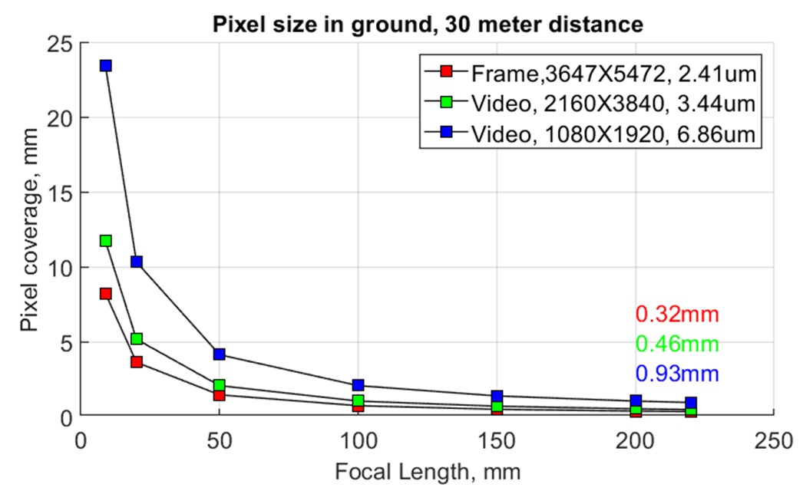
Camera Geometry

Slide 36
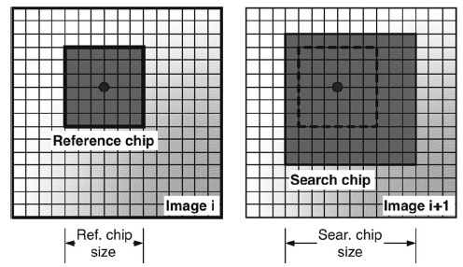
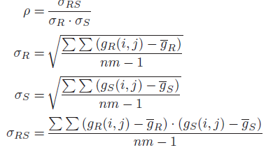
2D Normalized cross correlation
It chips out subset from image i
It searches the most similar patch in image i+1

Slide 37

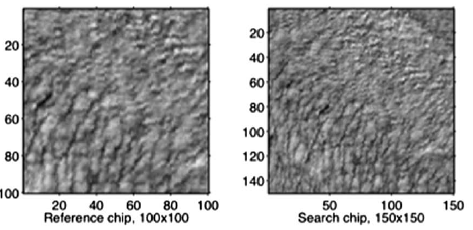
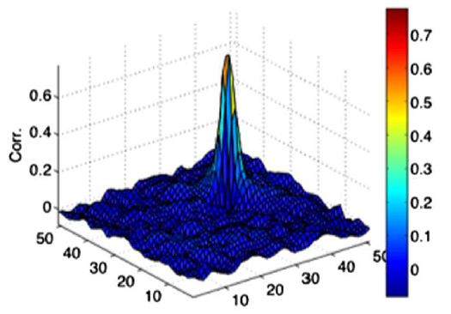
SubPixel displacement:
Quadratic surface fitting and find the pear

Slide 38
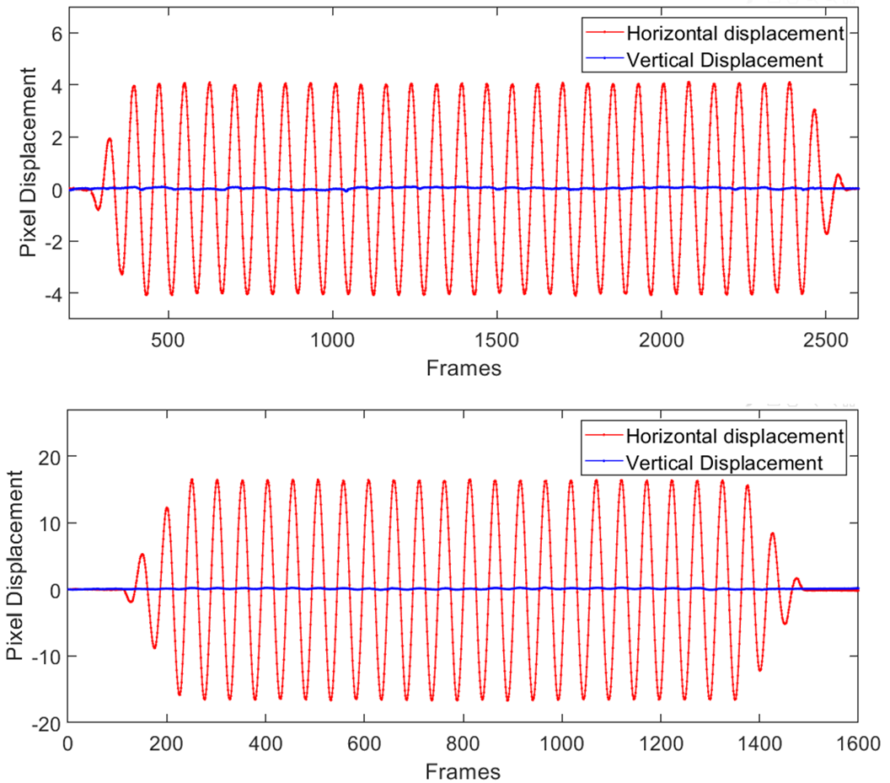
 | Camera Derived
 | Amplitude | Frequency
Set 1 | 0.25 inch | 0.782 Hz
Set 2 | 1.0216 inch | 1.172 Hz

Slide 39
 | Shake Table Feeds |  | Camera Derived
 | Amplitude | Frequency | Amplitude | Frequency
Set 1 | 0.25 inch | 0.78 Hz | 0.25 inch | 0.782 Hz
Set 2 | 1.00 inch | 1.17 Hz | 1.0216 inch | 1.172 Hz
Pixel size in Object space: 1.5875 mm (1 pixel)
Typical error of 2D correlation: 0.1-0.3 pixel
Difference of 0.0261 inch (or 0.55 mm) → 0.3 pixel error

Slide 40
Bridge candidates:
Local Bridge (1)
CA-SR 140 Temporary West Bridge, Merced River - El Portal, CA
Local / Freeway bridges (2)
Riverpark, Blackstone and Nees at Yosemite 41 Freeway overpass, Fresno, CA
Sequoia-Kings Freeway - 180/168 and Cedar Ave. Overpasses Fresno, California

Slide 41
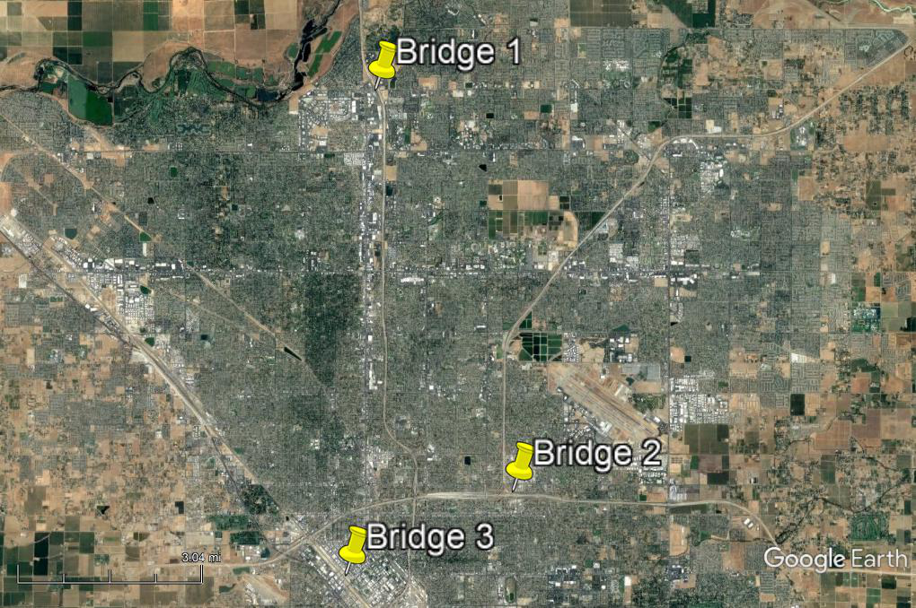
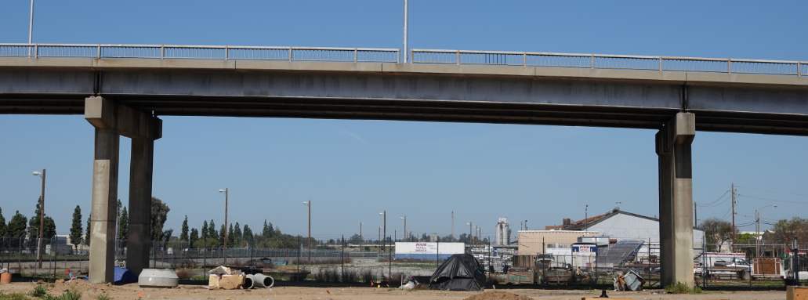
Bridge candidates:
Fresno, California
B) Bridge 1
A) Site Overview
D) Bridge 3
C) Bridge 2

Slide 42
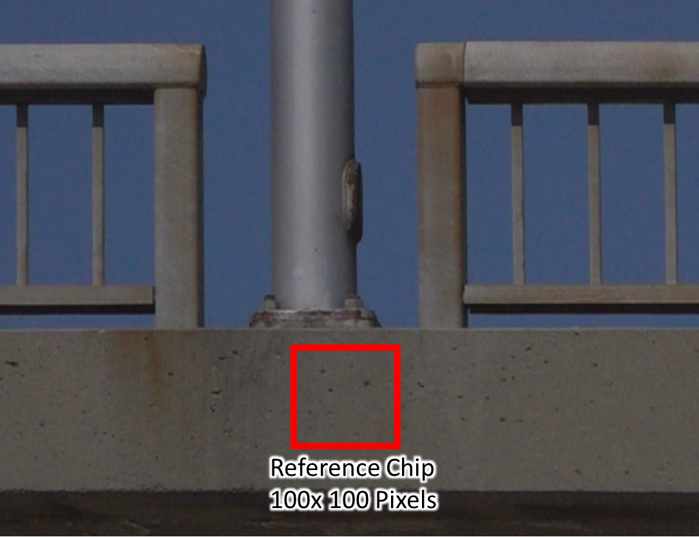

Slide 43
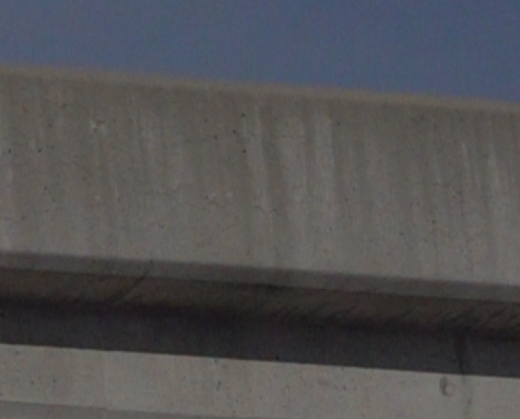
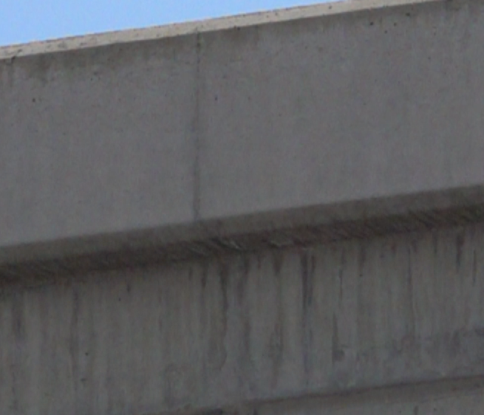
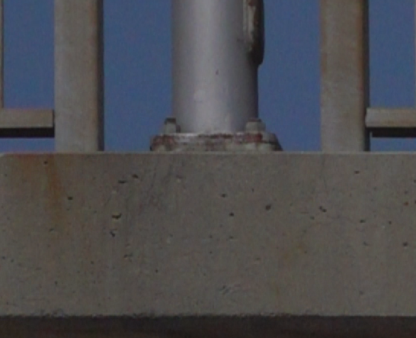
Bridge 1 subset
Bridge 2 subset
Bridge 3 subset
Maximum Zoom

Slide 44



Slide 45



Slide 46



Slide 47
 | Bridge 1 | Bridge 2 | Bridge 3
Object distance, meter | 45.74 | 26.75 | 37.05
Span length, meter | 30.06 | 44.23 | 34.64
Pixel size (mm) | 1.42 | 0.84 | 1.16
Pixel magnitude (pixel) | 3.64 | 9.43 | 4.78
Displacement magnitude (mm) | 5.20 | 7.87 | 5.53
Frequency | 12 | 9.6 | 13.82
Average 17 % of AASHTO criterion
Bridge frequency range

Slide 48



Velocity & Acceleration re within the range of similar bridges

Slide 49
Conclusion
DSLR camera/Zoom Lens/Slow motion
30-40 meters distance camera setup
Detects mm-level motion
Feasible Vibration study
  Motion/velocity/acceleration/frequency
Remote sensing technique (no contact)

Slide 50


Future Work

Slide 51

Bus Driver Ignoring Bridge Weight Limit

Slide 52
Questions or Comments??

