Slide 1
Feasibility Study Utilization of the Raw Intensity Return from Leica Scanstation P20 Measurements as a Geometric Tool to Assist in Control and Validation Targeting
Notes:
This PowerPoint template is designed to assist you in creating your own university-branded presentation.
You may alter the text boxes or graphic elements in the template to accommodate your content. Please do not alter the background image.
If you need assistance with this template, please contact the Office of University Communications at 559.278.8595.

Slide 2
Leica ScanStation P20
Notes:
Our study revolves around the use of the Leica Scanstation P20, which in turn relates to the Later models as well as any previous models. The goal will be for this research to reach other manufacturers as well.

Slide 3
Target Uses
Calibration
Registration
Validation

Slide 4
Leica ScanStation P20 High Density Data
Notes:
This is to be the benchmark Comparison

Slide 5
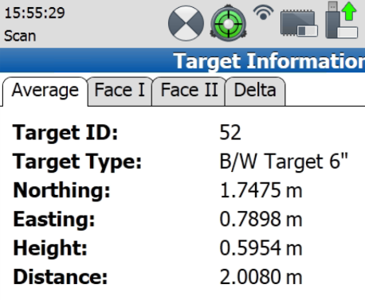
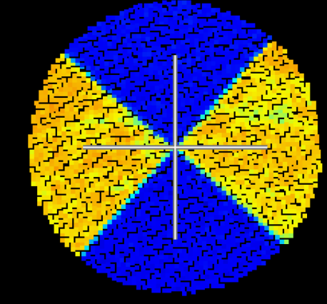
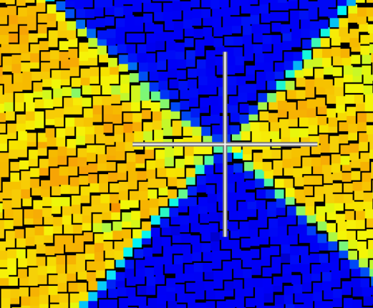
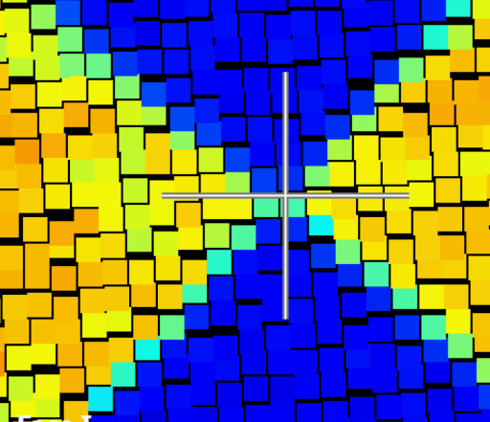
Leica P20 @ 2m
Notes:
@ 2m, you can highlight the scanners ability to identify the dividing line between the White and Black Colors of the target

Slide 6
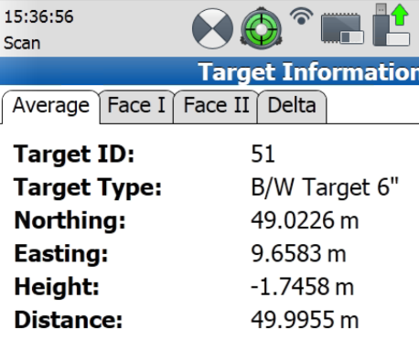
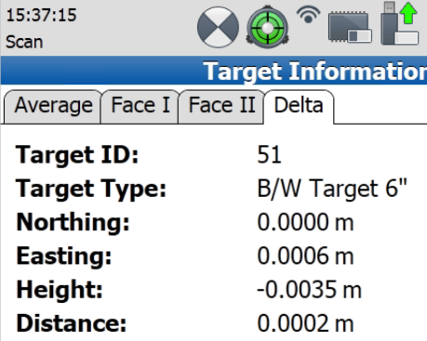
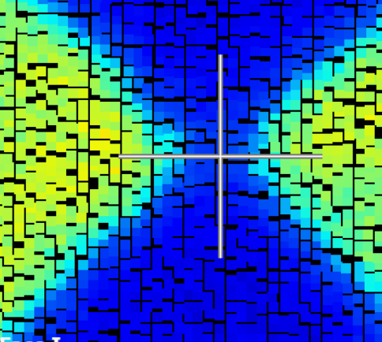
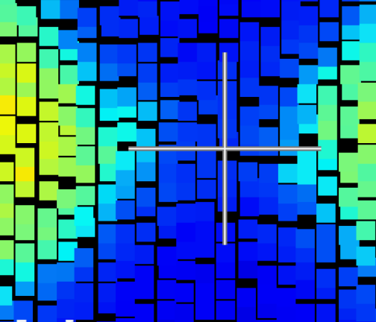
Leica P20 @ 50m
Notes:
@50m, you can see that the distortion begins to get greater. The division line between the white and black target becomes less precise, leaving room for a larger degree of calculation and best fitting to match the controlling center of the target

Slide 7
Leica P20
2m
50m

Slide 8
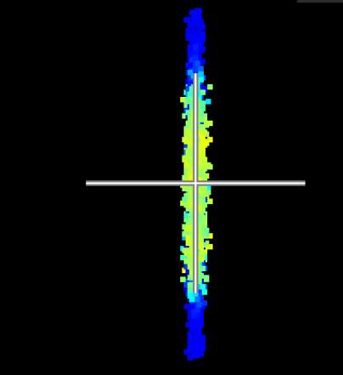
Leica P20 - Noise
2m
50m
Notes:
Side profile of the noise

Slide 9
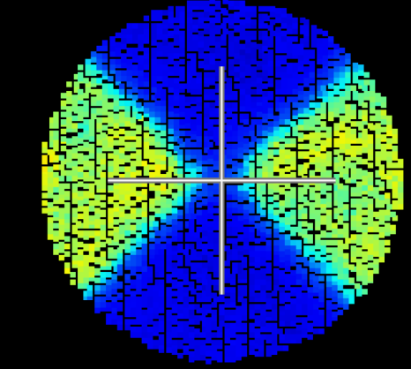
Leica ScanStation P20
Requires High Density of Data to determine target position
Utilizes difference in Intensity to identify controlling center
Different Distances = different intensity returns
2m
50m

Slide 10
Low Density Scan??
18” Target

Slide 11
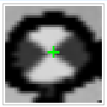
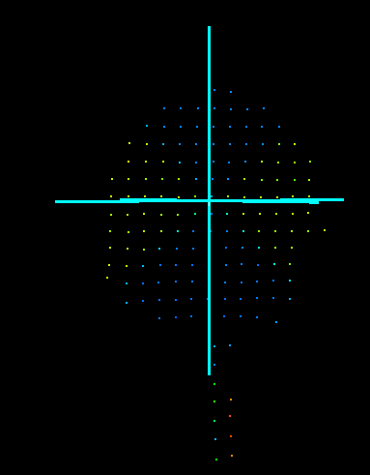
Leica P20 @ 2m, Low density (50mm @ 10m)
Target discovered by Leica Software
High Density vs Low Density (50mm @ 10m)
Δ 0.5mm Northing
Δ 2.8mm Easting
Δ 1.4mm Elevation
Notes:
It did acquire targets – but not accurately

Slide 12
Leica P20 @ 50m, Low density (50mm @ 10m)
Target Not Discoverable by Leica Software
Notes:
It did acquire targets – but not accurately

Slide 13
Problem:
Control only Possible with High Density Data
Not a perfect world
Dense scans not always available due to time constraints
Dense scans not always available due to location constraints

Slide 14
Leica P20
Can scan at a very low density
Can scan at a very High Density
Target Acquisition only available with High Density scans

Slide 15
Solution: Creation of Scan Target that can control and validate scan data with Low density scans

Slide 16
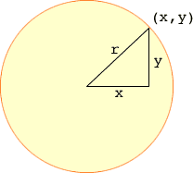
3 Point resection on target
$r_{n}^{2}={(x_{n}−x_{o})}^{2}+{(y_{n}−y_{o})}^{2}$

Slide 17
Varying Radial Gradients (6” Targets) - Paper target - printed on LaserJet printer

Slide 18
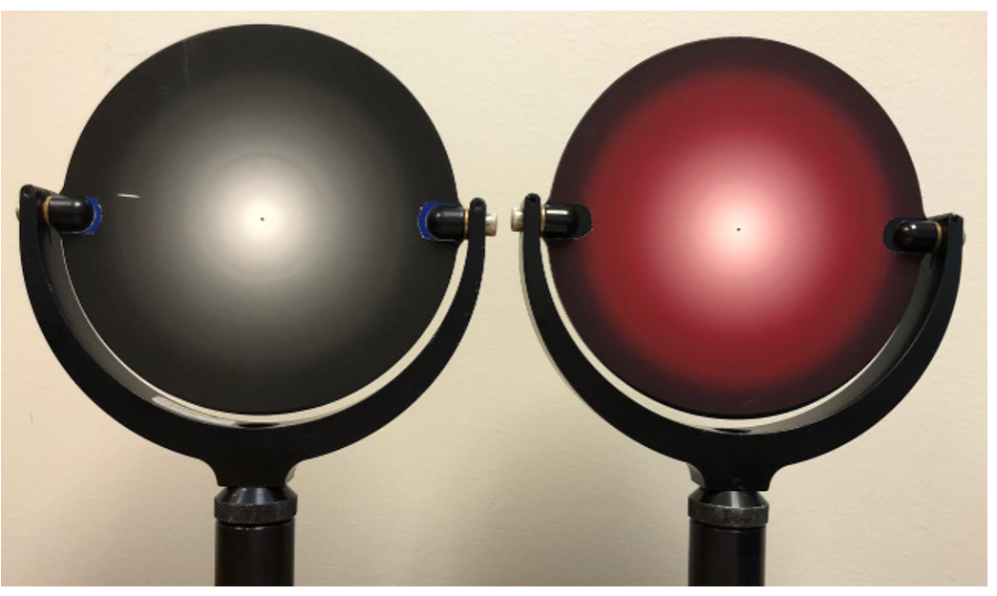

Slide 19
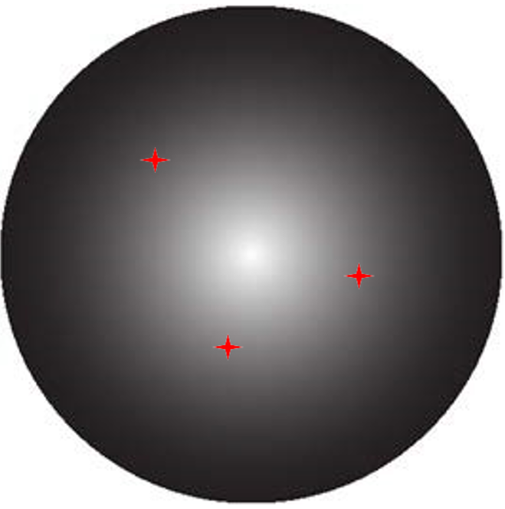
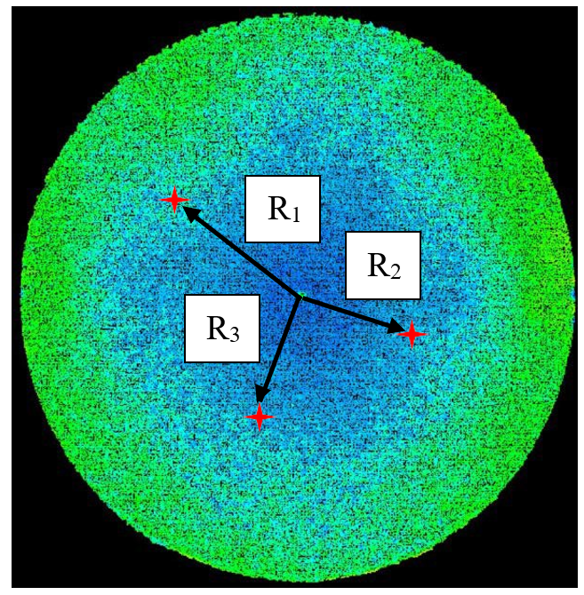
Radial Gradient Target – Unknown Radius from each Measurement

Slide 20
Calibrated Radial Gradient
Measured Intensity
Radius Determined from Calibrated Target
Calculated Resection for Controlling Center

Slide 22
Data Set #1 - 3 Randomly chosen points

Slide 23
Data Set #2 - 3 Random points - Linear

Slide 24
Data Set #3 - 2 Random Linear Line

Slide 25
Results – 10 Trials each data set

Slide 26
Angle of Incidence and Distance on ground targets

Slide 27
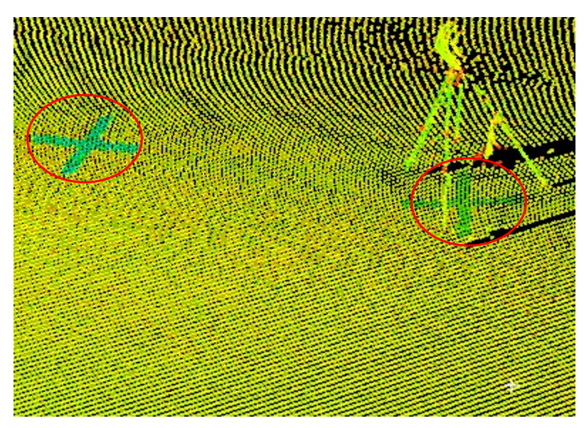

Slide 28
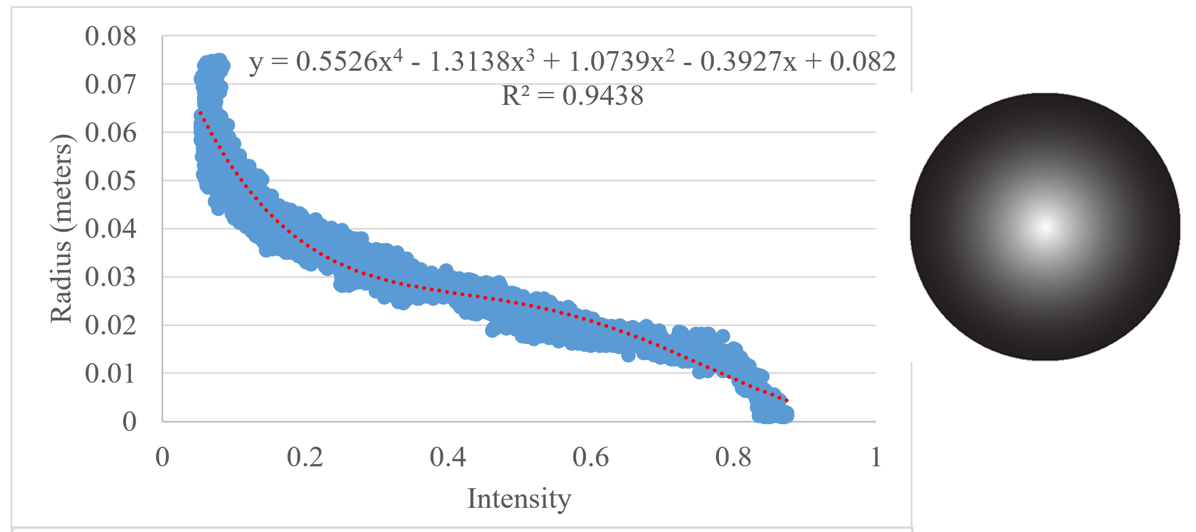

Slide 30
Discussion/Feasibility
Paper Target Low Density Scans – 1st Trial
Does not match reported accuracies from Leica Target – yet!
Preferred Target gradient will be linear – not a polynomial
Sub centimeter Accuracies regardless of angle of incidence and distance up to 20m

Slide 31
Feasible? Yes
Further Research
Linear gradient
Better printed target to control the gradient (less noise)
Test up to 50m to compare to Commercial products standards

