Slide 1
A COMPARATIVE ANALYSIS OF DATA SETS USING SUAS, TERRESTRIAL LIDAR, AND CONVENTIONAL TOPOGRAPHIC SURVEY METHODOLOGIES
A cooperative study between the US Army Corps of Engineers and Nicholls State University Geomatics
Cody Parks, LSI
Lead Survey Tech
USACE, New Orleans District
Dr. Balaji Ramachandran
Associate Professor of Geomatics, Nicholls State University
2019 Surveying and Geomatics Educators Society (SaGES) Conference
August 04 – August 08, 2019
Notes:
Good Morning, My Name is Cody Parks, and I am a Lead Survey Technician in Survey Section at The US Army corps of Engineers New Orleans District.
Today I will be presenting “A COMPARATIVE ANALYSIS OF DATA SETS USING SUAS, TERRESTRIAL LIDAR, AND CONVENTIONAL TOPOGRAPHIC SURVEY METHODOLOGIES”,
a cooperative study conducted by USACE and Nicholls State University.

Slide 2
Author’s Background
Mr. Cody Parks
Lead Survey Technician, Survey Section, USACE New Orleans District (MVN), January 2019 - Present
USACE-MVN sUAS Pilot in Command
Lead Technician, USACE-MVN Architect-Engineer Survey Services Inspections and Estimations Unit
Party Chief at Riverlands Surveying Company, LLC
Research Assistant at Nicholls State University
Cum Laude Graduate of Nicholls State University Geomatics Program, 2013
Private Pilot Certificate and Part 107 Certificate
Notes:
Brag about yourself blurb

Slide 3
MOTIVATION
sUAS Technology has evolved rapidly over that last two decades
Many manufacturers now quote photogrammetric accuracies commensurate with those of GNSS and Conventional Survey Methodologies.
USACE stands to benefit greatly from implementation of a successful sUAS survey program due to:
Time Savings
Personnel Costs Savings
Increased Personnel Safety
Notes:
A rapid evolution of technology

Slide 4
Why SUAS
Existing platforms are used for collection of up to date aerial imagery on small projects.
Low Manpower requirements for operation, in most cases a two-man Pilot/Observer team.
Presence of an evolving regulatory environment with reduced barriers to effective use of sUAS platforms

Slide 5
Study Objective
Perform Comparative Analyses between sUAS SFM Point Clouds, GNSS, terrestrial LiDAR, and conventional survey datasets to evaluate equivalencies.
Identify survey types and accuracies classes which stand to benefit from replacement with sUAS products
Determine optimal sensor, ground, control, and QA/QC configurations for future sUAS work.
Only existing comparable data was used in this study.

Slide 6
COST Analysis
Study parameters restrict testing to existing type aircraft already in use by USACE New Orleans District.
Based on In-house crew rates (including overhead) and normal rates of progress, and a typical 5 acre site. Man-day estimate include post-processing time.
Survey By GNSS - $5,000, 4 Man-days
Survey By Conventional - $9,000, 7 Man-days
Survey by Terrestrial LiDAR - $8,000, 6 Man-days
Survey by sUAS - $5,000, 3 Man-days

Slide 7
Case Evaluations
Four Typical USACE Engineering survey types were chosen for evaluation:
Case A – Post-Event Damage Assessment – Earthen Levee and Concrete Structure Combination
Case B – Pre-Use Survey for Post-Use Restoration
Case C – Monitoring for Beneficial Use of Dredged Materials Marsh Restorations
Case D – Periodic Inspection for Relative Movement in Structures
Case D was dropped from the evaluation set due to lack of coincident points. There are plans to replace Case D with currently scheduled work.

Slide 8
CASE A - Parameters
Post-Event Damage Assessment – Earthen Levee and Concrete Structure Combination
Performed at Wilkinson Pump Station near Myrtle Grove, LA
2018 GNSS and Digital Levels Initial Survey
2019 sUAS Photogrammetric Flight using eBee Plus Comparative Survey
senseFly SODA camera at 1 in./px. resolution
Survey Area Size – 17.4 Acres
7 Ground Control Targets
PPK GNSS Base Data
Transitional Points (Edges of Floodwall, Toe of Floodwall) excluded

Slide 9
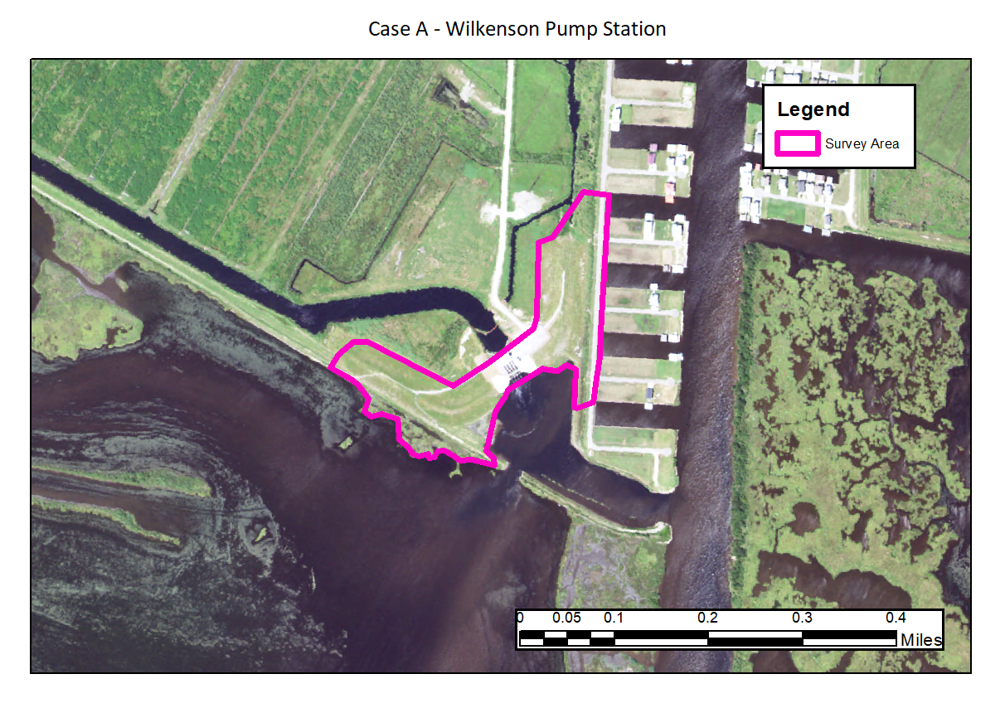
CASE A – Site Map

Slide 10
CASE A - Results
Statistical Analysis of Residuals
Sample Points: 150
Residual Minimum: -0.542 sft
Residual Maximum: 0.660 sft
Peak-to-Peak: 1.202 sft
Standard Deviation: 0.377 sft
GCP Error: 0.042 sft

Slide 11
CASE A – Assessment of Results
The dataset from this comparison was normally distributed, but skewed towards the positive tail.
This is believed to be caused by the 1 year separation in the two surveys, with the area possibly having subsided or settled slightly in the interim period between the initial Conventional survey and the recent sUAS operation.
Evaluation of the residual range indicated a survey with an acceptable standard deviation, but a peak-to-peak value that could give cause for rejection in civil design work.

Slide 12
Case B - Parameters
Pre-Use survey for Post-Use Restorations
Performed at West Shore Lake Pontchartrain Stockpile Areas
2019 GNSS / Total Station Initial Survey
2019 sUAS Photogrametric Flight using eBee Plus
senseFly SODA camera at 1 in./px. Resolution
Survey Area Size – 342 Acres
32 On-Ground Hardpoints used as GCPs
RTK GNSS Base Data
Points Known to be obstructed by Water (Centerlines of Ditches, Toes of Ditches, etc.) excluded

Slide 13
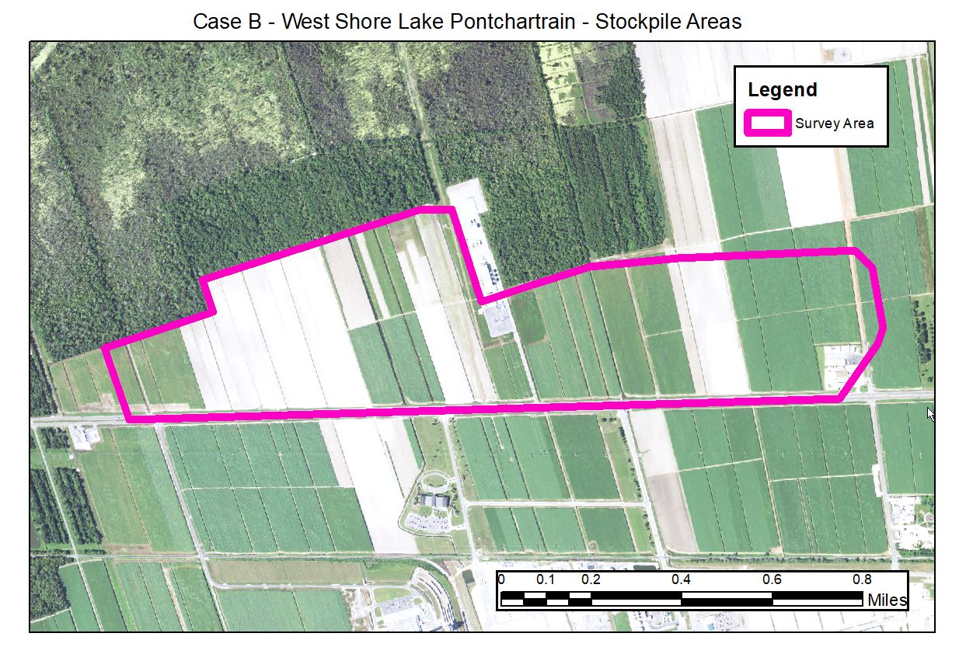
Case B – Site map

Slide 14
CASE B - Results
Statistical Analysis of Residuals
Sample Points: 294
Residual Minimum: -0.936 sft
Residual Maximum: 0.471 sft
Peak-to-Peak: 1.407 sft
Standard Deviation: 0.398 sft
GCP Error: 0.19 sft

Slide 15
CASE B – Assessment of Results
The dataset from this comparison contained two peaks, but was more centered on the zero point.
This is believed to be caused by the fact that the sample data for comparison came from two independent surveys, which were tied to different primary benchmarks.
Evaluation of the residual range indicated a survey with an marginaly acceptable standard deviation, but a peak-to-peak value that could give cause for rejection in civil design work.
Overall, it is believed that this sUAS survey did fulfill the intended purpose, as high-accuracy was not required for the activity being supported.

Slide 16
CASE C - PARAMETERS
Monitoring for Beneficial Use of Dredged Materials Marsh Restorations
Performed at Bayou Savage Restoration Area
2018 GNSS Initial Survey
2017 sUAS Photogrametric Flight using eBee RTK
Canon Power Shot G9X Camera 1in./px. Resolution
Survey Area Size – 129 Acres
4 Ground Control Points Used
RTK GNSS Base Data
No points were excluded from analysis within the limits of the sUAS data

Slide 17
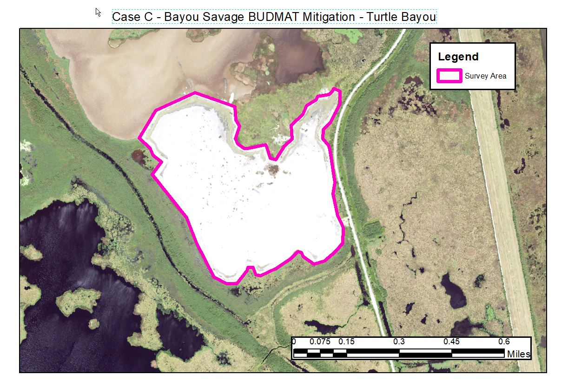
CASE C – Site Map

Slide 18
CASE C – Results
Statistical Analysis of Residuals
Sample Points: 1956
Residual Minimum : -2.056 sft
Residual Maximum : 0.850 sft
Peak-to-Peak: 2.906 sft
Standard Deviation: 0.703 sft
GCP Error: 0.01 sft

Slide 19
CASE C – Assessment of Results
The dataset from this comparison was normally distributed, but sked more toward the negative tail.
This is believed to be caused by the fact there was a 1-year separation in datasets, with the sUAS flight being the older dataset. This is also coupled with the BUDMAT projects have a very high rate of settlement expected as a result of the sand-pumping.
Evaluation of the residual range indicated a survey with an marginal standard deviation and peak-to-peak value, although this can be expected in an area with an unstable soil foundation.
Had the surveys been conducted at lesser interval, a better comparative analysis could be expected.

Slide 20
Conclusions and findings
The study shows that sUAS can offer significant cost and time savings to USACE for many types of survey applications not limited to aerial imagery and reconnaissance.
Based on the wide ranging residuals noted in the comparisons of historical datasets, it is evident that USACE-MVN’s practices involving the number of deployed GCPS during sUAS flights should be re-evaluated. Future sUAS surveys should also consider inclusion of semi-random ground sampling for further comparative analysis.

Slide 21
Conclusions and findings
While photogrammetric sUAS does not perform well along riparian transitions and cannot show the bottoms of inundated ditches, the footprint of required topographic surveys can be significantly reduced using a hybrid survey approach.
Even when safety of personnel precludes the deployment of GCPs, sUAS can be used to obtain point clouds with a high relative accuracy for interim use until proper ground-registration can be performed using observed hard features.

Slide 22
Acknowledgements
Dwayne Blanchard – USACE-MVN Chief of Survey Section
USACE-MVN In-House Survey Teams and sUAS Flight Crews
Nicholls State University Geomatics

Slide 23
Q&A
Thank you
Contact Information:
Dr. Balaji Ramachandran
Department of Applied Sciences
URL: http://www.nicholls.edu/doas
Ph.: (985)-448-4724
Email: balaji.ram@nicholls.edu
Notes:
I would now like to open the floor for questions.

