Slide 1
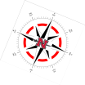


Using Unmanned Aerial Systems to create a Spatio-temporal Characterization of a Restored Barrier Island in Terrebonne Parish
Gary LaFleur Jr., Frank Yrle, Balaji Ramachandran,
Cody Parks, Brennon Dardar, Daniel Drennan
Nicholls State University
Biological Sciences Geomatics Center for Bayou Studies
gary.lafleur@nicholls.edu
2019

Slide 2
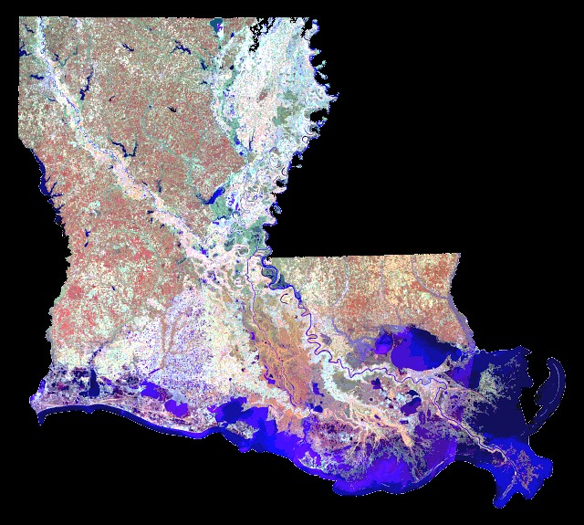
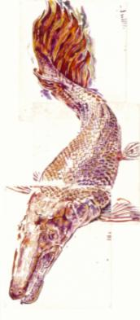
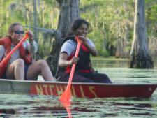

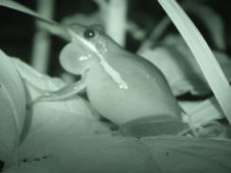
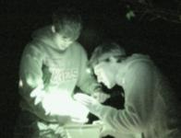
THE CHALLENGE:
training students in coastal sciences, while applying techniques to serve Coastal Restoration
Nicholls
Isles Dernieres
LAS 2012

Slide 3
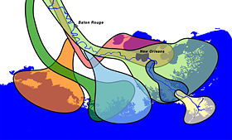

Baton Rouge
New Orleans
Oldest St Bernard lobe abandoned 3000 yr ago Most recently abandoned is Lafourche Lobe 1000 yr ago Isles Dernieres built by Teche and Lafourche lobes over 5000 yrs
2019
LAS 2012

Slide 4
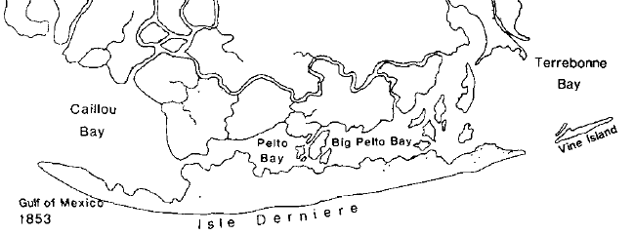
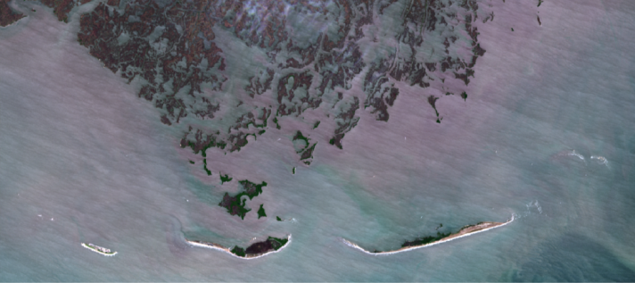
Coastal Land Loss at Isles Dernieres
Penland, S., Boyd, R., Nummedal, D., & Roberts, H. 1981. Deltaic barrier island development on the Louisiana coast. Supplement to Transactions of Gulf Coast Association of Geological Societies. 31, 471-476. Landsat 8 Imagery courtesy of the U.S. Geological Survey
2019

Slide 5


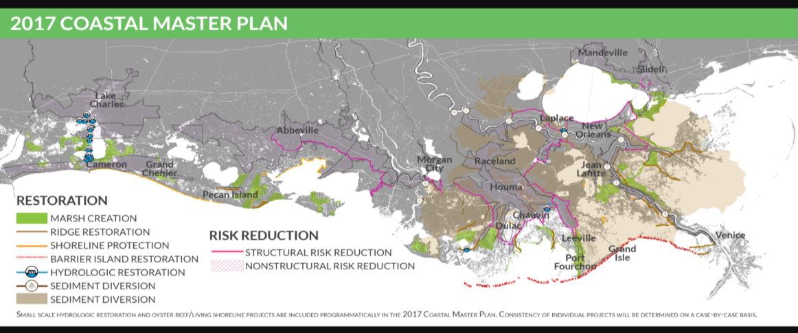
CWPPRA, BTNEP others documented Coastal Land Loss at 1 acre/ hour !
2005 Katrina/Rita
2006 Coastal Protection and Restoration Authority
2007 Coastal Master Plans Revised: 2012, 2017, 2023
***La Coast is an Ecosystem Laboratory for Student Training in Geo Sciences***
Documents available from CPRA at www.coastal.la.gov
2019

Slide 6
Today’s Presentation: Frank Yrle’s MS Thesis Project
Test whether barrier island vegetation could be resolved at the species level using UAV and image classification.
Compare 3 different image classification techniques to determine their relative merits of extracting barrier island vegetation from.
Test whether UX5 or UX5-HP airframes were better suited for conducting barrier island studies.
Discuss future opportunities of Geomatics Education at Nicholls
2019

Slide 7
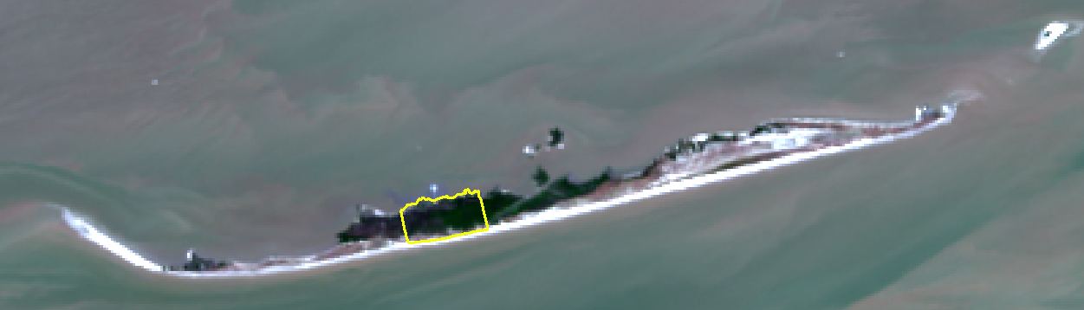
Location of Study
Trinity Island
15 miles from LUMCON
7 miles long
Study Area
0.6 mi x 0.3 mi
42.33 ha
2019
Landsat 8 Imagery courtesy of the U.S. Geological Survey

Slide 8
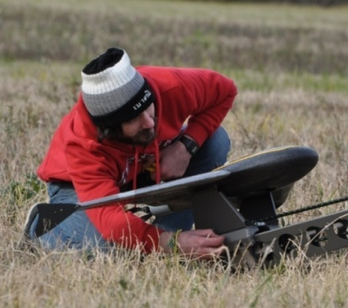
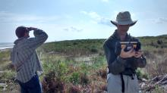
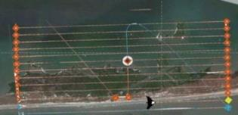
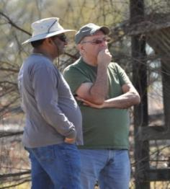
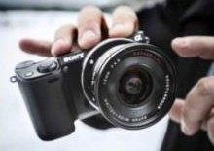
Airframes, Sensors,
Team-members
Trimble UX5
(Delair)
Fall & Winter Datasets
1 m. wingspan
80 Km/h
50 minutes endurance
SONY NEX -5R mirrorless 16.1 MP (APS-C)
True Color / NIR
Trimble UX5-HP
(Delair)
Spring Dataset
40 Minutes endurance
Sony a7r mirrorless 36.4 MP (Full-frame) True Color / NIR
Frank Yrle
Thanks to Peter Jansen, Licensed Pilot
Thanks to
Cody Parks, Brennan Dardar: Observers
Thanks to
George Rey for FAA COA Application and NOTAMS
2019

Slide 9
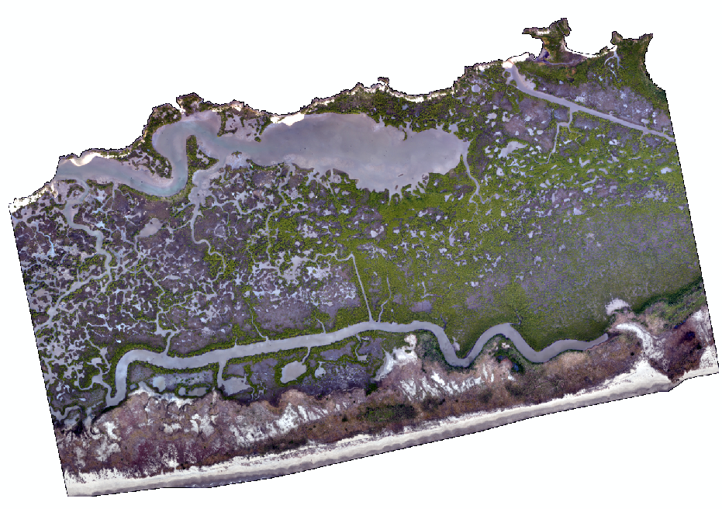
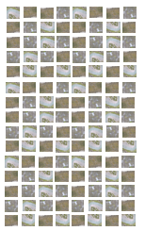
Image Processing
Trimble Business Center
Advanced Photogrammetry Module
Bundle Adjustment
RGB Orthomosaic
(1000 overlapping images)
2019

Slide 10
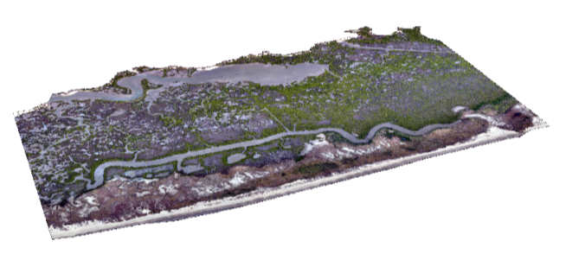
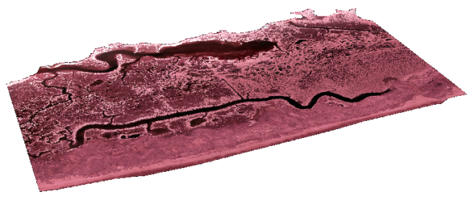
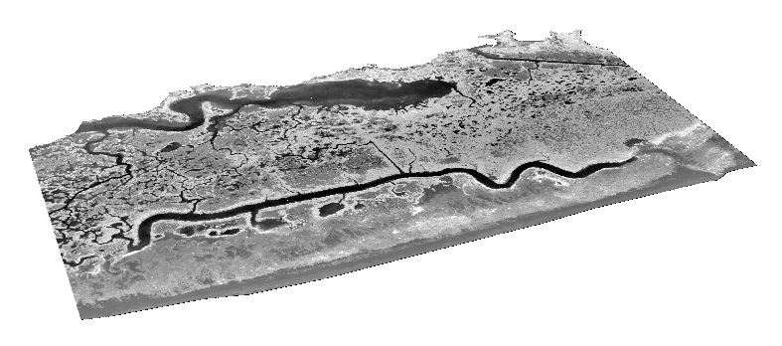
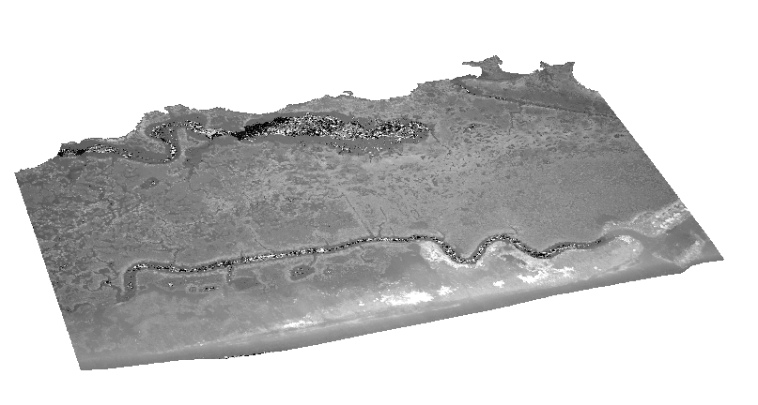
RGB Orthomosaic
Layer Stack
NIR Orthomosaic
Normalized Difference Vegetation Index
NDVI
Digital Surface Model
2019

Slide 11
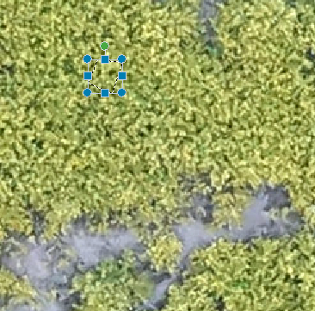
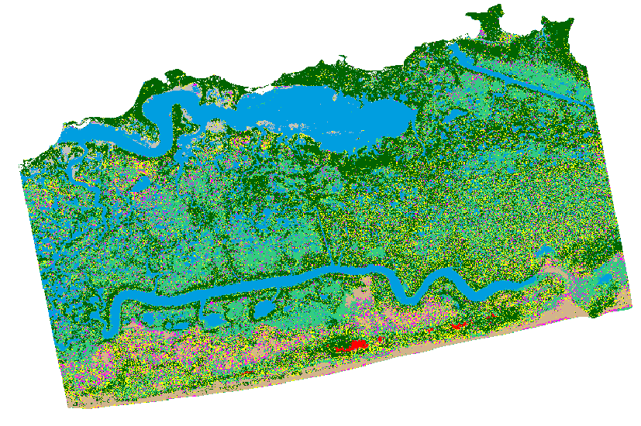
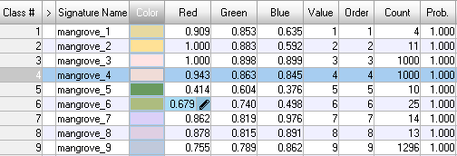
Pixel-based Image Classification
TECHNIQUE 1:
Unsupervised Classification
Iterative Self-Organizing Data Analysis (ISODATA)Technique
TECHNIQUE 2:
Supervised Classification
Maximum Likelihood Classifier
2019

Slide 12
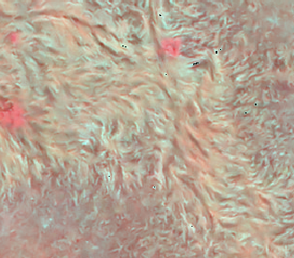
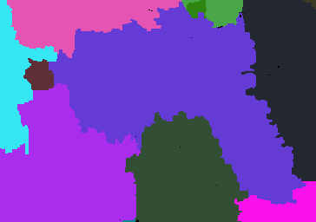
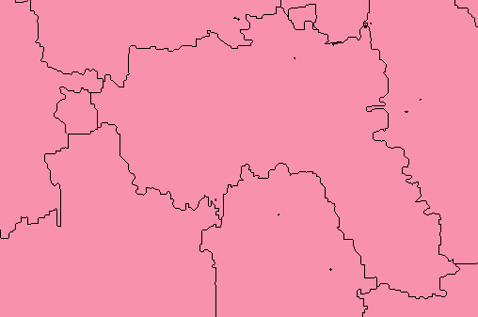
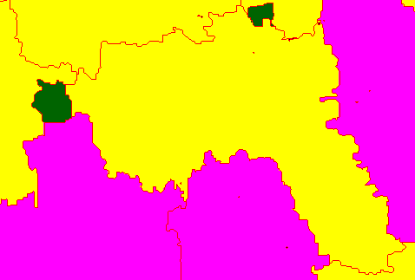
TECHNIQUE 3: Object-based Classification
Raster Object Parameters
Texture: 0.10
Spectral: 0.90
Size: 0.50
Shape:0.50
Vector Object Functions
Empirical Distribution Analysis
Label Operator
2019

Slide 13
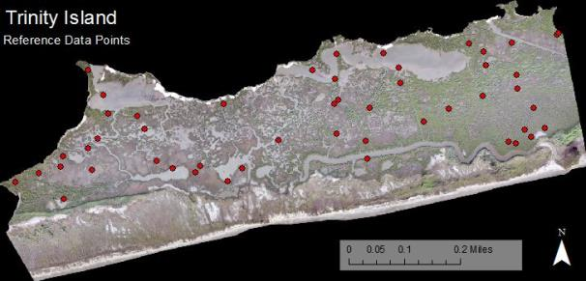
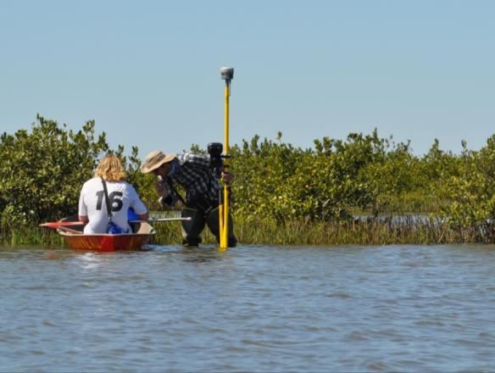
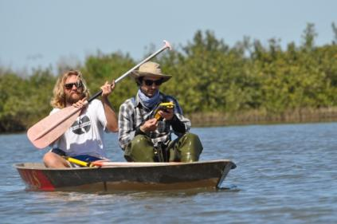
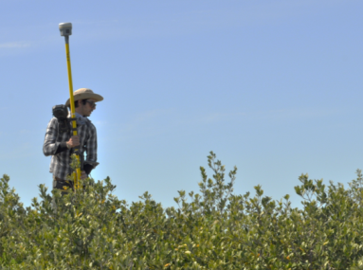
Collecting reference data (Ground-truthing)
Visited 74 random points
Recorded cover class
Accuracy assessment
2019

Slide 14
Conventional Vegetation Survey
Most Common Cover
Germinans
  black mangrove
S. Alterniflora
smooth cordgrass
S. Patens
marsh hay cordgrass
P. australis
roseau cane
Water
Sand
Sediment / Oyster
2019

Slide 15
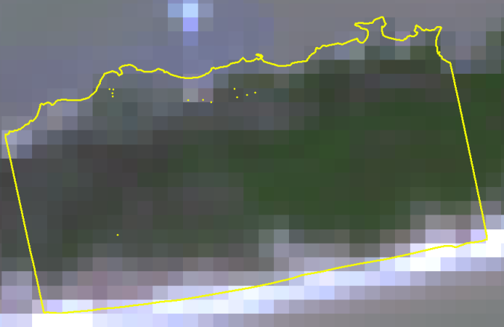
Results – Objective 1
Landsat 8 Imagery
Could not resolve vegetation at the species level
Landsat 8 Imagery courtesy of the U.S. Geological Survey
2019

Slide 16
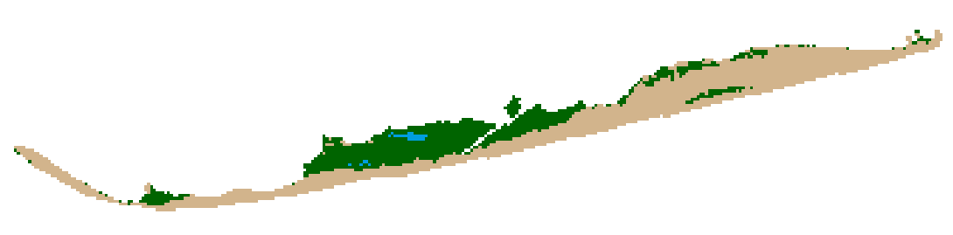
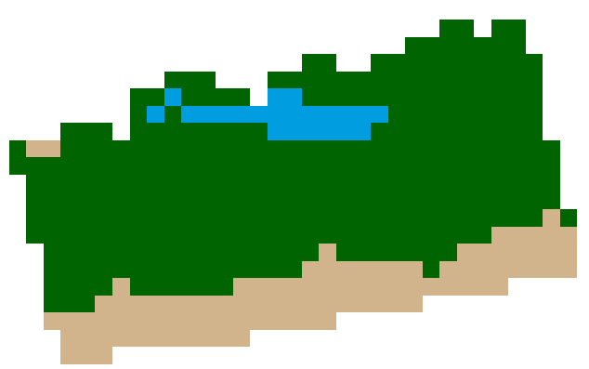
Objective 1
Trinity Island
Unsupervised Classification
ISODATA – 20 classes
Resulted in three classes
  Soil - Water - Vegetation
Study area
2019

Slide 17

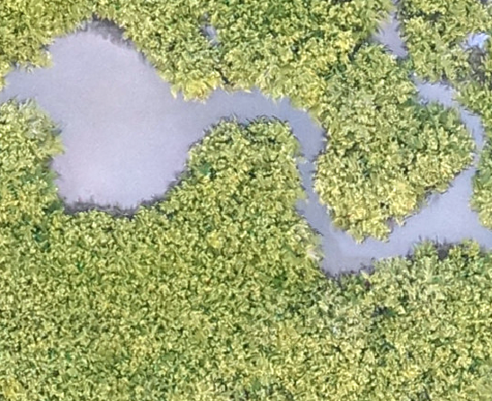
Resolved Species: Black Mangrove, Avicennia germinans
RGB Orthomosaic
Avicennia germinans
2019

Slide 18

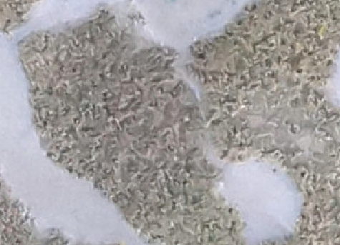
Resolved Species: Smooth Cordgrass, Spartina alterniflora
RGB Orthomosaic
Spartina alterniflora
2019

Slide 19

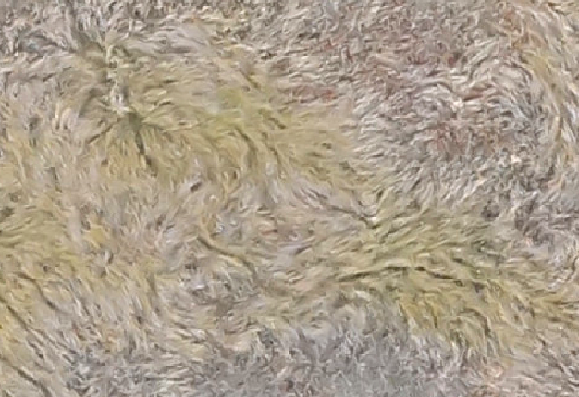
Resolved Species: Salt Meadow Cordgrass, Spartina patens
RGB Orthomosaic
Spartina patens
2019

Slide 20

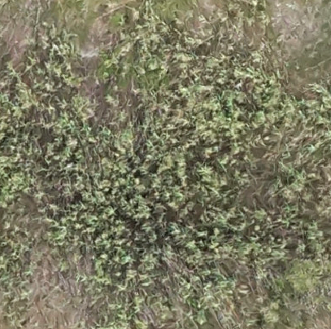
Resolved Species: Roseau Cane, Phragmites australis
RGB Orthomosaic
Phragmites australis
2019

Slide 21
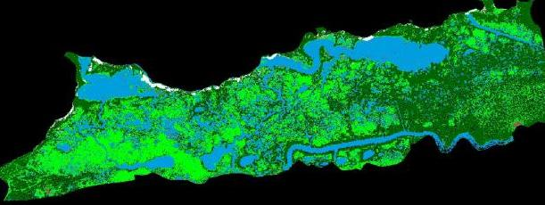
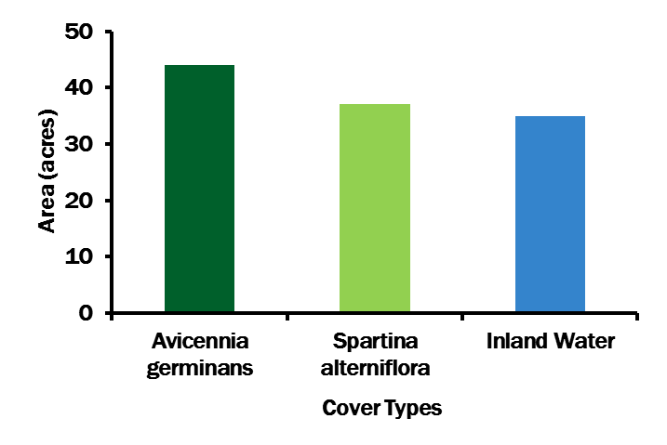
Measurements of Cover
Cover Types | Area (acres) | Area (hectares)
Avicennia germinans | 43.96 | 17.79
Spartina alterniflora | 36.80 | 14.89
Inland Water | 35.31 | 14.29
Avicennia
germinans
Spartina
alterniflora

Slide 22
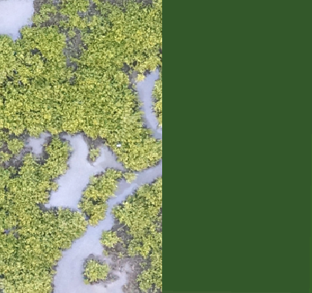
Pixel size – (UX5 vs Landsat 8)
30 m
 | Spatial Resolution | Number of Pixel(s) | Pixels in Study Area (42.33 ha) | Temporal Resolution
Landsat 8 | 30m | 1 pixel | 470 pixels | 16 days
UX5 | 4cm | 562,500 pixels | 264,590,889 pixels | on-demand
2019

Slide 23
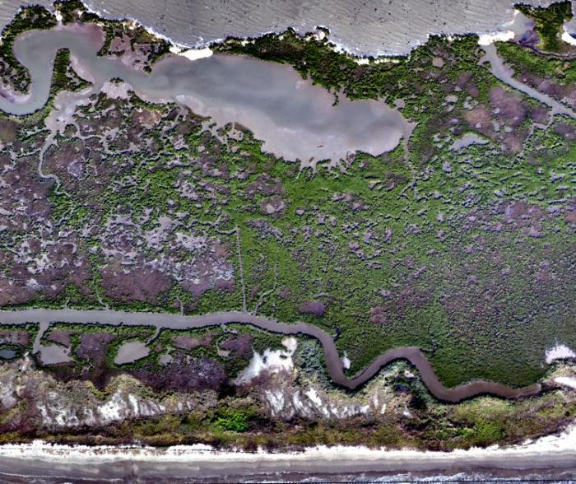
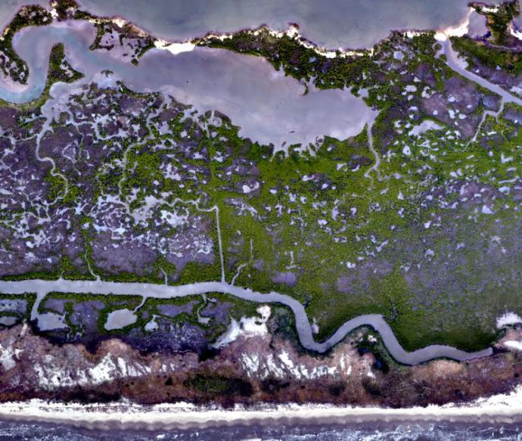
Spatio-temporal Comparison
Fall
Winter
2019

Slide 24
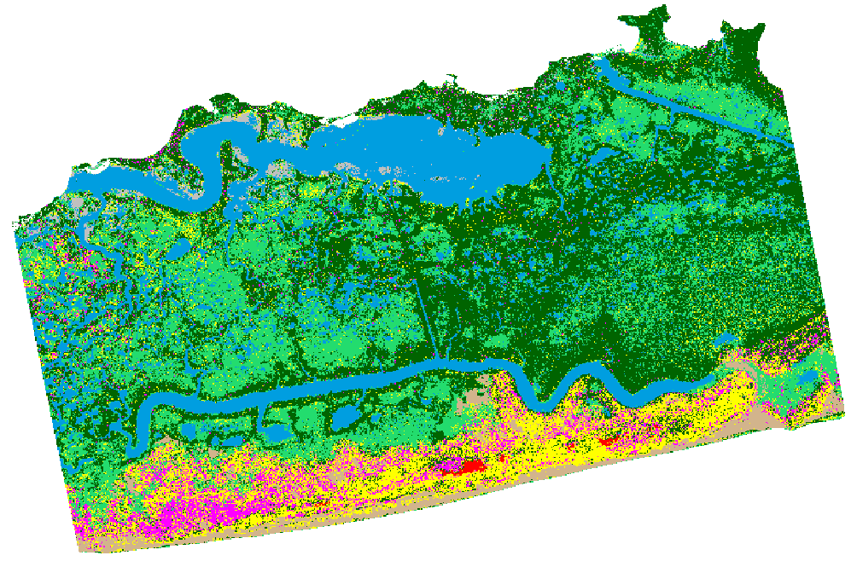
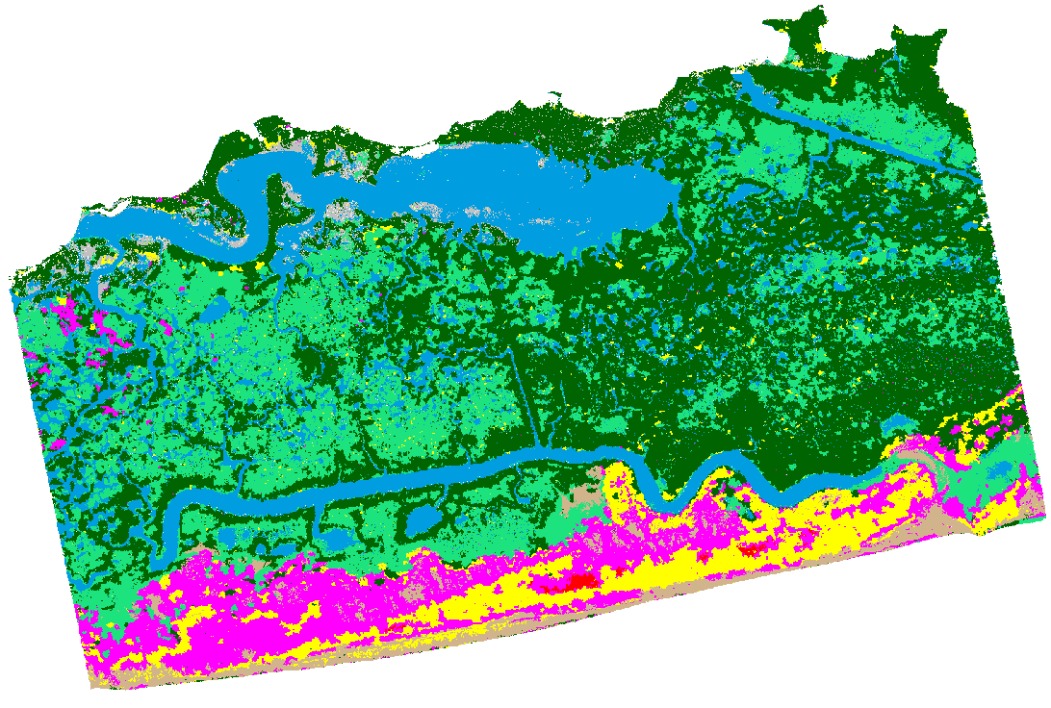
Fall Dataset - Image Classification
 | Classification Method | Overall accuracy | Kappa Statistic Value
Fall | Unsupervised | 55.41% | 0.46
 | Max. Likelihood | 74.32% | 0.68
 | Object-based | 68.92% | 0.62
Unsupervised Classification
Maximum Likelihood Classification
Object-based Classification
2019

Slide 25
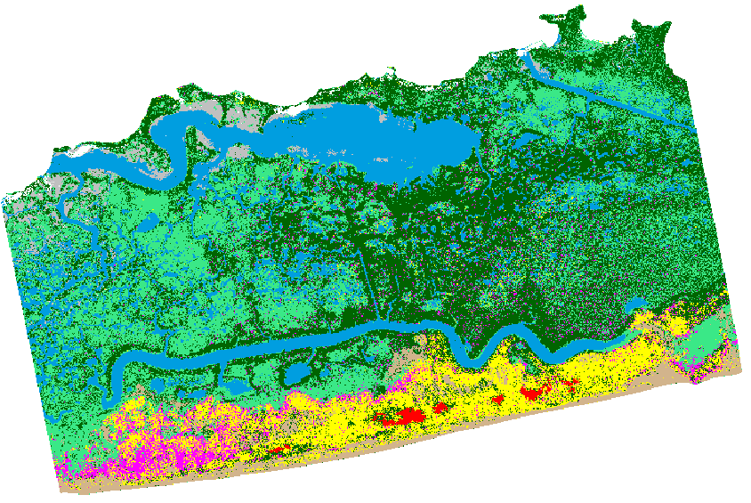
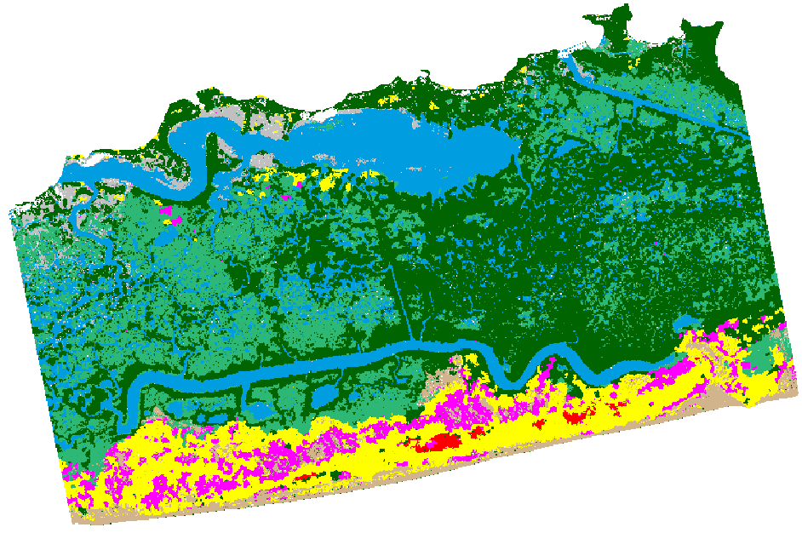
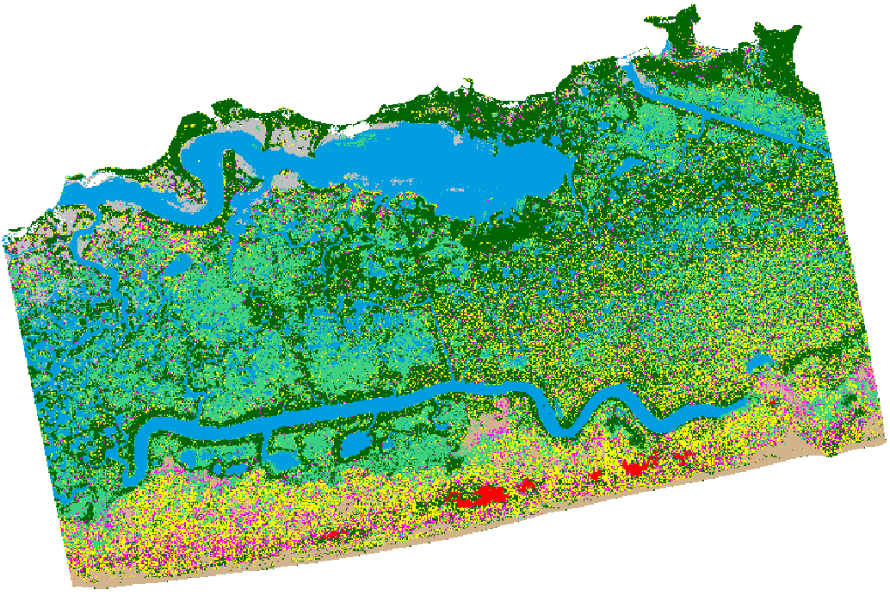
Winter Dataset – Image Classification
 | Classification Method | Overall Accuracy | Kappa Statistic Value
Winter | Unsupervised | 59.46% | 0.50
 | Max. Likelihood | 64.86% | 0.57
 | Object-based | 75.68% | 0.70
Unsupervised Classification
Maximum Likelihood Classification
Object-based Classification
2019

Slide 26



Spring Dataset – Image Classification
 | Classification Method | Overall Accuracy | Kappa Statistic Value
Spring | Unsupervised | 59.68% | 0.51
 | Max. Likelihood | 66.13% | 0.59
 | Object-based | 69.35% | 0.63
Unsupervised Classification
Maximum Likelihood Classification
Object-based Classification
2019

Slide 27
Preliminary Recommendation: Object Based in Winter
 | Classification Method | Overall Accuracy | Kappa Statistic Value
Fall | Unsupervised | 55.41% | 0.46
 | Max. Likelihood | 74.32% | 0.68
 | Object-based | 68.92% | 0.62
Winter | Unsupervised | 59.46% | 0.50
 | Max. Likelihood | 64.86% | 0.57
 | Object-based | 75.68% | 0.70
Spring | Unsupervised | 59.68% | 0.51
 | Max. Likelihood | 66.13% | 0.59
 | Object-based | 69.35% | 0.63
2019

Slide 28


Objective 3: Comparison between UX5 & UX5-HP
 | Spectral Bands | Spatial Resolution | Pixels in Study Area (42.33 ha) | Size of Layer Stack | Processing Time | Endurance
UX5 | RGB / NIR | 4cm | 264,590,889 pixels | 37 GB | 1 day | 50 min
UX5-HP | RGB / NIR | 2cm | 1,058,363,556 pixels | 163 GB | 2 days | 40 min
UX5 sufficient for resolving
A. germinans from S. alterniflora
Maybe UX5 HP would be useful for resolving
ghost crab burrows vs ghost shrimp burrows
or Rangia vs Oyster
2019

Slide 29

We are expanding our methods
from monitoring plants to
animals
Ghost shrimp indicate ecological integration of new sand
burrows occur in 10 cm mounds
2019

Slide 30


Preliminary flights outside of the IDBIR at 200 feet:
Resting White Pelicans appear undisturbed by DJI Quadcopter
2019

Slide 31


Future Work and Instruments
Oct 2018 Before Construction Feb 2019 After Construction
Nicholls monitoring restoration site that was designed and constructed by BHP, AWF, RES
2019

Slide 32


Nicholls State University: Closest to the Coast
March 2019 July 2019
Considering using Unmanned Aerial Systems to enhance monitoring
2019

Slide 33




Where there was once open water, now there is grass, trees, invertebrates, fish,
nesting birds, a new food web
2019

Slide 34

Nicholls
IDJC
The community of Isle de Jean Charles resettlement project: 48 million from HUD
To relocate 30 miles North from brackish marsh to higher ground N of US 90, Sugar Cane fields and Woods near Bayous Terrebonne & St Louis
2019

Slide 35


CPRA-Nicholls partnership announced
to create a new River Center to highlight
Atchafalaya sources for Coastal Restoration
Modeling results can be compared to
Geospatial results collected using sUAS
Courtesy of Dr. Clint Wilson, LSU
https://sites01.lsu.edu/faculty/cwillson/river-model/
2019

Slide 36
Conclusions
Resolved four major barrier island vegetation species
Object-based Classification had highest accuracy for major vegetation species over two seasons
UX5 model slightly better suited here compared to UX5-HP
Looking forward to new RIVER CENTER at Nicholls and monitoring of marsh creation, levee cohesion, and community migrations
2019

Slide 37







Questions ?
gary.lafleur@nicholls.edu
balaji.ramachandran@nicholls.edu
LDWF
2019

Slide 38
Questions ?
gary.lafleur@nicholls.edu
balaji.ramachandran@nicholls.edu
LDWF
2019

Slide 39
Conventional Vegetation Survey vs. Image Classification
±3.88
±3.10
Solid Bar: Conventional Vegetation Survey
Dashed Line: Image Classification
The accuracy of human surveying vs
The power of Big Data
2019

Slide 40

What can we do? Listen to the islanders
2019

Slide 41

What can we do? Celebrate the elders of the Island
Tou Lou Lou Salut to Mr. Theo Chaisson, Nicholls Masters Students
2019

Slide 42

Other types of data: 3D Point Cloud

Slide 43





Future Work and Instruments
Terrebonne, Lafourche, Jefferson Parishes
Terrebonne Parish Levee District
ZX5, multispectral, and LIDAR
2019

Slide 44

Trinity Island was created by the Lafourche Lobe
Kosters, E. & Suter, J. 1993. Facies relationships and systems tracts in the late Holocene Mississippi deltaic plain. Journal of Sedimentary Petrology. 63, 727-733.
2019

Slide 45

Trinity Island is currently at Stage 2, Transgressive BI Arc
Penland, S., Boyd, R., & Suter, J. 1988. Transgressive depositional systems of the Mississippi Delta plain; a model for barrier shoreline and shelf sand development. Journal of Sedimentary Petrology. 58, 932-949.
2019

Slide 46


APPROVALS
FAA
Certificate of Authorization:
for
Terrebonne Levee District,
George Rey, COTS
LDWF Permit to conduct flights
IDBIR Refuge, outside of nesting season.
2019

Slide 47


Trinity Island Ecosystem Questions
Freezing Weather and Snow on Coast Dec 9 / Jan 14 2018
appears to have burned black mangroves on Trinity
But green leaves are sprouting
as seen in May, 2018
2019

