Slide 1
Enhancing student learning of the fundamentals of surveying with the help of the ICAP framework
Elena Rangelova and Ivan Detchev
Department of Geomatics Engineering, University of Calgary

Slide 2
Outline
Motivation
The ICAP framework
Designing learning activities
Assessment of learning
Provisional results
Concluding remarks
Student self-reflection
1

Slide 3
Motivation
Low student cognitive engagement in the course
  Last year study – 6 lectures were observed
  The length of the bar is indicative of the strength of the teaching and learning environment
  Students engaged when the teacher wrote on the board (grey bar is 2.6/3)
  Slides used (1.4/3)
Ways to increase student engagement
  Flipping the course
  Enhancing active learning in class and
  contextualizing it

Slide 4
The ICAP Framework
Levels of learning according to Chi and Wylie (Educational psychologist, 2014)
  Passive: Students store information, which remains inert until it is triggered for a specific learning goal.
  Active: Students integrate new information by making connections to prior knowledge, which is activated in order to accomplish a specific learning goal.
  Constructive: Students infer and construct new knowledge from the integrated knowledge.
  Interactive: Students “co-infer” knowledge when they collaborate on a learning task.

Slide 5
Designing Learning Activities
Divide a chapter/unit in lessons.
Define measurable learning goals for each lesson.
  Address simple concepts and different levels of cognitive engagement
  Examples:
    Knowledge retrieval: be able to correct a measured distance for systematic errors.
    Comprehension: be able to explain in which ways systematic errors affect a measured distance.
    Analysis: be able to categorize the environmental effects on a measured distance with respect to gross, random and systematic errors.
Plan enough constructive and interactive exercises.
Iterate the procedure to find a reasonable balance between the four levels of learning.

Slide 6
Designing Learning Activities
The hierarchy of learning outcomes in the second-year surveying course

Slide 7
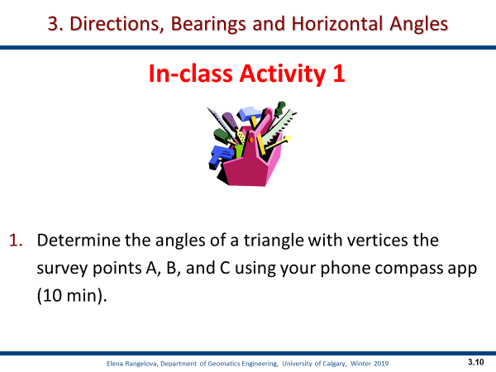
Designing Learning Activities
An example of an interactive group exercise

Slide 8
Designing Learning Activities
Balancing the four modes
of learning
Learning level/mode | Lesson |  | Lecture | Chapter
 | #6 | #7 | #6 and #7 | Total
 | min | min | min | min | %
Passive | 10 | 5 | 15 | 61 | 29
Active | 11 | 9 | 20 | 108 | 51
Constructive | 2 | 8 | 10 | 29 | 13
Interactive | 5 | 4 | 9 | 14 | 7
Total | 28 | 26 | 54 | 212 | 100

Slide 9
Assessment of Learning
Observations of the teacher and student behavior
  Similar to ELCOT (Sanders, Spiegel, and Sherer, ASEE, 2017, 2018)
  Two-minute frequency of observations
  Fine-grain data

Slide 10
Assessment of Learning
Students
SL | Listen to the teacher’s explanation | Passive
SW | Wait for the teacher
STPE | Talk to peers during the teacher’s explanation
SNP | Do not participate in activities
SNA | Occupied with unrelated activities
STN | Take notes | Active
SPQT | Pose a question to the teacher
SPQP | Pose a question to peers
SWI | Work individually
SRN | Read their notes
SDG | Draw a graph | Constructive
SSS | Suggest a solution
SDP | Design a procedure
SPE | Provide evidence
SDO | Discuss outcomes
SCA | Choose an alternative
SIP | Iterate a process/procedure
SR | Reflect on learning
SEC | Explain a concept | Interactive
SES | Explain a solution
SEP | Explain a procedure
SPS | Provide a summary
SRF | Respond to feedback
SD | Debate
SP | Present
Observation codes
Teacher
TEX | Explains a concept
TAQ | Answers a question
TPQ | Poses a question
TWB | Writes on the board
TW | Waits for the class to finish an activity
TMO | Moves through the class and observes students doing an activity
TDG | Discusses with a group of students
TDC | Discusses with the entire class
TC | Draws a conclusion
TGA | Assigns a group activity
TF | Provides feedback to the class
TAD | Performs administration work
TI1S | Interacts with one student

Slide 11
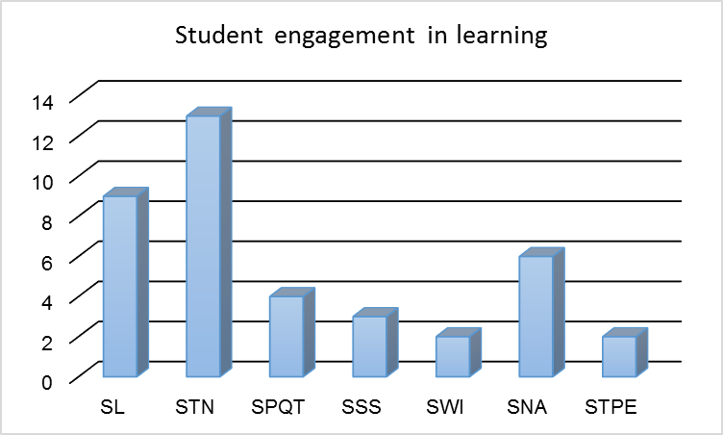
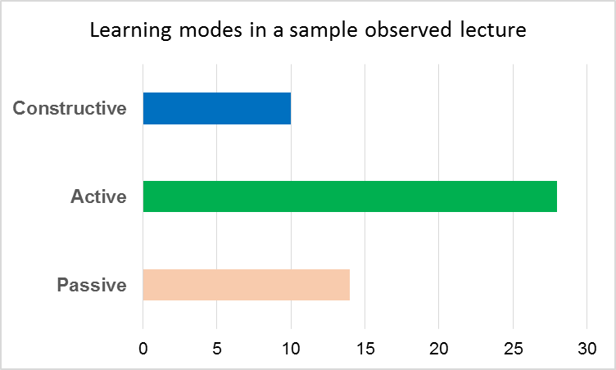
Provisional Results of Classroom Observations
Observed three 50-minute lectures
Most time spent on developing the conceptual knowledge
Attendance: 22-26 students
Engagement: 80% on average

Slide 12
Student Self-reflection
Concepts/Tasks | Total lack of confidence | Lack of confidence | Some lack of confidence | Neutral | Somewhat Confident | Confident | Very Confident
I can | 1 | 2 | 3 | 4 | 5 | 6 | 7
1. define level surface, elevation and vertical datum
2. explain and calculate the curvature of Earth correction
3. explain and calculate the vertical refraction correction

Slide 13
Concluding Remarks
ICAP-based approach implemented successfully
The time spent practicing active and constructive learning accounted on average for 78% of the three observed lectures.
Protocol is refined to capture better the teaching and learning dynamics.
Student self-reflection is important and is an integral component of experiential learning.

Slide 14
Acknowledgements
Elena Rangelova is a Schulich School of Engineering Chair in Innovative Teaching
Both authors acknowledge Taylor Institute of Teaching and Learning, University of Calgary

Slide 15
Thank you!
SaGES 2019, August 04 – August 08, 2019 •
Nicholls State University • Thibodaux, Louisiana

