Slide 1
Learning About Surveying Program from Peer Groups
Jinseok Hong, Ph.D.
Surveying and Mapping Science
East Tennessee State University
August 6, 2019

Slide 2
Outline
Various introduction courses for first-year students at ETSU
Goals of the courses (SURV 1570/SURV 4570 – Portfolio I/II)
Contents (topics) of the courses
Feedback from students
Opportunities For Improvement
Q&A

Slide 3
Effort to increase the number of student in the Surveying Program at ETSU
Most of Surveying programs in U.S. suffer from low enrollment
To increase the number of students,
Recruiting: Open house, Boy Scot Merit Badge, career fair, distance education, etc.
Retention: Involvement with student club, scholarships, advising, etc.

Slide 4
Introduction Courses For First-year students at ETSU
University Level: ETSU 1020 Foundations of Student Success)
3 credits, 29 sections in every fall semester
Department Level: ENTC 1510 Student in University
2 credits, 4 sections in every fall semester
Program Level: SURV 1570/4570 (Portfolio I/II – 1 credit each)
1 section each in every fall semester

Slide 5
Goals of the Courses
SURV 1570 (Portfolio I) | SURV 4570 (Portfolio II)
Common: Speaking in a public setting
Courses, and curriculum of the program | Give practice in organizing and running an effective meeting
The broad nature of surveying as a profession | Administer the FS exam, which is a requirement to take
Scholarships, student and professional organizations | Mentoring freshmen
Co-op, summer employment, and career opportunities in surveying
Helping a meeting as part of a team with a shared goal

Slide 6
Contents (topics) of the courses
Guest Speakers:
Career Center: resume, job interview skills
Center for Quality Enhancement: various study skills
Academic Advisor: registration processes, Internship, Co-op
Counselling center: stress management, suicide prevention
Alumni: shared their experiences during/after school, project samples

Slide 7
Contents (topics) of the courses
Student Speakers to introduce:
Surveying core courses
Scholarships/Student Club
HP 33 or 35 calculator
Overview of FS exam (how to prepare, things to remember, etc.)
SURV 4570 students portfolios (short advices)
Report on social activities with mentors and mentees

Slide 8
Contents (topics) of the courses
Toaster Master™ Format Meetings:
Instructor: begins and ends, prepares agendas, backup for meeting chair
Meeting chair (seniors/instructor): run a meeting, backup for other duties
2~3 major speaker (freshmen): introduce given topics

Slide 9
Contents (topics) of the courses
Toaster Master™ Format Meetings:
Impromptu master (any students): prepares and administer topics for impromptu speeches, determines the impromptu speech of the day
Timer (freshmen): keep time for each speaker
Technical observer (any students): keeps track of grammatical errors, ums, ahs, poor eye contact, etc.

Slide 10
Contents (topics) of the courses
Other activities:
Attending a local chapter of TAPS
Library tour
Assigning mentors and mentees
Social activities (concert, sports, dinner) with mentor/mentees

Slide 11
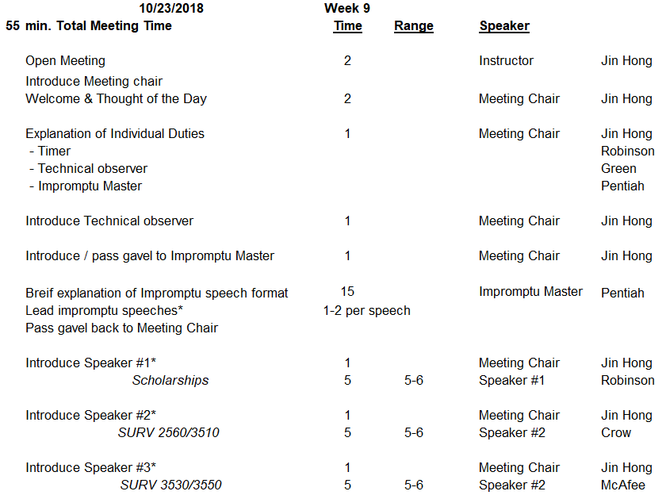
Sample Agenda

Slide 12
Feedback from Students
Strengths of the course:
Being able to meet and engage with the other students that you will most of your time with
Being able to get understanding of what all students will be doing while in the program
Having seniors in the program as mentors
It is good for speaking in front of people
Get rid of it. This class time would have been far better spent working with the equipment.

Slide 13
Opportunities For Improvement
More students’ engagement from the beginning
Various other interesting/useful activities
Financial management education: FAFSA, work study, loan, etc.)

Slide 14
Any Questions ?

