Slide 1

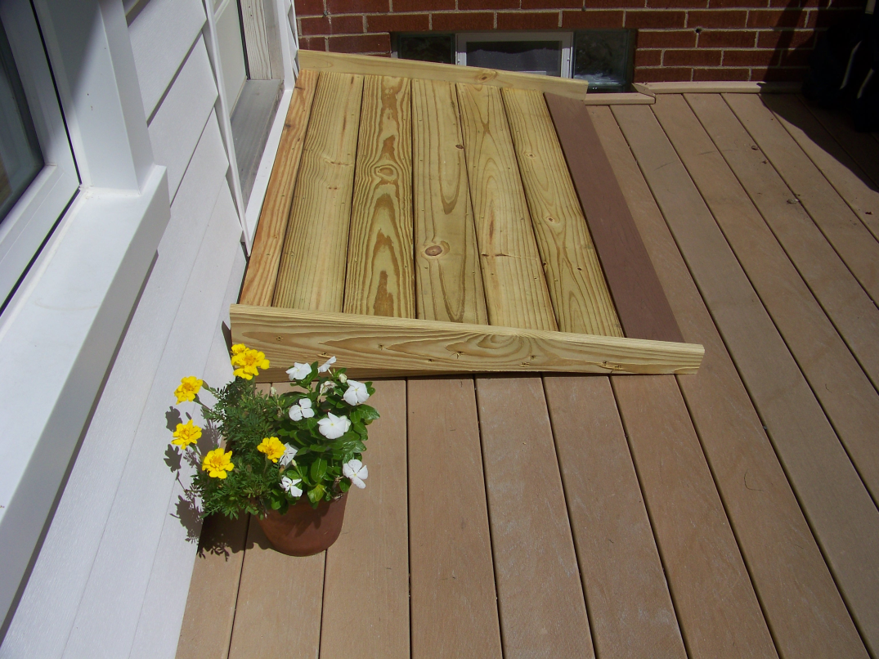
Least squares estimation and statistical testing
Department of Geomatics Engineering
Ivan Detchev and Elena Rangelova
Mon, Aug 5, 2019
SaGES, Nicholls State University, Thibodaux, LA

Slide 2
Least squares course
Course name and number:
  ENGO 361 – Least squares estimation (prior to 2019)
  ENGO 363 – Estimation and statistical testing (since 2019)
Second year core geomatics engineering course
Offered in winter semester (January to April)
Challenges:
  Program bottleneck
  High rate of W/D/F grades

Slide 3
Course topics
Introduction to adjustment of observations
Multivariate statistics and mathematical models
Error propagation and pre-analysis of survey measurements
Least squares method
Parametric, conditional, and combined (implicit) model adjustments
Special topics: combination of models, summation of normals, sequential least squares adjustment, parameter observations
Statistical analysis

Slide 4
Research study
Identifying threshold concepts

Slide 5
SoTL study and framework
High level objectives
  Identify threshold concepts in geomatics engineering courses
  Develop tools or implement activities to address these threshold concepts
  Observe any changes in students’ learning and knowledge retention
Threshold concepts
  Liminality, transformation, integration, reconstruction, irreversibility, boundedness, troublesomeness, and discourse
Notes:
Currently primarily focusing on the first objective
Threshold concept definition – something a learner cannot progress without (Meyer and Land, 2003); characteristics (Baillie et al., 2013)
Liminality – crossing the threshold (being stuck); integration – “clicking” together; boundedness – related to a specific sub-discipline; discourse - jargon

Slide 6
Methods for identifying threshold concepts
In-class observations
  Content, delivery, and students’ engagement (protocol)
Minute papers
  Muddiest concepts on a specific course module (free form)
End-of-term surveys
  Difficult topics / troublesome concepts (free form)
  Attendance, course satisfaction, instruction facilitation (ordinal/interval choices)
Analysis of grades
  Exam questions reflecting the concepts in question
  To be completed
Notes:
This is a “what-is” not “what-works” study; methods here are not necessarily for teaching but for exploring the threshold concepts
In-class observations: content, instruction, and cognitive and behavioural engagement
Minute papers: per chapter; asking the students to name one concept which they find vague, difficult, not well-explained, not well-understood and why?
EofTS – two topics students excel at; two topics they found particularly difficult and within them specific concepts that are troublesome; in addition to other questions related to class attendance, level of satisfaction etc.
Grades – correlation between difficult topics/troublesome concepts?
In the future add interviews?
“Triangulate” between the different methods to come up with candidates for threshold concepts

Slide 7
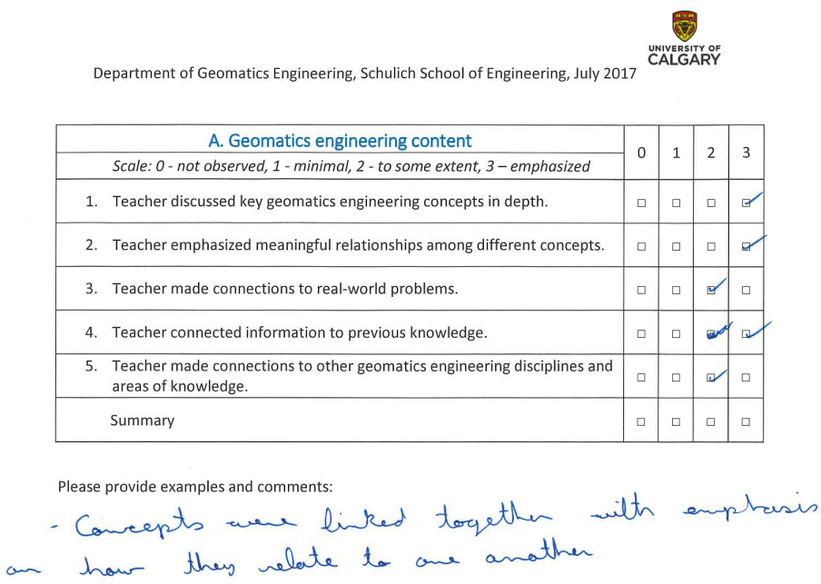
In-class observation example
Notes:
Ordinal choices and comment section

Slide 8
List of lectures observed
Lecture # | Date | Lecture topic | # of students attending
1 | Jan 24, 2018 | Math models | 25
2 | Jan 28, 2018 | Error propagation | 23
3 | Feb 7, 2018 | Method of least squares | 24
4 | Feb 16, 2018 | Parametric least squares adjustment (tutorial) | 11
5 | March 14, 2018 | Implicit/combined least squares adjustment | 23
6 | March 26, 2018 | Special topics in least squares (examples) | 23
7 | April 9, 2018 | Statistical distributions and confidence intervals | 22

Slide 9
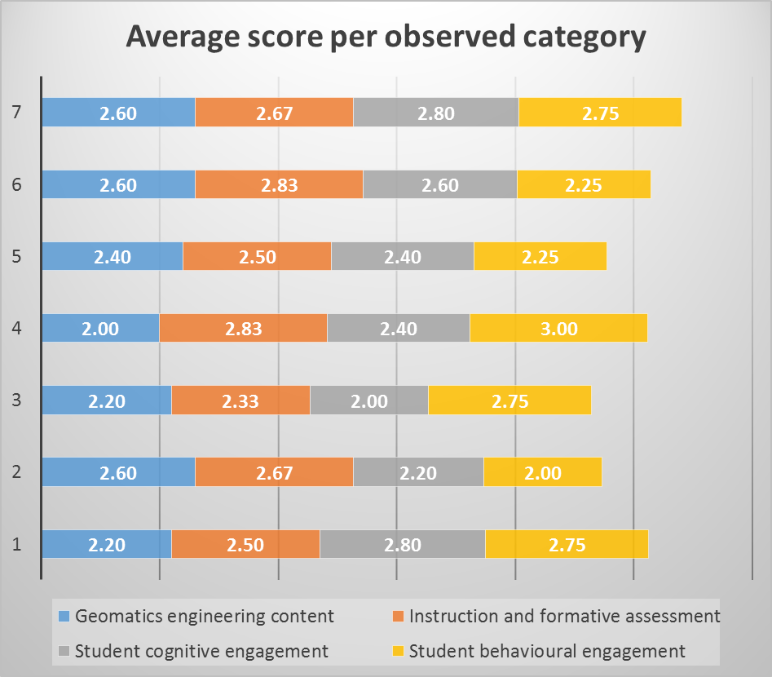
Scores for the observed lectures

Slide 10
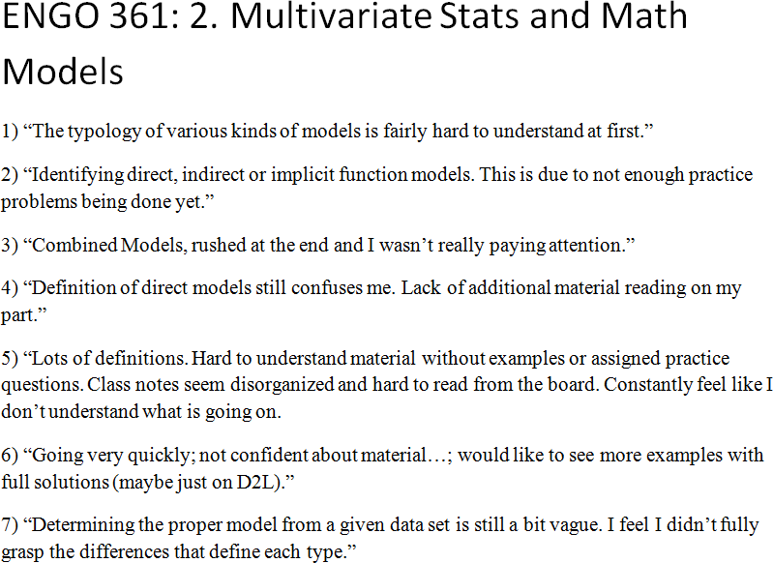
Minute paper example
Notes:
Free form -> sometimes hard to interpret

Slide 11
Summary of minute paper responses
Ch. # | Chapter topic | # of responses | Troublesome concepts
1 | Introduction to the adjustment of observations | 21 | Weighted mean [x5]
2 | Multivariate statistics and mathematical models | 20 | Types of functional models [x10]
3 | Error propagation and pre-analysis of survey measurements | 12 | None
4 & 5 | The least squares method, and Parametric least squares adjustment | 7 | When/how to apply a least squares adjustment [x2]
6 | Conditional least squares adjustment | 12 | Derivation of solution vectors, hyper matrix partitioning [x2]
7 | Implicit least squares adjustment | 11 | Derivation of solution vectors, hyper matrix partitioning [x2]
8 | Special topics in least squares adjustment | 13 | Hyper matrices [x3] Lagrange multipliers [x2]

Slide 12
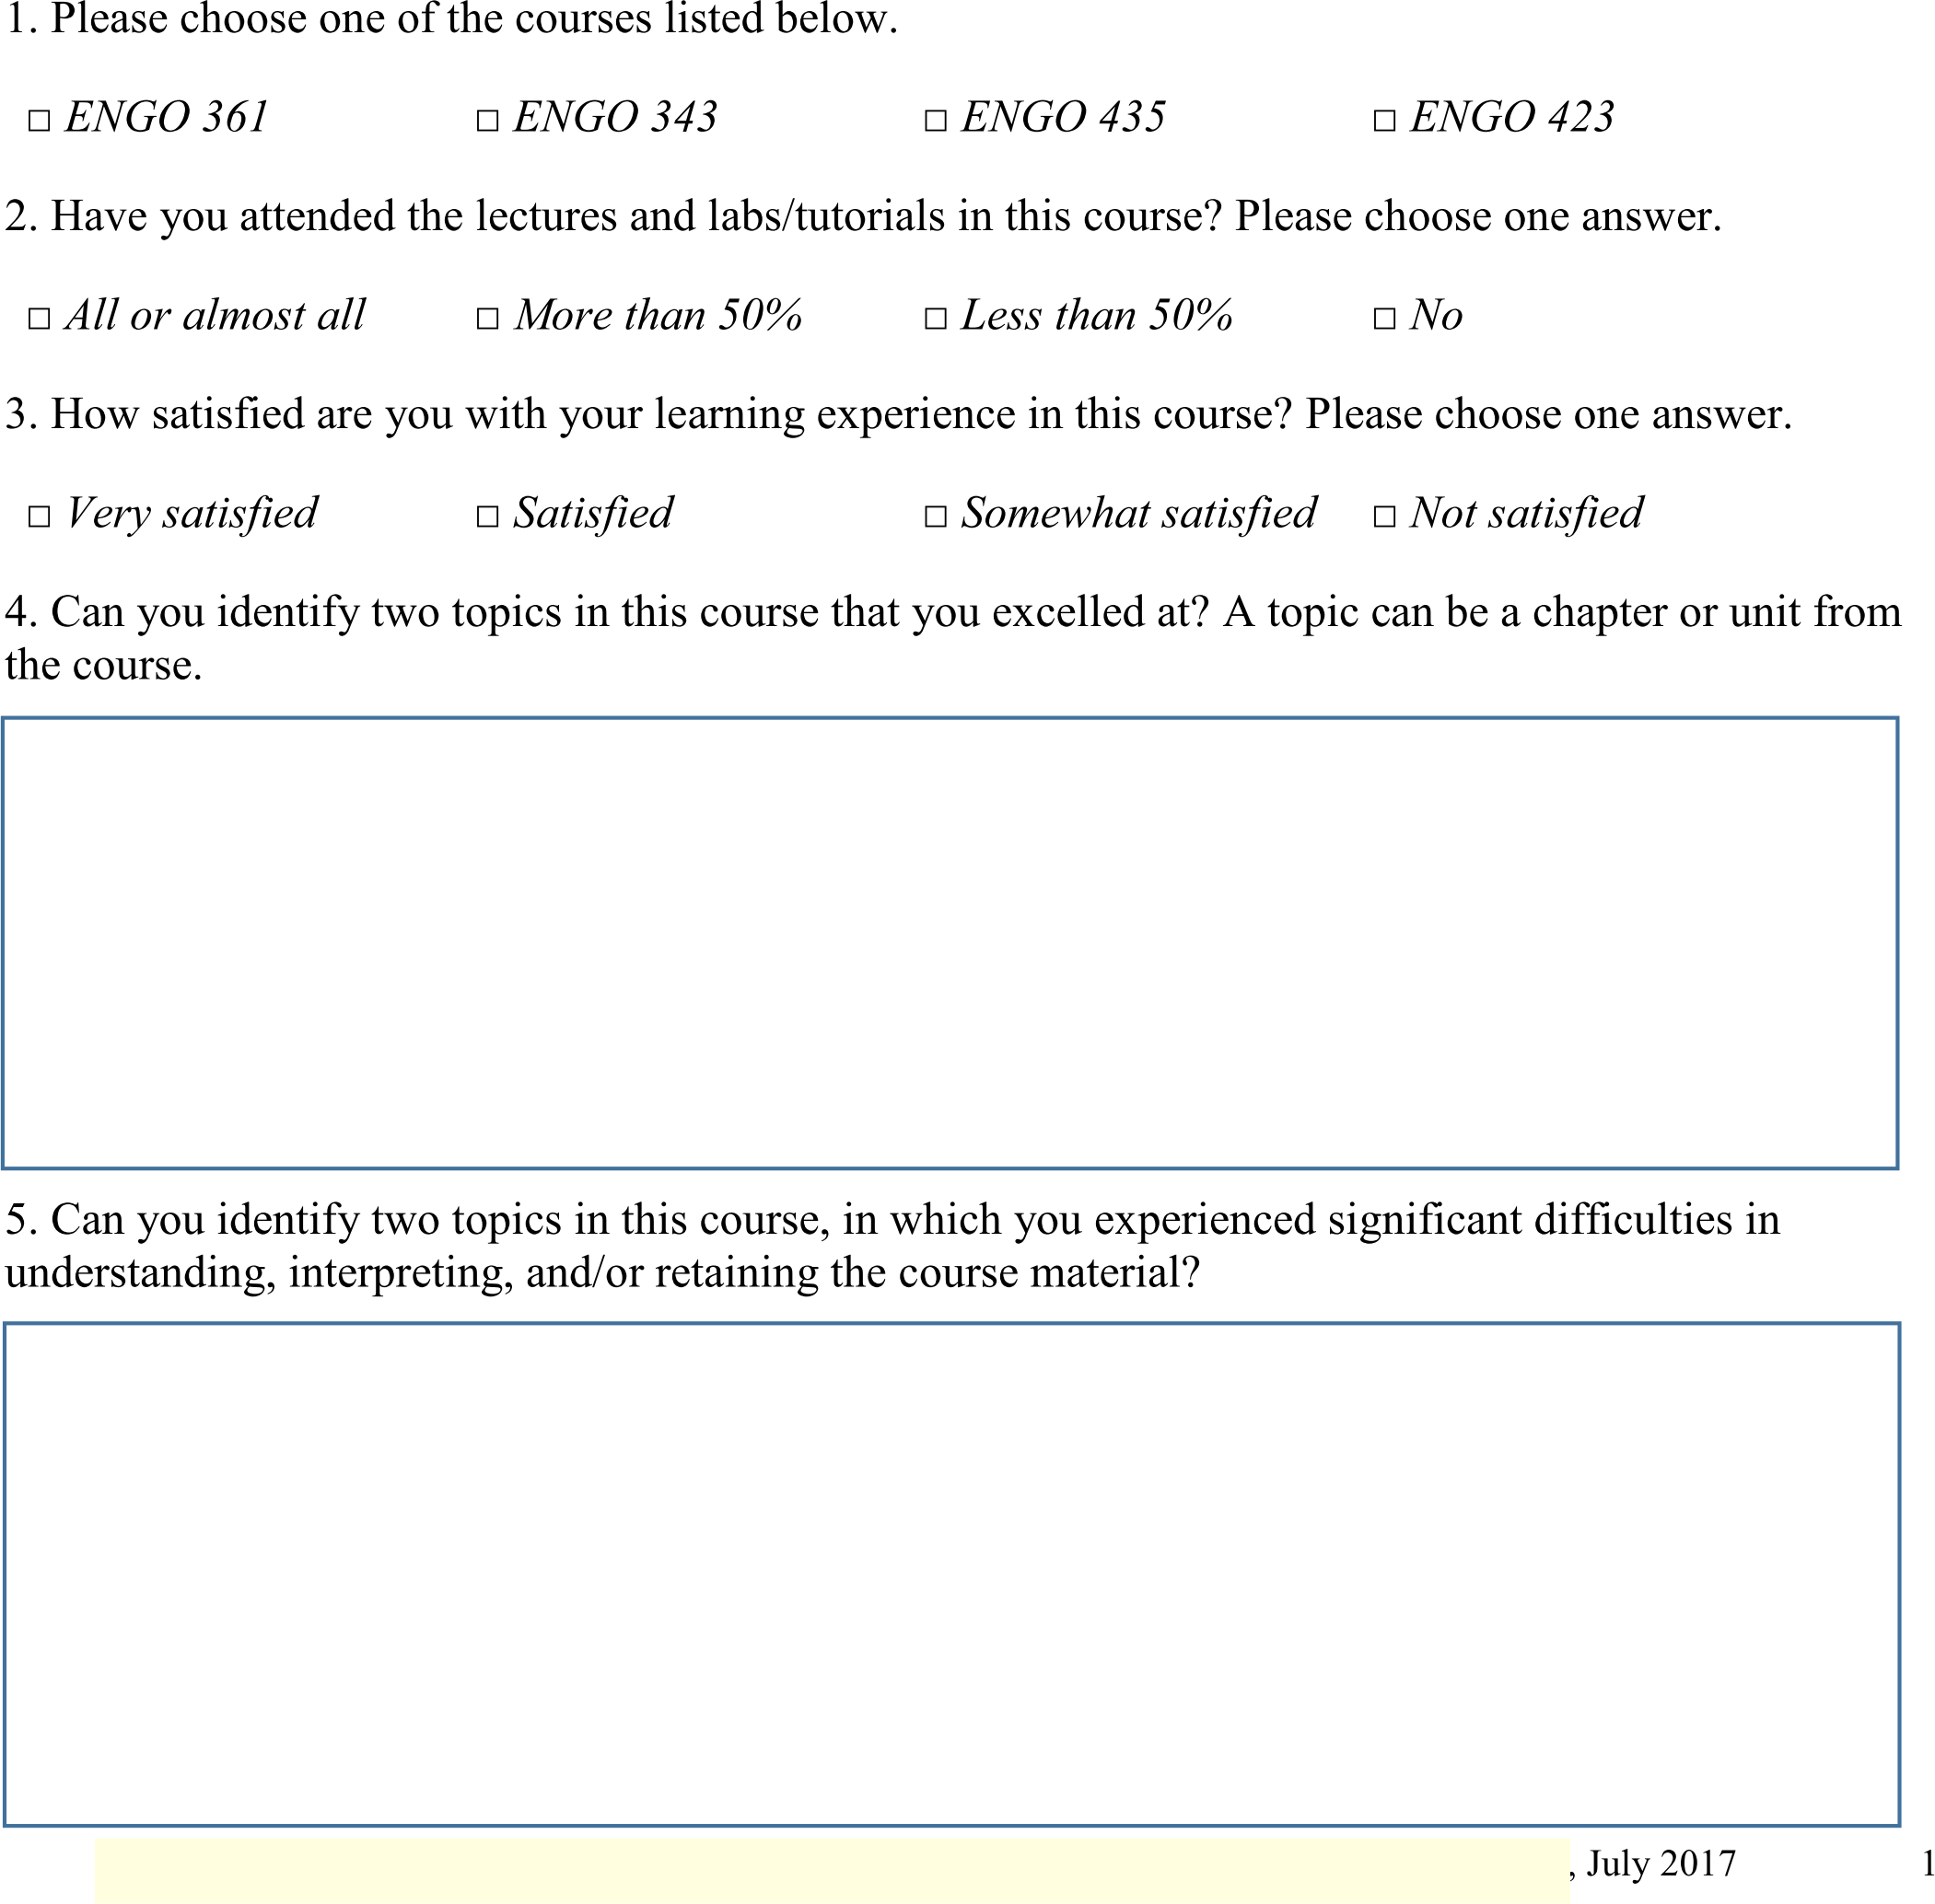
End-of-term survey example
Notes:
Mixture between categorical, ordinal/interval and free form choices; small class sample so it is hard to draw any correlations

Slide 13
End-of-term survey quantitative responses
Attributes | Response options | Students’ responses
Class attendance | All or almost all: | 57.1 %
 | More than 50%: | 42.9 %
 | Less than 50%: | 0 %
 | No: | 0 %
 | No response: | 0 %
Course satisfaction | Very satisfied: | 4.8 %
 | Satisfied: | 66.7 %
 | Somewhat satisfied: | 4.8 %
 | Not satisfied: | 19.0 %
 | No response: | 4.8 %
Instructor facilitation | To a great extent: | 9.5 %
 | To some extent: | 66.7 %
 | Not at all: | 14.3 %
 | No response: | 9.5 %

Slide 14
Course re-development
Wins and fails

Slide 15
Lecture content
Introduction to adjustment of observations
Multivariate statistics
Statistical distributions and confidence intervals
Mathematical models
Least squares method
Conditional, parametric, and combined (implicit) model adjustments
Special topics: combination of models, summation of normals, sequential least squares adjustment, parameter observations
Statistical/hypothesis testing
Error propagation and pre-analysis of survey measurements

Slide 16
Laboratory assignments (25%)
Lab 0: Numerical computations in C/C++, and data visualization in Matlab
Lab 1: Single and multi-variate statistics, and confidence intervals
Lab 2: Conditional least squares adjustment
Lab 3: Parametric least squares adjustment
Lab 4: Implicit least squares adjustment, and statistical testing
Lab 5: Parametric least squares adjustment with parameter observations, and statistical testing

Slide 17
Quizzes (25%), and self-assessment questions
Six quizzes instead of a single midterm exam
  Quizzes run in a team-based learning (TBL) mode:
    Individual quiz first
    Group quiz next
Multiple sets of self-assessment questions
  One for each quiz and one for the final exam
  Final answers (not complete solutions) provided
Final exam (50%)
  Reflects the covered lecture content, lab assignments, quizzes, and self-assessment questions

Slide 18
Final outcome
Grade category | 2017 | 2018 | 2019
A-, A, A+ | 7 (35%) | 13 (39.4%) | 23 (42.6%)
B-, B, B+ | 3 (15%) | 8 (24.2%) | 9 (16.7%)
C-, C, C+ | 8 (40%) | 7 (21.2%)& | 10 (18.5%)* | 13 (24.1%)
F, D, D+, W | 2 (10%) | 5 (15.2%) | 12 (22.2%)* | 9 (16.7%)
Total # of students | 20 | 33 | 54
& In 2018, three students successfully passed a supplemental exam
to receive a C-
* In 2019, three students are eligible to write a supplemental exam,
and could potentially receive a C-

Slide 19
Conclusions
Research study
  Helpful in identifying some troublesome knowledge
  Must create a concept inventory for the course
  Must re-do and enhance instruments for other characteristics of threshold concepts other than difficulty
Course re-development
  Created more assessment items
  Increased % of A level grades
  Decreased % of C level grades
  % of F/D/W level grades remains high

Slide 20


Acknowledgements
Taylor Institute for Teaching and Learning

Slide 21
Time for questions
?

Slide 22
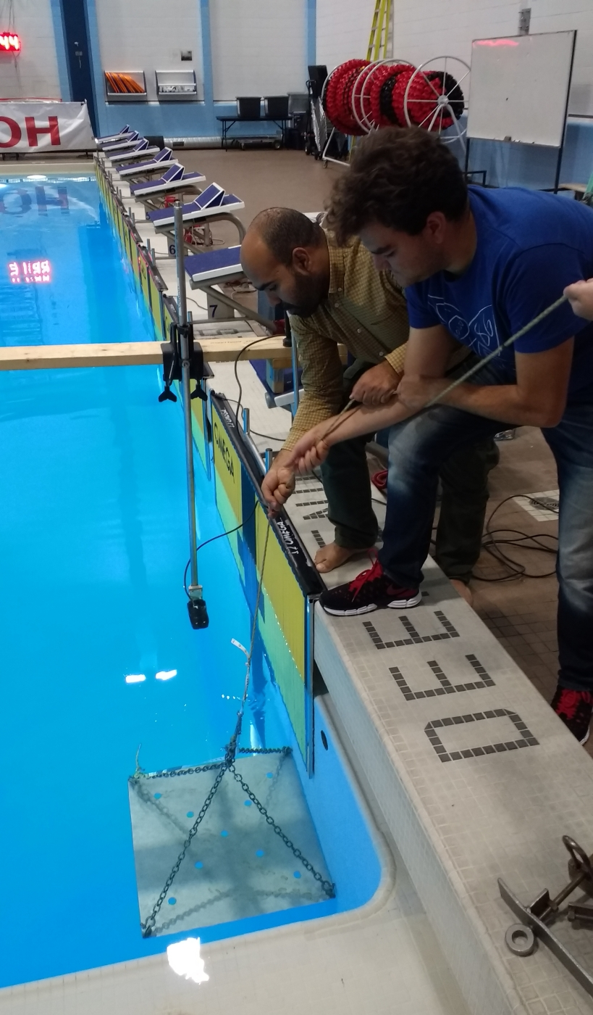
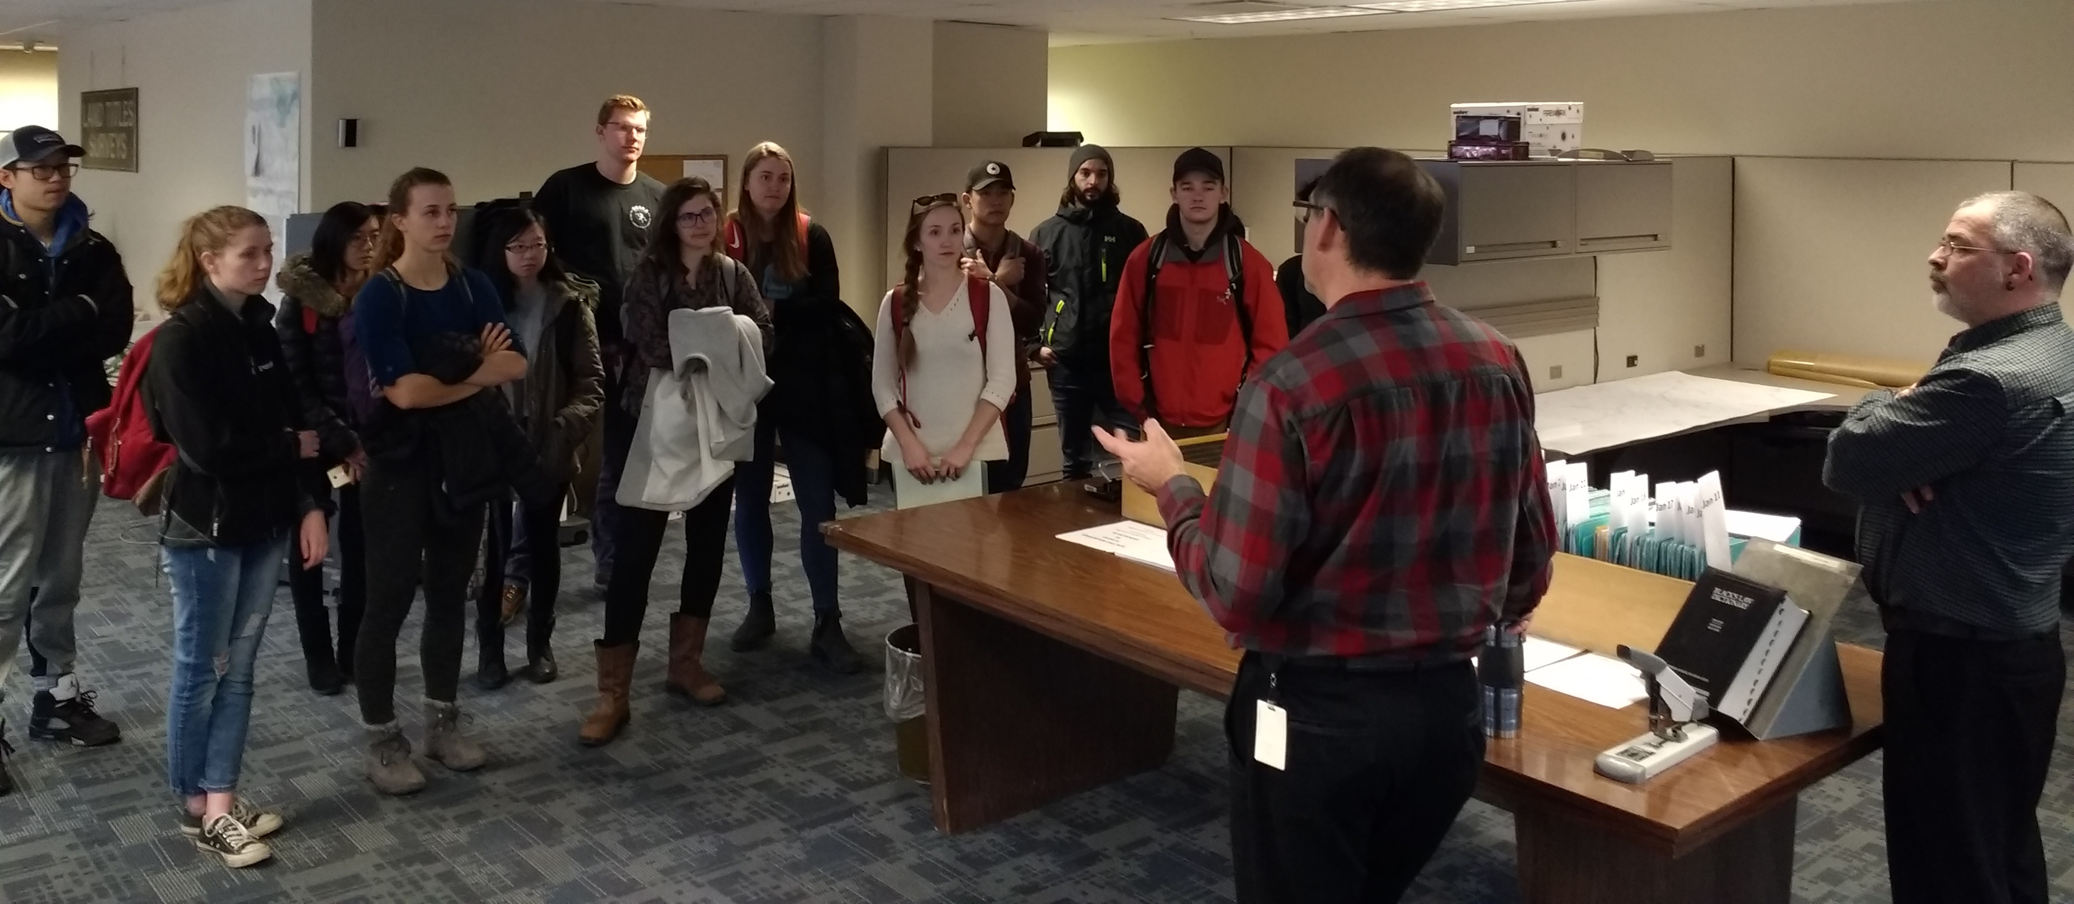
Background information
Geomatics engineering
  Surveying and mapping,
  GNSS positioning and navigation,
  GIS, remote sensing, etc.
Learning environment
  Good mixture of theory and practice,
  But hard and applied discipline
  Superficial vs. deep learning?
Notes:
Lectures, labs, tutorials, field work camp, capstone projects; small classes, state-of-the-art equipment and software
Similar to other engineering disciplines students are overwhelmed with content and retention appears to be low

Slide 23
Results
In-class observations
  Feedback from observer (non-expert)
  Tutorials more engaging than lecture periods
Minute papers
  Narrow scope
  Some definite candidates for threshold concepts
  A lot of “white noise”
End-of-term surveys
  Broad scope
  Mixed responses
Notes:
Clear as mud
Background of observer

Slide 24
Discussion
Should in-class observations be conducted by someone with relevant background or by a non-expert?
What is the best timing for minute papers?
How can students be encouraged to focus their responses on concepts and not general feedback?
Switch from free form to more categorical or ordinal choice questions in minute papers and end-of-term surveys?
Good response rate, but small class size – is this a problem?
Notes:
Observations: by a geomatics engineer or by a non-expert? Pros and cons?
Timing of minute papers? How to refocus students’ responses to concepts, not general feedback
What questions to ask in the EofTS and whether to assign ordinal or interval variables?
Exams: is it fair to focus an exam on the most difficult concepts?
Small class size -> good response rate but still not many samples

