Slide 1

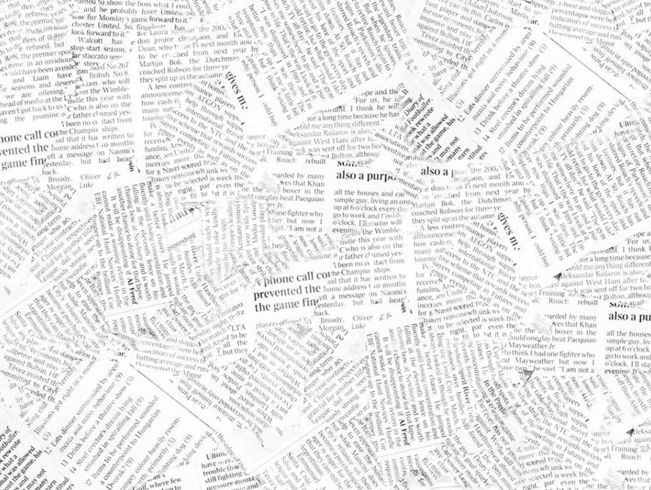
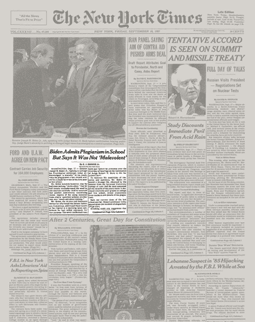
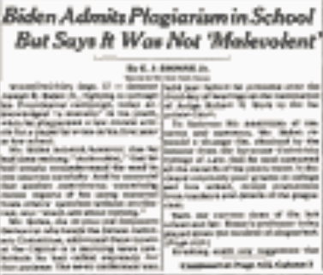



AutoCAD© Detective:
Whose Line is it Anyway
Biden Admits Plagiarism in School
But Says It Was Not ‘Malevolent’
FAKE NEWS
Notes:
Advantages, Disadvantages

Slide 2
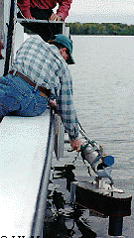
AutoCAD© Detective:
Whose Line is it Anyway
About Me
Education:
B.Sc (H) (UBC) – Geological Oceanography (1995)
M.Sc.E (UNB) – GGE/Ocean Mapping (2000)
Industry (15+ years):
-Geomatics Data Technician
-Multibeam & Hydrographic Survey Consultant
-Field Lead/Survey Manager
-LiDAR System Integrator, Senior Geomatics Specialist
FUGRO Seafloor Surveys International
OceansWest Marine Consultants Inc
Optimal Geomatics (LiDAR)
GeoDigital International (LiDAR)
Notes:
Advantages, Disadvantages

Slide 3
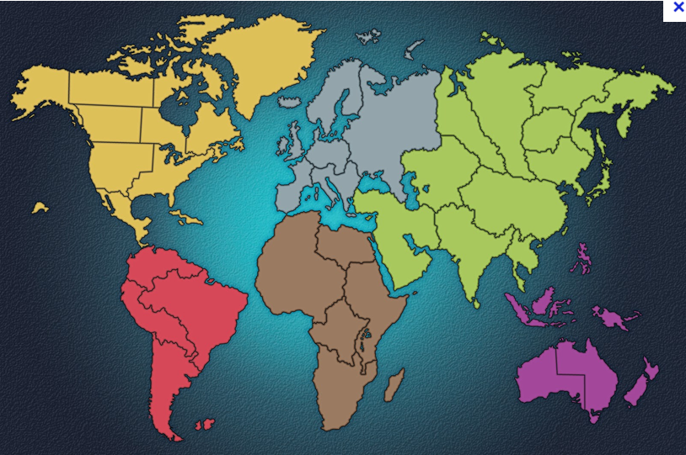

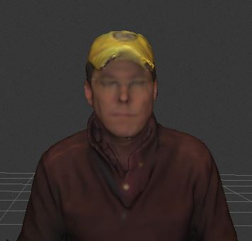
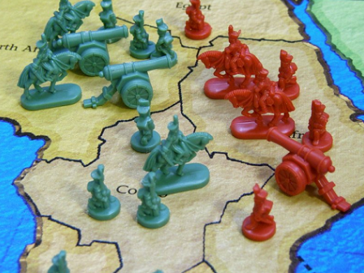
AutoCAD© Detective:
Whose Line is it Anyway
About Me
Teaching Disciplines with BCIT Geomatics Dept.
Earth/Ocean Sciences
AutoCAD
Remote Sensing Disciplines
Hydrography
LiDAR
Photogrammetry
HDS – TLS Scanning
POINT CLOUD DISCIPLINES
- BCIT Geomatics Diploma
- BCIT Geomatics Degree
Anyone up for a game of RISK
Notes:
Advantages, Disadvantages

Slide 4

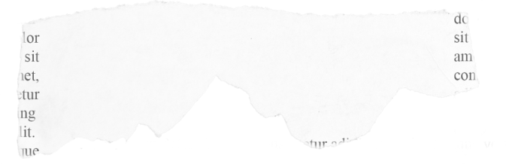

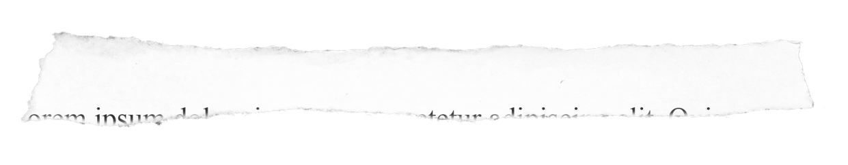

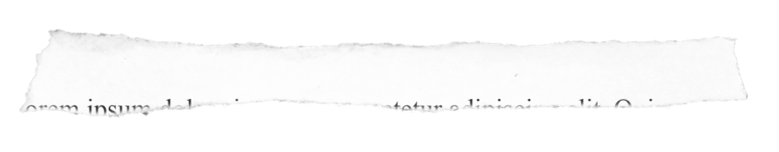
AutoCAD© Detective:
Whose Line is it Anyway
McMaster University:
Cheating
Are we doing enough?
Students Disciplined
in Harvard Scandal
PLAGIARISM in
AutoCAD ©
University Students are using “Contract Cheating”
Cheating at UK
Universities soars
Conrad Black expelled from UCC for selling exams
Notes:
Advantages, Disadvantages

Slide 5
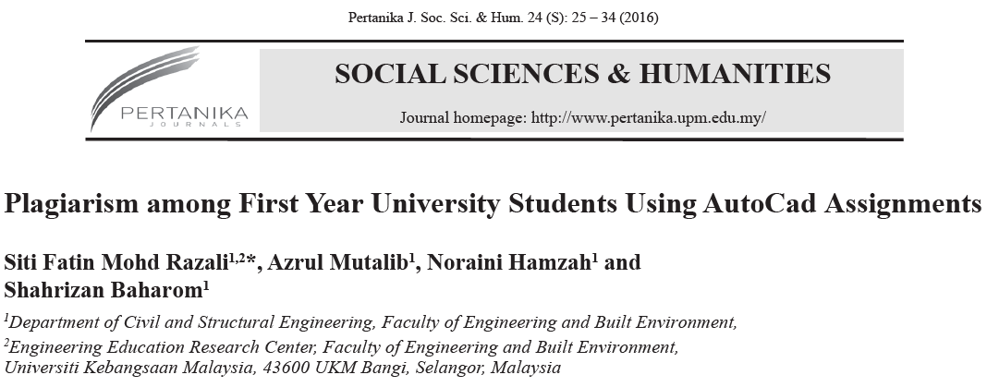
AutoCAD© Detective:
Whose Line is it Anyway
Plagiarism has become ingrained culture among university student around the world
Findings: Four Week Study Tracking 75 Students
25% of students plagiarized on every assignment
47% of students plagiarized on at least 1 assignment
Rates of plagiarism increased over course
Notes:
Advantages, Disadvantages

Slide 6
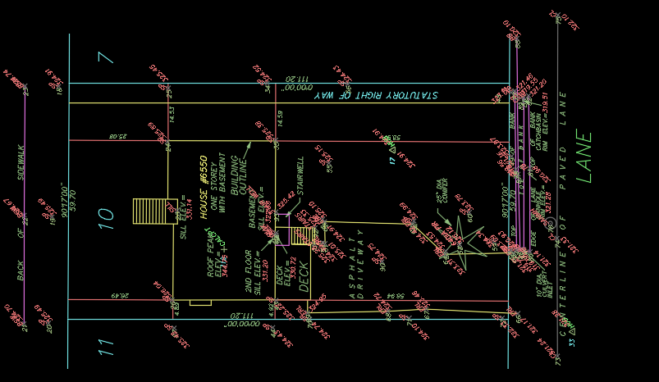
AutoCAD© Detective:
Whose Line is it Anyway
Plagiarism in software based classes difficult to detect
Easy to use softcopy and submit as their own
  If similar learning outcome – how does one detect it!
DWG Audits - Particularly onerous in large classes
Appearance of ‘Lack of Monitoring’ / ‘Lack of Action’ feeds behaviour
ONGOING + CONSISTENT Monitoring is CRUCIAL
But HOW?
Notes:
Advantages, Disadvantages

Slide 7
AutoCAD© Detective:
Whose Line is it Anyway
TIME>: shows time when DWG file created.
Assumes impossible for students to create DWG at exactly same time
Limited in SCOPE, does not negate BLOCK Import or XREFs
Notes:
Advantages, Disadvantages

Slide 8
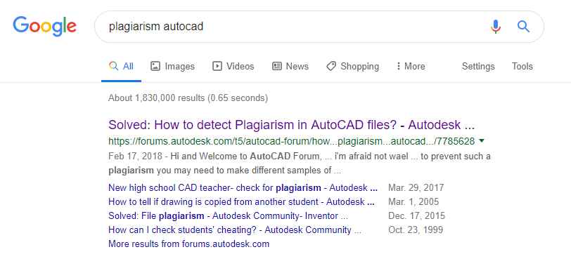
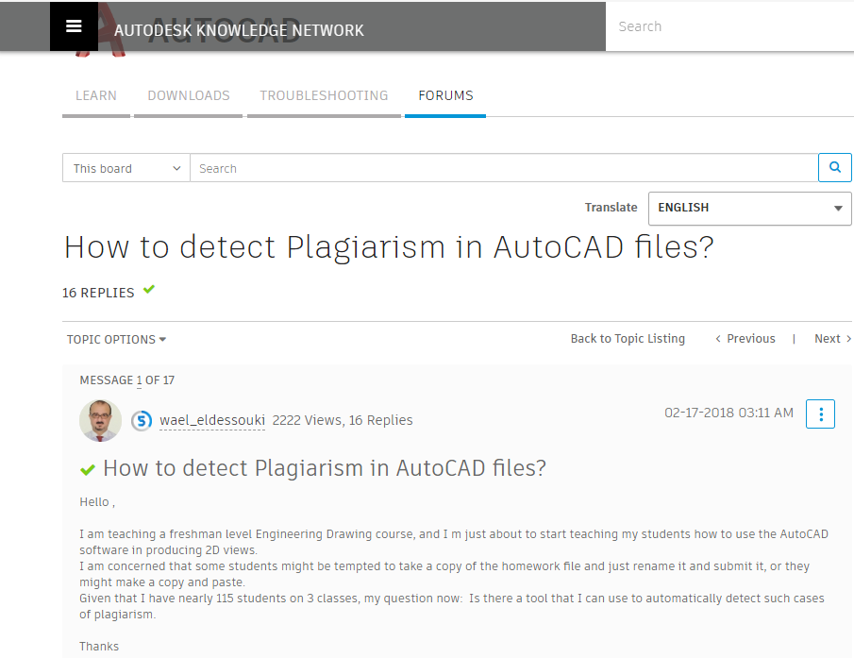
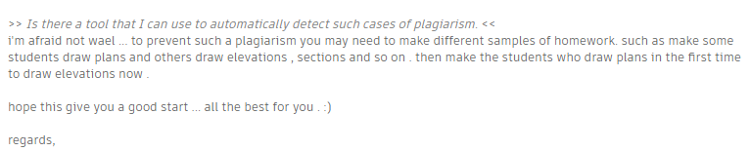
AutoCAD© Detective:
Whose Line is it Anyway
FAKE NEWS
Notes:
Advantages, Disadvantages

Slide 9
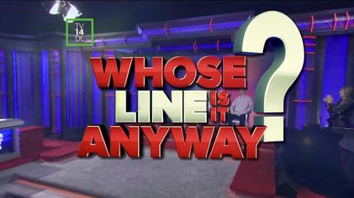

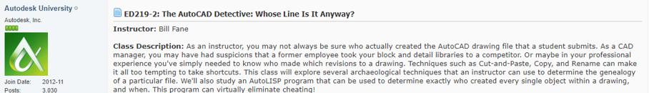
AutoCAD© Detective:
Whose Line is it Anyway
Notes:
Advantages, Disadvantages

Slide 10
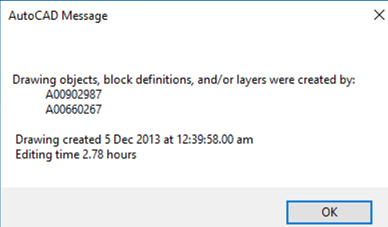
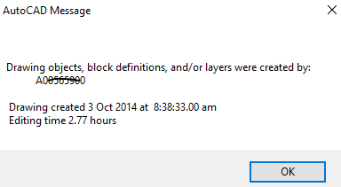
AutoCAD© Detective:
Whose Line is it Anyway
BCIT using “NoCheat” AutoLISP routine (Author: Bill Fane – BCIT)
Silently Adds invisible tags to every Object
    Login Name
    Time/Date of Object(s) Creation
    Includes Layers
    Includes Block Definitions
    Never tags same objects twice
On Startup> Opens DWG & Scans Objects >
  Generates List of Login Names
If two or more Login Tags – Generates Alert
Distinguishes between Instructors vs Students
  Instructor = (Read/Write)
  Student = (Read Only)
Notes:
Advantages, Disadvantages

Slide 11
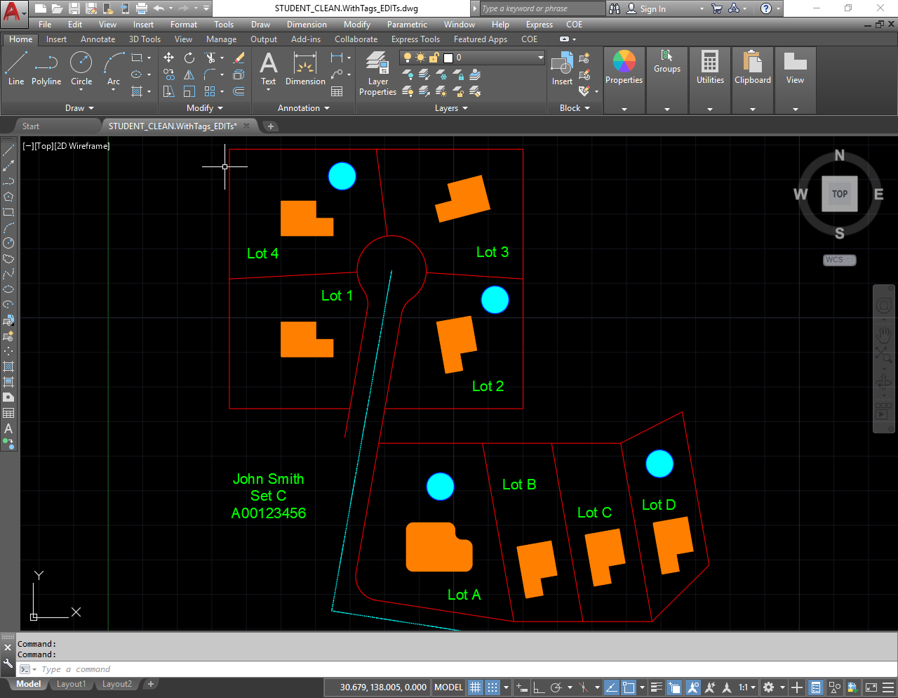
AutoCAD© Detective:
Whose Line is it Anyway
But is it really theirs? ☹ ☹ ☹ ☹
Notes:
Advantages, Disadvantages

Slide 12
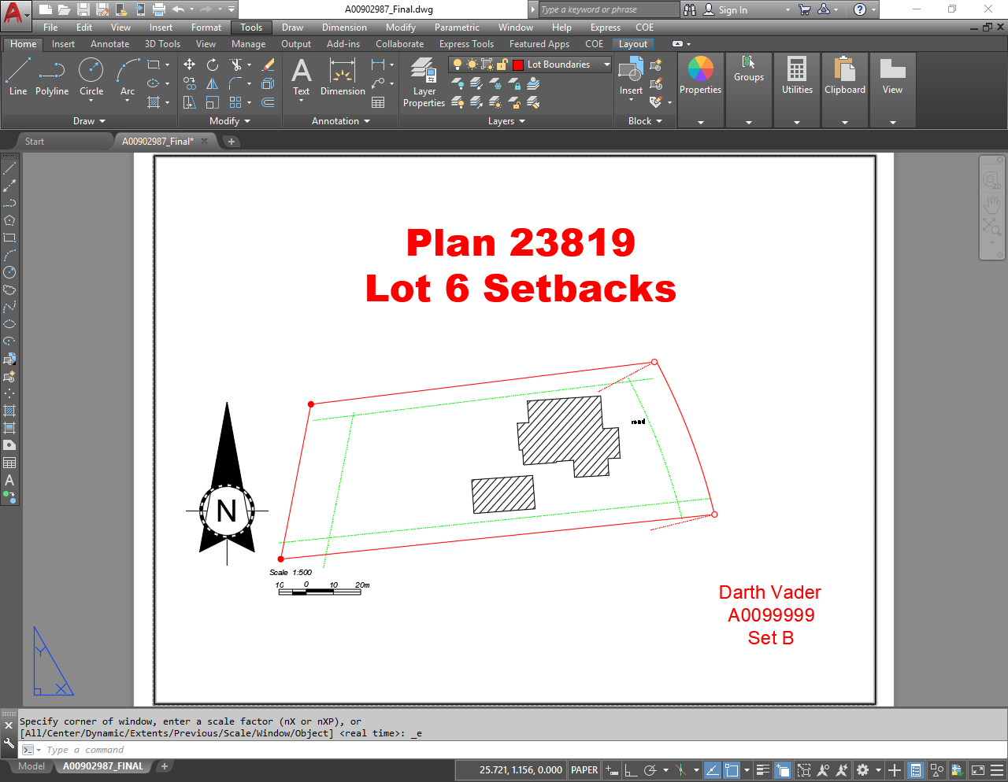
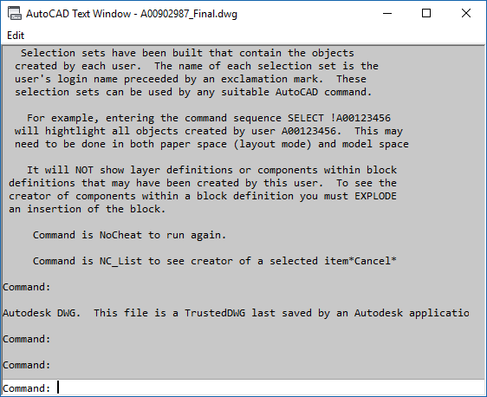
AutoCAD© Detective:
Whose Line is it Anyway
A FINAL EXAM – imported as BLOCK (exploded)
Notes:
Advantages, Disadvantages

Slide 13
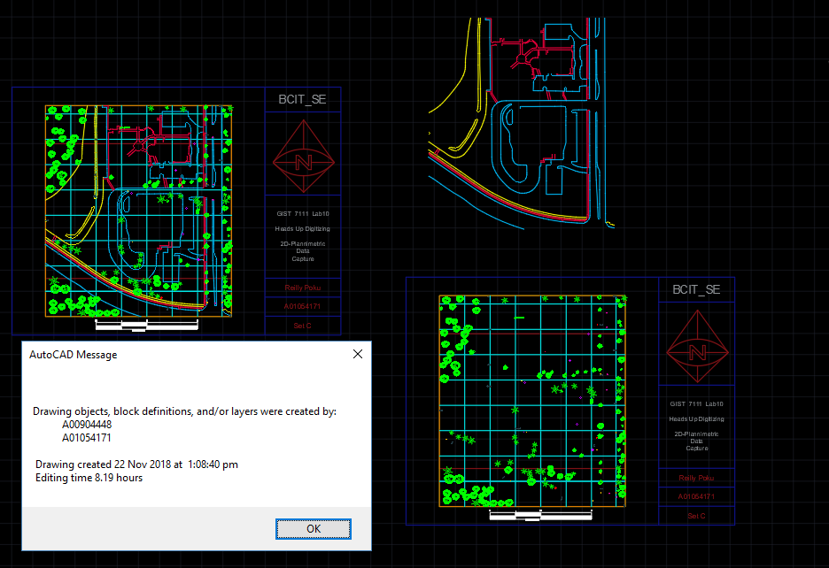
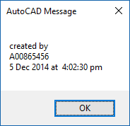
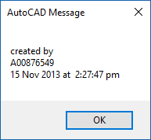

AutoCAD© Detective:
Whose Line is it Anyway
NC-LIST !StudentA
NC-LIST !StudentB
Notes:
Advantages, Disadvantages

Slide 14
AutoCAD© Detective:
Whose Line is it Anyway
REQUIREMENTS
    All Computer Lab CAD machines must have it pre-installed
    Each User must have unique Username (BEST in NETWORK)
    Student Level Policies differ from Instructor Policies
      STUDENT: Network Drive Access that is Read-Alone
      INSTRUCTOR: Network Drive Access that is Read/Write
    Only works for Regular AutoCAD 20## and variants
      But trouble with C3D!!!!
      Does not work with LT
    ITServices builds a single CAD image/configures it.
    USE TEMPLATE DWT files stored on NETWORK as SEED!
Notes:
Advantages, Disadvantages

Slide 15


AutoCAD© Detective:
Whose Line is it Anyway
CAD Lab – Student “Client” Machines
Silently running NoCheat LISP
Must configure ACADDOC.LSP
Must set {Support Path}
Must set {Template Path} (DWTs)
Network Location
  STUDENTS: ReadOnly
  INSTRUCTORS: Read / Write Access
    {Support Path}> NC.vlx --- NoCheat LISP
  DWT STORAGE
Notes:
Advantages, Disadvantages

Slide 16
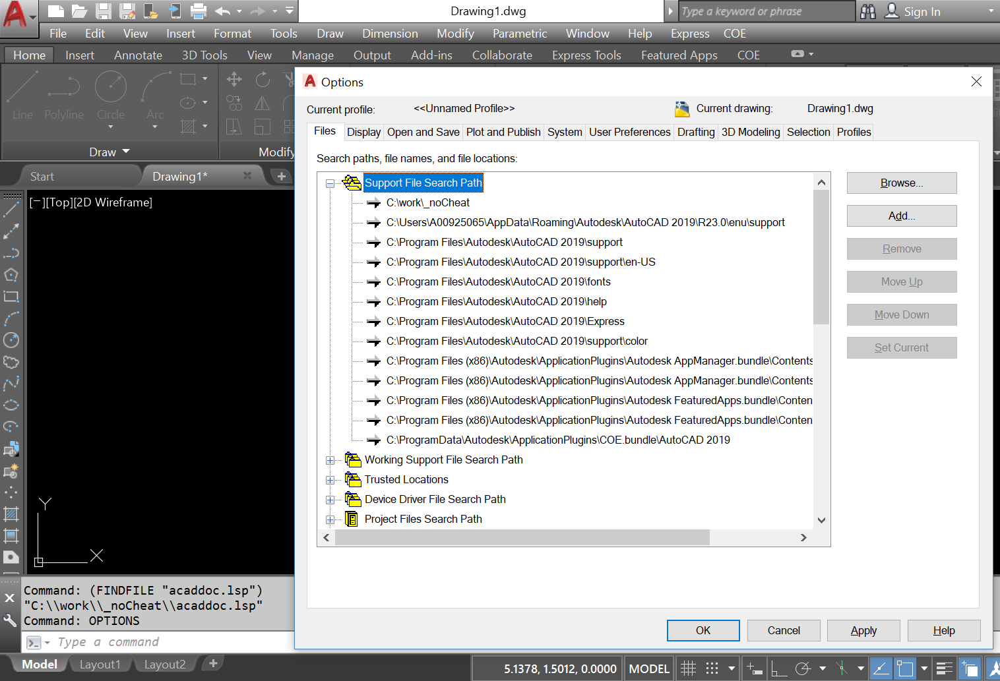

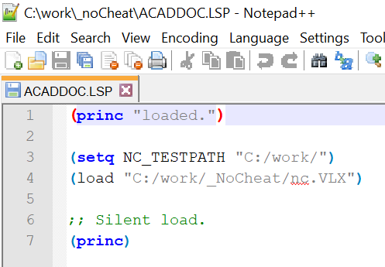

AutoCAD© Detective:
Whose Line is it Anyway
Notes:
Advantages, Disadvantages

Slide 17
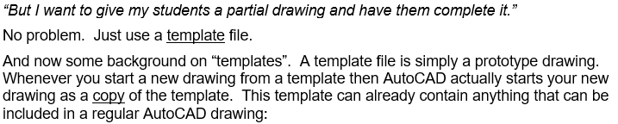
AutoCAD© Detective:
Whose Line is it Anyway
Network Location
STUDENTS: ReadOnly
INSTRUCTORS: Read / Write Access
{Support Path}> NC.vlx --- NoCheat LISP
{Support Path} configured via ACADDOC.lsp
DWT STORAGE
Determining the provenance of an CAD drawing begins before
a DWG is every created. Never Give a Student a starter DWG.
USE A TEMPLATE DWT file instead.
Notes:
Advantages, Disadvantages

Slide 18
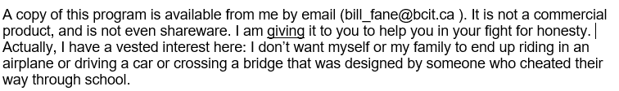
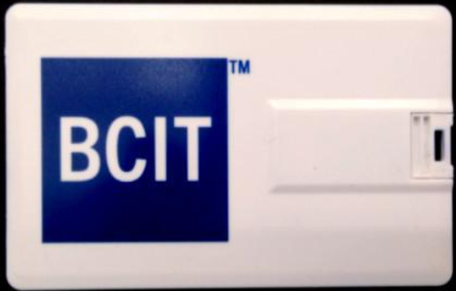
AutoCAD© Detective:
Whose Line is it Anyway
BCIT using “NoCheat” AutoLISP routine for years
Positive Side effects
  Decreased plagiarism in other related courses
  Students master the fundamental skills
    Built CAD knowledge from first principals
Notes:
Advantages, Disadvantages

Slide 19
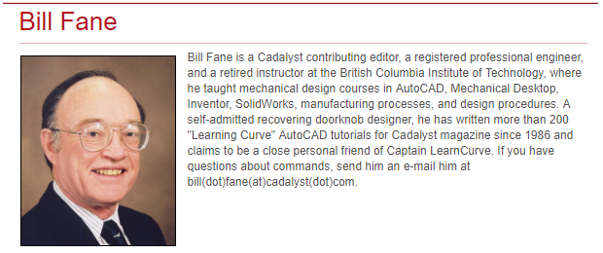
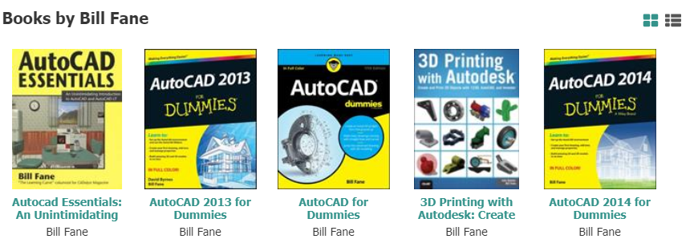
AutoCAD© Detective:
Whose Line is it Anyway
Notes:
Advantages, Disadvantages

Slide 20

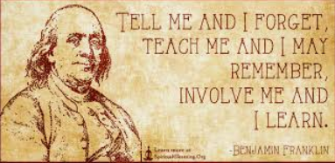
AutoCAD© Detective:
Whose Line is it Anyway
Notes:
Advantages, Disadvantages

Slide 21
AutoCAD© Detective:
Whose Line is it Anyway
Thank You
Notes:
Advantages, Disadvantages

