Slide 1
An interactive Web-GIS application for identifying flood vulnerable areas based on GNSS meteorology
Hoda Tahami, Jihye Park,Majidreza Farahani
School of Civil and Construction Engineering
Oregon State University
August 2019

Slide 2
Presenter Info
Hoda Tahami is a PhD candidate and gradaute research assistant in Geomatics program at Oregon State University working under supervision of Dr. Park.
She received her Master of Science in Geospatial Information System with mainly focus on web and mobile GIS applications.
Her PhD research focuses mainly involve space geodetic techniques for atmospheric monitoring/prediction
Sample of her web GIS and geovisualization projects can be found at:
https://hodatahami.github.io/bootstraprepositoriesdesign/

Slide 3
Outline
Background in Severe Weather Study
The Preliminary Study on prediction of a storm path using GNSS
A short-term forecasting for storm-induced Precipitation using GNSS-Meteorology
A web-GIS perspective on meteorological hazard monitoring using GNSS remote sensing
Conclusion

Slide 4
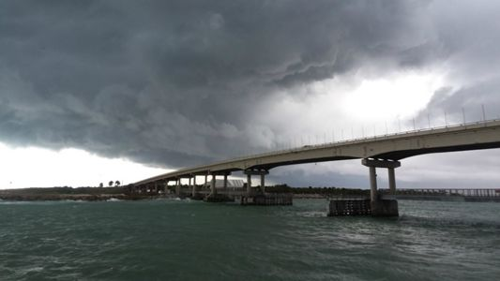
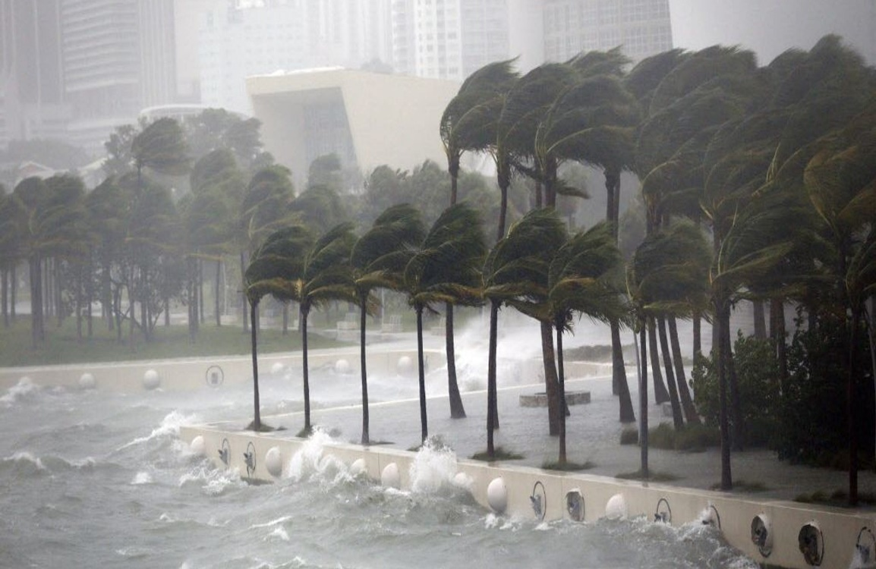
Background
Water vapor is one of the most important components to form clouds and precipitation, and an ingredient in most major weather events.
Precipitable Water Vapor (PWV) is a physical parameter that is difficult to measure with adequate spatial and time resolution under all weather conditions.
Largest errors in Numerical Weather Prediction (NWP) come from limitations in our ability to describe water vapor variability in time and space and it is one of the major error sources in short-term forecasts of precipitation.
2

Slide 5
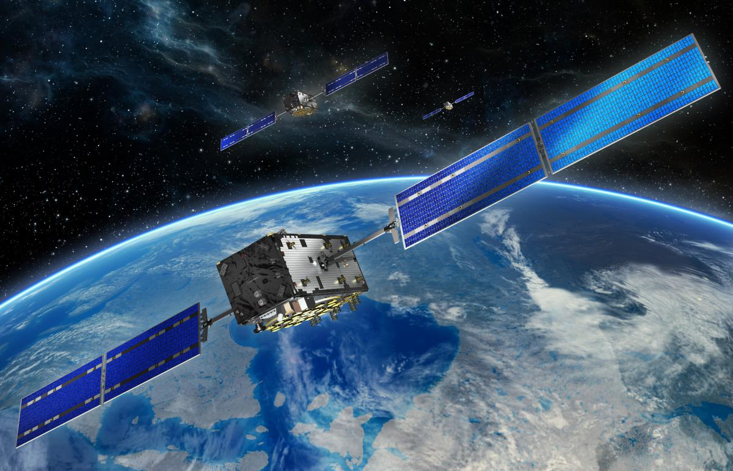
Weather Monitoring/Forecasting with GNSS
Water vapor measurements derived from GNSS observations
with high temporal and horizontal resolution
under all weather conditions, including thick cloud cover and precipitation
without the need for external calibration.
cost effectiveness
4

Slide 6
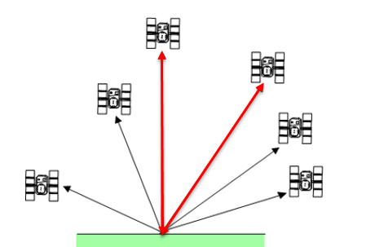
PWV Estimation Using GNSS
The total tropospheric delay in slant path delay can be mapped onto the zenith direction.
Total Zenith Delay (TZD) is computed using a mapping function depending on the elevation angle of the satellite.
TZD
Tropospheric Path Delay
$$θ$$
$TZD=ZHD×m_{h}$($θ$)$+ZWD× m_{w}\left(θ\right)$
PWV = $ZWD×Π$
where
ZHD: Zenith Hydrostatic Delay
ZWD: Zenith Wet Delay
$m_{h}\left(θ\right)$ and $m_{w}\left(θ\right)$ are the hydrostatic and wet mapping functions with respect to the satellite elevation angel ($θ)$.
$Π^{−1}$=${10}^{−6} ×$ρ × $R_{v}$($\frac{(3.739±0.012){10}^{5}}{T_{m}}$+$(22.1±2.2$))
$$T_{m}=70.2+0.72 T_{s}$$
6
Notes:
$Π$: Conversion factor
ρ : the water vapor density
$R_{v}$: gas constant
$T_{m}$: weighted mean temperature

Slide 7
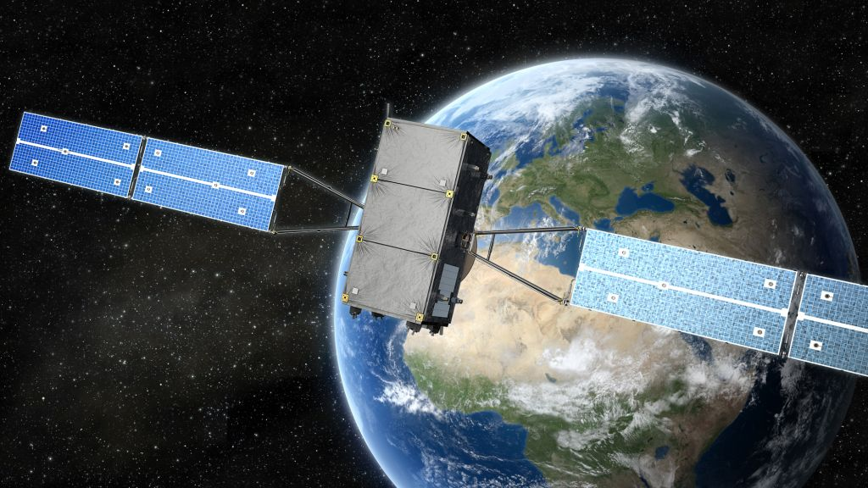
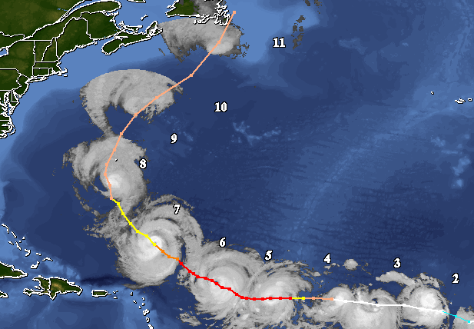
The Preliminary Study on The Prediction of a
Severe Rainfall By GNSS Derived PWV Analysis

Slide 8
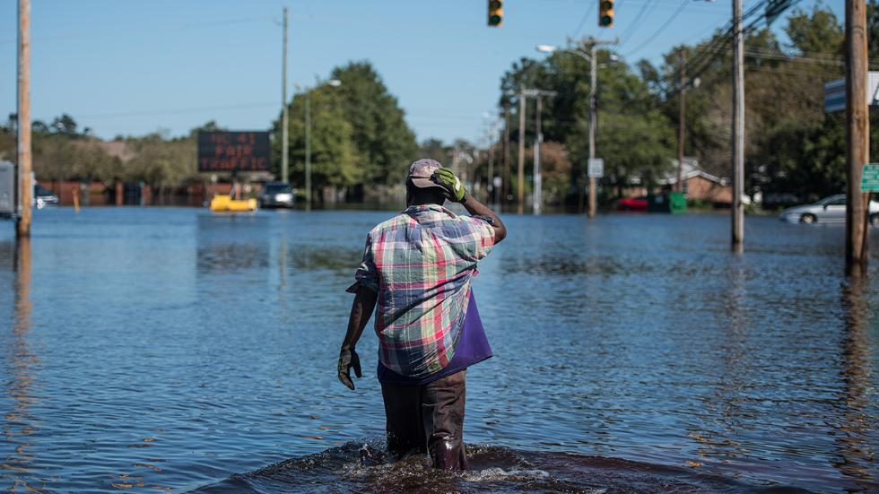
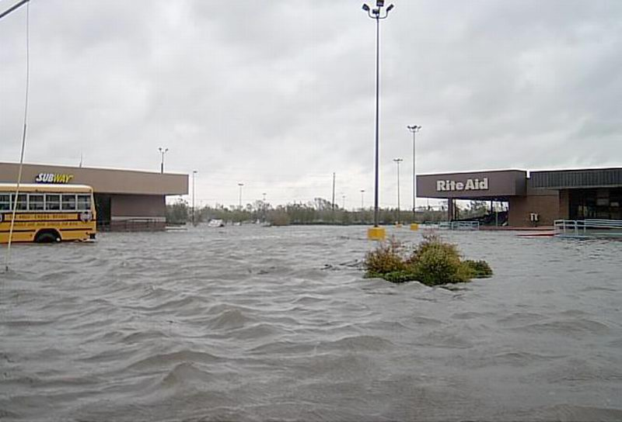
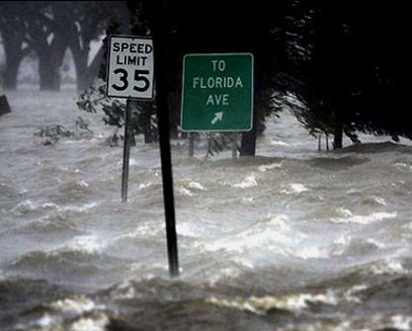
Hurricane Matthew 2016
A total of 603 deaths (34 in the United States)
Could cause ~ $10 billion in damage estimates
8

Slide 9
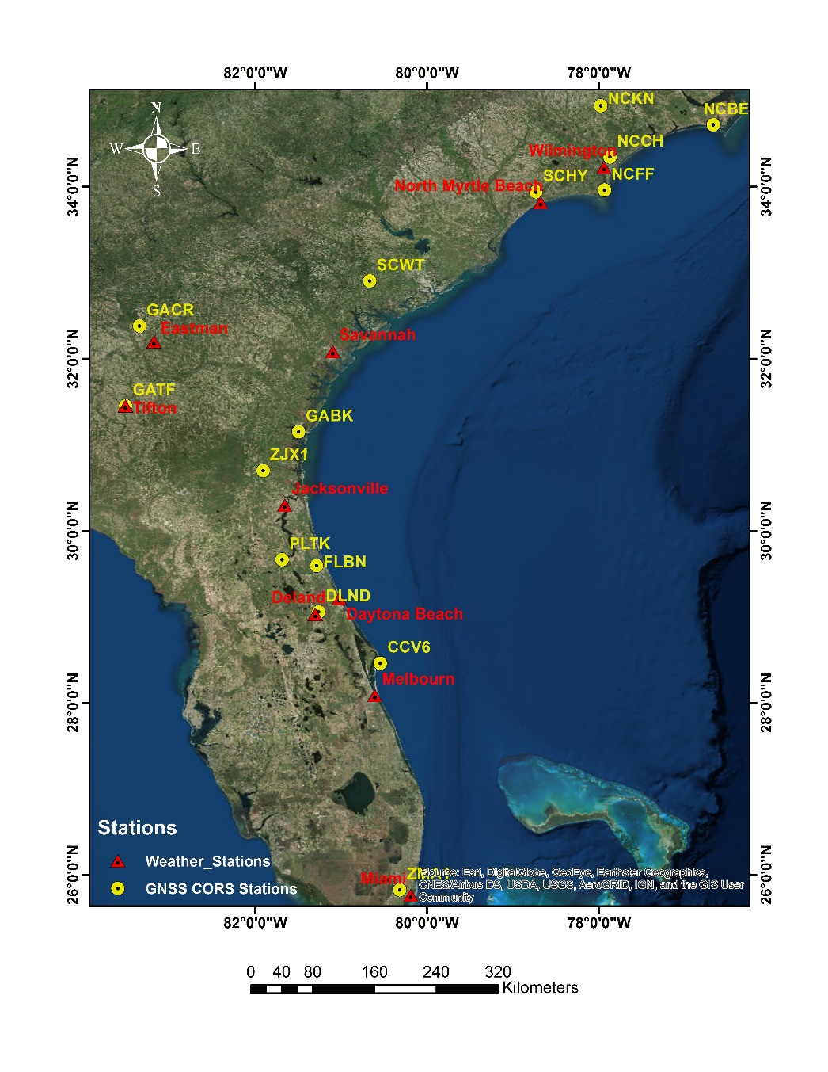
Observations:
6-10 October 2016
15 CORS stations
10 weather stations
Temporal Resolution:
30 sec of GNSS CORS obs
60 minutes for weather data
Processing:
APPS
satellite orbits and clock
correction from JPL final products
Cutoff angle:15 degree
9

Slide 10
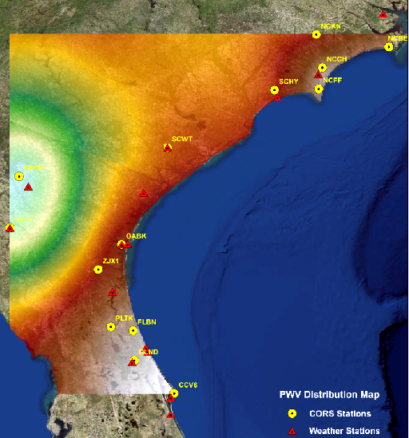
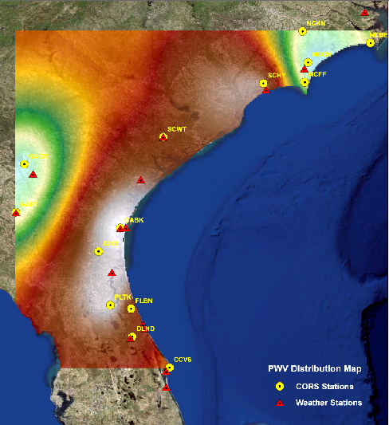
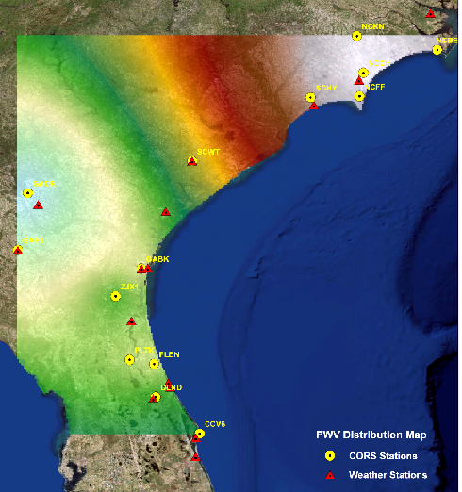
PWV Variation During Event Period
10/6/16 12:00 PM UTC
10/7/16 12:00 PM UTC
10/8/16 12:00 PM UTC
10

Slide 11
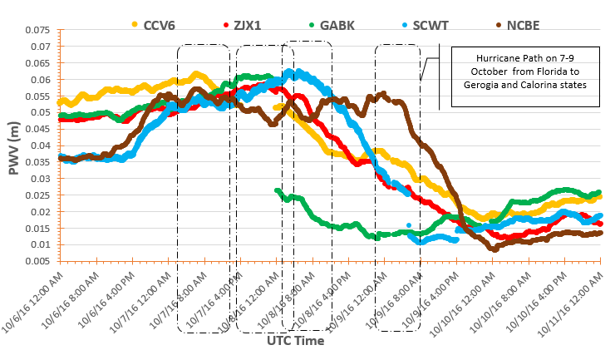
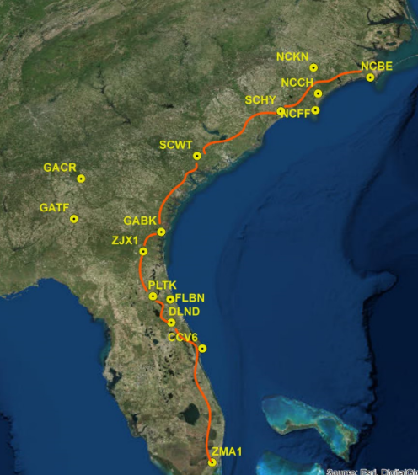
PWV Variation During Hurricane Matthew
11

Slide 12
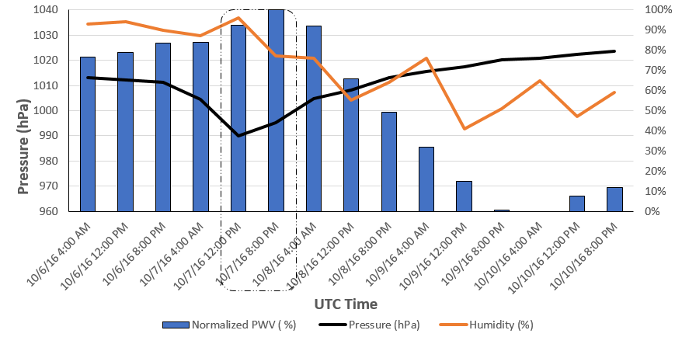
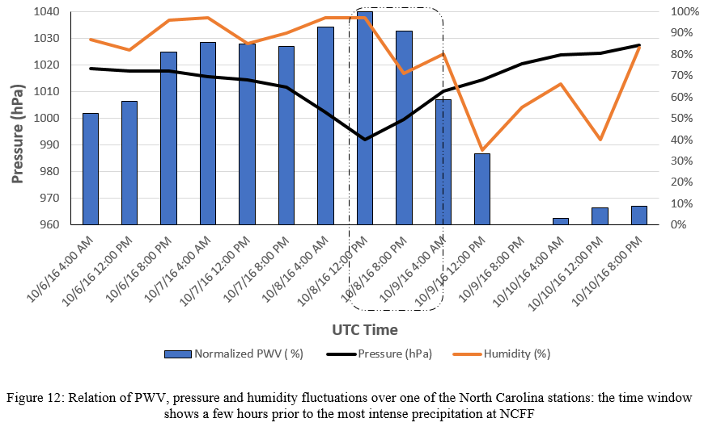
Weather Stations’ Met Parameters
ZJX1 (Florida)
NCFF (North Carolina)
12

Slide 13
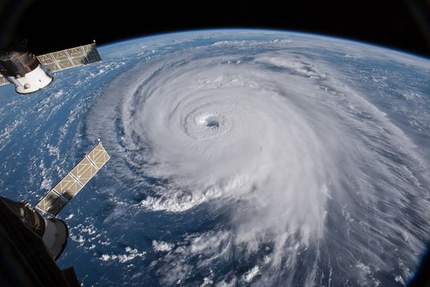
A Short-term Forecasting For Hurricane-induced Precipitation Using GNSS Meteorology

Slide 14
Work flow
Input Data
GNSS CORS
Meteorological Data
Processing
PWV computation
(Hourly Weighted average)
MET data Interpolation
(Hourly Weighted average)
Modeling
Selection of reference Observation for the model
PCA
Multivariate Regression
Path Prediction
Minimum Residuals Clustering
Verification
Comparison with NWS Products
Statistical Tests

Slide 15
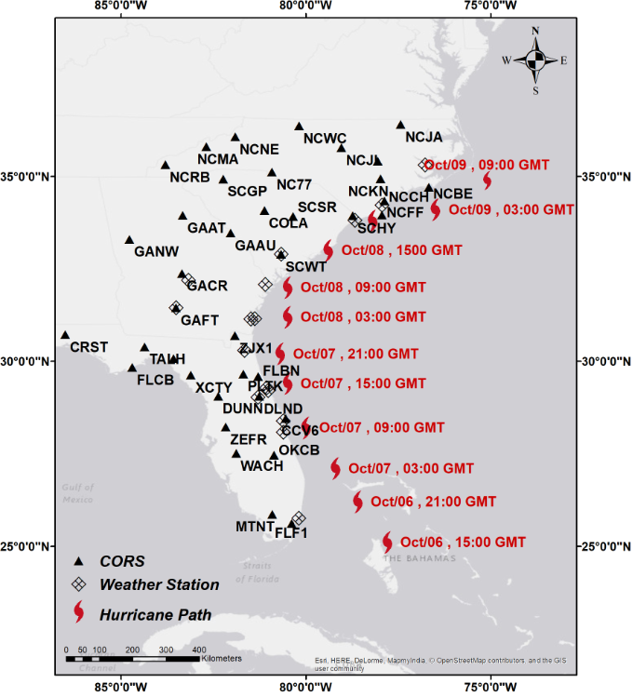
Case Study
Hurricane Matthew
Observations:
5-11 October 2016
38 CORS stations
14 weather stations
Temporal Resolution:
5 minutes for CORS
60 minutes for weather data
The blue circles shows the stations used for deriving the model’s coefficients.

Slide 16
PWV Estimation Using Multiple Regression Analysis
Estimation of PWV based on meteorological factors
$$\left({PWV}_{t+1}\right)= \overline{{PWV}_{t}}+c_{1}\left({PWV}_{t}−\overline{{PWV}_{t}}\right)+c_{1}\left(P_{t}−\overline{P_{t}}\right)+c_{3}\left(T_{t}−\overline{T_{t}}\right)+c_{4}\left({RH}_{t}−\overline{{RH}_{t}}\right)+e$$
$\left({∆PWV}_{t+1}\right)$=$c_{i}[∆{PWV}_{t}, ∆P_{t}$,$∆T_{t}$,$∆{RH}_{t}$]+ e
Where
T is temperature; P is pressure; RH is relative humidity; PWV is precipitable water vapor and t is time.
In this study, a model with 1h, 6h, 12h and 24h lead time is applied to forecast PWV that is resulted to predict the storm path for 1h, 6h, 12h, and 24h forecast.

Slide 17
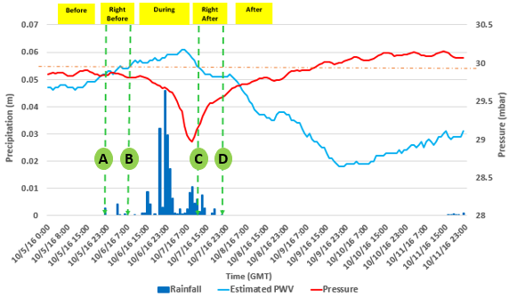
Implementation of Prediction Models
The PROC and other atmospheric parameters behave differently at the different stage of hurricane.
The principle regression model should be tailored to each stage in the hurricane lifetime.
Classification of model based on PWV threshold (green circles)

Slide 18
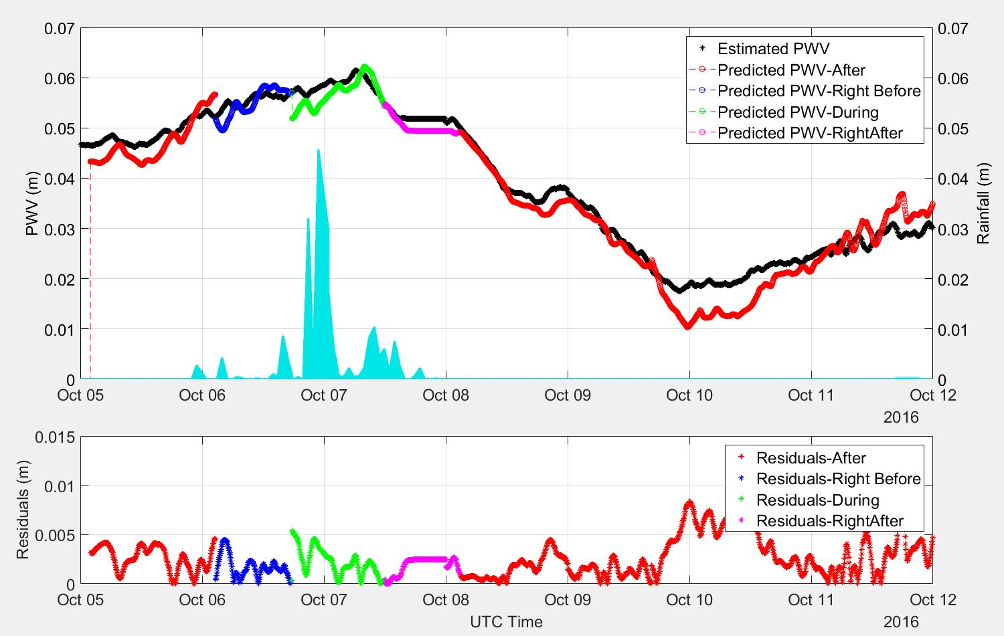
Implementation of Prediction Models
Among all CORS stations in the test site, six stations are selected for determining the coefficients of the prediction model.
The remaining stations are used for validating the results.
Prediction models and the corresponding residuals for CCV6 during 5-12 Oct, 2016; The top panel shows the models in different colors that are mapped over the actual PWV time series (Black line) and the blue bars represent the recorded actual rainfall on the station for the mentioned period.; the bottom panel shows the residuals of observations with respect to each model.

Slide 19
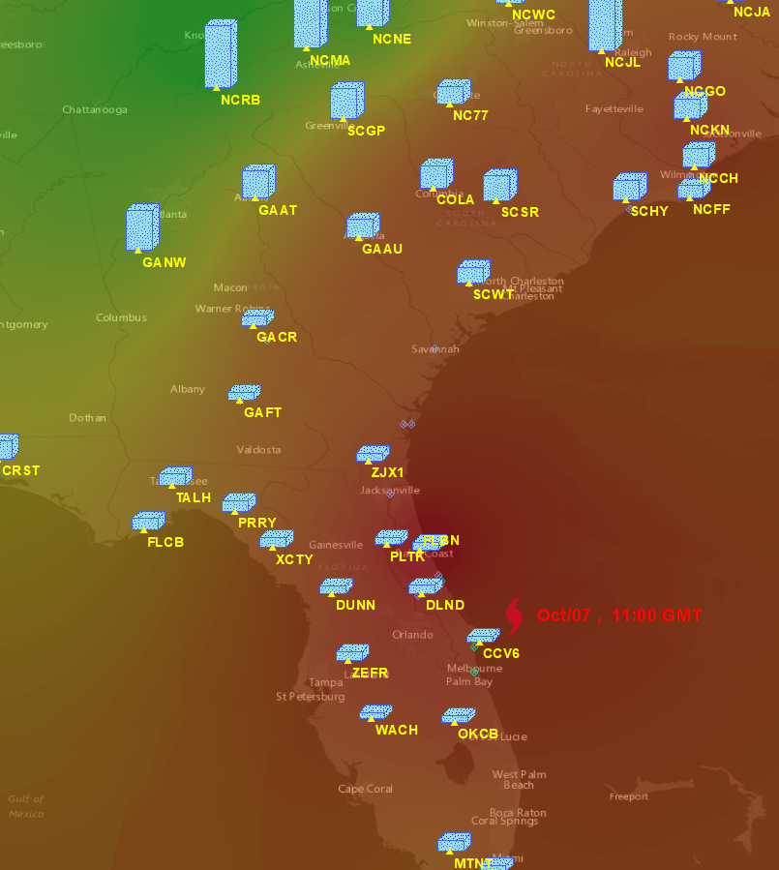
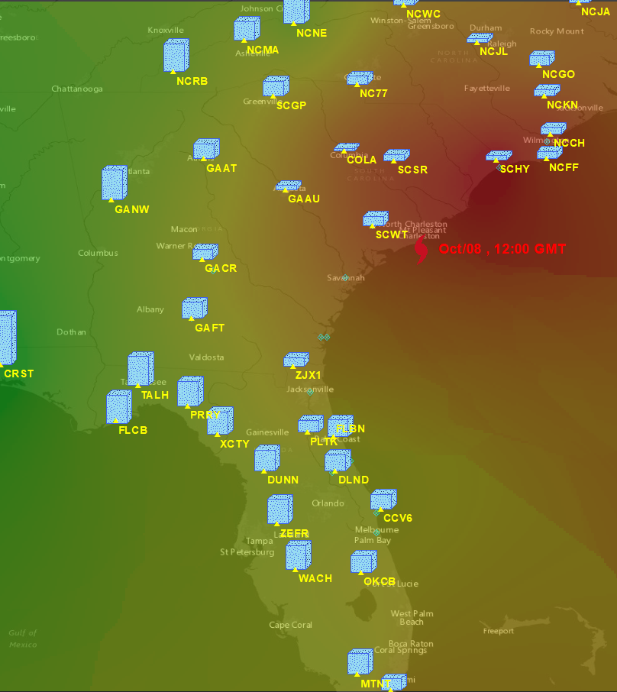
Model’s Residuals Over Hurricane Phases
Distribution of actual PWV and the residuals for the “right before” and “after” models over the area corresponding to 7 October at 11:00 am (left) and 8 October at 12:00 pm (right).

Slide 20
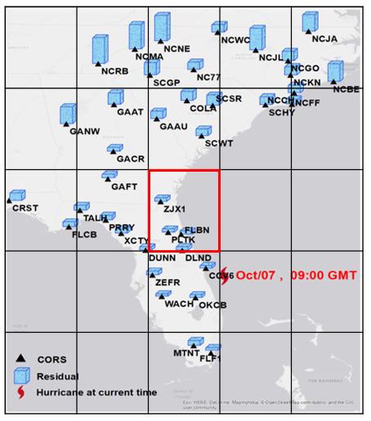
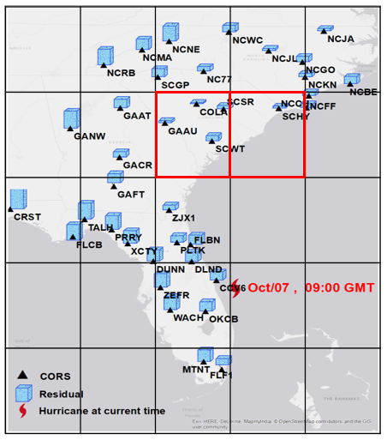
Path Prediction Using Model’s Residuals
Predicted residuals for CCV6 on 7 Oct, 2016. The red hurricane mark shows the reported time and location of the hurricane provided by National Weather Service. In each image, red grid shows the stations fall into the hurricane and black girds show the grids correspond the stations located outside the hurricane center

Slide 21
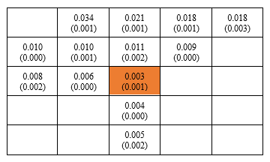
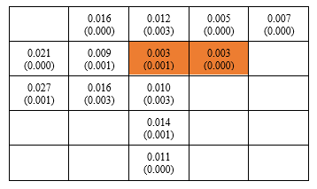
Numerical Comparison of Model’s Residuals
The numerical comparisons of prediction residuals for the grids located inside and outside of the hurricane using “right before” model:

Slide 22
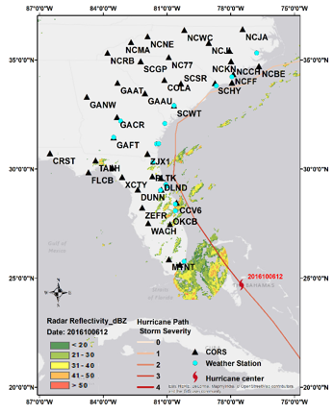
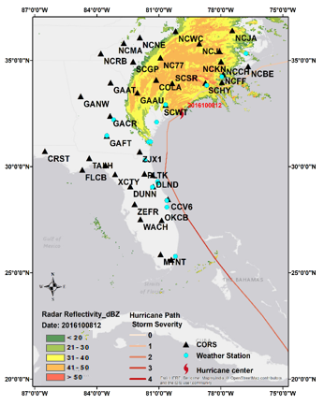
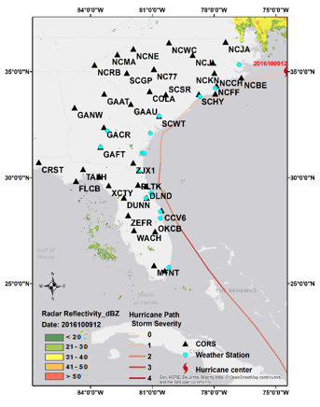
Hurricane Matthew 2016

Slide 23
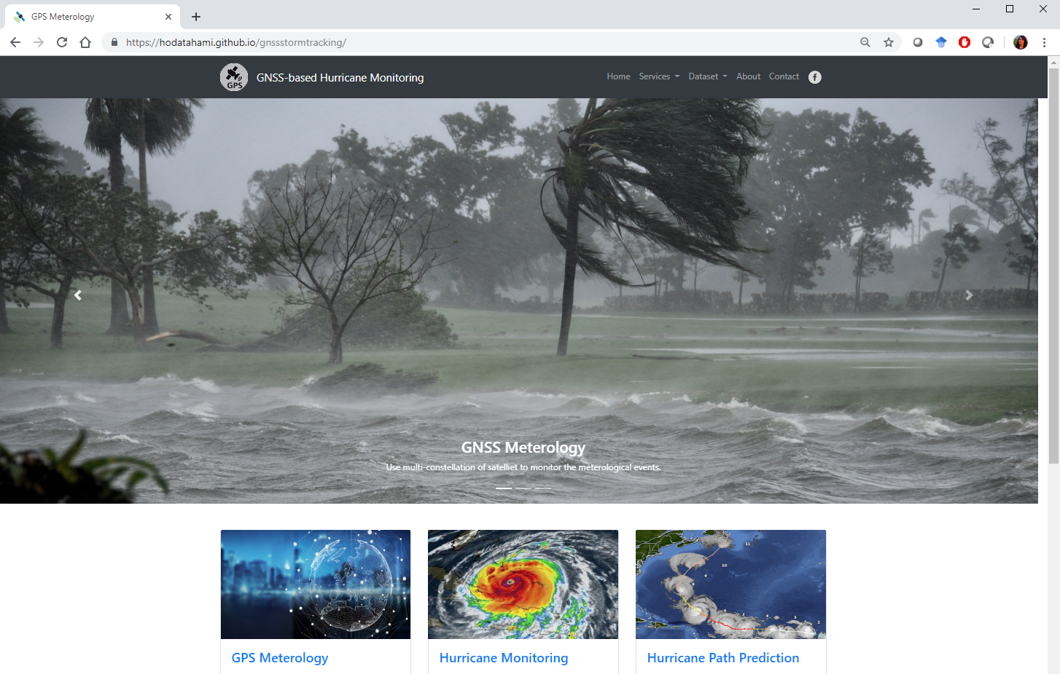
Web-based GNSS Meteorology: A Web-GIS Perspectives on Meteorological Hazard Monitoring Using GNSS Meteorology

Slide 24
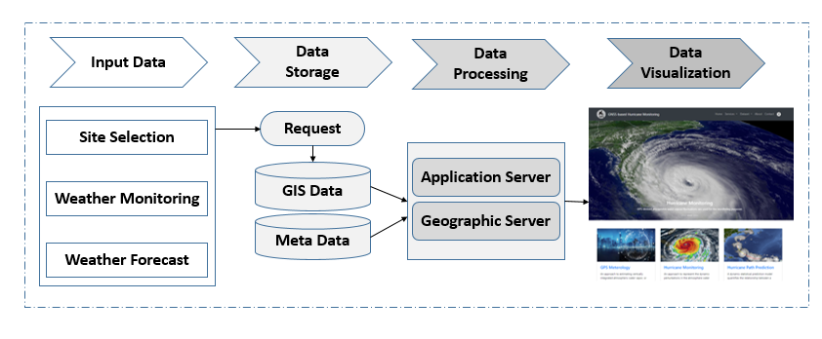
Platform Conceptual Architecture

Slide 25
Web map libraries
Development of the responsive web thematic map is done by applying several java scripts libraries including:
Bootstrap
CartoDB,
Leaflet
D3
SpatialSankey

Slide 26
Interactive Representation of MET data for CORS
https://hodatahami.github.io/gnssstormtracking/index.html

Slide 27
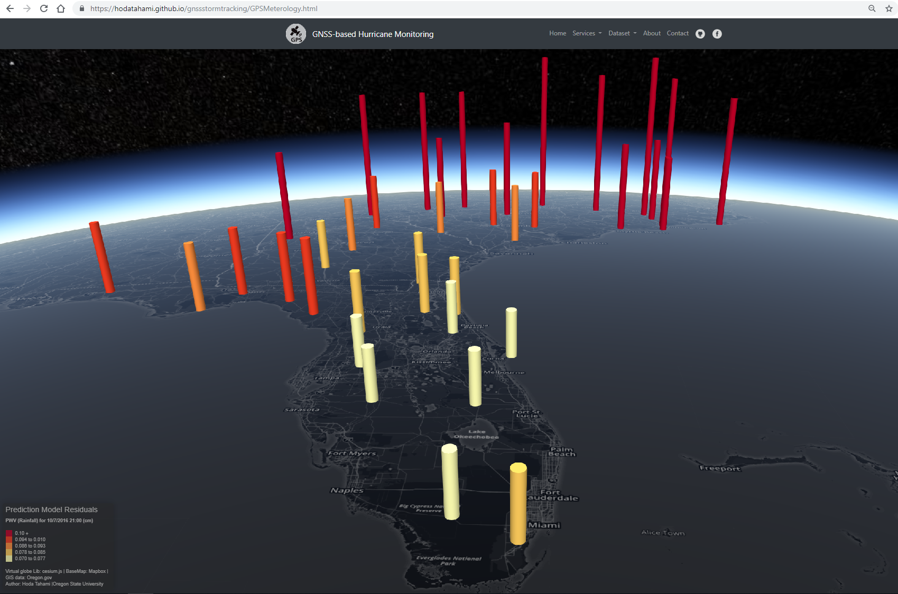
Interactive Representation of Predicted PWV

Slide 28
Conclusion
In ground-based GNSS meteorology, by using the spatial- temporal variability of PWV derived from GNSS observations and meteorological variables, a short-term forecasting method is established to track the hurricane and its intensity using Principle Component Regression (PCR)
The distribution pattern of the predicted PWV residual, and its magnitude in the region can be used for storm tracking.
By combining geo-visualization technique with predicted GNSS-derived PWV, the vulnerability to flooding due to potential sever rainfall are effectively provided in near real-time.

Slide 29
Thank you
Questions?!

