Slide 1
E-Portfolios, Licensure, Continuing Education and Employment:
The Perfect Storm of Opportunity for the Surveying Student
presented by:
A. Richard Vannozzi, MS, PLS
School of Engineering Technology
University of Maine
Orono, Maine
anthony.vannozzi@maine.edu
Surveying and Geomatics Educators Society Conference
Nicholls State University, Thibodaux, LA
August 6, 2019
© A.R. Vannozzi 2019

Slide 2
What is an E-Portfolio?
Chronical education & experience digitally;
“Living” resume or CV;
Includes samples of documents to support claims (Artifacts);
Demonstration of competencies;
Essentially, a personal/professional website.
© A.R. Vannozzi 2019

Slide 3
Why E-Portfolios?
Eliminates paper;
Easier to supply and easier to access;
Multiple applications;
Easily modifiable;
Demonstrates learning and professional progress.
© A.R. Vannozzi 2019

Slide 4
Why does NSPS care?
Help members manage their continuing education records;
Help younger members document their work for licensure;
Support professional credentialing efforts;
Support Boards of Licensure with Continuing Education audits;
Help state societies archive continuing education records;
Helps providers make their availability/outline known/archived.
© A.R. Vannozzi 2019

Slide 5
The research – two phases
Funded by the NSPS Foundation
PHASE I
Described a system of “badging” for surveying continuing education;
Learners
Instructors
Content Developers
Providers
Regulators
Accreditors
Employers
© A.R. Vannozzi 2019

Slide 6
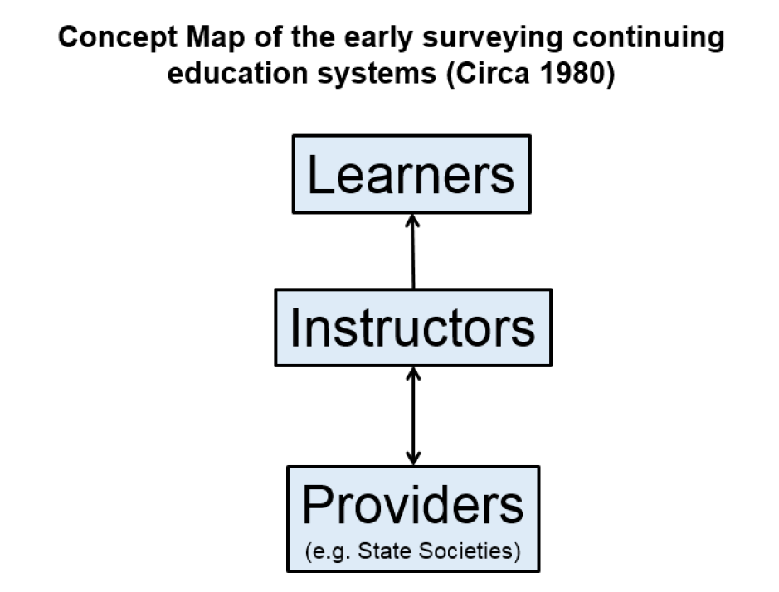
PHASE I: Yesterday
© A.R. Vannozzi 2019

Slide 7
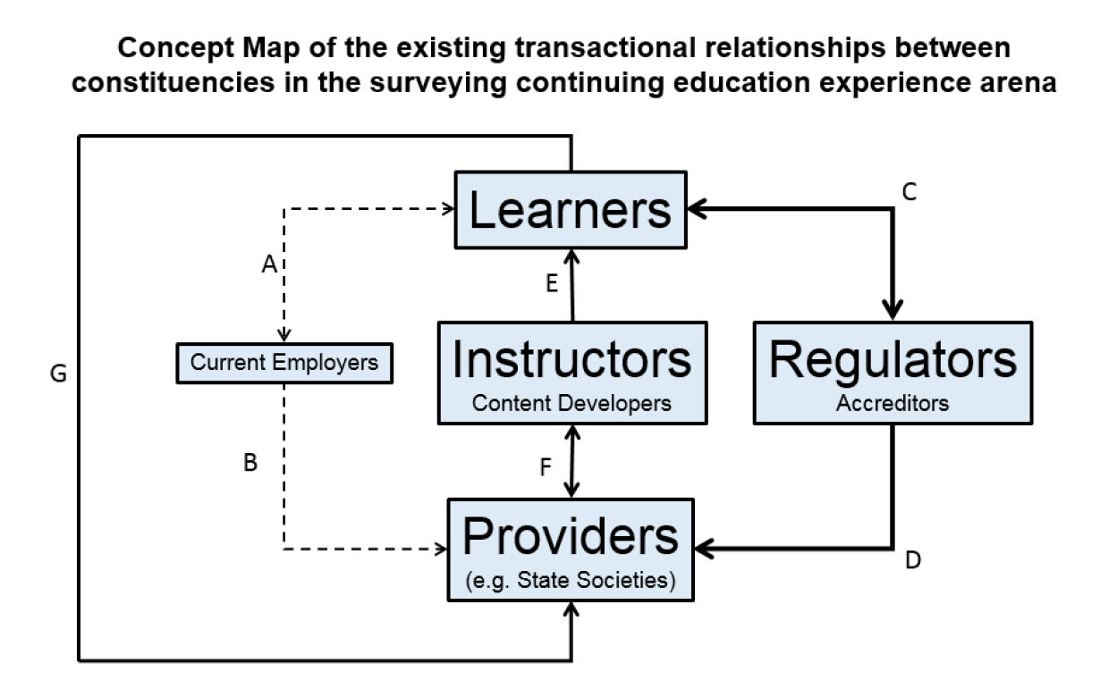
PHASE I: Today
© A.R. Vannozzi 2019

Slide 8
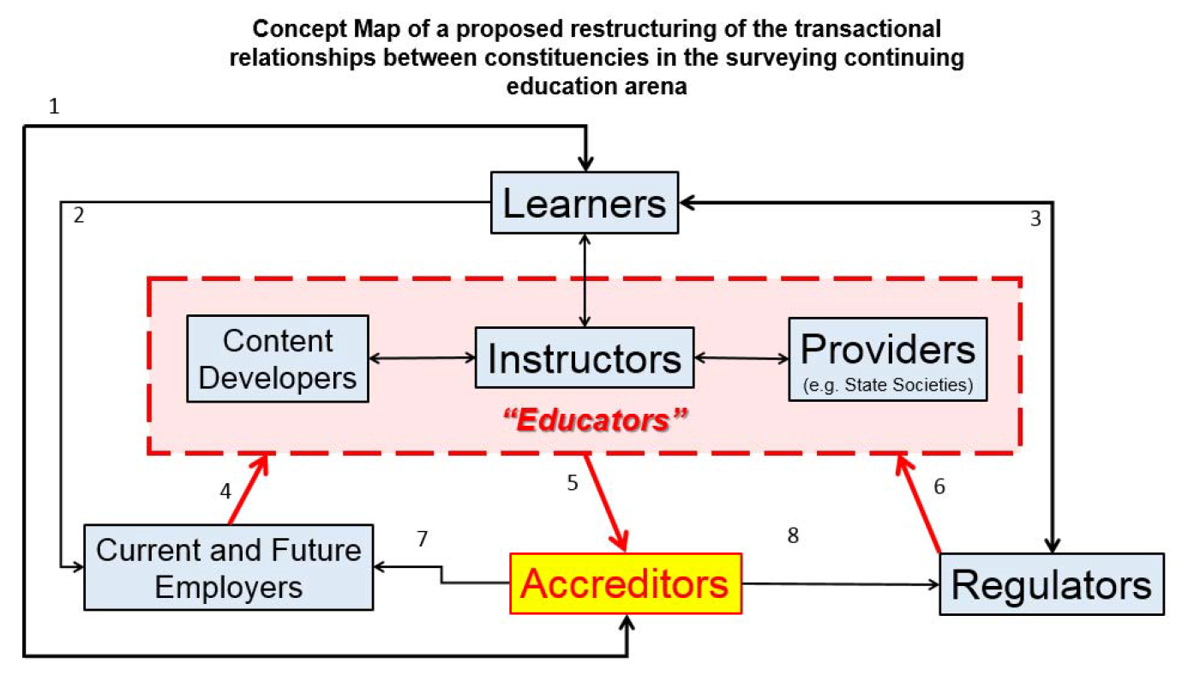
PHASE I: Tomorrow
© A.R. Vannozzi 2019

Slide 9
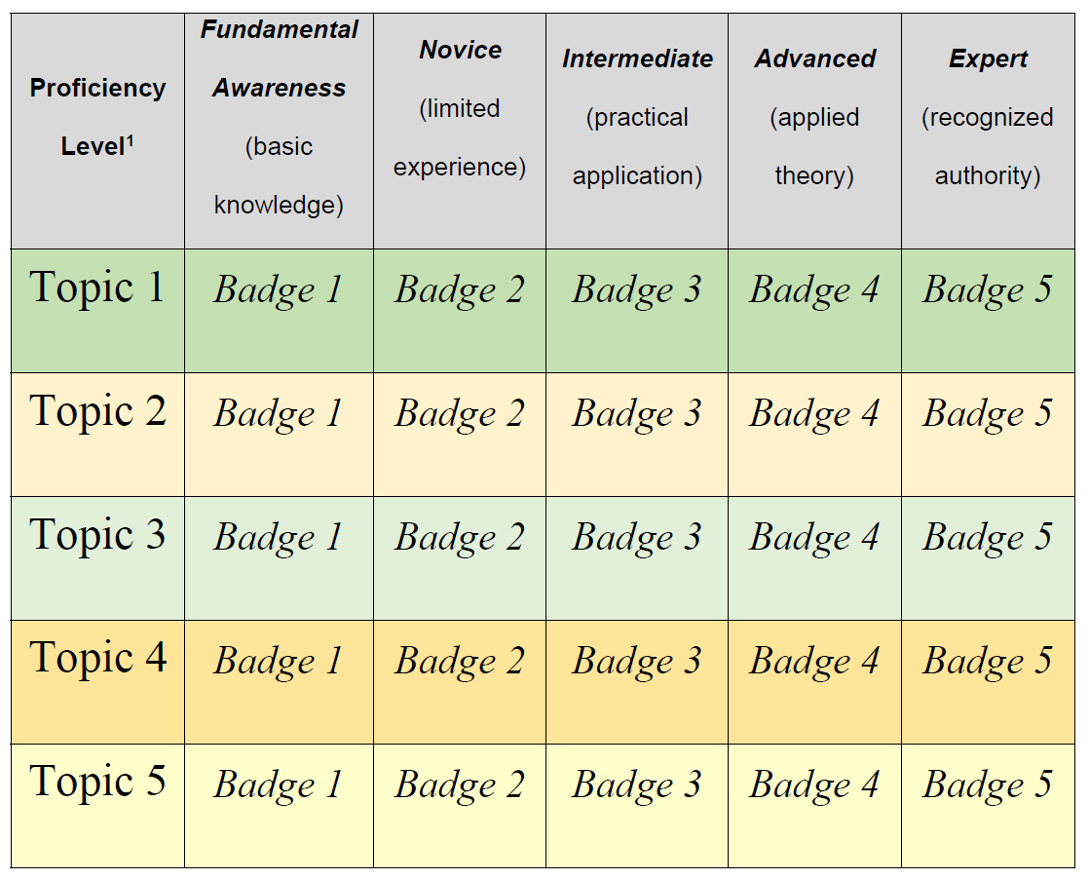
PHASE I: Badging Concept
© A.R. Vannozzi 2019

Slide 10
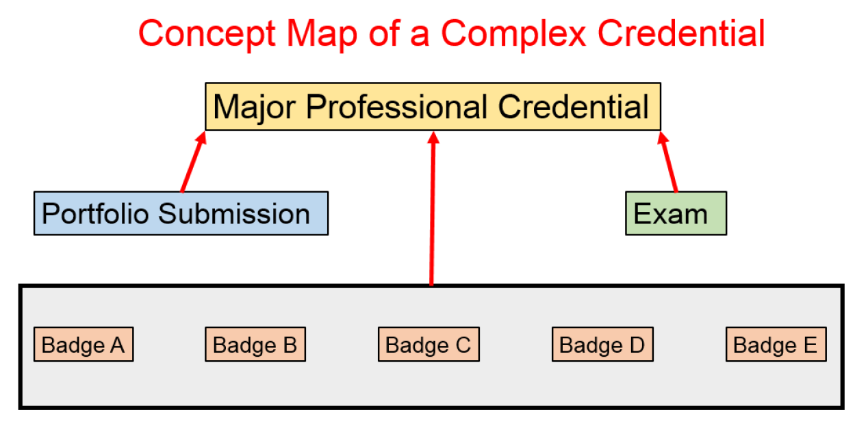
PHASE I: Credentialing
© A.R. Vannozzi 2019

Slide 11
PHASE II: Prototypes
K.I.S.S.! Built in Google Sites:
Basics are free and easy to use;
Scalable;
Easy to duplicate and revise workflows;
User community support is plentiful;
Low chance of becoming obsolete or incompatible with future products.
© A.R. Vannozzi 2019

Slide 12
PHASE II: Prototypes
Utilizes Google Drive:
Storage of Sites and Artifacts;
Scalable;
Drag & Drop;
Easy to use.
© A.R. Vannozzi 2019

Slide 13
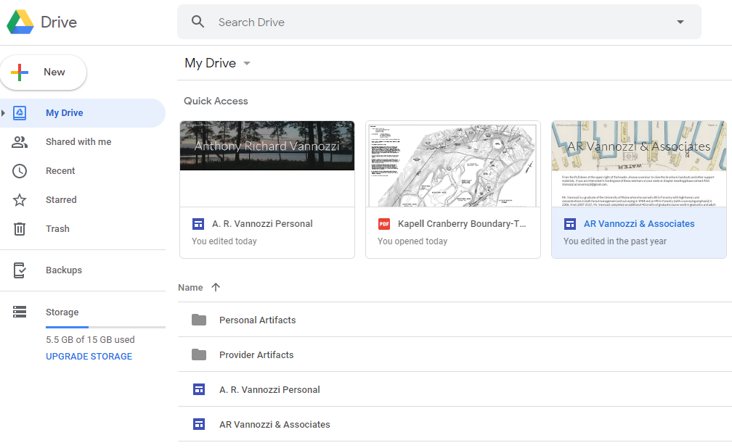
PHASE II: Prototypes: Personal & Provider
© A.R. Vannozzi 2019

Slide 14
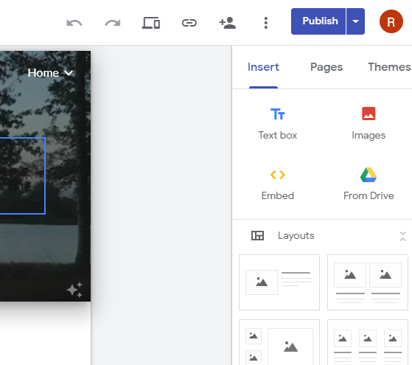
PHASE II: Prototype: Personal
WYSIWYG
Public/Private Settings
© A.R. Vannozzi 2019

Slide 15
PHASE II: Prototype: Personal
Collaboration (Share)
Send link to view
Preview
© A.R. Vannozzi 2019

Slide 16
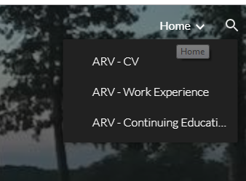
PHASE II: Prototype: Personal
Typical Landing Page
Pulldown to organize info
© A.R. Vannozzi 2019

Slide 17
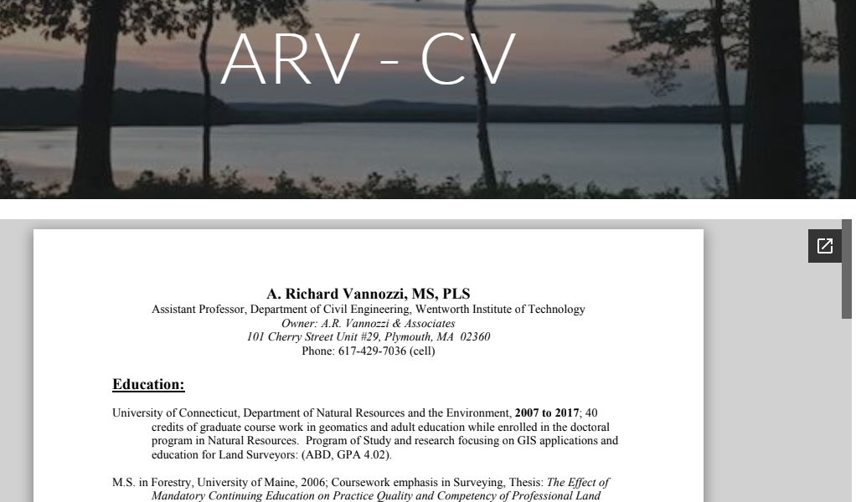
PHASE II: Prototype: Personal
© A.R. Vannozzi 2019

Slide 18
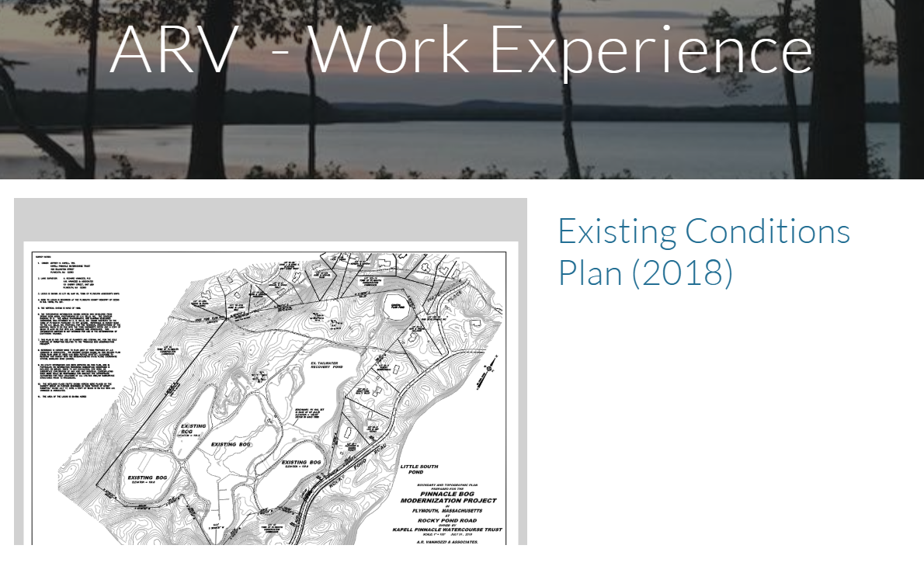
PHASE II: Prototype: Personal
© A.R. Vannozzi 2019

Slide 19
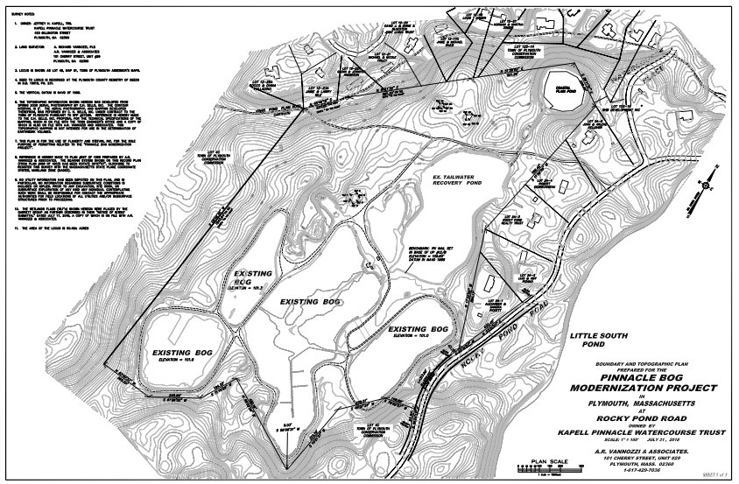
PHASE II: Prototype: Personal
© A.R. Vannozzi 2019

Slide 20
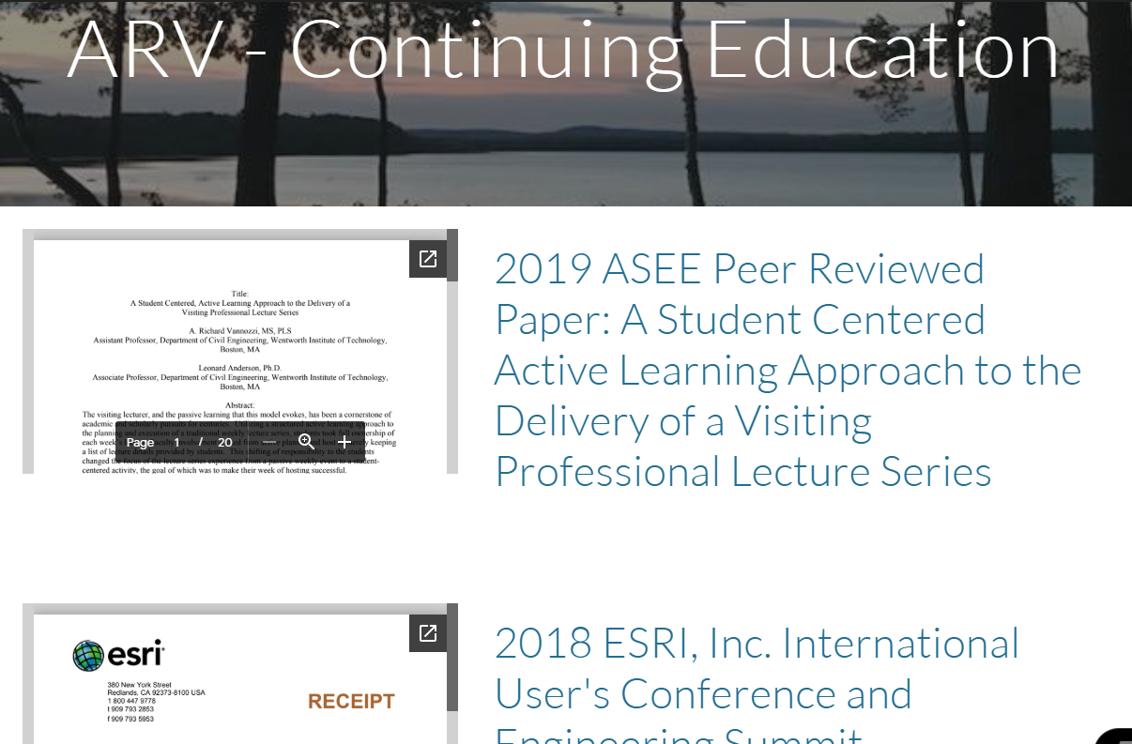
PHASE II: Prototype: Personal
© A.R. Vannozzi 2019

Slide 21
PHASE II: Prototype: Personal
© A.R. Vannozzi 2019

Slide 22
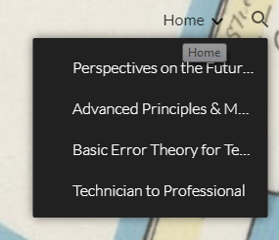
PHASE II: Prototype: Provider
Typical Landing Page
Pulldown to organize info
© A.R. Vannozzi 2019

Slide 23
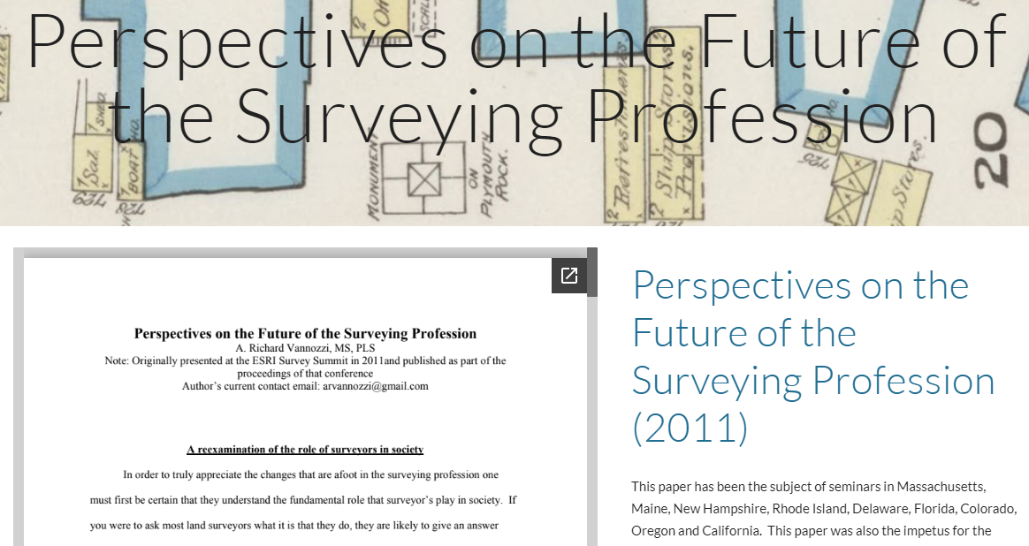
PHASE II: Prototype: Provider
© A.R. Vannozzi 2019

Slide 24
PHASE II: Prototype: Provider
© A.R. Vannozzi 2019

Slide 25
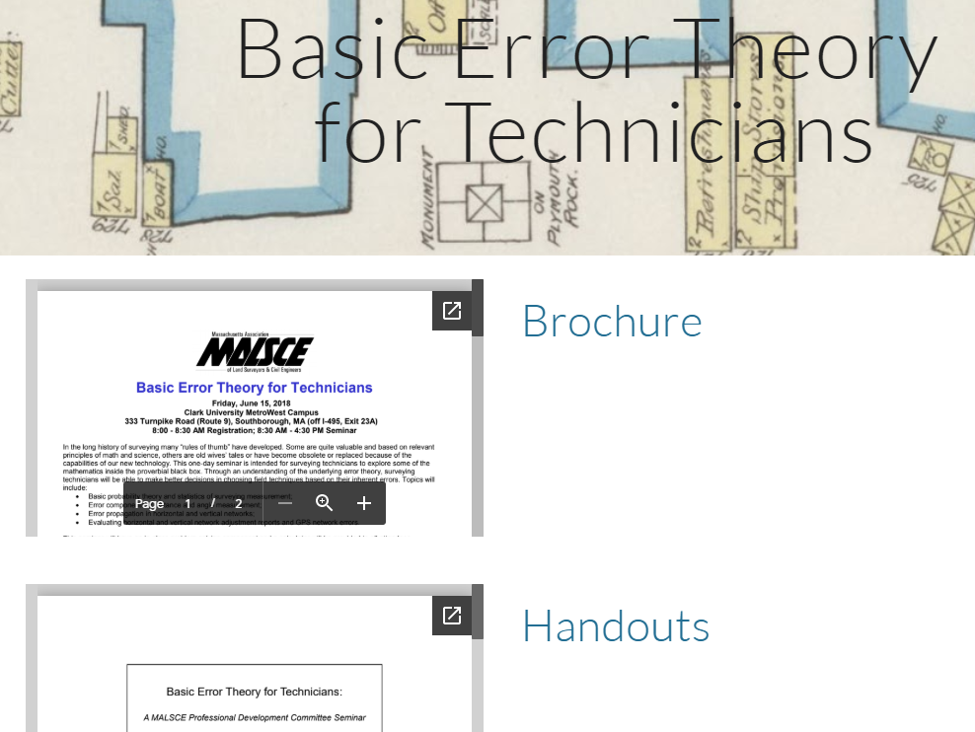
PHASE II: Prototype: Provider
© A.R. Vannozzi 2019

Slide 26
Implementation: Phase over time
Start with students;
Capture all activities without having to reach back
More opportunity to use
Young Surveyors Network;
Particularly engaged professionals
More opportunity to use
© A.R. Vannozzi 2019

Slide 27
Implementation: Phase over time
Providers…a modern “Speakers Bureau” through NSPS;
State association sites;
Current practitioners (limited need: continuing education record);
Boards of Licensure for Audits/Applications.
© A.R. Vannozzi 2019

Slide 28
Working with Students
Introduce in Freshman Seminar/Intro Course;
Include Portfolio-ing to all courses;
Finalize in Capstone;
Use in accreditation;
Google Sites is more portable than those associated with LMS (Blackboard);
NSPS Student Competition.
© A.R. Vannozzi 2019

Slide 29
E-Portfolios, Licensure, Continuing Education and Employment:
The Perfect Storm of Opportunity for the Surveying Student
Questions?
presented by:
A. Richard Vannozzi, MS, PLS
School of Engineering Technology
University of Maine
Orono, Maine
anthony.vannozzi@maine.edu
© A.R. Vannozzi 2019

