Slide 1
Strategies used for recruiting and retention in the Geospatial Informatics educational field
by
Steve Ramroop, Ph.D., GISP
Program Director / Associate Professor,
Surveying and Geomatics Sciences Program,
Geospatial Informatics Department,
Troy University,
Presented at
2019 Surveying and Geomatics Educators Society (SaGES) Conference
August 04 – August 08, 2019
• Nicholls State University •
Thibodaux, Louisiana

Slide 2
CONTENTS: Introduction (myself) Introduction (paper) Brief history of the Surveying and Geoamtics Sciences Program, Troy University Program Characteristics Curriculum packaging Student Base Program Stake Holders Recruiting strategies Closing remarks References

Slide 3
Introduction (myself)
Dr. Steve Ramroop has been teaching at Troy University for the past 16 years, ungraduated students in the field of Geospatial Informatics.
He has extensive experience in the field of Land Surveying which was his first degree, and specialized experience in the field of Geographic Information Systems (GIS) which was his MSc, and PhD degrees. His credentials are as follows:
  Doctor of Philosophy (PhD) in GIS, 2002. University of Otago, Dunedin, New Zealand.
  Master of Science (MSc) in GIS, 1995. International Institute for Aerospace Survey and Earth Science, Enschede, The Netherlands.
  Bachelor of Science (BSc) in Land Surveying, 1992. University of the West Indies, St. Augustine, Trinidad.
Dr. Ramroop is a certified GIS professional (GISP) since 2011. His research area of interests lies in the following areas: Georesource sharing; Interoperability; GIS application development using multiple geodata sources; Remote Sensing; Photogrammetry; LIDAR.
Dr. Ramroop published in numerous journals; gave presentations at conferences; journal reviewer in his specialized field of research interest; symposium organizer; GIS sensitizing to students in High School and Community Colleges.
Dr. Ramroop is an Associate Professor, and the Program Director for the Surveying and Geomatics Sciences Program at Troy University.

Slide 4
1.0 Introduction
  Brown (2018) has expressed a common concern, a senior lecture at Stockholm University, stated “Outside of our community, and arguably even within our wider community, the term ‘geomatics’ is unfamiliar.”
  Ajvazi et. al., (2016) stated that the land surveying profession fast changes have been taking place in the last fifty years.
  “The traditional top-down approach substituted by bottom-up methodologies; in many cases the point-by-point measurement is changed by 3D laser scanning or Unmanned Aerial Systems, which produces huge amount of data, but it needs new algorithms for information extraction; instead of a simple data provision land surveyors support complex spatial decisions.”
  Bednarczyk (2017) discussed that the advent of widespread use of mobile devices (smartphones, tablets), which, in fact, are computers with quite big computing power and many sensors, made it possible to implement virtual reality in completely different way called Augmented Reality (AR).
  In this article is discussed the strategies are explained in terms of their characteristics, and their implementations within the context of the historical development of the Surveying and Geomatics Sciences Program at Troy University

Slide 5
2.0 History of the Surveying and Geomatics Sciences Program, Troy University
1998 The Program was created within the Department of Social Sciences, with one full-time professor and two adjunct faculty members. A Bachelor of Social Sciences degree, with a Geomatics concentration, was awarded to graduates. The first graduates with a Geomatics concentration graduated in 2002.
2000 The Program was restructured under the Department of Mathematics, Physics, Computer Sciences and Geomatics, as a Bachelor of Science degree with a Geomatics Major.
2003 The additional faculty member in Geomatics was appointed in August 2003. A GIS minor was added to the curriculum for non-Geomatics majors.
2005 Upon the Program Director’s return to his home state, the remaining full-time faculty member was appointed the interim Program Director, and a search for another faculty member began.
2007 The interim Program Director was appointed Program Director and a Professional Land Surveyor who had been serving as an adjunct faculty member since the start of the program was appointed full-time.
2008 A third faculty member with a terminal degree in Geodesy was appointed.
2009 The Program’s name was changed from “Geomatics” to the current name “Surveying and Geomatics Sciences.”
2010 A third faculty member was added to the faculty. The Program was changed from a Major to a degree Program. After a comprehensive curriculum review, the Major consisting of 47 hours in Surveying and Geomatics Sciences courses, was changed to a degree Program consisting of 59 hours in Surveying and Geomatics Sciences courses.
2010 ABET Self-Study Report submitted on 1st July 2010
2013 Accreditation awarded to the Surveying and Geomatics Sciences Program until 30th September, 2017.
2016 Request for renewal of ABET accreditation submitted by 31st January, 2016
2016 ABET Self-Study Report submitted on 1st July 2016

Slide 6
3.0 Program Characteristics
  Accredited
  Foundation
  Technology driven
  Achievements
  Scholarships
  Geomatics professionals

Slide 7
4.0 Curriculum packaging
The curriculum has the following credentials that are incorporated in our recruiting strategies:
  The full degree program is offered on the main Troy University campus;
  Courses cover all aspects of the NCEES knowledge areas for students to be successful in passing the Fundamentals of Surveying (FS) exam at their first attempt;
  In residence classes are one to one interaction;
  Courses incorporate hands-on usage of cutting edge hardware and software; and
  20 credit hours of Geomatics classes are offered online for students wanting to do a minor, and for working technicians/professionals requiring the minimum credits hours required for they to sit for the FS exam

Slide 8
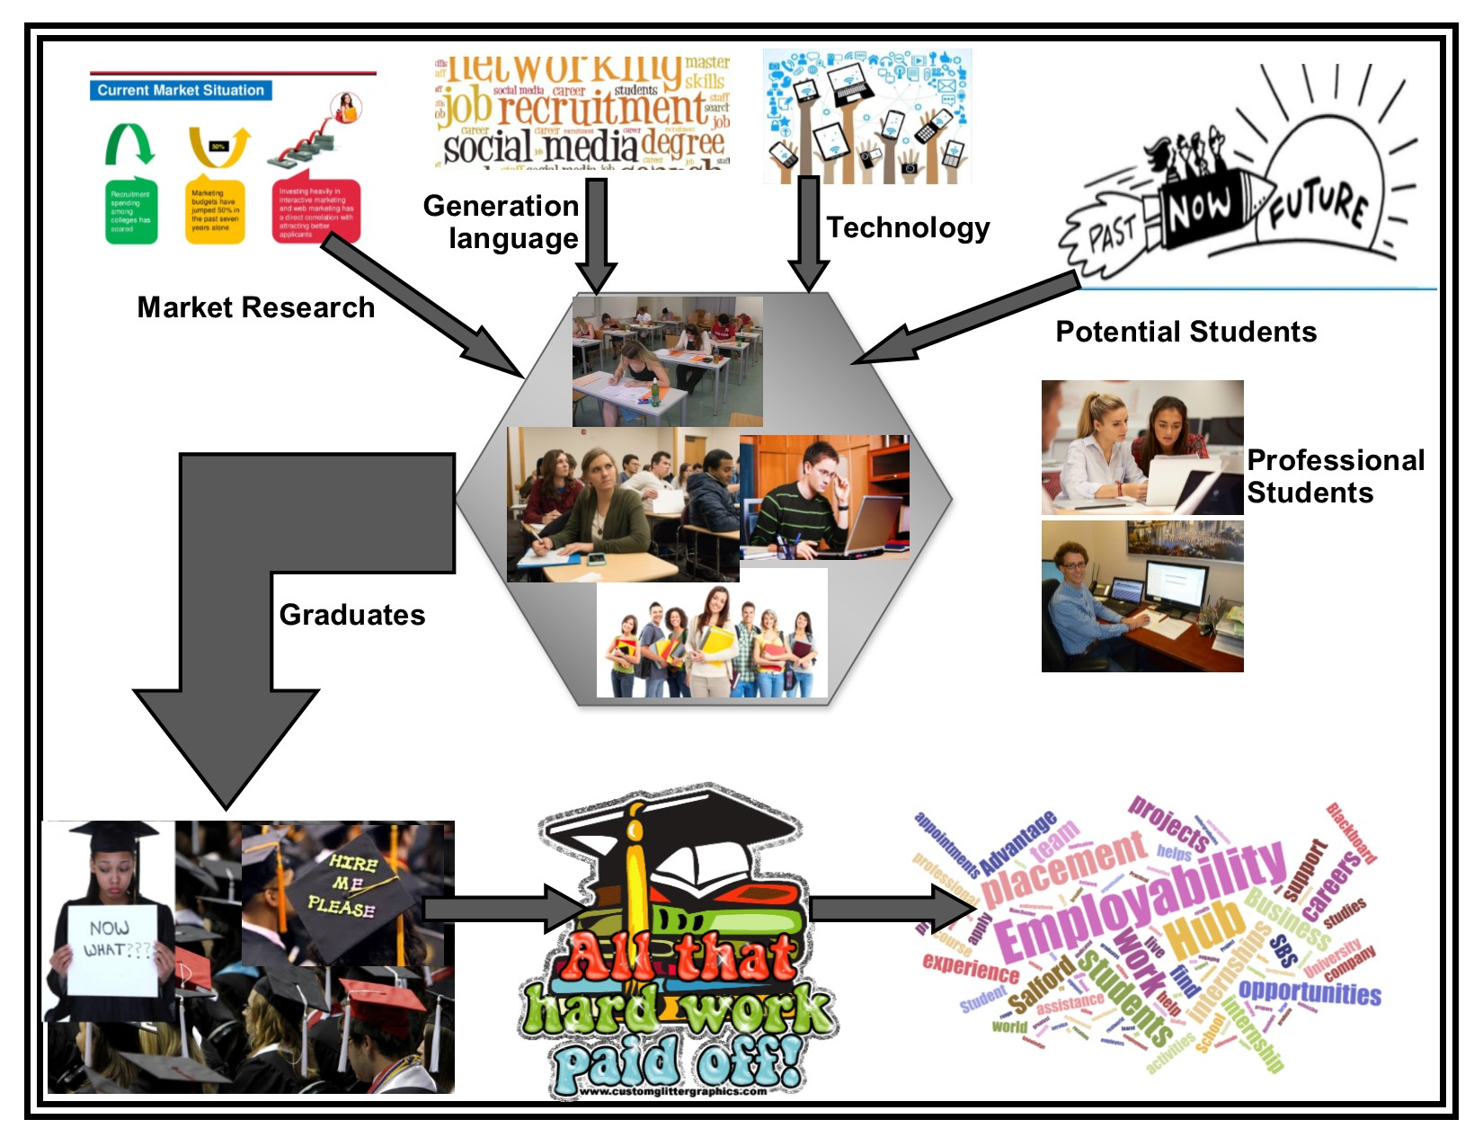
Classification:
Traditional students
Online students
Hybrid students
5.0 Student Base

Slide 9
6.0 Program stake holders
  Students
  Employers
  Professional societies
  Licensure board
  National Council of Examiners for Engineering and Surveying

Slide 10
7.0 Recruiting Strategies
  Drop and recruit
  Curriculum offering and language
  Departmental Sensitizing
  Planned University events
  Community outreach
  Internet and social media
  Stake-holder integration

Slide 11
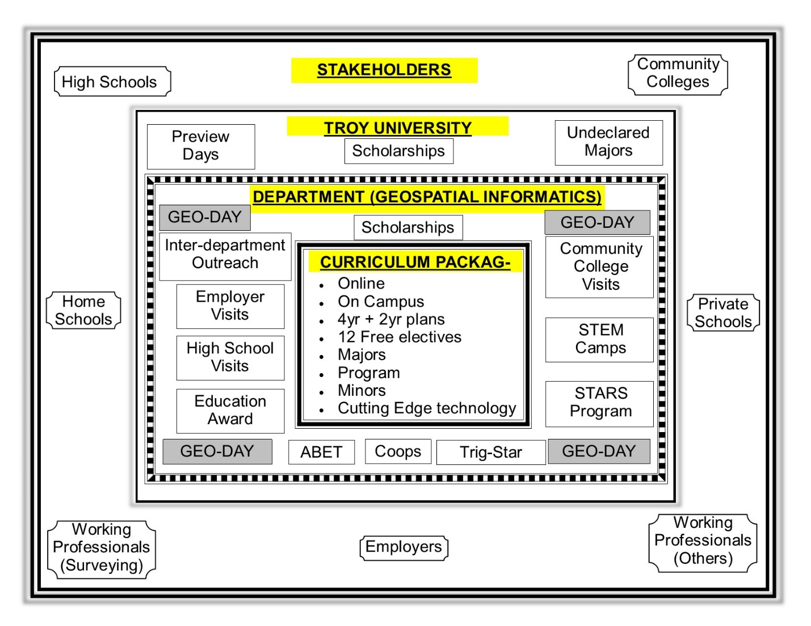

Slide 12
8.0 Closing Remarks
Lessons learnt has over the years has been tremendous and be classified as work in progress.
Continued due diligence, commitment, and passion for the field of Geospatial Informatics are all essential ingredients to its success.
The way forward is one which is dependent upon by the Department’s personnel on board and their motivation in making reality our share goals and aspirations of the multitude of Geospatial Informatics professions.

Slide 13
9.0 References
Elithorp, James A, Jr. “A student recruitment program for geomatics,” Surveying and Land Information Science; Gaithersburg Vol. 63, Iss. 3, (Sep 2003): 173-181.
Brown, Ian, Sep 2018. “How Can We Attract Students to Geomatics?”GIM International, gim-international.com are published by: Geomares, P.O. Box 112, 8530 AC Lemmer
Vuurtorenweg 18 B, 8531 HJ Lemmer, The Netherlands.
Ajvazi, Besim, Loshi, Fisnik and Márkus, Béla (2016). “From Surveying to Geomatics,” Landscape & Environment, 10 (3-4), page 153-160.
Bednarczyk, Michał (April 2017). “The Use of Augmented Reality in Geomatics.” “Environmental Engineering” 10th International Conference Vilnius Gediminas Technical University, Lithuania, 27–28 April 2017, http://enviro.vgtu.lt
Abdalla, Rifaat (February 2019). “Introduction Chapter: From Land Surveying to Geomatics - Multidisciplinary Technological Trends.” E-Learning Strategies for Geomatics Students. IntechOpen, publisher of Open Access books.
Brown, Ian (April 2019). “How Can We Attract Students to Geomatics?” GIM International. Geomares, P.O. Box 112, 8530 AC Lemmer, Vuurtorenweg 18 B, 8531HJ, Lemmer The Netherlands

Slide 14
… The End …
Questions???

