Slide 1
LDPs: Another Look
Thomas H. Meyer
SaGES 2019 Thibodaux, LA

Slide 2
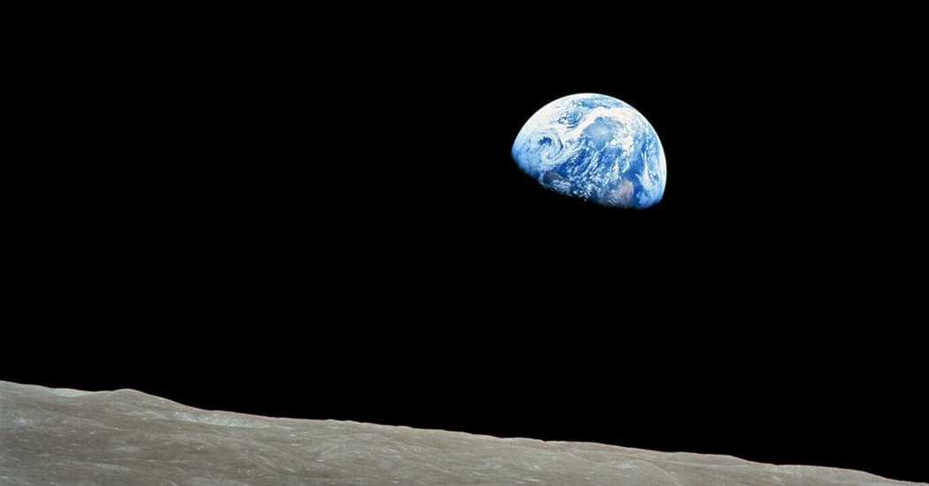
Raison d’être for map projections
It’s round

Slide 3
Distances on spheroids are not easy
distance along which kind of curve?
great ellipse? normal section? loxodrome? curve of alignment?
geodesic: for Clairaut’s constant c and $θ=\arcsin\left(\left[\sin{φ}\right]/k\right)$
$$s_{B}−s_{A}=\frac{a\left(1−ε^{2}\right)}{\sqrt{1−c^{2}ε^{2}}}\int_{θ_{A}}^{θ_{B}}{{\left(1−k^{2}ε^{2}\sin^{2}{θ}\right)}^{−3/2}dθ}$$
$$k=\sqrt{\frac{1−c^{2}}{1−c^{2}ε^{2}}}$$
This is an elliptic integral
think of these as mile markers along the geodesic

Slide 4
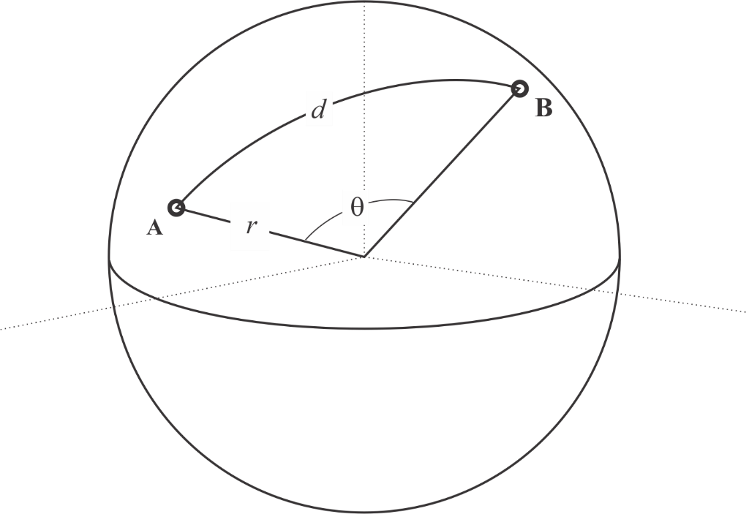
Distances on a sphere : easy
distance along a circle : $d=r θ$
arc length of a great circle from stations A to B on a sphere
$$s_{B}−s_{A}=r θ \\ =r\operatorname{acos}\left(A∙B/\left(\left|A\right|\left|B\right|\right)\right)$$
XYZ coordinates

Slide 5
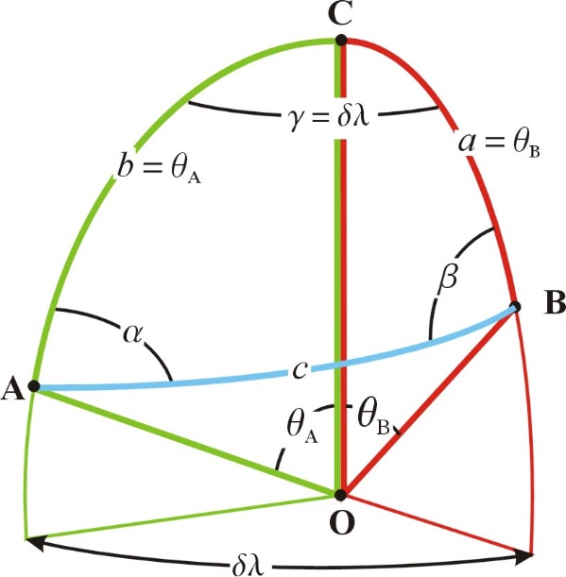
Sphere directions
Directions along a great circle available using spherical trig or vector methods.

Slide 6
Curves: not ideal
Working with directions and distances on curved surfaces is not familiar to most of us.
We’d rather work with planar geometry.

Slide 7
Planes are easy, or, at least, familiar
distance between two stations on a straight line:
$$d=\sqrt{{\left(x_{B}−x_{A}\right)}^{2}+{\left(y_{B}−y_{A}\right)}^{2}}$$
direction between two stations on a straight line:
$$α=\operatorname{atan}\left( \frac{x_{B}−x_{A }}{y_{B}−y_{A }}\right)$$

Slide 8
Planes are what we want.
Curves are what we have.
Map projections are the solution.

Slide 9
A map projection is..
N.B. on the spheroid!
A projection which maps a sphere (or spheroid) onto a plane.
-- Weisstein, Eric W. "Map Projection." From MathWorld--A Wolfram Web Resource.
http://mathworld.wolfram.com/MapProjection.html

Slide 10
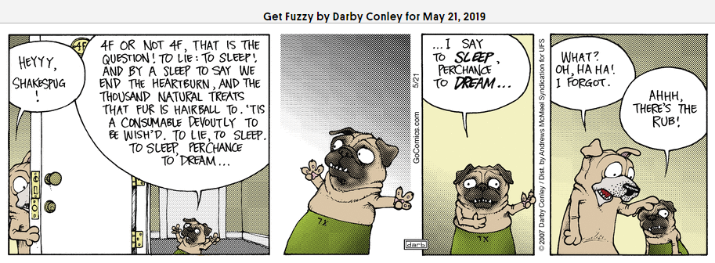
Here’s the rub
We make observations wherever we happen to be,
which is often not on our reference ellipsoid
GRS 80 as placed by whichever NAD 83 you’re using, or
GRS 80 as placed by the NATRF 2022, soon to be

Slide 11
Places move farther apart by going up!

Slide 12
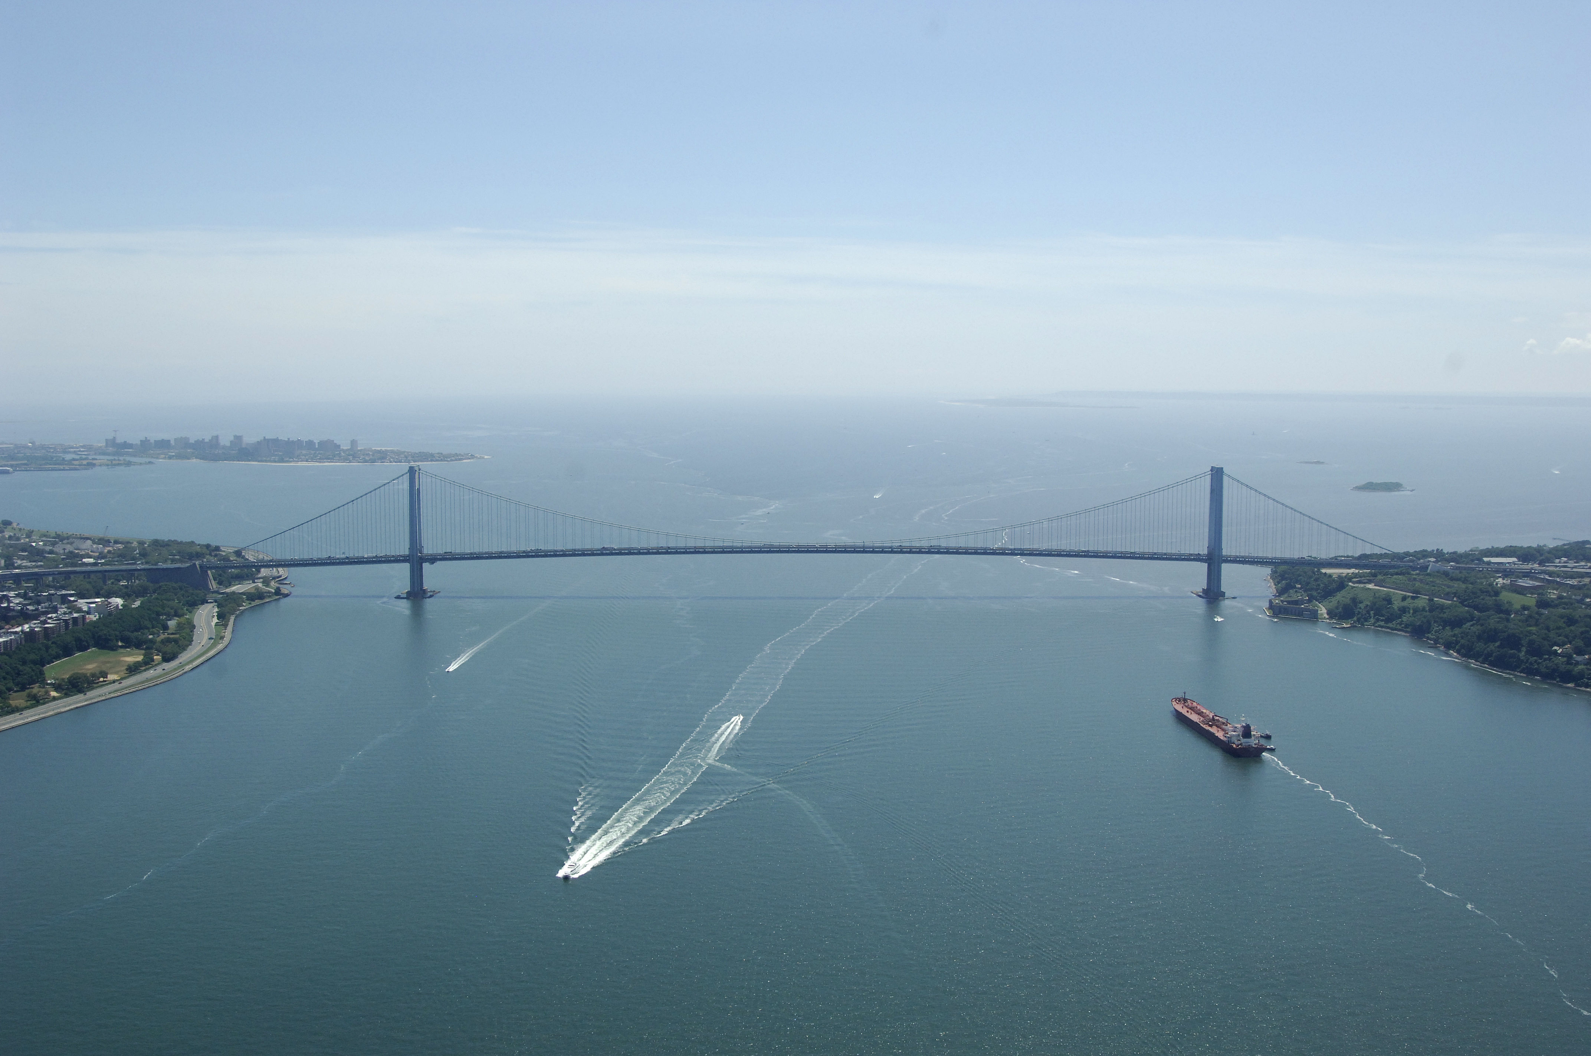
The Verrazano Narrows Bridge
4,260 ft long
deck is 228 ft above mean high water
towers are 693 ft tall
$$towers are 1.5" farther apart at top than at the deck$$

Slide 13
Separation vs Elevation

Slide 14
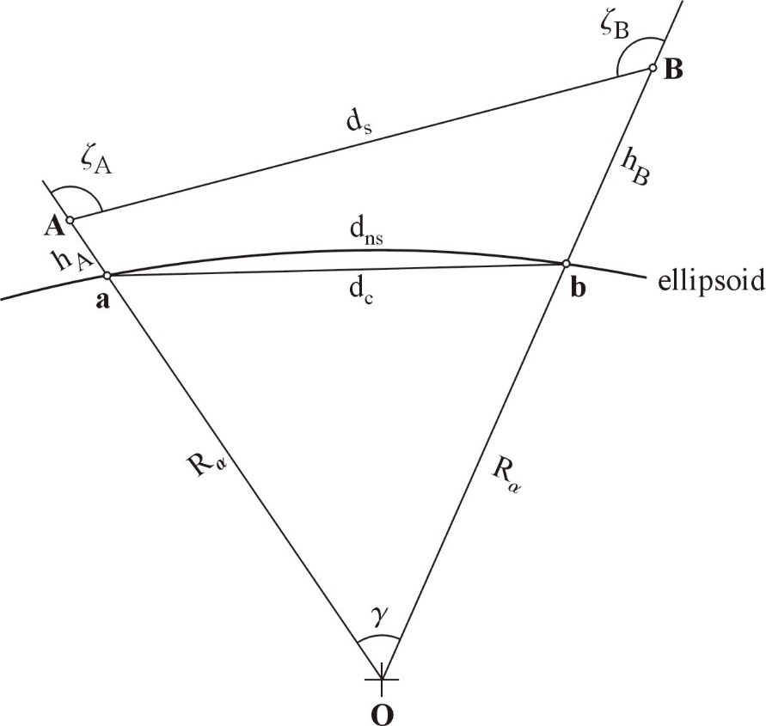
Reduce Slant Distance: Seldom Done
not a circle (it’s a normal section)
these don’t intersect, actually,
so this isn’t a planar figure
these aren’t equal in general
not the geocenter

Slide 15
Reduce Horizontal Distance: Super Simple
$$d_{ground}=\left(R+h\right) θ$$
so
$θ=d_{ground}$/$\left(R+h\right)$
and
$$d_{ns}=R θ$$
Substituting gives
$d_{ns}=d_{ground}\frac{R}{R+h}$
reduction factor

Slide 16
Reduce Horizontal Distance: Issues
This isn’t a planar horizontal distance.
a and b are not usually at the same height.
use the average
What to use for the radius?
$$R_{B}≠R_{A}$$
Stem says use “mean radius of Earth” p. 49
R = 6,372,000 m = 20,906,000 ft

Slide 17
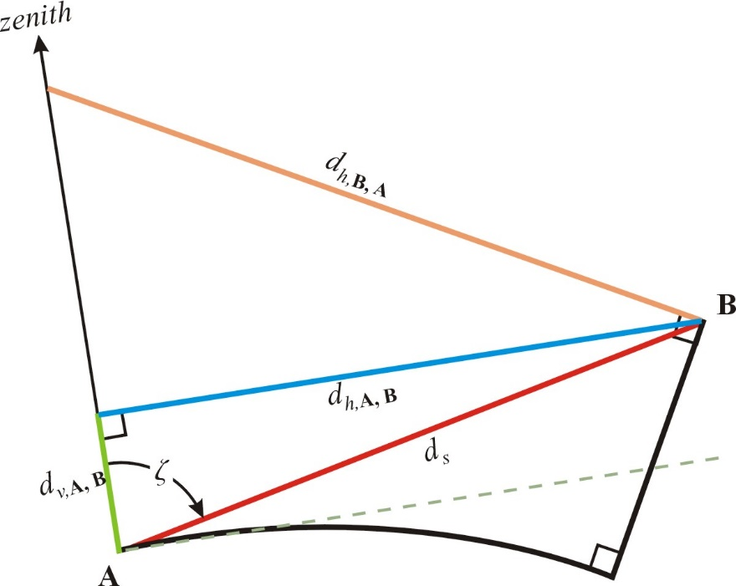
Planar Horizontal Distances Are Ambiguous
We will revisit this in awhile…

Slide 18
Common knowledge
Everybody knows we must reduce distances to the ellipsoid.
But what about angles?

Slide 19
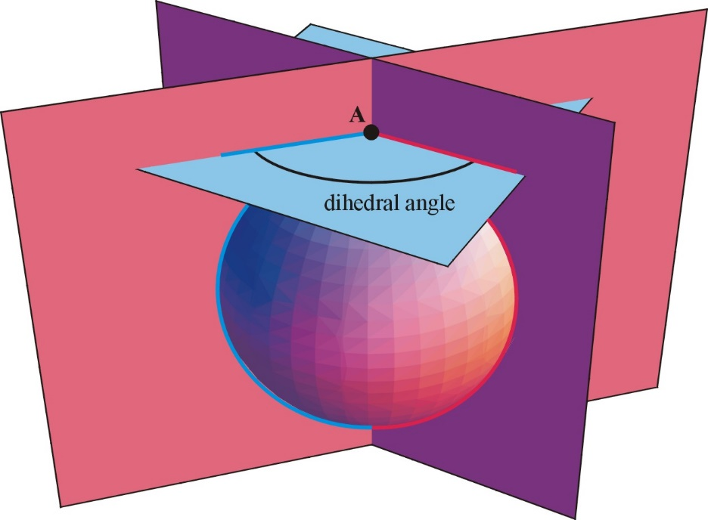
We observe dihedral angles
axis normal to the reference ellipsoid
total station at A
after accounting for the deflection of the vertical…
horizontal surface at elevation as
defined by the total station = perpendicular
to the normal axis
plane containing normal axis and fore sight
plane containing normal axis and back sight

Slide 20
Q?
Are angles observed at elevation the same as those observed on the ellipsoid?

Slide 21
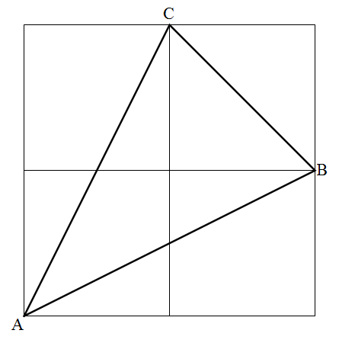
Here’s an example
$$107°W, 36°N$$
$$106°W, 35°N$$
$$108°W, 34°N$$

Slide 22
Dihedral angles
 | A | B | C
h = 1600 m | 36.228698736526186662° | -81.5747261443448773287° | 62.21804979535223139°
h = 0 m | 36.228704976721981022° | -81.5746656459809987242° | 62.21810405351898718°
Abs diff (sec) | 0.02246… | 0.21779… | 0.19533…
Angles at elevation are different than angles on the ellipsoid

Slide 23
For the details, see…
Rollins, C.M. and Meyer, T.H. (in press) Four Methods for Low Distortion Projections. Journal of Surveying Engineering.

Slide 24
Conformality
Conformality is a property of projections that means “to preserve angles between the two surfaces involved in the projection.”
For all map projections to date, the two surfaces are
a reference ellipsoid (or a sphere), and
the mapping surface
Because angles at elevation differ from angles on the ellipsoid,
map projections as we know them today are not conformal unless the observations were observed at h = 0

Slide 25
This bears closer examination
Current map projections map from the ellipsoid to the mapping surface.
For a current map projection to be conformal for observations made at elevation, we must
(first) define an elevated reference surface to be able to correctly discuss conformality – we must define the two surfaces explicitly, and then
(second) show that the projection from the elevated reference surface to the mapping surface preserves angles.

Slide 26
The Elevated Reference Surface
We suggest that explicitly defining an elevated reference surface is natural and beneficial.
Needed to formally analyzing map projections from observations at elevation.
Can provide a non-ambiguous, well-defined meaning for horizontal distance.
Needed when working with vertical distances referred to, say, the ground.

Slide 27
Choices
We believe choosing a “serious” Earth model is best: has non-constant Gaussian curvature
eliminates cylinders, cones, planes
Possibilities
An ellipsoid of revolution whose parameters are chosen to fit the (elevated) area-of-interest,
An equipotential surface,
A surface of constant h offset from the reference ellipsoid, a constant-h surface

Slide 28
Back to Horizontal Distance
Now, given an elevated reference surface,
we define the horizontal distance between two points to be the arc length of the (shortest) geodesic in the elevated reference surface between the projections of the points on to the elevated reference surface.
This definition provides an unambiguous meaning for horizontal distance,
although it depends on which elevated reference surface was chosen.

Slide 29
From Stem SPCS
State plane coordinates are derived from latitudes and longitudes. Latitudes and longitudes are based on an ellipsoid of reference and a horizontal datum that approximates the surface of the Earth. Accordingly, field observations measured on the ground must first be reduced to the surface of the horizontal datum before they are further reduced to the map-projection surface—the grid.
this is the surface of the ellipsoid as placed by the datum

Slide 30
Low-Distortion Projections
Surveyors are trained to apply reductions between using observations to produce, for example, State Plane Coordinates.
It is possible to craft map projections to minimalize, or even eliminate, the need to apply reductions, within tolerances.
Such projections are called low-distortion projections (LDP)

Slide 31
Four Methods
We present four methods of creating LDPs and analyze them.
The first method is not new, the others are new.
We use the constant-h surface for our elevated reference surface.

Slide 32
Constant-h surface
A surface offset by a constant distance from an ellipsoid is not itself an ellipsoid.
Latitudes and longitudes on a constant-h surface are identical to the latitudes and longitudes of corresponding points on the ellipsoid.

Slide 33
LDP Method 1
Because, for a constant-h surface, the latitudes and longitudes at elevation equal those on the ellipsoid, simply use those coordinates as the inputs to the traditional formulas of a conformal projection of the ellipsoid.
We call the offset of the constant-h surface the “design height” and denoted it by $h_{0}$

Slide 34
Use lon, lat at elevation in the map projection based on a reference ellipsoid

Slide 35
Analysis
It is possible to derive the east-west scale factor and the north-south scale factor of this projection.
These scale factors are not equal.
Method 1 is not conformal from the elevated reference surface to the mapping surface.
This result is fully general. In particular, it does not depend on the parameters, or even the kind of projection (we assume a traditionally conformal projection was chosen), that was used for the mapping.

Slide 37
How bad is that?
If applied to a place at $30°$N at h = 2500 m,
the degree of non-conformality would be about the same as
creating a map in an otherwise perfect mapping plane, and
using International Feet on the x-axis and
using US Survey Feet on the y-axis.

Slide 38
LDP Method 2: the ellipsoid-for-elevation
A constant-h surface is not an ellipsoid, but it is close to one.
We call that ellipsoid the ellipsoid for elevation.
Ref the reference ellipsoid:
same origin and same orientation
axes are elongated by the LDP design height $h_{0}$
changes to $a, ε^{2}$
This is an auxiliary ellipsoid
NOT a reference ellipsoid, nothing to do with the datum
Part of the internal logic only

Slide 39
$$φ^{′}and φ$$
Geodetic latitude on the ellipsoid for elevation:
$$φ^{′}=φ+\frac{h_{0} a ε^{4}\sin{(4φ)}}{16{(a+h_{0})}^{2}}$$
Reveals that ${|φ}^{′}−φ|$ < 0.2 milliseconds for $h_{0}=1600$ m.
We can say $φ^{′}≅φ$

Slide 40
Procedure Method 2
Previous eq. not used
to provide $φ′$
EfE instead of
reference ellipsoid
use $a′$ and ${\left(ε^{′}\right)}^{2}$

Slide 41
Analysis
It is possible to derive the east-west scale factor and the north-south scale factor of Method 2.
These scale factors are not equal, but they are almost equal.
Method 2 is an improvement on Method 1.

Slide 43
LDP Method 3: tweak the latitude
Method 2 tweaked only the map-projection parameters.
Method 3 tweaks both the map-projection parameters and the latitude being projected.
$$φ^{′}=φ+\left(\frac{h_{0}ε^{4}}{16 a{\left(1+h_{0}/a\right)}^{2}}\right)sin(4φ)$$

Slide 44
Analysis
It is possible to derive the east-west scale factor and the north-south scale factor of Method 3.
These scale factors are not equal, but Method 3 is better than Method 2.

Slide 47
Method 4: A conformal LDP
At the time we wrote the paper, deriving actually conformal LDP formulas had not been done.
They are now done, but were not done in time for our paper.
Alas.

Slide 48
Remarks
See our paper in JSE for a worked-out example for Albuquerque, NM.
Improving conformality is at odds with simplicity.
Method 2 is our recommendation (today)
has much less non-conformality than Method 1,
uses well-known map-projection formulas,
no new formulas for coders to implement
has only one design parameter, $h_{0}$, beyond those of the map projection
we promote the idea of explicitly defining $h_{0}$ and stipulating the elevated ref. surface.

Slide 49
Remarks, continued
Method 3
has much smaller non-conformality than Method 2,
uses well-known map-projection formulas, but
requires new formulas for coders to implement,
has only one design parameter, $h_{0}$, beyond those of the map projection.
Method 4
Exactly conformal
Most complicated
Not published yet

Slide 50
Future Work
Determine $h_{0}$ in practice in concert with the map-projection parameters.
Somewhat complicated, multi-dimensional optimization problem.
Work out suites of practical comparisons of the four methods for comparison and for didactic purposes.
Work out conformal map projections.
Analyze other choices for the elevated reference surface.

