Slide 1
Accuracy assessment of small UAS surveys and the role of GCPs with and without GNSS-PPK positioning
Dr. Dimitrios Bolkas; dxb80@psu.edu
Department of Surveying Engineering, Pennsylvania State University, Wilkes-Barre Campus
SaGES Conference 2019
Thibodaux, LA
Notes:
Images collected from unmanned aerial systems (UASs) offer the means to create point-clouds and elevation models of high resolution and accuracy. However, accuracy of derived models varies based on several parameters such as flying height, direct geo-referencing versus ground control points, camera settings during data-acquisition, type of camera and camera calibration, shadow areas, and scene complexity. Understanding how these factors affect errors in elevation models, as well as the spatial distribution of these errors, can be important in order to understand limitations of collected data. This workshop aims to investigate how these factors affect the accuracy of UAS surveys and provide best practices for field data acquisition.
Course Objective
How camera calibration affects UAS accuracy
How target-scene affects UAS accuracy
How the number of ground control points affects UAS accuracy
Ground control point versus direct geo-referencing
Flying height and UAS data processing
Anticipated Learning Outcomes: Participants will:
Understand how discussed factors affect elevation accuracy
Understand the difference in accuracy between ground control point and direct geo-referencing
Learn best practices for field data acquisition

Slide 2
Introduction
Dimitrios Bolkas, PhD
Assistant Professor of Surveying Engineering
Engineering degree: Rural and Surveying Engineering, Aristotle University of Thessaloniki, Greece
Ph.D. in Geological Sciences and Geological Engineering, Queen’s University, Kingston, Canada
Research interests:
Laser scanning
Unmanned aerial systems
Earth monitoring applications
Geoid and gravity-field modeling
Virtual environments and virtual reality

Slide 3
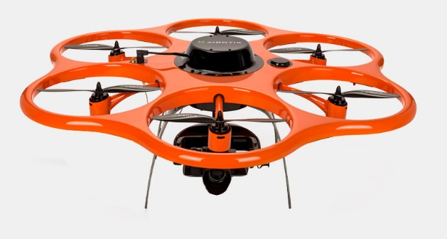
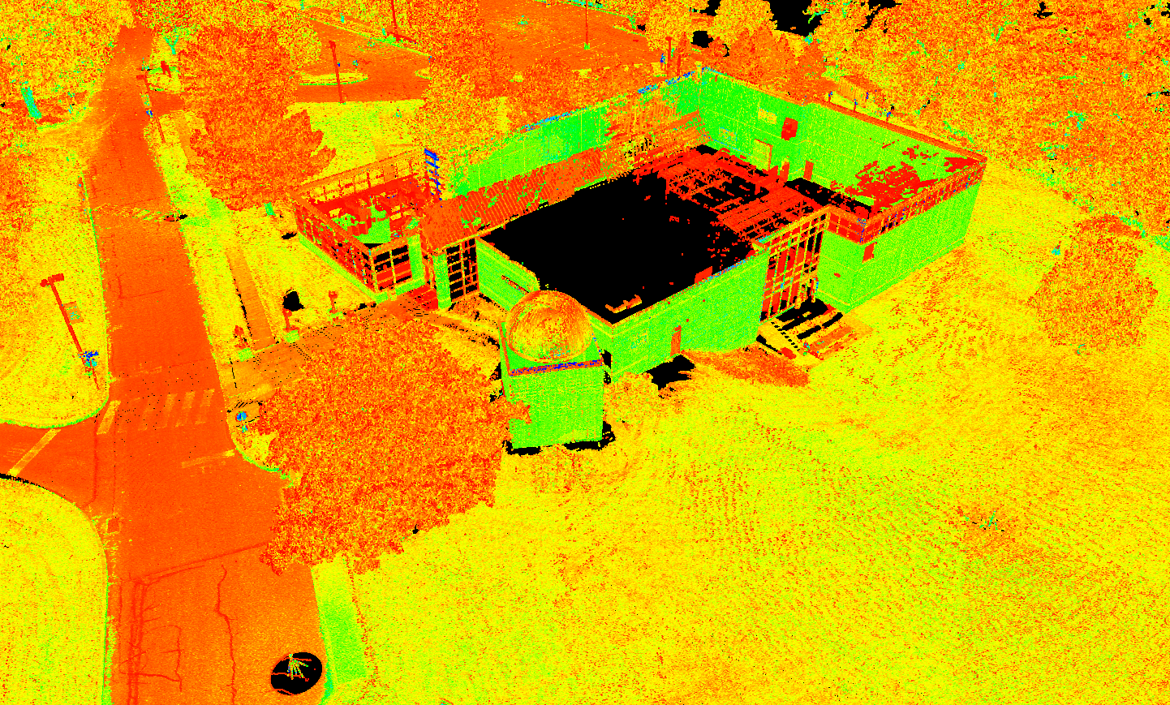
Outline
Motivation
Objectives
Unmanned aerial system (UAS) and data
Ground control point (GCP) scenarios
Assessment Data
Results on UAS accuracy
Conclusions

Slide 4
Motivation
Knowing the accuracy of sUAS derived elevations is important for several applications
Accuracy of photogrammetric UAS surveys can vary based on (Eltner et al. 2016):
Type of digital camera and camera self-calibration
Flying height
Target scene, texture, shadows
Number of images and their overlap (geometry)
Image matching performance (software)
Number of ground control points (GCPs) for geo-referencing
Notes:
such as topographic mapping, earthwork volume calculations, landslide and rockslide monitoring, and detecting building damage

Slide 5
Objectives
Impact of GCPs on elevation accuracy of sUAS surveys
Utility of having survey-grade GNSS-kinematic positioning

Slide 6
Previous Studies
GCP-only
High accuracy with 3-4 GCPs (~20 GCP/km²)
Accuracy significantly degrades even when using 4, 5, or even 9 and 15 GCPs
Direct Geo-referencing
<10 cm (~4 in) with no GCPs
GCP+GNSS
3-6 cm (1-2.5 in) with 1 GCP
Notes:
Include oblique
that high accuracy can be maintained with at least 3-4 GCPs (or more than ~20 GCP/km²), if these are evenly distributed in the study area and high overlap of images exists (Shahbazi et al. 2015; Tonkin and Midgley 2016; Gindraux et al. 2017)
3-6cm from a 90-m altitude flight with 2-cm ground spacing

Slide 7
Processing Workflow
Images
Initial alignment of Photos and camera self-calibration
Automatic detection of tie points
Manual GCP addition
Refinement of alignment, camera self-calibration, and geo-referencing
Dense point-cloud generation
Dense point-cloud
DEM generation
DEM
Notes:
Both ‘ traditional’ photogrammetry and SfM
approaches use bundle adjustment optimization, but typically
differ in whether the control data are used prior to, and within,
the bundle adjustment process (photogrammetry), or only after
bundle adjustment in the form of a separate coordinate transfor-
mation (SfM
In contrast, typical SfM approaches use significantly fewer
control points because the 3D model is built from information
in the image set alone (‘inner constraints’only). Control data are
then used to scale and orient the model to the‘real’ coordinate
system, but do not contribute to reducing any distortion of the
model shape. Nevertheless, convergence between the workflows
of the photogrammetric and computer vision communities is
increasing, andseveral SfM-based applications now allowcontrol
measurements to be included in the bundle adjustment.
Quality levels this is manual input;
Processing of the images was conducted with Agisoft Photoscan software. Image alignment was achieved using automatically selected tie points; the 90 m flight utilized ~25,000 points, and the 50 m flight utilized ~80,000 points.

Slide 8
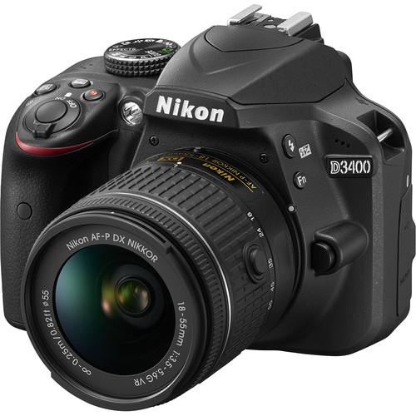
sUAS: Equipment
Aibot X6
Take-off weight 4.6-6.6 kg
GNSS-RTK
Flight time 8-10 minutes with one battery set
https://aibotix.com/products/aibot-x6
Nikon D3400
24.2 Megapixels
Focal length: 18-55 mm
Weight: 395 grams + 265 grams = 660 grams
https://www.nikonusa.com/en/nikon-products/product/dslr-cameras/d3400.html

Slide 9
Flight Parameters
Date: October 1 2017
Two flights: 90 m (300 ft) and 50 m (160 ft)
Nadir Images only
Camera settings
18 mm focal length
Shutter speed 1/1,000
Ground speed of 3/m sec
Aperture f/3.5-5.9
ISO 400
Notes:
; results in 3 mm sensor motion
The two flights took place around noon to utilize overhead sunlight and to avoid long shadows.
3.5m/sec is the sweet spot, this is what aibotix says, this is what I found as well

Slide 10
Flight Parameters (Cont.)
Photograph overlap was set to 70% forward and 50% side
90 m (300 ft)
50 m (160 ft)
22 pictures
57 pictures
Notes:
The two flights took place around noon to utilize overhead sunlight and to avoid long shadows.

Slide 11
sUAS Study Area and Control
Penn State Wilkes-Barre
23 GCPs
Area 2.25 ha
250 m (820 ft)
90 m (300 ft)
Notes:
. Post-adjustment standard deviations where at the level of 1 mm for easting and northing coordinates, and 2 mm for elevations. The coordinate system is the North American Datum 1983 (NAD83) (National Adjustment of 2011), State Plane Coordinate System, Pennsylvania North Zone. Orthometric heights, with respect to the North American Vertical Datum (NAVD) of 1988, are computed using an average geoid value of -32.727 m. The geoid value is derived from the National Geodetic Survey (NGS) geoid model GEOID 12B (NGS 2012).

Slide 12
GCP Scenarios
0 GCPs
1 GCPs
2 GCPs
3 GCPs
4 GCPs
5 GCPs
(a), (b), (c), and (d) are tested for the case of GNSS-assisted geo-referencing

Slide 13
GCP Scenarios (Cont.)
6 GCPs
8 GCPs
12 GCPs
16 GCPs
20 GCPs
23 GCPs

Slide 14
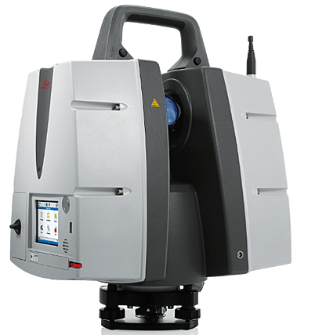
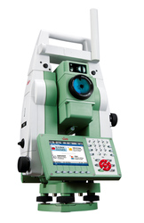
Assessment Data
Leica Scanstation P40
Average point spacing of 0.5 cm to 1 cm
Total station Leica TS 15: 93 Checkpoints
Notes:
The TLS point-clouds were collected on June 6 2017 using a Leica Scanstation P40 with resolution of 2 mm at 10 m. TLS scans were acquired from 12 scanner setups (triangles in Fig. 3a). The point-cloud was segmented in 10 sub-areas in order to assess the spatial variability of the sUAS-derived DEM errors (Fig. 3a). The segmentation is based on the characteristics of the encountered target-scenes. Average TLS point-spacing is 0.5 cm - 1 cm in most areas of Fig. 3a (roof, observatory, road shadow, road sloped, pavement, parking 1 and parking 2). In field areas (field area, field sloped 1 and field sloped 2 in Fig. 3a) ground points are extracted in a grid of 30 cm × 30 cm using Leica Cyclone (version 9) software, in order to create a consistent reference surface for comparison of this and future UAS campaigns.
Checkpoints in 93 locations were collected using a Leica Viva TS 15 M total station. These points are located in building corners, corners of concrete structures, parking stripe corners, and crosswalk strip corners (Fig. 3b). Checkpoints were observed from at least two different positions. The average observed discrepancy was 0.7 cm for easting and northing coordinates, and 0.3 cm for orthometric heights. The GNSS network, TLS data, and checkpoints were also used in Bolkas et al. (2019) for the accuracy assessment of sUAS datasets.

Slide 15
Results: GCP-only
90 m altitude – Elevation comparison from TLS

Slide 16
Results: GCP-only
50 m altitude – Elevation comparison from TLS

Slide 17
Results: GCP+GNSS
90 m altitude – Elevation comparison from TLS

Slide 18
Results: GCP+GNSS
50 m altitude – Elevation comparison from TLS

Slide 19
Results: Checkpoint Comparison
90 m
50 m
GCP-only
90 m
50 m
GCP+GNSS

Slide 20
Results: Geo-referencing
GCP-Only
GCP+GNSS

Slide 21
Conclusions
GNSS reduces requirements for GCPs
GCP-only geo-referencing at least 8-12 GCPs (85 m – 65 m separation distance) are needed in order to reduce RMSE values at the 1-2 cm level
GCP+GNSS geo-referencing: 1-2 GCPs can lead to RMSE values of <5 cm; RMSE values drop to 1-2 cm when using 4-5 GCPs (separation distance of 120 m and 105 m, respectively)
Complex areas such as buildings increase GCP requirements in both cases to improve camera self-calibration
Notes:
Data captured from two flights at different altitudes (90 m and 50 m). The study area had a size of 22,500 m²

Slide 22
More Information
Bolkas, D. (2019). Assessment of GCP number and separation distance for small UAS surveys with and without GNSS-PPK positioning. Journal of Surveying Engineering 145 (3).
Bolkas, D., Sichler, T. J., & Mcmarlin, W. (2019). A Case Study on the Accuracy Assessment of a Small UAS Photogrammetric Survey using Terrestrial Laser Scanning. Surveying and Land Information Sciences 78(1).

Slide 23
Acknowledgements
Mr. Timothy Sichler for flying the UAS
Wyatt McMarlin, Matthew Boyes, Nicholas Myers, Aaron Martinez, and Evan Decker are acknowledged for their aid in the TLS and UAS data-acquisition
Frank Lenik and Bruce Marquis from Leica Geosystems for providing the Leica Scansation P40
This project was supported and funded by:
The Research Development Grant of ETCE (Engineering Technology and Commonwealth Engineering)
Undergraduate Research Allocation (Penn State Wilkes-Barre
Former Assistant DAA, Dr. Albert Lozano

Slide 24
Thank you for your attention!

Slide 25
Results: Self-Calibration
GCP-Only

Slide 26
Results: Self-Calibration
GCP+GNSS

Slide 27
Results: Geo-referencing
GCP-Only

Slide 28
Results: Geo-referencing
GCP+GNSS

Slide 29
Some GCP Geometry Scenarios
Geometry of GCPs is not so important for > 4 GCPs, as we all expect to derive good/logical geometries
Investigate geometry for:
GNSS + 1 GCP
GNSS + 2 GCPs
GNSS + 3 GCPs
200 m
165 m
210 m
140 m
70 m
155 m

Slide 30
GCP Geometry Scenarios: Results
90-m flight

Slide 31
GCP Geometry Scenarios: Results
50-m flight

Slide 32
Experiment
Parameter | Camera self-calibration scenarios
 | 1 | 2 | 3 | 4 | 5
f | Yes | Yes
$c_{x}$ and $c_{y}$ | Yes | Yes
$B_{1}$ and $B_{2}$ | Yes | Yes
$K_{1}$ and $K_{2}$ | Yes | Yes
$$K_{3}$$ | Yes | Yes
$$K_{4}$$ | Yes | Yes
$P_{1}$ and $P_{2}$ | Yes | Yes
$$P_{3}$$ | Yes | Yes
$$P_{4}$$ | Yes | Yes
Rolling Shutter | Yes | No
Correlations between parameters $K_{2}$, $K_{3}$ and $K_{4}$, and $P_{2}$, $P_{3}$ and $P_{4}$.
For the 90-m flight: $ρ_{K_{2},K_{3}}=−0.98$, $ρ_{K_{2},K_{4}}=0.94$, $ρ_{K_{3},K_{4}}=−0.99$, $ρ_{P_{2},P_{3}}=0.71$, $ρ_{P_{2},P_{4}}=−0.76$, and $ρ_{P_{3},P_{4}}=−0.97$.
This suggested that 3rd and 4th order terms could be omitted from the calibration model as they are over-redundant

Slide 33
Experiment
Parameter | Camera self-calibration scenarios
 | 1 | 2 | 3 | 4 | 5
f | Yes | Yes | Yes
$c_{x}$ and $c_{y}$ | Yes | Yes | Yes
$B_{1}$ and $B_{2}$ | Yes | Yes | Yes
$K_{1}$ and $K_{2}$ | Yes | Yes | Yes
$$K_{3}$$ | Yes | Yes | No
$$K_{4}$$ | Yes | Yes | No
$P_{1}$ and $P_{2}$ | Yes | Yes | Yes
$$P_{3}$$ | Yes | Yes | No
$$P_{4}$$ | Yes | Yes | No
Rolling Shutter | Yes | No | Yes
High correlation between the principal point offset in the x-direction and $P_{1}$ ($ρ_{c_{x},P_{1}}=0.97$ and $ρ_{c_{x},P_{1}}=0.87$ for the 90-m and 50-m flight, respectively)
Created two more scenarios
Notes:
The correlation between decentering parameters and principal point offsets is well known and is due to the polynomial nature used in the Brown model (Tang and Fritsch 2013).

Slide 34
Experiment
Parameter | Camera self-calibration scenarios
 | 1 | 2 | 3 | 4 | 5
f | Yes | Yes | Yes | Yes | Yes
$c_{x}$ and $c_{y}$ | Yes | Yes | Yes | Yes | No
$B_{1}$ and $B_{2}$ | Yes | Yes | Yes | Yes | Yes
$K_{1}$ and $K_{2}$ | Yes | Yes | Yes | Yes | Yes
$$K_{3}$$ | Yes | Yes | No | No | No
$$K_{4}$$ | Yes | Yes | No | No | No
$P_{1}$ and $P_{2}$ | Yes | Yes | Yes | No | Yes
$$P_{3}$$ | Yes | Yes | No | No | No
$$P_{4}$$ | Yes | Yes | No | No | No
Rolling Shutter | Yes | No | Yes | Yes | Yes

Slide 35
Camera Self-calibration: Result
90-m flight: RMSE in cm
Area | Camera self-calibration scenario
 | 1 | 2 | 3 | 4 | 5
Parking 1 | 1.6 | 1.8 | 1.5 | 1.7 | 1.6
Parking 2 | 2.1 | 2.0 | 2.2 | 2.1 | 2.1
Road sloped | 1.7 | 4.8 | 1.5 | 1.5 | 1.5
Road shadow | 3.8 | 5.4 | 4.1 | 4.0 | 4.1
Pavement | 3.0 | 3.1 | 2.7 | 2.9 | 3.0
Roof | 4.3 | 13.8 | 4.4 | 5.3 | 4.0
Observatory | 9.6 | 12.8 | 10.4 | 9.2 | 8.2
Field area | 4.5 | 8.1 | 4.4 | 4.5 | 4.5
Field sloped 1 | 3.1 | 3.6 | 2.9 | 3.0 | 3.1
Field sloped 2 | 5.0 | 5.0 | 5.2 | 4.9 | 4.7

Slide 36
Camera Self-calibration: Result
50-m flight: RMSE in cm
Area | Camera self-calibration scenario
 | 1 | 2 | 3 | 4 | 5
Parking 1 | 1.1 | 1.2 | 1.1 | 1.1 | 1.2
Parking 2 | 1.2 | 1.2 | 1.1 | 1.2 | 1.2
Road sloped | 0.7 | 0.7 | 0.6 | 0.6 | 0.7
Road shadow | 2.7 | 4.6 | 2.5 | 2.5 | 2.6
Pavement | 1.6 | 1.4 | 1.5 | 1.5 | 1.5
Roof | 6.6 | 7.8 | 5.0 | 8.0 | 3.6
Observatory | 10.9 | 25.0 | 8.3 | 8.9 | 7.6
Field area | 5.0 | 6.8 | 5.2 | 5.4 | 5.1
Field sloped 1 | 3.4 | 2.9 | 3.2 | 3.3 | 3.2
Field sloped 2 | 4.4 | 4.6 | 4.4 | 4.2 | 4.3

Slide 37
Camera Self-calibration: Result
Using total station checkpoints
Flight | Coordinate | Camera self-calibration scenario
 |  | 1 | 2 | 3 | 4 | 5
90-m | Easting | 1.9 | 1.9 | 1.8 | 1.9 | 1.7
 | Northing | 1.9 | 4.0 | 2.2 | 2.3 | 1.9
 | Orth. height | 3.2 | 3.5 | 3.0 | 3.1 | 3.0
50-m | Easting | 2.1 | 2.4 | 1.8 | 2.1 | 1.4
 | Northing | 2.2 | 1.5 | 1.7 | 2.7 | 1.3
 | Orth. height | 1.2 | 2.0 | 1.1 | 1.2 | 1.1

Slide 38
sUAS: Equipment
Aibot X6
Dead weight: 3.4 kg
Take-off weight 4.6-6.6 kg
Flight height up to 500 m (1,640 ft) over ground; 3,000 m (9,843 ft) above sea level
Flight time 8-10 minutes with one battery set
https://aibotix.com/products/aibot-x6

Slide 39
sUAS: Equipment
Nikon D3400
24.2 Megapixels
Sensor size 23.5 mm × 15.6 mm
Image area 6,000 × 4,000 pixels
Shutter up to 1/4,000
ISO 100 – 25,600
Focal length: 18-55 mm
Max aperture: f/3.5-5.6
Weight: 395 grams + 265 grams = 660 grams
https://www.nikonusa.com/en/nikon-products/product/dslr-cameras/d3400.html
Notes:
660 gram; Maximum Angle of View (DX-format); Minimum Angle of View (DX-format)
28°50'
76°

Slide 40
Height Comparison
sUAS-derived DEM
TLS point-cloud
$${ΔΗ}_{i}^{DEM}=H_{i}^{\left.UAS (DEM\right)}−H_{i}^{TLS}$$
$$RMSE= \sqrt{{mean}^{2}+{StD}^{2}}$$
$H_{i}^{TLS}$ is the orthometric height of point i derived from TLS; $H_{i}^{UAS (DEM)}$ is the UAS-derived orthometric height that is interpolated from the UAS DEM onto the location of point i; and ${ΔΗ}_{i}^{DEM}$ is their height difference at point i.
Notes:
Assuming coordinate errors, originating from the TLS point-cloud, present little or practically no contribution into the height differences, any deviation from zero in Equation (1) will reflect the error in the UAS-derived DEMs. Also, Equation (1) shows that positive height differences indicate that UAS elevations are higher than TLS elevations, and negative height differences that UAS elevations are lower than TLS elevations.

Slide 41
Coordinate Comparison
Comparison from checkpoints
$${ΔE}_{i}^{image}=E_{i}^{\left.UAS (image\right)}−E_{i}^{TS}$$
$${ΔN}_{i}^{image}=N_{i}^{\left.UAS (image\right)}−N_{i}^{TS}$$
$${ΔH}_{i}^{image}=H_{i}^{\left.UAS (image\right)}−H_{i}^{TS}$$
where,$E_{i}^{TS}$, $N_{i}^{TS}$, $H_{i}^{TS}$ are the easting and northing coordinates, and orthometric height of total station point i; $E_{i}^{UAS (image)}$, $N_{i}^{UAS (image)}$, $H_{i}^{UAS (image)}$ are the easting and northing coordinates, and orthometric height of the corresponding point i in the UAS images; and ${ΔE}_{i}^{image}$, ${ΔN}_{i}^{image}$, ${ΔH}_{i}^{image}$ are the differences in easting and northing coordinates, and orthometric height.
$$RMSE= \sqrt{{mean}^{2}+{StD}^{2}}$$
Notes:
From the height differences of Equation (1) and the coordinate differences of Equation (2) first order statistics can be derived such as mean, standard deviation (StD), and root mean squared error (RMSE), which indicate the amount of error existing in the UAS data. The RMSE value is computed as $RMSE= \sqrt{{mean}^{2}+{StD}^{2}}$.
TLS checkpoints have an error of at least 1 cm..

