Slide 1
Evaluating the Efficiency of small Unmanned Aerial Systems (sUas) Against Conventional Field Surveying Techniques for Monitoring Earthen Levee System in South Louisiana
Brennon Dardar¹, Dr. Balaji Ramachandran², Dr. Gary LaFleur³
1. Geodetic Surveyor, National Geospatial-Intelligence Agency, Holloman AFB, New Mexico
2. Geomatics Department, Nicholls State University, Thibodaux, Louisiana
3. Department of Biological Sciences, Nicholls State University, Thibodaux, Louisiana

Slide 2
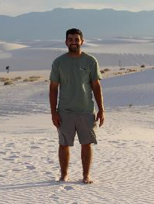
Background
Brennon Dardar
Former Undergraduate Research Assistant
Graduate of Nicholls’ Geomatics Program,
Applied Science
National Geospatial-Intelligence Agency (NGA)
Geodetic Surveyor

Slide 3
Background
Nicholls Geomatics and small Unmanned Aerial Systems (sUAS)
Working on sUAS technology since 2005
Coastal Restoration
Deepwater oil and gas production platform inspection
Infrastructure monitoring
Park management
Surveying
Agriculture
Levee monitoring

Slide 4
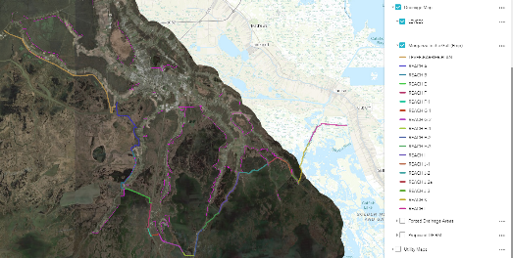
Introduction
The Terrebonne Levee and Conservation District's mission is to provide protection by maintaining the integrity of the levee systems and flood control structures.

Slide 5
Objectives
Compare the accuracy of photogrammetry derived sUAS deliverables against topographic surveying methods
Differential Leveling
Real Time Kinematic (RTK) Survey
Terrestrial Laser Scanning System (TLSS)
Light Detection and Ranging (LIDAR)
Evaluate the effectiveness of photogrammetry derived sUAS deliverables for monitoring levee structural stability

Slide 6
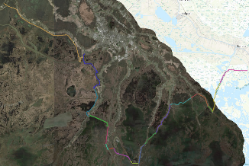
Study site
Reach F
4.5 mile portion of Morganza to the Gulf
In Dulac, LA
My study’s focus is 200 ft. of levee.

Slide 7
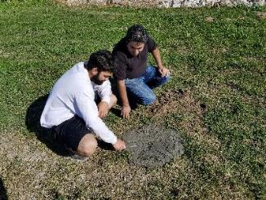
Methodology
Monument setup at Reach F
Control-GARY
4 hour GNSS static survey
National Geodetic Survey (NGS) OPUS solution
LAT(N) | LON(W) | EL HGT
29◦ 20’ 36.31178” | 90◦ 44’ 15.48236” | -23.309 m
*REF FRAME: NAD_83(2011) (EPOCH:2010.0000)
Northing (Y) | Easting (X) | ORTHO HGT
93640.713 m | 1057850.618 m | 1.310 m
*State Plane Coordinates ( Zone 1702 Louisiana South)

Slide 8
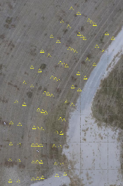
Methodology
Nails placed at a 20ft. (6.096 m.) stations along the levee alignment.
Nails placed at each station included variations in grade (crown, toe shoulder etc.)

Slide 9
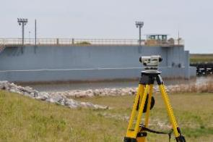
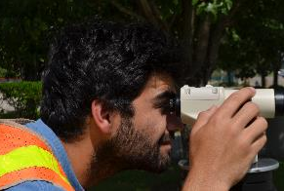
Methodology
Differential Leveling
Nikon AC-2s Automatic Level and Crain Level Staff/Rod
20ft. interval cross sections.
Points at each station included changes in grade (crown, toe shoulder etc.)

Slide 10
Methodology
Real Time Kinematic (RTK) GNSS Survey
Trimble R10 GNSS Receivers (Base and Rover), and Pacific Crest ADL Vantage Pro Radio Unit
20ft. interval cross sections
Same location as differential leveling points

Slide 11
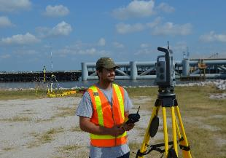
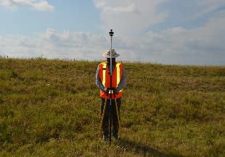
Methodology
Terrestrial Laser Scanning System (TLSS)
Trimble VX Spatial Station
1 to 250 meter range; up to 15 points/sec, typically 5 points/sec; 10mm minimum point spacing

Slide 12
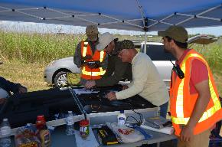
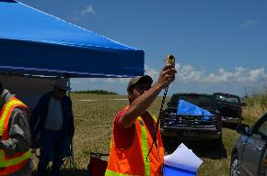
Methodology
Photo Derived Small Unmanned Aerial System (sUAS)
Trimble UX5HP (Delair), Sony Alpha a7R prosumer camera with 35mm wide-angle lens, and Kestrel 4500 Pocket Weather Tracker
Fixed wing sUAS

Slide 13
Methodology
Light Detection and Ranging (LIDAR)
Active Sensor
RIEGL VUX-1 UAV
10 mm survey-grade accuracy
500,000 measurements / second
Up to 330˚ field of view
Lightweight (3.5 kg) and rugged unit

Slide 14
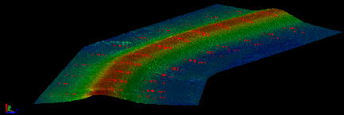
Methodology
Data processing software:
Trimble Business Center (TBC) 4.0
All data surfaces were created within TBC to be compared using the same TIN surface algorithm.
Photogrammetry derived 3D point cloud
TIN surface derived from above 3D point cloud

Slide 15
results
Differential Leveling
RTK Survey
Sections | Number of Points | Time (min.) | Volume (m³)
6.096 m (20 ft.) | 77 | 82 | 2332.0
12.192 m (40 ft.) | 42 | 45 | 2337.9
30.480 m (100 ft.) | 21 | 23 | 2337.7
Sections | Number of Points | Time (min.) | Volume (m³)
6.096 m (20 ft.) | 77 | 60 | 2322.9
12.192 m (40 ft.) | 42 | 38 | 2326.4
30.480 m (100 ft.) | 21 | 24 | 2315.3

Slide 16
results
Diff. Leveling v/s RTK
Legend
Surface | Color
Conventional Differential Leveling
RTK GNSS Survey

Slide 17
results
Differential Leveling
TLSS
Sections | Number of Points | Time (min.) | Volume (m³)
6.096 m (20 ft.) | 77 | 82 | 2332.0
12.192 m (40 ft.) | 42 | 45 | 2337.9
30.480 m (100 ft.) | 21 | 23 | 2337.7
Number of Scans | Number of Points | Time (min.) | Volume (m³)
16 | 101621 | 565 | 2494.8
$2494.8m^{3}−2332.0m^{3}=162.8m^{3}$ Difference

Slide 18
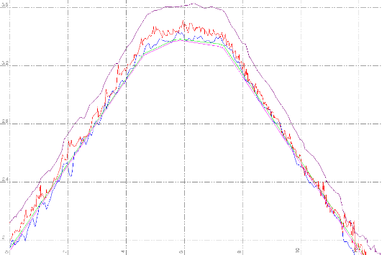
Results
Legend
Surface | Color
Conventional Differential Leveling
RTK GNSS Survey
TLSS
LIDAR
Photogrammetry Derived

Slide 19
Results
Volume excess measured from TLSS surface model = 162.8 m³
Surface area = 898.1 m²
Avg. grass height = 17.78 cm
Estimated volume excess due to noise (grass) = 159.7 m³
Volume difference RTK v/s Photogrammetry = 38.2 m³

Slide 20
Results
Diff. Leveling, LIDAR, and Photo Derived
Legend
Surface | Color
Conventional Differential Leveling
LIDAR
Photogrammetry Derived

Slide 21
Results
sUAS
Setup time for GNSS base station: 10 min.
Setup time for 34 photo controls: 60 min.
Flight mission related time: 53 min.
Processing time: 18 hours.
Dell Precision Workstation, Intel Xeon 2.4 GHz Dual Processor, 64.0 GB RAM, 64 bit Windows 7 Professional Operating System

Slide 22
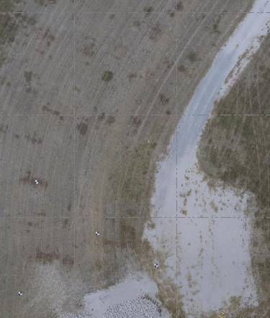
Results
Check Point | East (ΔX) m | North (ΔY) m | Elevation (ΔZ) m
Mean | 0.0113 | -0.0016 | -0.0019
Stand Dev | 0.0075 | 0.0064 | 0.0012
RMSE | 0.0132 | 0.0062 | 0.0022
RMSEr | 0.0146
Hor. Accuracy | 0.025 | @ 95% Confidence Level
Vert. Accuracy | 0.004 | @ 95% Confidence Level

Slide 23
Results
Number of Flights | Number of Points | Time (min.) | Volume (m³)
1 | 67,226,871 | 123 | 2353.5
$2353.5m^{3}−2332.0m^{3}=21.5m^{3}$ Difference Between Differential Leveling and Photogrammetry Derived sUAS deliverables

Slide 24
Results
Number of Flights | Number of Points | Time (min.) | Volume (m³)
1 | 34,969,416 | 100 | 2379.8
$2379.8m^{3}−2332.0m^{3}=47.8m^{3}$ Difference Between Differential Leveling and LIDAR

Slide 25
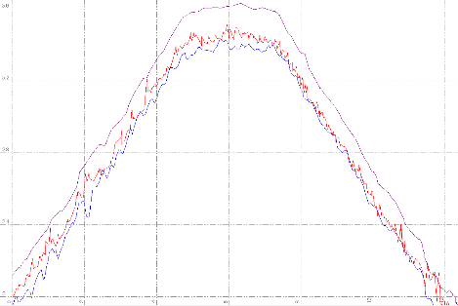
results
TLSS, Photo Derived, and LIDAR Cross Sections
Legend
Surface | Color
TLSS
LIDAR
Photogrammetry Derived
All surface model profiles follow the same trend but shift due to noise.

Slide 26
Conclusions
Differential Leveling to RTK 9.1 m³ = 11.9 yd³
Diff. Leveling to Photo Derived 21.5 m³ = 28.21 yd³
In other words over 200 ft., the volume estimation is off by almost 2 small truck loads.
Over 4.5 miles the volume estimates would be off by 238 loads.
sUAS orthomosaics will be a valuable topographic map.
sUAS proves to be well suited as a levee monitoring tool by providing accurate volumetric estimates compared to other topographic surveying methods.

Slide 27
acknowledgements
This study was funded by Terrebonne
Parish Consolidated Government (TPCG)
grant.
I would like to thank the following individuals:
Mr. George Rey, Mr. Peter Jensen, Mr. Mert Pellegrin, Mr. Cody Parks, Mr. Terry Parks, Mr. Lee Drennan, and Mr. Amir Izadi
I would also like to thank Chustz Surveying LLC. and Terrebonne Levee and Conservation District.

Slide 28
Questions?
Thank you
Contact Information:
Brennon Dardar
Geodetic Surveyor
National Geospatial-Intelligence Agency
Graduate of Nicholls’ Geomatics Program, Applied Science
E-mail: bdardar1@nicholls.edu
Dr. Balaji’s contact Phone: (985) 448-4724

