Slide 1
Immersive Media for Introductory Survey Laboratory Exercises
Brian J. Naberezny, PLS, GISP
Dimitrios Bolkas, Ph.D.
Jason Kepner
Jeff Chiampi
Eric Williams
The Pennsylvania State University

Slide 2
Please excuse my absence
Brian J. Naberezny, PLS, GISP
Lecturer in Civil and Environmental Engineering
Introduction to Surveying Course
Fall: 6 lab sections of 24 students
Spring: 4 or 5 lab sections of 24 students
Enrollment | Major
70% | Civil and Environmental Engineering (Required)
25% | Architectural Engineering (Required for some)
4% | Mining Engineering (Required)
1% | Other (Elective)

Slide 3
The Team
Dimitrios Bolkas: Assistant Professor in Surveying, PSU W-B
Jeff Chiampi: Lecturer in Computer Science, PSU W-B
Jason Kepner: UG Student in Telecommunications, PSU W-B
Eric Williams: UG Student in Surveying, PSU W-B
Darius Khademi: UG Student in Civil Engineering, PSU UP
Joshua Pannaman: UG Student in Civil Engineering, PSU UP

Slide 4
Lab Challenges: Time constraints
Morning Lab
Three hours lab
Instruction Portion
Demonstrate use and care of equipment
Explain how to perform lab exercise
Execution Portion
Lab groups develop a plan
Gather and Return equipment
Walk to and from practice area
Compare field note and exchange information needed to complete lab
15 Minutes between lab sections
Extremely difficult or impossible to schedule makeup/extra lab time
Instruction
3 Hours
Execution
Mid-Day Lab
Instruction
3 Hours
Execution
Notes:
The relatively short amount of time available for the lab creates a constraint. Introducing students to new equipment and procedures and explaining how to complete the lab activity can take up as much as 1/3 of the lab period. Students may have less than two hours to execute the lab. Some days labs or labs and lectures are scheduled back-to-back so it is not possible to give students a few extra minutes to complete their fieldwork. The number of lab sections, instructor schedule, and student schedules makes it almost impossible to find common time for students to have extra time to finish their lab. Challenging to adequately instruct and allow students sufficient time to execute.

Slide 5
Lab Challenges: Engaging students
Instruction portion limited to classroom setting
Can be difficult to communicate effectively outdoors
Too many distractions outdoors
Classroom space insufficient to allow complete hands-on training
Active learning can be time consuming reducing amount of time available to complete lab exercise
Instruction portion becomes a balancing act of lecture, engagement, and time management

Slide 6
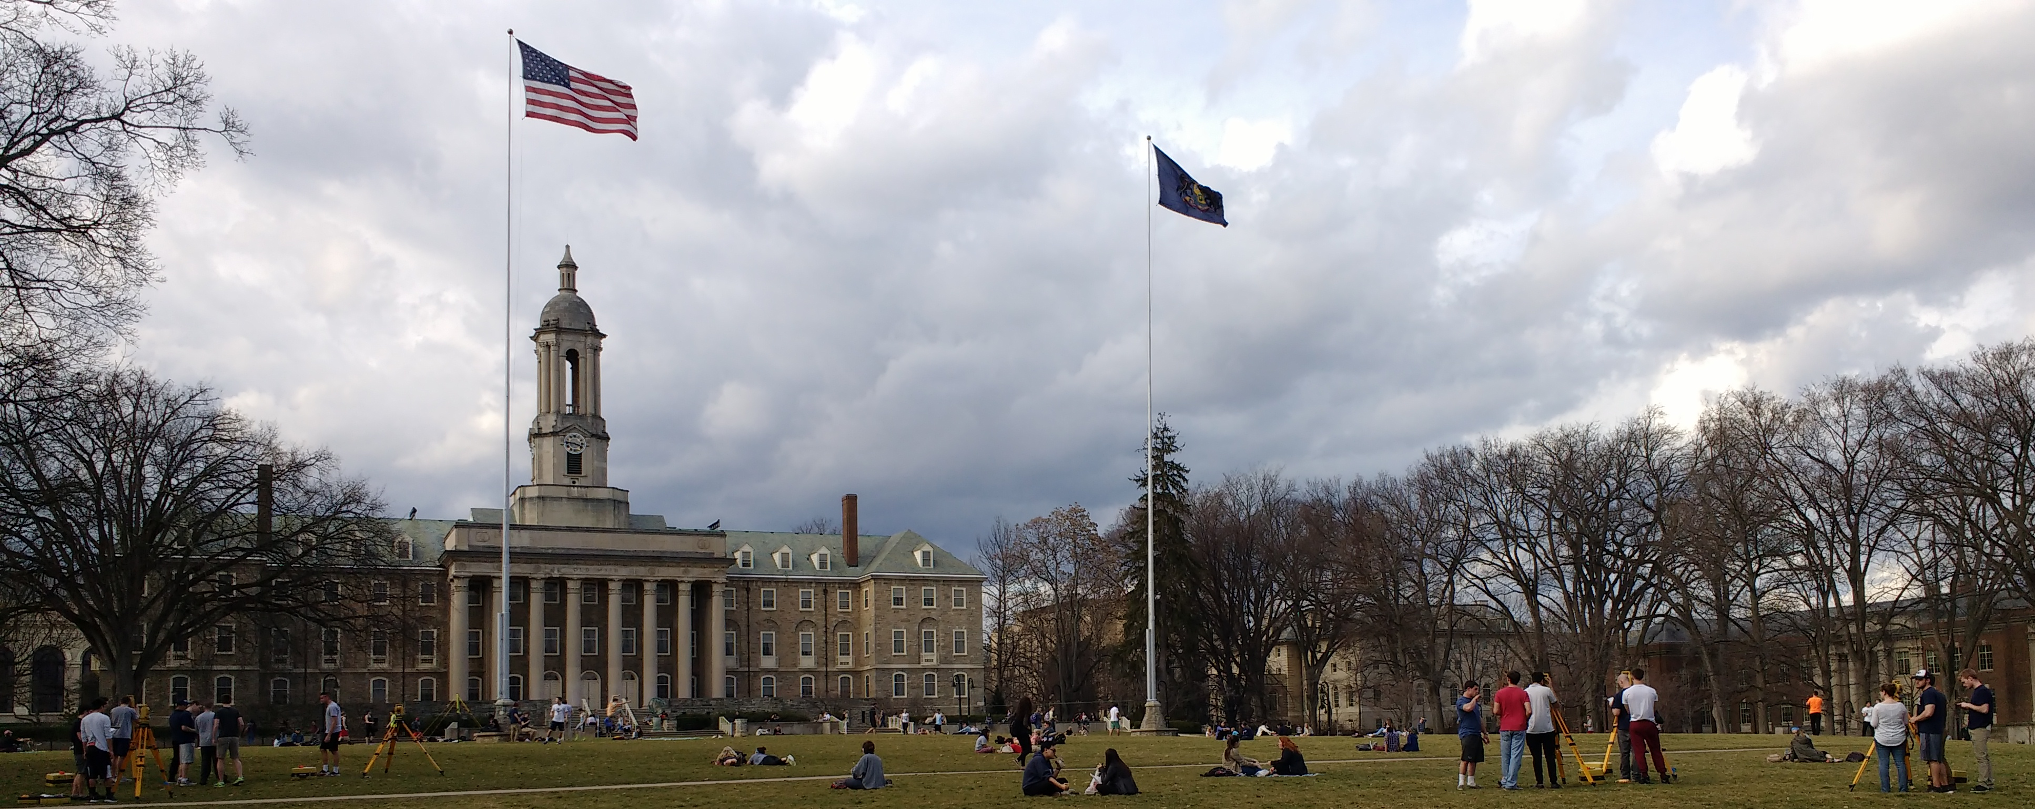
Lab Challenges: Engaging students
Instruction portion limited to classroom setting
Too many distractions outdoors
Can be difficult to communicate effectively outdoors
Notes:
Providing complete hands-on instruction to the entire class is difficult. Outdoor practice area has sufficient space but it is also used as a formal and informal gathering space. Stages, lights, voleyball, frisbee, etc. are all distractions. Loud noises and music make instruction to the entire class difficult. Lack of whiteboard makes presenting some topics challenging. Have not had success instructing lab outdoors.

Slide 7
Lab Challenges: Engaging students
Classroom space not large enough to accommodate tripods
Active learning can be time consuming reducing amount of time available to complete lab exercise
Instruction portion becomes a balancing act of lecture, engagement, and time management
Notes:
The indoor classroom is not large enough for each group to setup and maneuver around a tripod so complete hands-on instruction is not possible. Students do get hands-on time with the equipment while sitting at their desks but stability and height keep this from being a truly productive activity. The instruction portion for each lab is difficult to plan. Students must learn new equipment and procedures, be engaged, and have sufficient time to complete their lab activity. The hope is that the students in each group collectively paid attention enough to glean the important details.

Slide 8
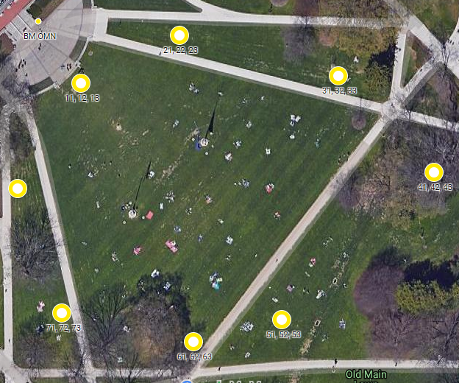
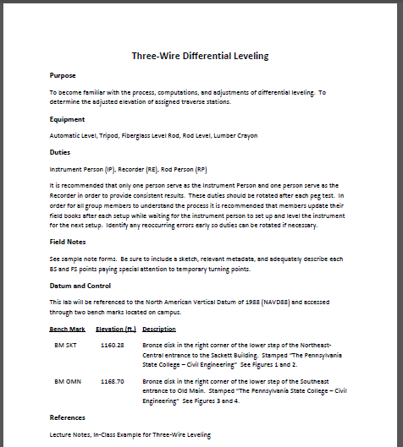
Lab Challenges: Execution resources
Single Instructor
Students geographically dispersed
Impossible to provide timely help to all students
Lab write up can be difficult to visualize
~ 250 ft.
Notes:
When executing the labs students are primarily relying on what information they absorbed during the instruction portion. A single instructor is available during the lab execution portion but students are geographically dispersed making it difficult for the instructor to provide timely instruction to all of the lab groups. Students have access to the lab writeup but it can be difficult to visualize field or equipment procedures.

Slide 9
Gate Checks implemented to help reduce instruction time
Lab write up is posted on LMS at least one week prior to lab session
LMS quiz or activity “Gate Check”
Based on lab write up and/or relevant lecture material
Must score 100%, Unlimited attempts, Questions change
Automatically graded by the LMS
Completion required prior to lab session
LMS prevents those failing to successfully complete the Gate Check from submitting their lab resulting in a zero (0)
Notes:
- Students have access to the lab write up through the Learning Management System. These are posted at least one week prior to the lab session. Most students did not look at the lab write up prior to the lab! In order to better prepare students for lab and hopefully reduce instruction time, Gate Checks were implemented.
- There are typically online quizzes based on the lab write up and any relevant lecture material. Students must score 100% on the Gate Check. If they score less than 100%, they can retake the quiz multiple times. Questions are pulled from a question bank so they will not see the same exact questions each attempt. These quizzes are graded automatically by the LMS so there is no demand on instructor time. All labs are submitted through the LMS and students failing to successfully complete the Gate Check prior to their lab period are locked out from submitting their lab and are assigned a zero.
Extra Information:
It is extremely rare that a student fails a Gate Check. Issues are usually with those that did not attempt it prior to the deadline.

Slide 10
Effectiveness of Gate Checks has not been formally evaluated
Most students do not read the lab write up if a Gate Check is not required
Gate Check has slightly improved student comprehension
Students only skim lab write up sufficiently to complete the Gate Check
Student perception is required reading, not engaging in lab preparation
Notes:
No formal assessment of Gate Checks has been performed but informal feedback and observations indicate

Slide 11
360 video has potential to engage students
Video simultaneously captured with multiple lenses
Individual videos are stitched together providing a single panoramic video
360 capable software allows viewer to pan tilt, rotate the video using mouse, keyboard, finger gestures
VR Headset viewing controlled using head gestures
Stereoscopic capable cameras provide depth which enhances VR Headset viewing
Consumer cameras $300 - $1000
Professional cameras $3K - $20K, Weekly rental $200 - $1000
Notes:
May not need to discuss this slide much if explained in the preceding presentation.

Slide 12
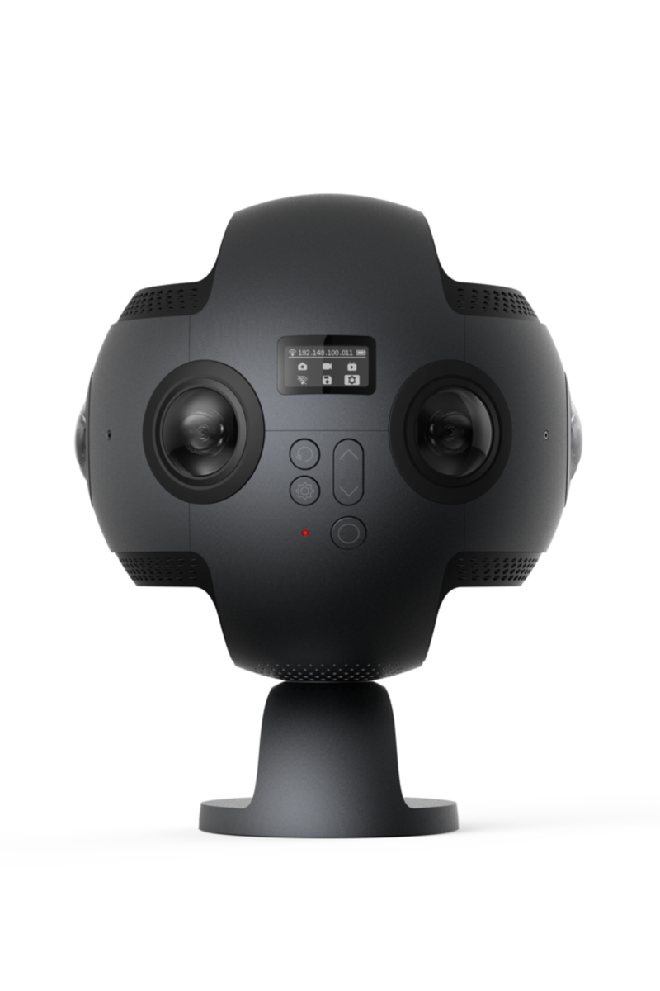
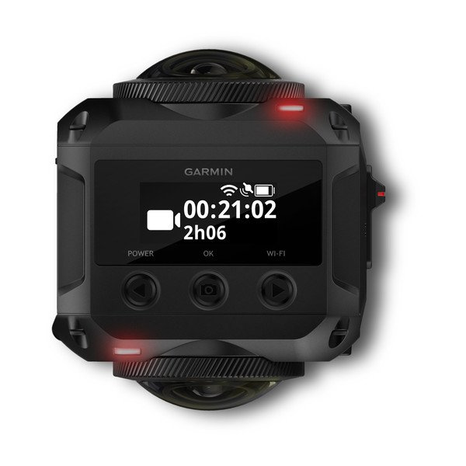
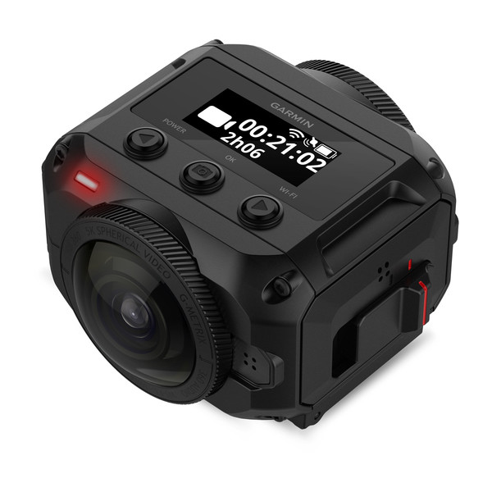
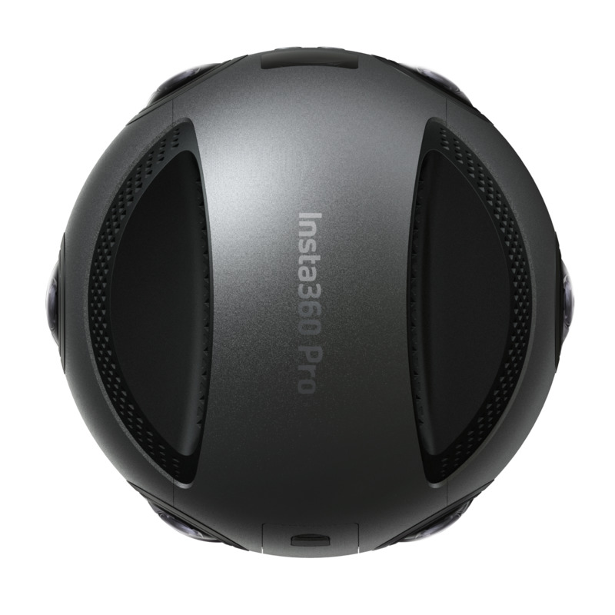
360 video has potential to engage students
Video simultaneously captured with multiple lenses
Individual videos are stitched together providing a single panoramic video
Some cameras can record stereoscopic video
Consumer cameras $300 - $1000
Professional cameras $3K - $20K Weekly rental $200 - $1000
Lens 2
Garmin Virb
Insta360 Pro
Lens 1
Stereoscopic
6 Lenses
Notes:
THIS SLIDE HAS ANIMATIONS!
May not need to discuss this slide much if explained in the preceding presentation.
Renting may be more beneficial than purchasing. Technology is rapidly changing.

Slide 13
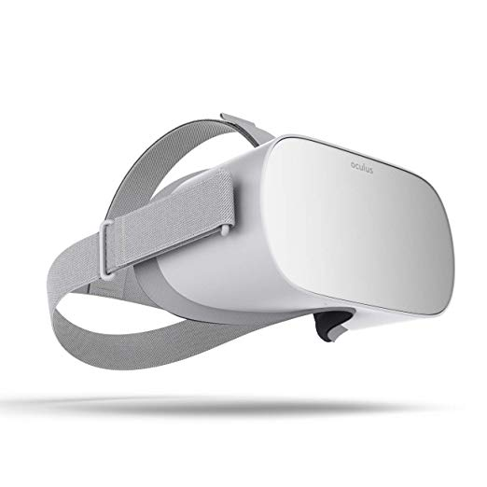
360 video has potential to engage students
360 capable software allows viewer to pan tilt, rotate the video using mouse, keyboard, finger gestures
VR Headset viewing controlled using head gestures
Stereoscopic capable cameras provide depth which enhances VR Headset viewing
Notes:
Elements can be placed in video that forces students to interact with the video. They must turn around to view something, or they must look up or down to view something. They must click on a hot spot. Directional cues (arrows, etc.) can be provided.

Slide 14
360 Video Example

Slide 15
MC-REU provided opportunity to develop videos
8 Week Research Experience for Undergraduates
Undergraduate Student – Jason
Wilkes-Barre Campus Mentor – Dimitrios and Jeff
University Park Campus Mentor – Brian
Goal to develop videos that
Engage students and improve their comprehension
Reduce lab introduction time
Increase time available for lab execution
Provide an effective resource to assist with lab execution

Slide 16
Gate Checks will require watching videos
Most labs will have two videos
Demonstrate use and care of equipment
Demonstrate how to perform the lab
Labs with videos
Distances Lab
Point Referencing
Pacing
Differential Leveling Lab
Angle Measurement Lab
Traversing Lab
Topographic Mapping Lab: Data Collection
Notes:
Gate Checks will require watching videos. Videos will be posted in a way where they have to watch the entire video before they can complete their quiz. Note there is no way to actually force watching the video but it will have to play for the duration.

Slide 17
Effectiveness of immersive videos will be assessed in the Fall
Campus | Students | Lab Sections | Lab Group Size
University Park | 150 | 6 | 4 or 5
Wilkes-Barre | 10 | 1 | 3
Control Sections
Access to lab write up prior to gate check
Access to videos during lab
Introduction will remain the same as previous semesters
Test Sections
Access to lab write up and videos prior to gate check
Introduction time will be limited to questions
Optional “pre-survey” feedback on lab specific videos
Notes:
Can’t force students to provide feedback on videos as part of the Gate Check quiz. Their feedback must be voluntary.

Slide 18
Effectiveness of immersive videos will be assessed in the Fall
Metrics
Number gate check attempts
Timing of introduction portion
Timing of lab groups to complete execution portion
Number of questions during introduction and execution
Grades for each lab
Optional “post-survey” feedback on lab specific videos
Optional “end of semester survey” feedback on videos in general
Final lab
All students will have access to videos prior to gate check
See which chose video over lab write up
Notes:
There are lots of metrics that may be useful for evaluating the effectiveness of the videos. Surveys will be the primary source.

Slide 19
Future work and improvements
When is traditional, 180, or 360 more effective?
What device(s) are students using to view videos and which are most effective?
Preference for narrated audio or live recording?
Stereoscopic vs Monoscopic video?
Only had access to a consumer grade cameras
Dropped frames created a distraction
Stereoscopic video not utilized
Rent a camera for improved resolution and stereoscopic capabilities
Notes:
180 Video may be more effective for demonstrating use and care of equipment. 360 Video may be more effective when demonstrating how to complete a lab. Traditional video may be as effective as 180 but easier to accomplish due to easier editing.
Devices used for viewing may limit video format or file size.
We were unable to develop any stereoscopic videos. The two stereoscopic cameras we had access to had issues with low frames per second resulting in choppy video that was distracting especially when viewing in a VR Headset.
Will consider renting a professional camera for any future videos.

Slide 20
Questions?
Brian Naberezny
nabs@psu.edu
Dimitrios Bolkas
dxb80@psu.edu

