Slide 1
Dr. Balaji Ramachandran contractors educational trust fund Super endowed professor T BAKER SMITH Endowed Professor Nicholls Geomatics Program (2003 - Present) department of applied sciences
27th Biennial Surveying and Geomatics Educators Society Conference, August 04 - 08, 2019 Thibodaux, Louisiana

Slide 2
THANKS
Mr. Jason Graham – Nicholls Web Administrator
Ms. Liz McCurry – Director of Continuing Education
Dr. Joe Paiva, SaGES President

Slide 3
Background
Professor Emeritus Dr. Terry J. Dantin - founder of the program
Two-year process involving members of Louisiana State Board of Registration for Professional Engineers and Land Surveyors (LAPELS) and the Louisiana Society of Professional Surveyors (LSPS)
Dr. David Gibson out-of-state consultant
Louisiana State Board of Regents (BOR) approves the program in summer of 2003
Geomatics program completed sixteen years

Slide 4
Program Faculty
Faculty | Tenure at Nicholls
Dr. Balaji Ramachandran | Fall 2004 - Present
Mr. Maurice Temfak | Fall 2007 - Spring 2010
Dr. Henry Foust | Fall 2010 - Spring 2012
Dr. Soumya Selvarajan | Fall 2011 - Spring 2012
Dr. Sudhagar Nagarajan | Fall 2012 - Spring 2013
Mr. Stephen Flynn | Spring 2013 – Fall 2018
Dr. James Elithorp | Spring 2014 – Spring 2019
Professor Emeritus Terry Dantin – Faculty forever (our own Energizer Bunny)

Slide 5
GEOMATICS Program BY Numbers (2003 - 2019)
Endowed Professorships
$300,000 Contractors Educational Trust Fund Super Endowed Professorship
$100,000 T Baker Smith (Clifford Smith) Endowed Professorship
$100,000 Morris & Sandra Hebert (mph, Inc.) Endowed Professorship

Slide 6
GEOMATICS Program BY Numbers (2003 - 2019)
Student Scholarships
$150,000 Jules Oreste Chustz Memorial Student Endowed Scholarship (Eight to ten $1,000 awards given out annually)
$100,000 Contractor’s Educational Trust Fund Endowed Scholarship (Five to six $1,000 awards given out annually)
Louisiana Society of Professional Surveyors Education Foundation - 1 @ $1,000 per year

Slide 7
GEOMATICS Program BY Numbers (2003 - 2019)
Student Scholarships
The C. L. Jack Stelly & Associates Excellence in Geomatics Scholarship - 1@ $2,500 per year
T Baker Smith Inc., (Adopt a Student) Scholarship 1 @ $5,000 per year
Mph, Inc., Scholarship – 5 @ $1,000 per year
Fugro Chance Inc., Excellence in Geomatics Scholarship - 2 @ $1,000 per year
C&C Technologies Inc. excellence in Geomatics Scholarship - 4 @ $1,000 per year

Slide 8
GEOMATICS Program BY Numbers (2003 - 2019)
Program Graduates
84 graduates so far and counting….
22 students have completed 30 hrs. to obtain their Professional Licensure
21 PLS & 49 Surveying interns and counting…
Nicholls passing rate is around 95% for first time takers (National passing rate is between 40-70% for first time takers)

Slide 9
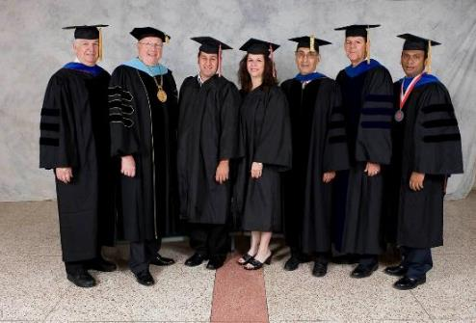
GEOMATICS Program BY Numbers (2003 - 2019)
Program Graduates

Slide 10
GEOMATICS Program BY Numbers (2003 - 2019)
Where are our Graduates?
Hired by big and small surveying firms both in-state and out-of-state
T Baker Smith, mph, Inc., Chustz Surveying, Riverland Surveying, Forte & Tablada, SAM Inc., Fenstermaker, Acadia Land Surveying etc....
Several of them have gone to start their own firms

Slide 11
GEOMATICS Program BY Numbers (2003 - 2019)
Where are our Graduates?
Paul LeBlanc
Software Developer at ESRI

Slide 12
GEOMATICS Program BY Numbers (2003 - 2019)
Where are our Graduates?
Jessica Freeman
Brennon Dardar
National Geospatial-Intelligence Agency (NGA)

Slide 13
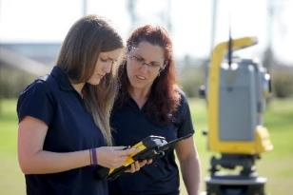
GEOMATICS Program BY Numbers (2003 - 2019)
Where are our Graduates?
Monica Crout
Louisiana Department of Transportation and Development (LADOT)

Slide 14
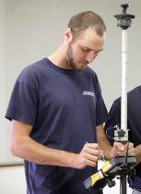
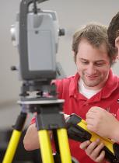
GEOMATICS Program BY Numbers (2003 - 2019)
Where are our Graduates?
Kent Hebert & Cody Parks
US Army Corps of Engineers, New Orleans District

Slide 15
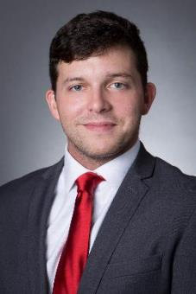
GEOMATICS Program BY Numbers (2003 - 2019)
Where are our Graduates?
Daniel Drennan
Research Assistant III,
Wyss Institute, Harvard SEAS,
Cambridge, MA
Aspiring to pursue graduate studies
at Harvard University

Slide 16
Partnerships
No Cost Annual Loan Agreement with Navigation Electronics Inc. worth $155,000. Placement of five high precision survey grade Trimble R10 GNSS receivers, five mapping grade Trimble GEOXH GNSS receivers, Trimble Business Center, Trimble Pathfinder Office, Trimble Realworks, and Trimble Terrasync Software
Harold Charles “Charlie” Poche Laser Scanning and Visualization Lab

Slide 17
Research
Geomatics faculty have secured over four million dollars in infrastructure and research grant
Cooperative Endeavor Agreement between Nicholls State University Geomatics Program and Terrebonne Parish Consolidated Government from 2005 – present
US Army Corps of Engineers, New Orleans District signs first cooperation agreement with Nicholls Geomatics Program in 2013
Non funded cooperative agreement with US Department of Agriculture (USDA) – 2018 - Present

Slide 18
GEOMATICS UAS PROGRAM Milestones (2005 – Present)
First University in Louisiana to have achieved the distinction of obtaining FAA-COA for civilian research application – (2005 - 07)
Over ten years of proven record of exploring and investigating the adoption of existing and emerging UAS technologies as pertinent to the Geomatics and related professions
First in the nation to apply UAS for Deepwater Oil and Gas Production Platform Inspection – (2010 - 11)
Obtained Extended Visual Line of Sight (EVLOS) for levee monitoring – over 3 miles
Applied UAS for Coastal Restoration and Monitoring, Deepwater Oil and Gas Production Platform Inspection, Critical Infrastructure Monitoring, Levee Monitoring, Agriculture, and Park Management.

Slide 19
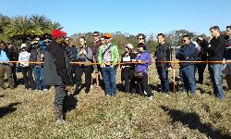
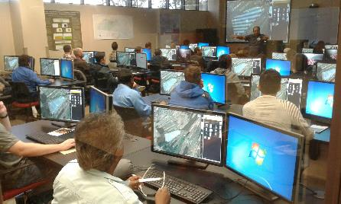
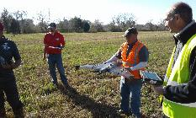
GEOMATICS UAS PROGRAM Milestones (2005 – Present)

Slide 20
Geomatics service LEARNING PROJECTS
GEOM 104 Geomatics Service Learning (0-0-1) – mandatory zero credit hour course
Community
All professional liability issues should be properly addressed before engaging in any community based service learning activities.
a) Mapping out recreational trails
b) Performing topographic surveys for Nicholls Golf Course, Recreational Fields, Local school stadium drainage studies etc.
c) Getting involved in state and local restoration efforts

Slide 21
Geomatics service LEARNING PROJECTS
Professional
Attend Louisiana Society of Professional Surveyor (LSPS) district meetings
b) Attend and volunteer in LSPS Annual Conventions
c) Attend other relevant professional organization meetings and events
d) Be active in LSPS student chapter
Program
a) Help host Annual GIS Day and Surveyor’s Day
b) Help in Science Olympiad, Science fair, Nicholls Family Day, Scholars Day and other events
c) Help in promoting the Geomatics program in their respective high schools
d) Participate in “adopt a highway” program developed by the student chapter
e) Work with faculty on research projects

Slide 22
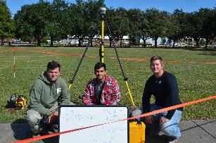
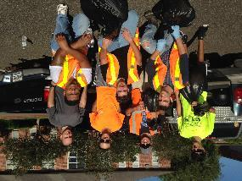
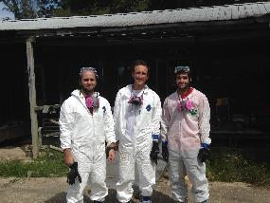
Geomatics service LEARNING PROJECTS
Students Volunteering in Baton Rouge Flood Relief Efforts
2016 NGS South Louisiana Survey – 36 hr. static survey
LA1 Highway Cleanup

Slide 23
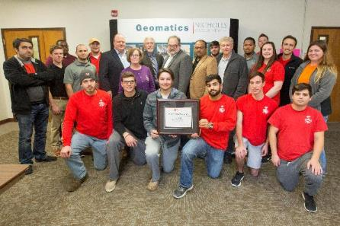
Geomatics Program
Accredited through 2021-22
Recipient of NCEES Surveying Education Award 2016 & 2017

Slide 24
Geomatics Program (2019 –Future)
Memorandum of Understanding (MoU) between Nicholls Geomatics and UNO Civil Engineering Programs
Concentration in Unmanned Systems
Concentration in Hydrographic Surveying

Slide 25
Q&A
Thank you
Contact Information:
Dr. Balaji Ramachandran
Associate Professor of Geomatics
Department of Applied Sciences
URL: http://www.nicholls.edu/doas
Ph.: (985)-448-4724
Email: balaji.ram@nicholls.edu

Slide 26
sUAS Current R&D Focus

Slide 27
FAA approved research sites
sUAS test site – Nicholls Farm
Instruction and Research

Slide 28
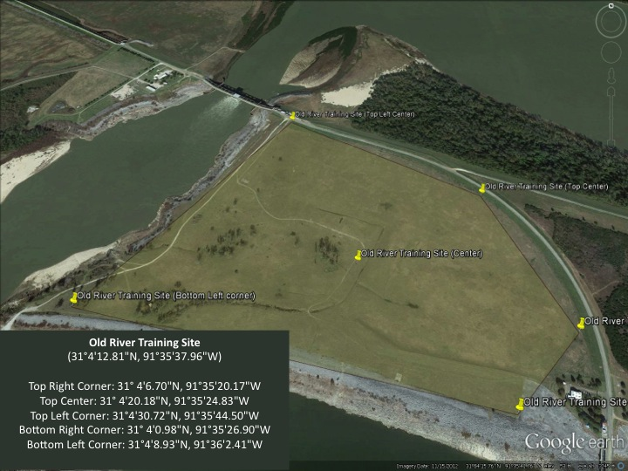
FAA approved research sites
Barrier Islands
USACE- Old River Control Structure

Slide 29
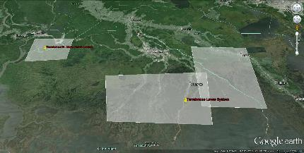
FAA approved research sites
Terrebonne Levee District
Shell Deepwater Platform

