Slide 1




Slide 2

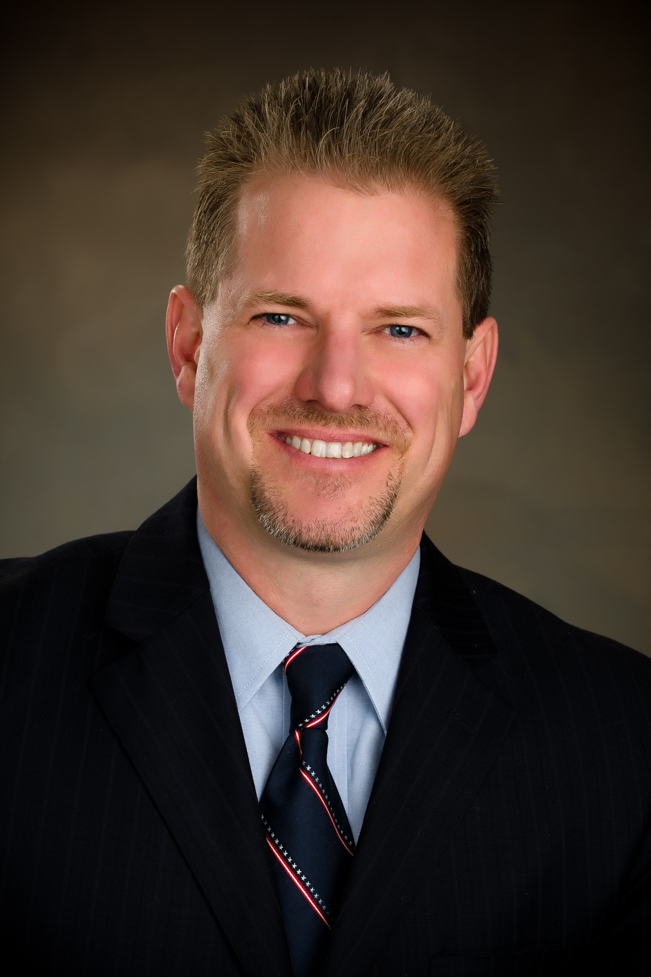


Timothy W. Burch
NSPS Vice President
NSPS Secretary (2015-2019)
NSPS Governor/Director – Illinois (2007-2015)
Brand Ambassador – “Get Kids into Survey”
Director of Surveying – SPACECO, Inc. (Rosemont, IL)
Licensed in Illinois & Wisconsin

Slide 3



Slide 4


Slide 5
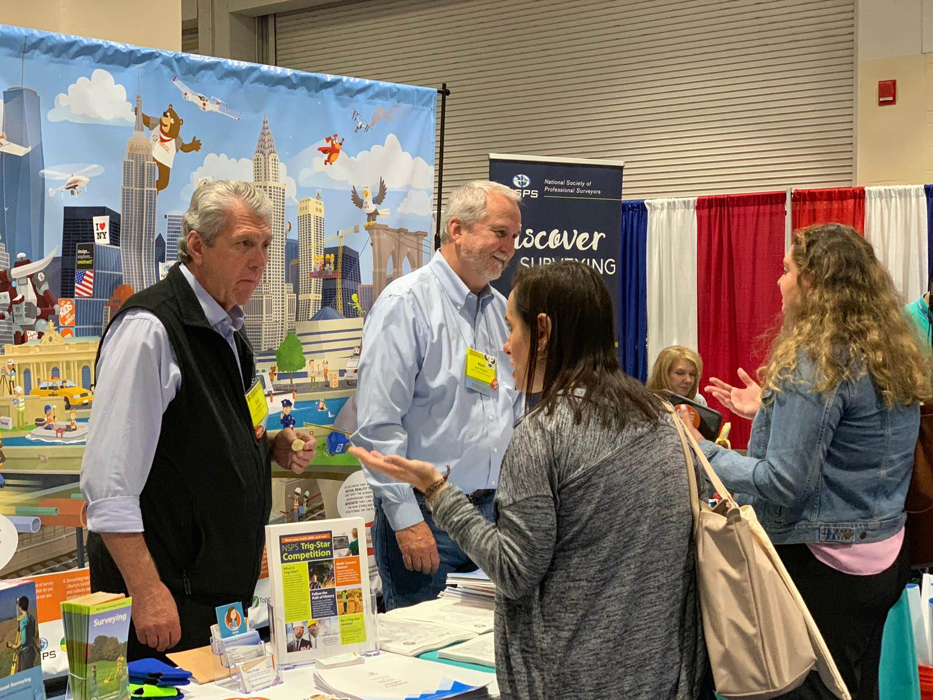
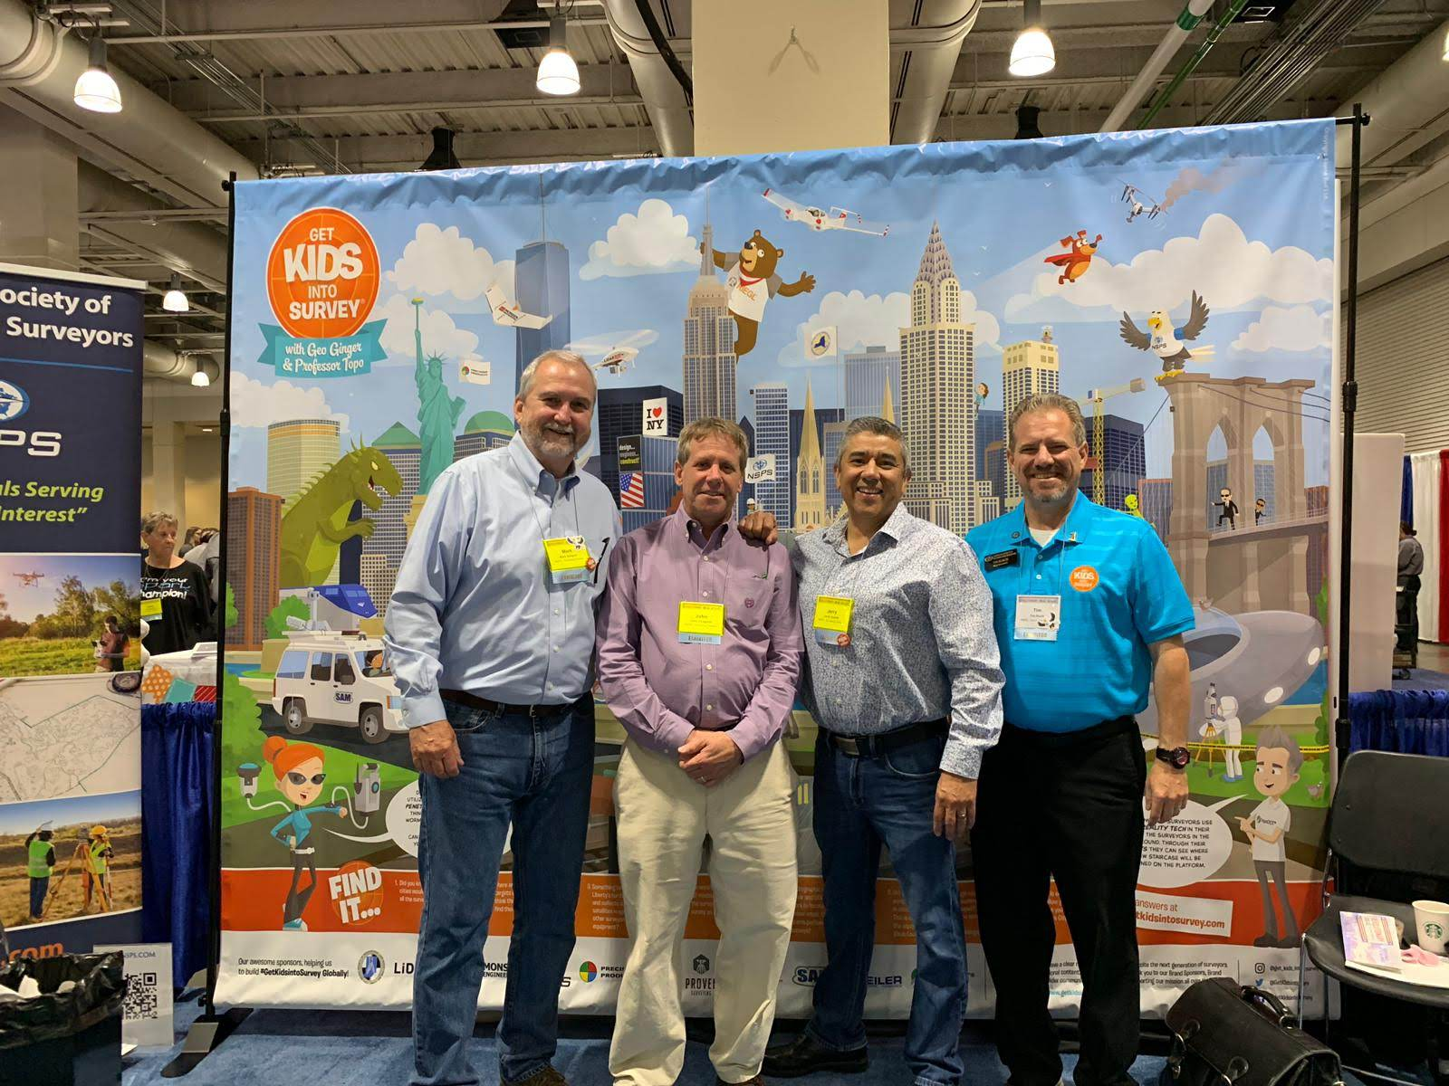
This is not The future of surveying

Slide 6
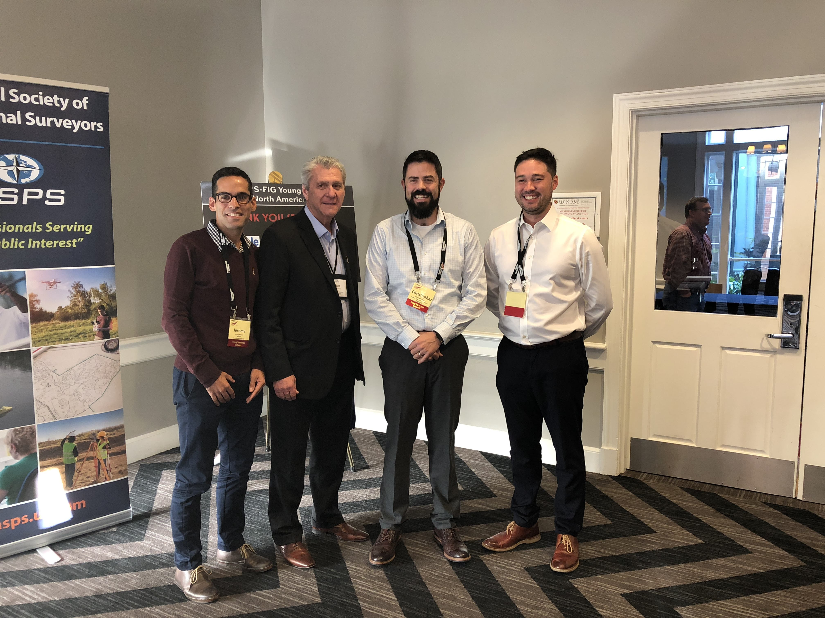
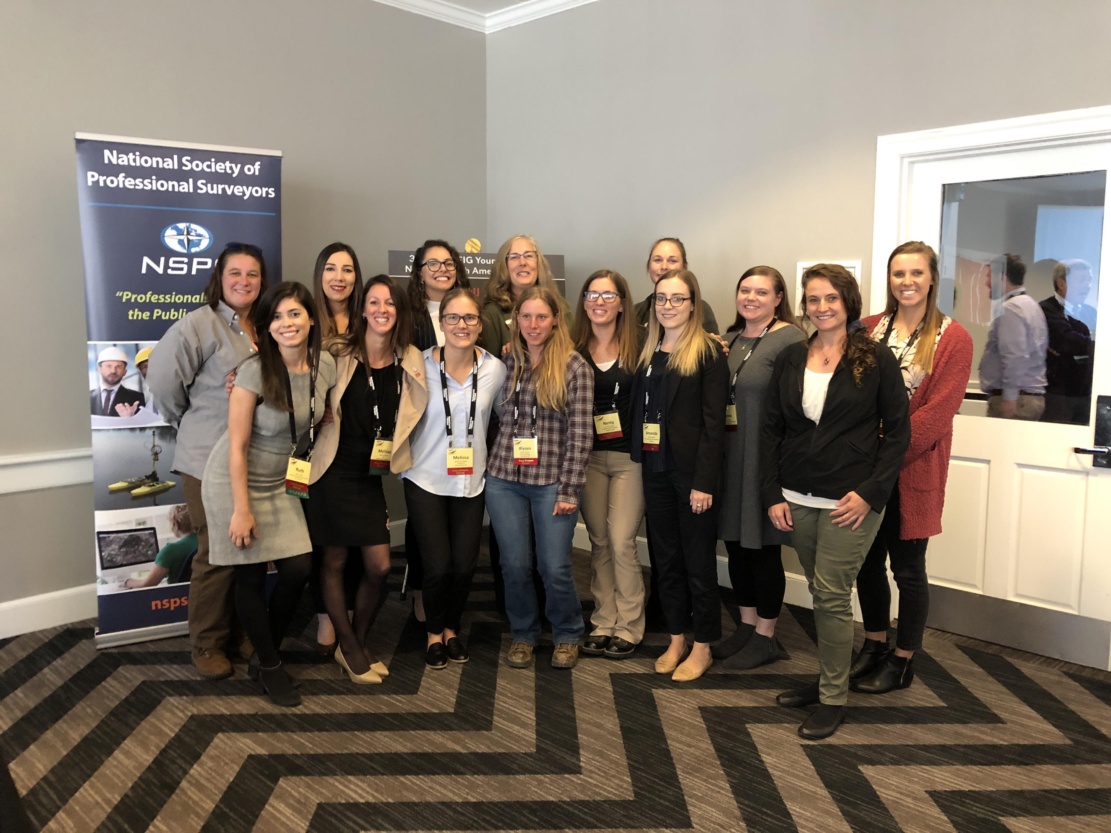
This is the future of surveying

Slide 7
This is the future of surveying

Slide 8
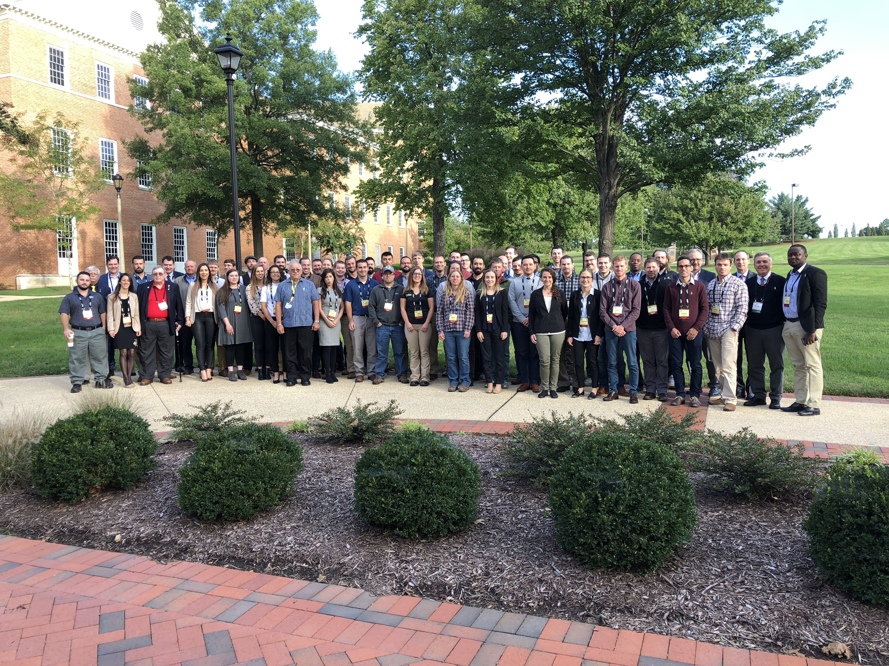
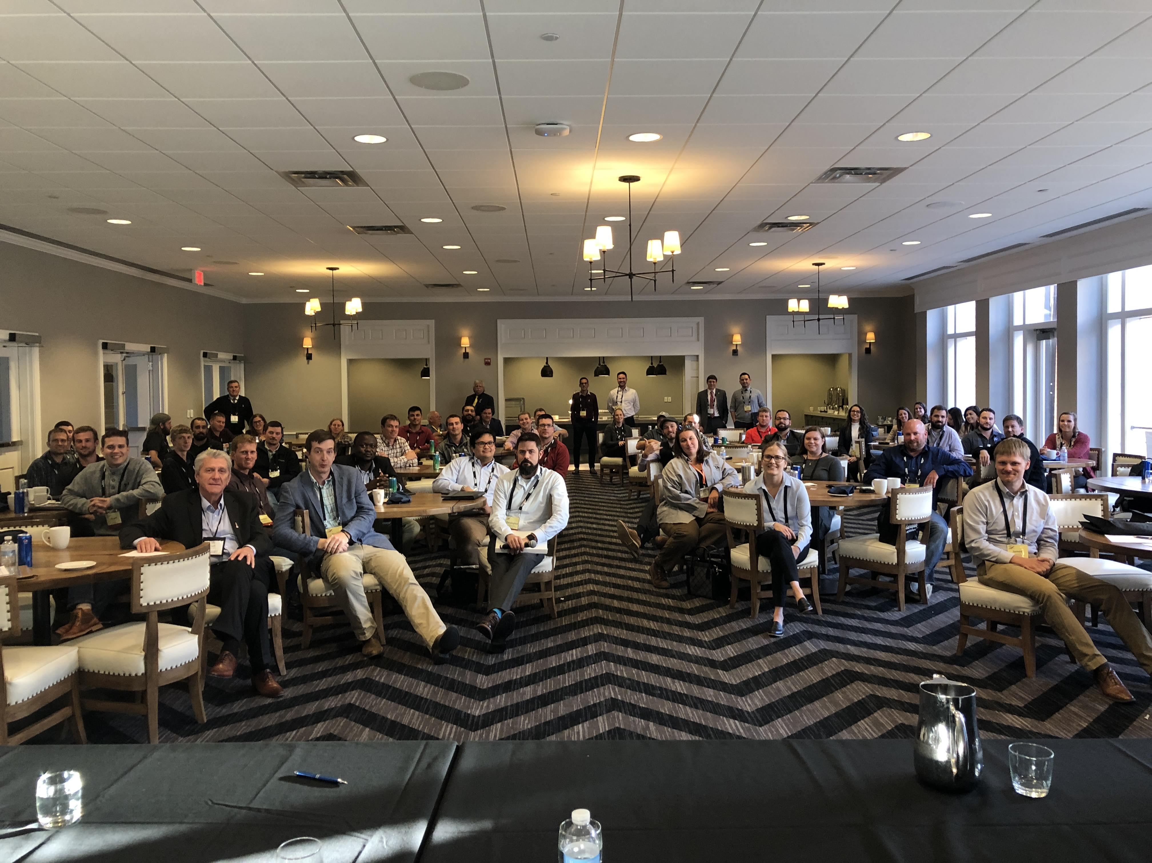
This is the future of surveying

Slide 9
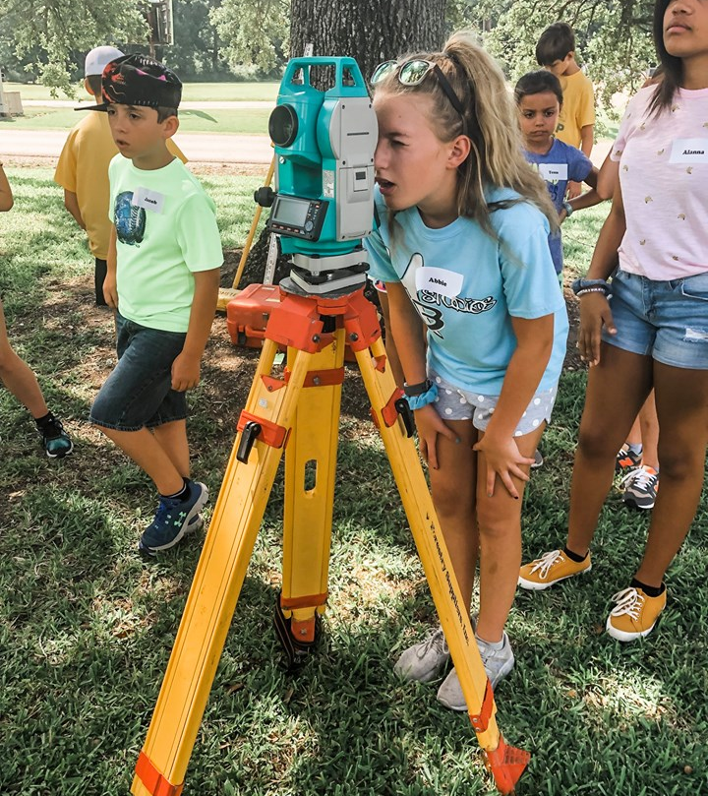
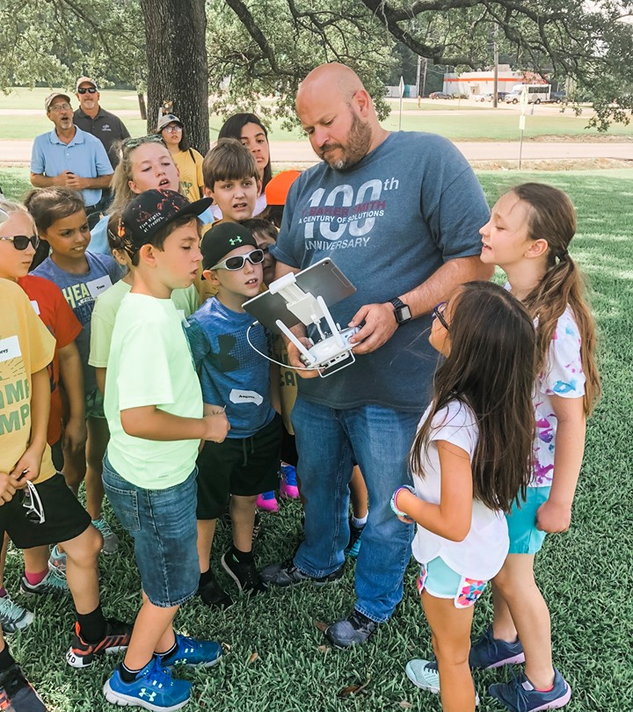
This is the future of surveying

Slide 10

Is the surveying profession at a crossroads?

Slide 11
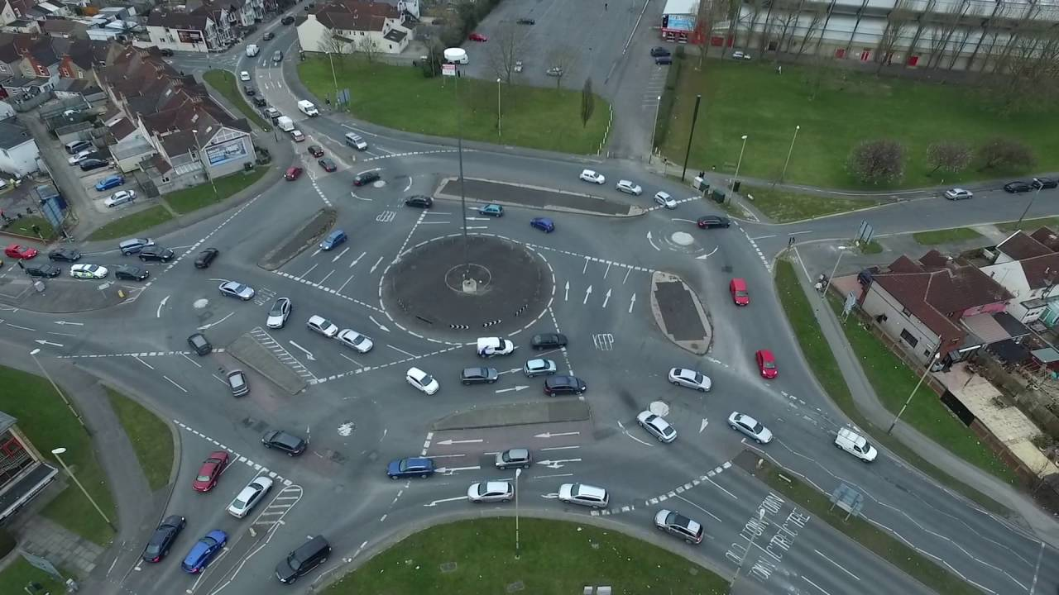
Or are we simply not embracing all aspects of “surveying?”

Slide 12
WHERE ARE WE GOING?
WHERE DO WE RECRUIT?
HIGH SCHOOL - STEM PROGRAMS
  TRIG-STAR
  SKILLSUSA / TWIST
SCOUTING - BOYS AND GIRLS
  STEM MERIT BADGES
JUNIOR HIGH
  FUTURE CITY
ELEMENTARY
  “GET KIDS INTO SURVEY”
WHAT ARE WE RECRUITING FOR?
EMERGING TECHNOLOGIES
  AUTONOMOUS VEHICLES
    LAND/AIR/WATER
  REMOTE SENSING
    PHOTOGRAMMETRY
    LIDAR
    SLAM
GEOSPATIAL
TRADITIONAL SURVEYING

Slide 13
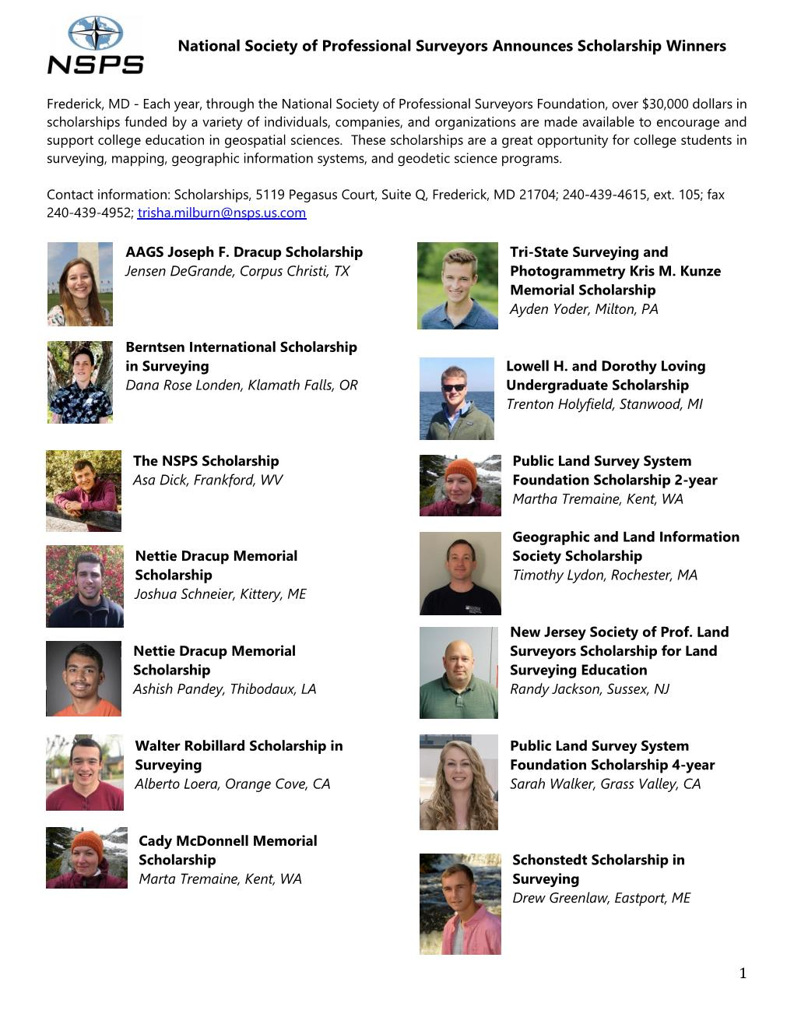
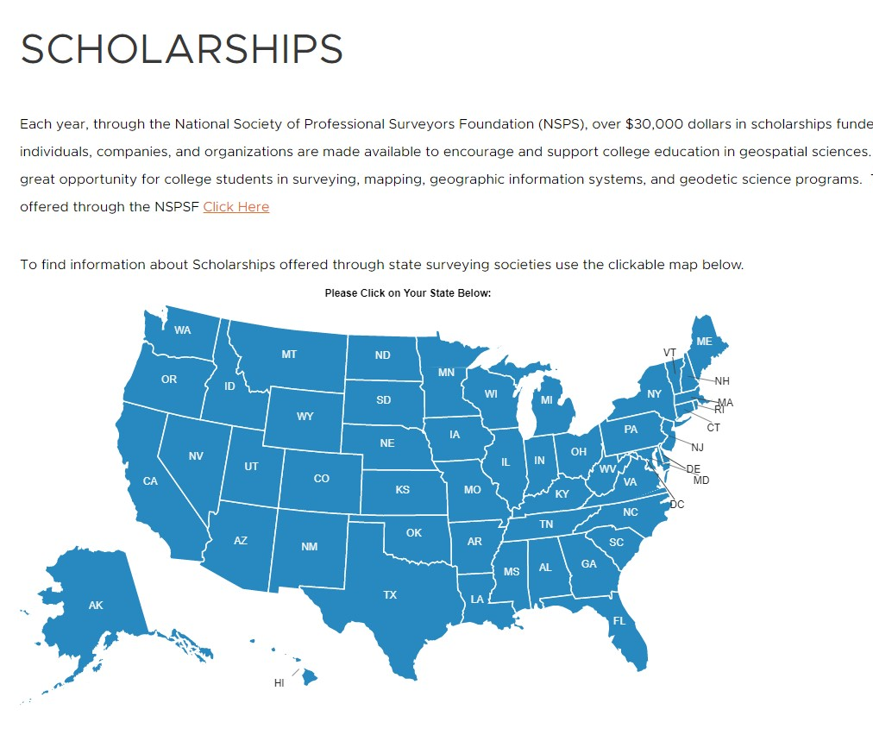

Slide 14
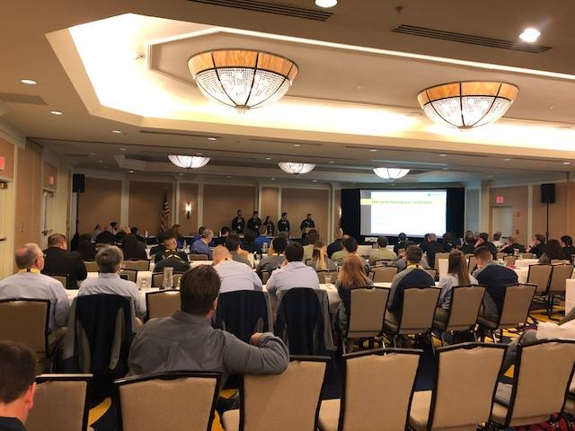
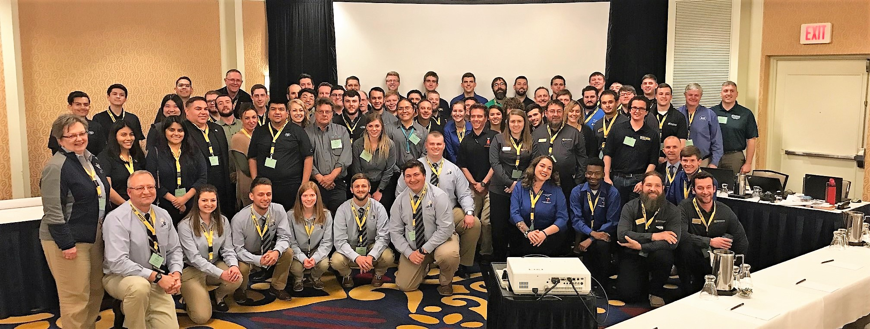
Nsps Student Competition

Slide 15
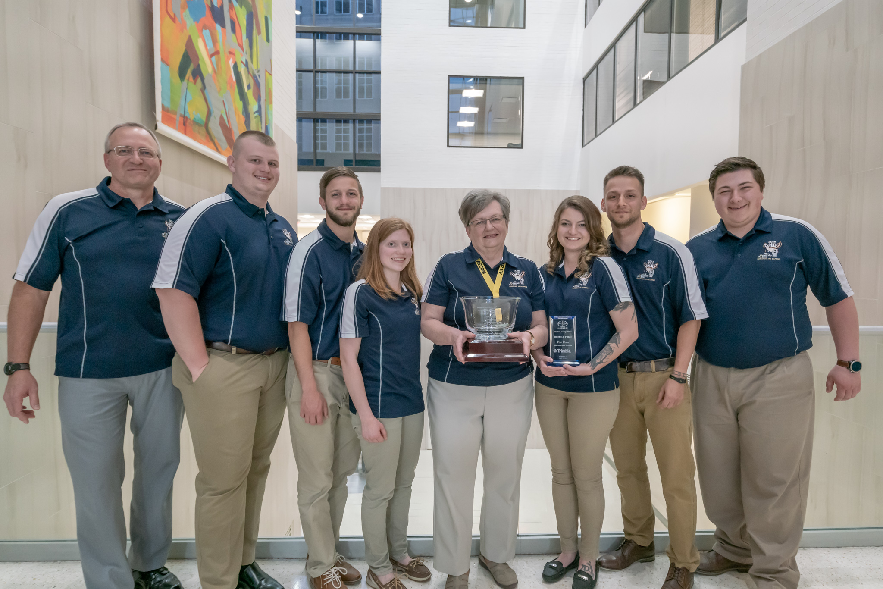
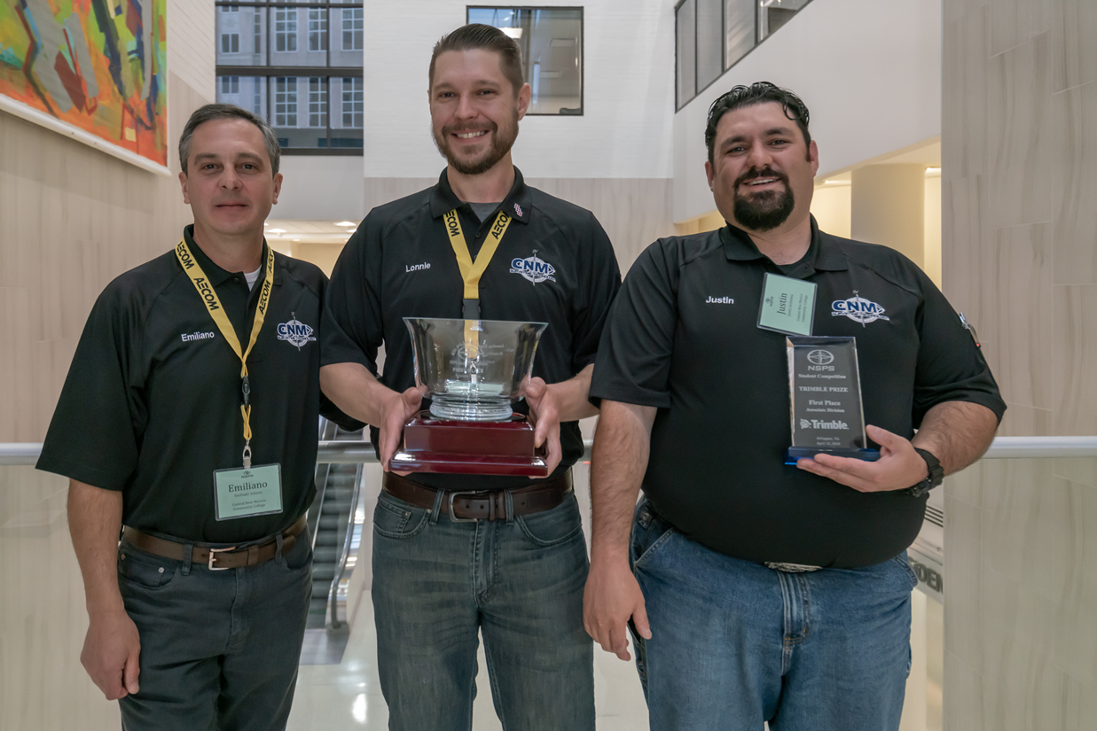
1st place
4-year program
University of Ohio Akron
Nsps Student Competition 2019
1st place
2-year program
Central New Mexico Community College

Slide 16


Slide 17


Slide 18





Slide 19


Slide 20



Slide 21

Our fourth year attending and exhibiting at the ASCA National Conference
Many surveying affiliates and companies are attending state-level conferences to expand our story
NSPS recognizes a nationwide need for many professions, trades and occupations in addition to surveyors
Surveying offers both professional and technical track careers

Slide 22

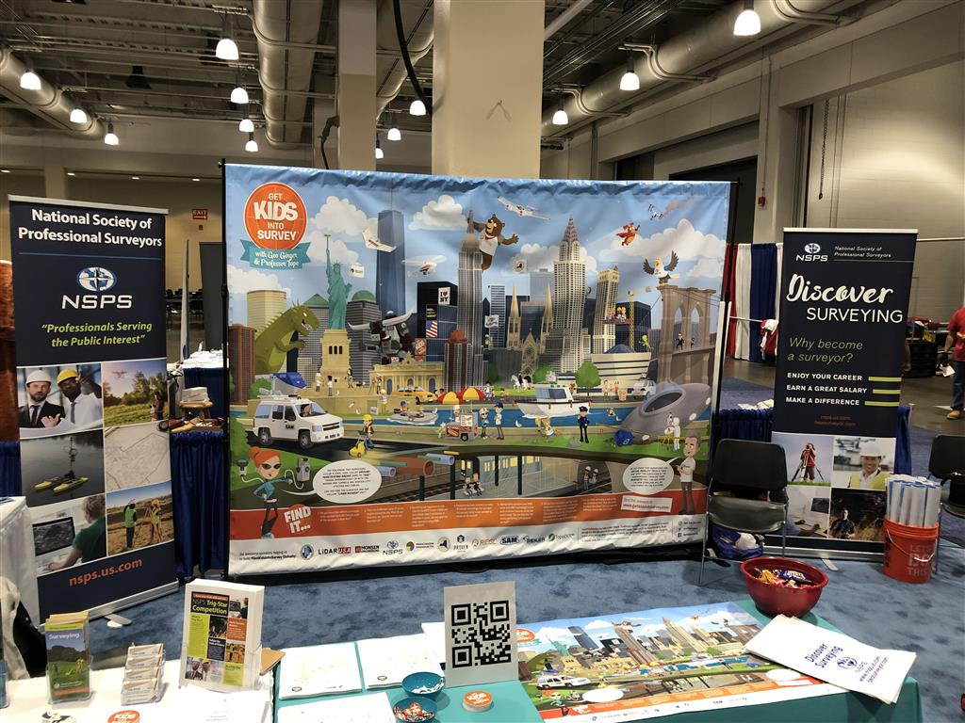
NSPS Booth @ ASCA 2019 - boston

Slide 23
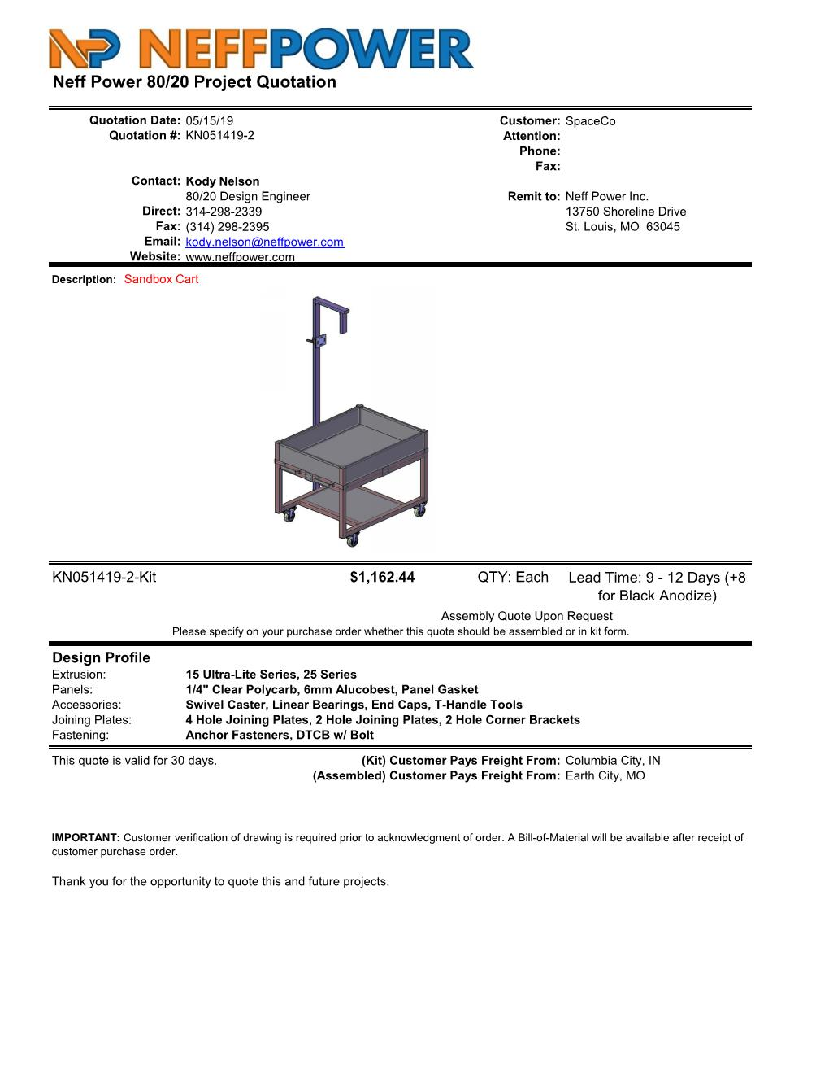
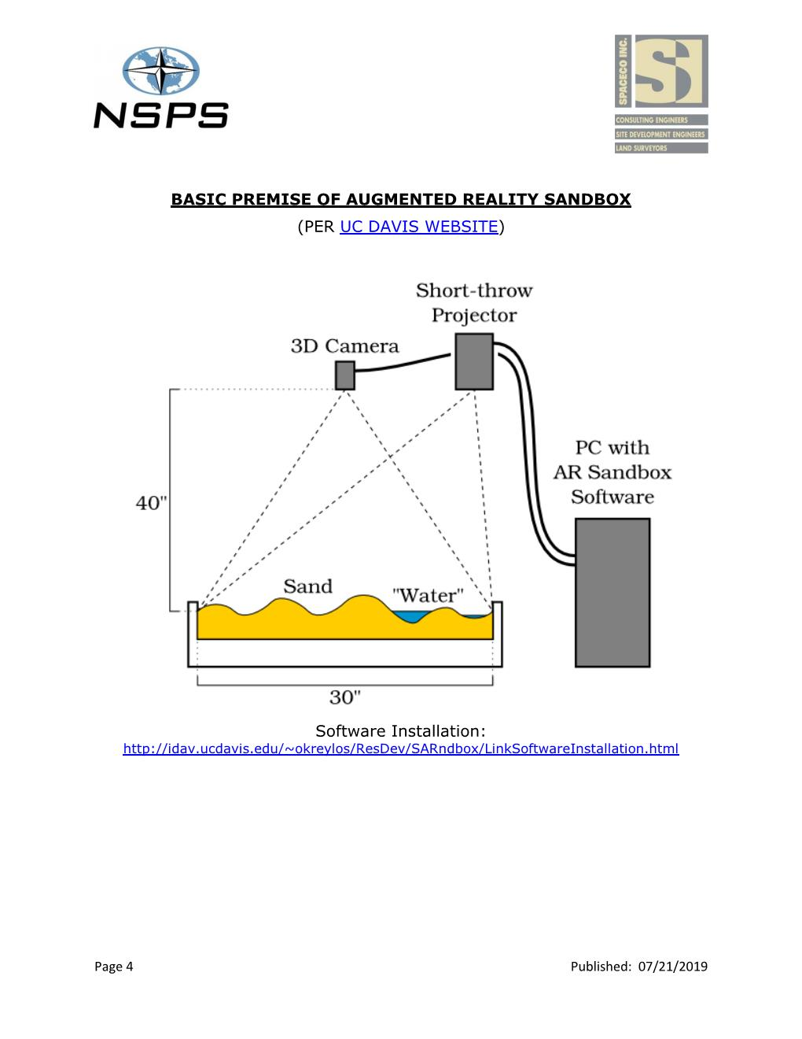
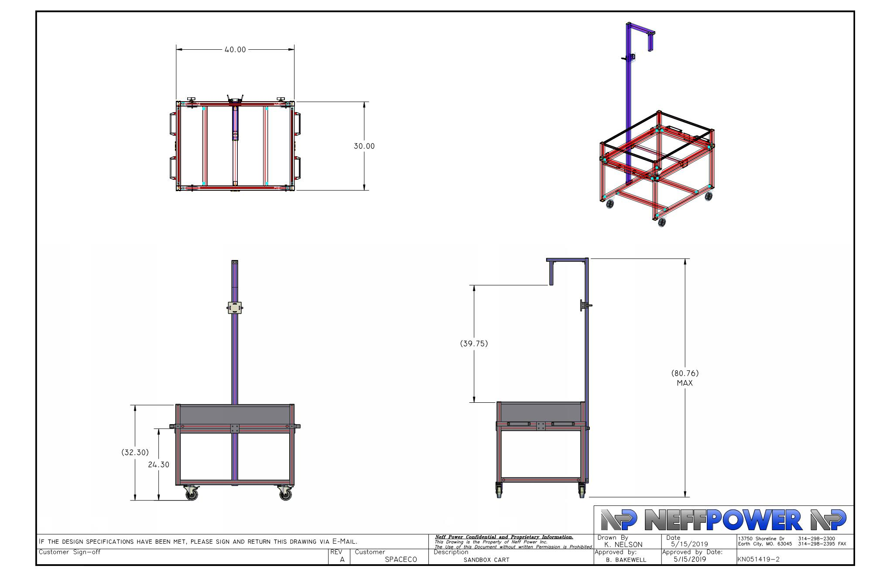
Augmented reality sandbox parts list and instructions

Slide 24
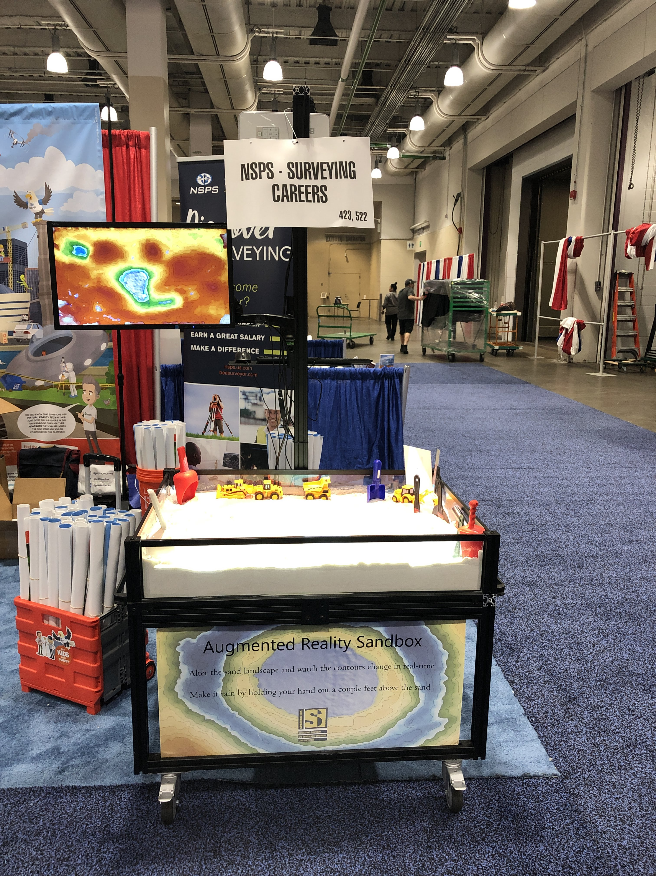
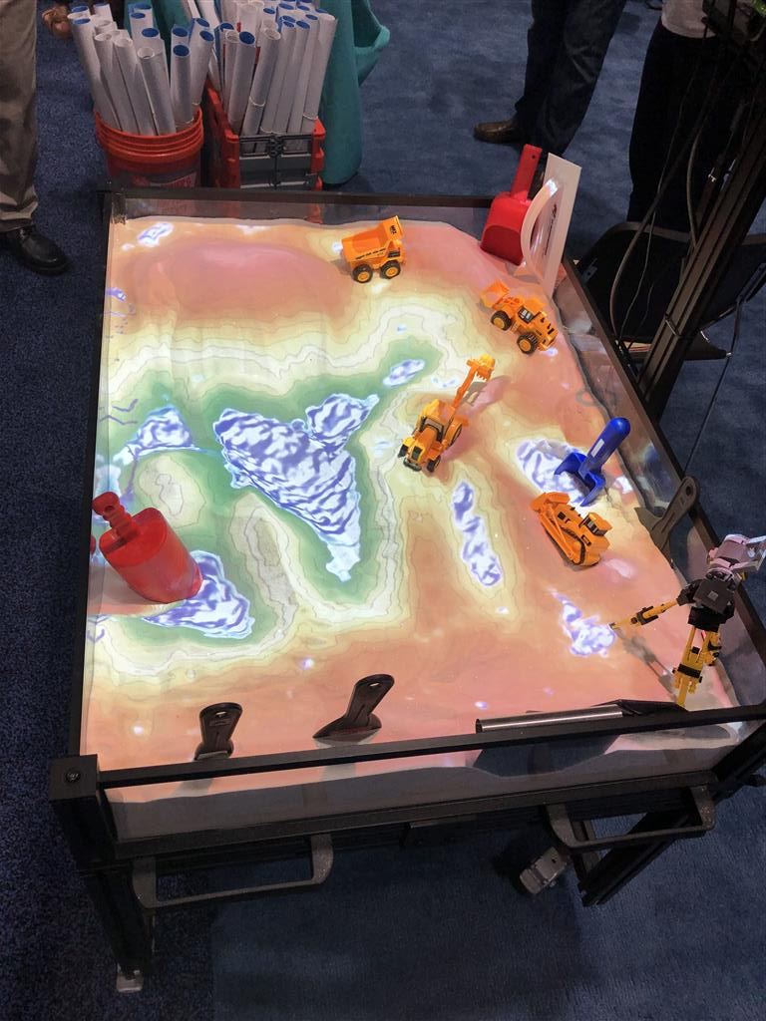
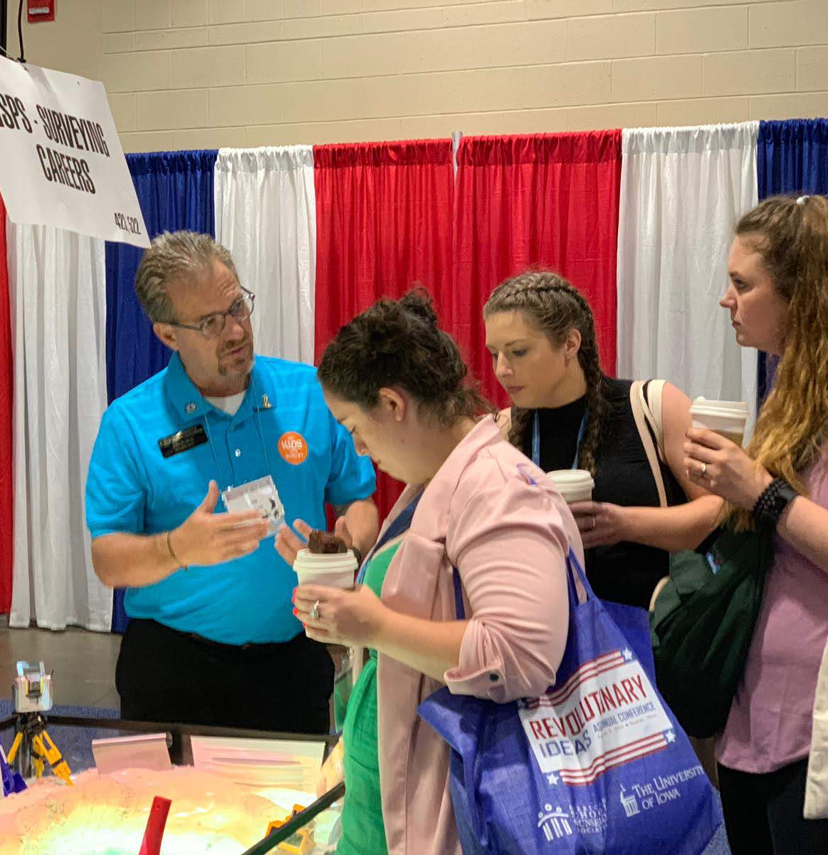
Do you have your sandbox?

Slide 25


Slide 26
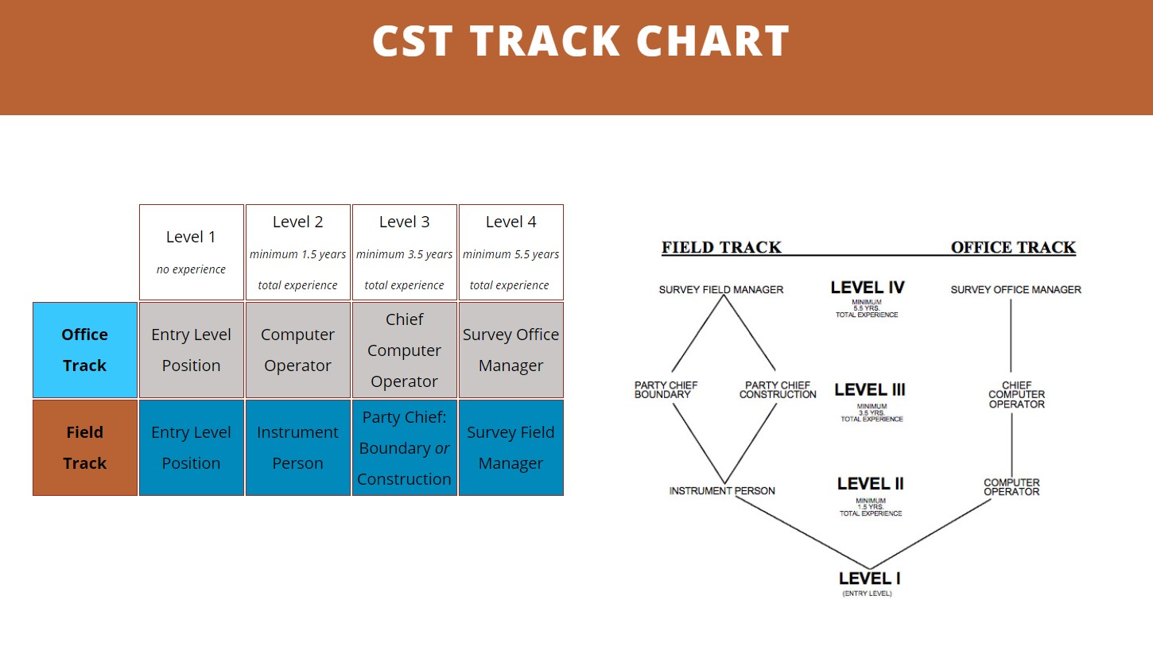

Slide 27

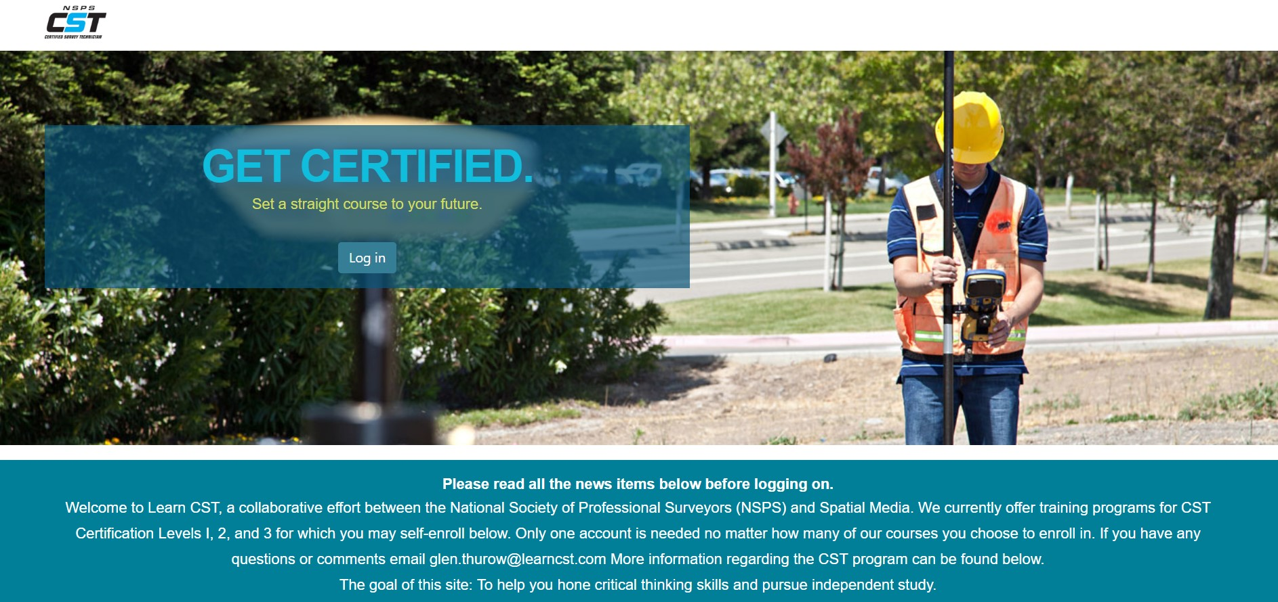
LearnCST.com

Slide 28

NSPS BROCHURES

Slide 29


Slide 30
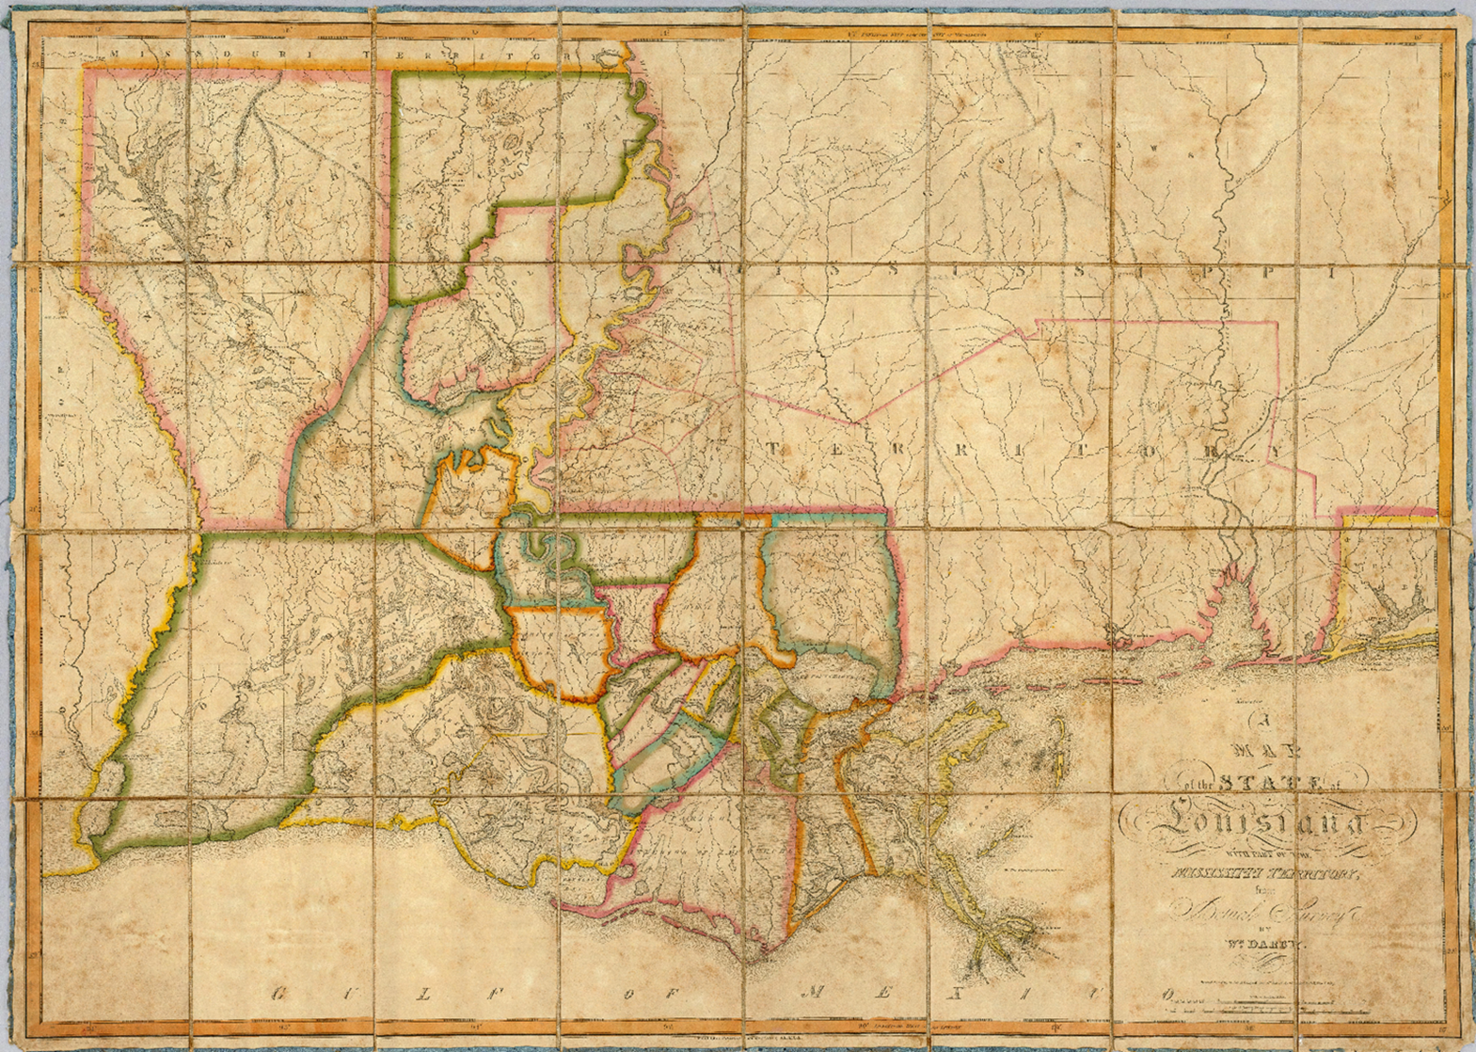
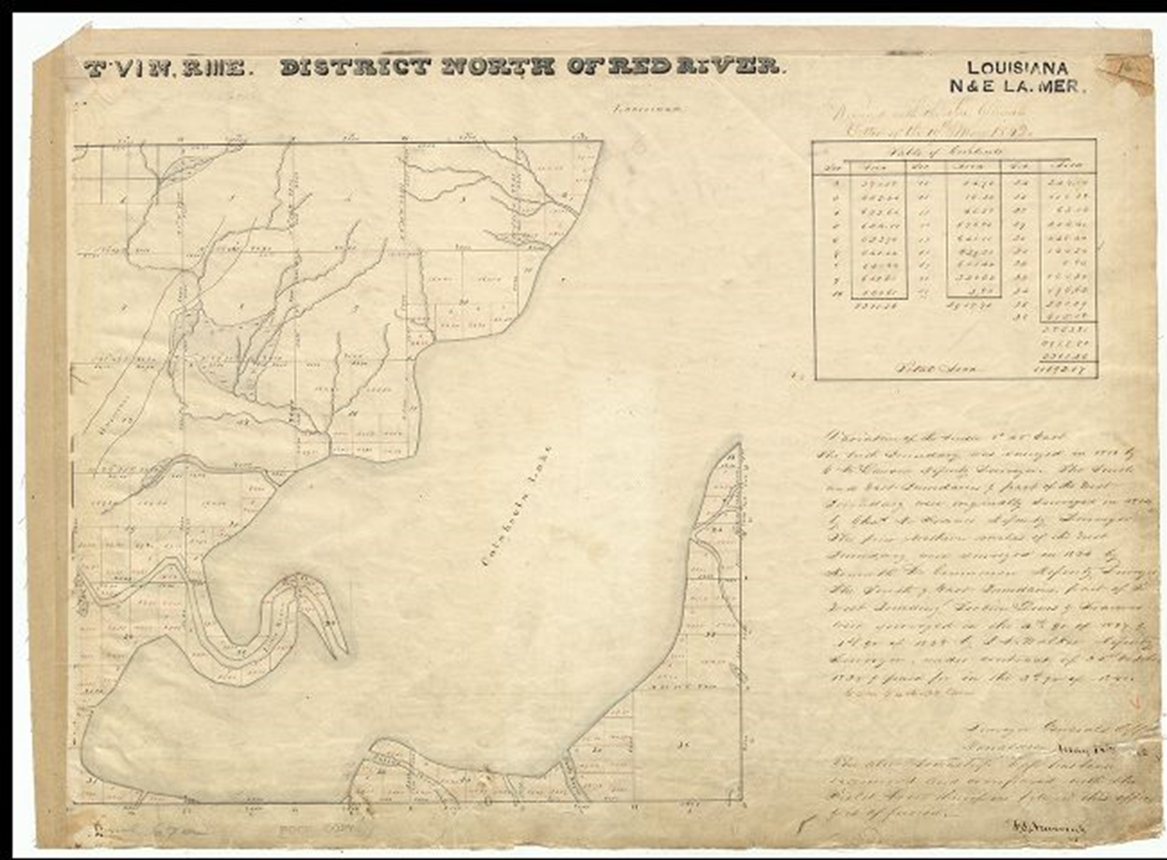
Crooks v. state of Louisiana
What should determine boundaries?
Cartography map or glo/blm survey?
The local courts ruled the mapmaker…
By local mapmaker
Gov’t Survey

Slide 31
Nsps government affairs
Crooks VS State of Louisiana
January 2019
Case filed with the State Supreme Court that involved ignoring the original GLO plat and rules associated with the disbursement of Federal Lands
NSPS contacted less then 2 weeks before an Amicus Brief was needed to be filed with the State
NSPS ExCom Board decided to move forward to protect the historic system used by 30 states
NSPS ExCom Board members worked with a Wisconsin Surveyor that also was a Wisconsin Bar member to construct an Amicus Brief to recognize the GLO Plats
NSPS ExCom Board worked with a Louisiana Attorney to file within 6 Days of first notification
Case waiting to be heard before Louisiana State Supreme Court (July 2019)

Slide 32
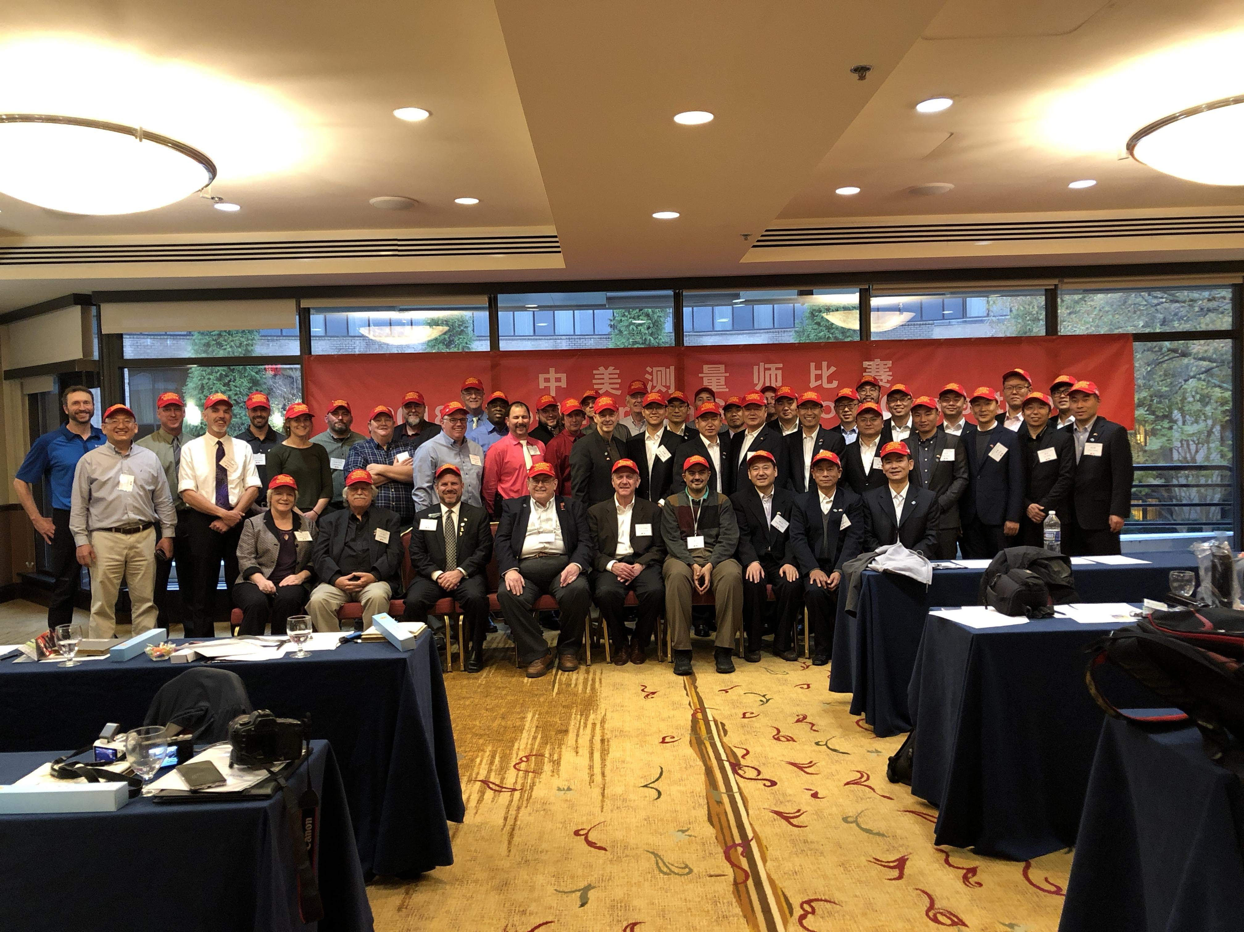
SINO American surveying competition
Washington dc - November 2018

Slide 33
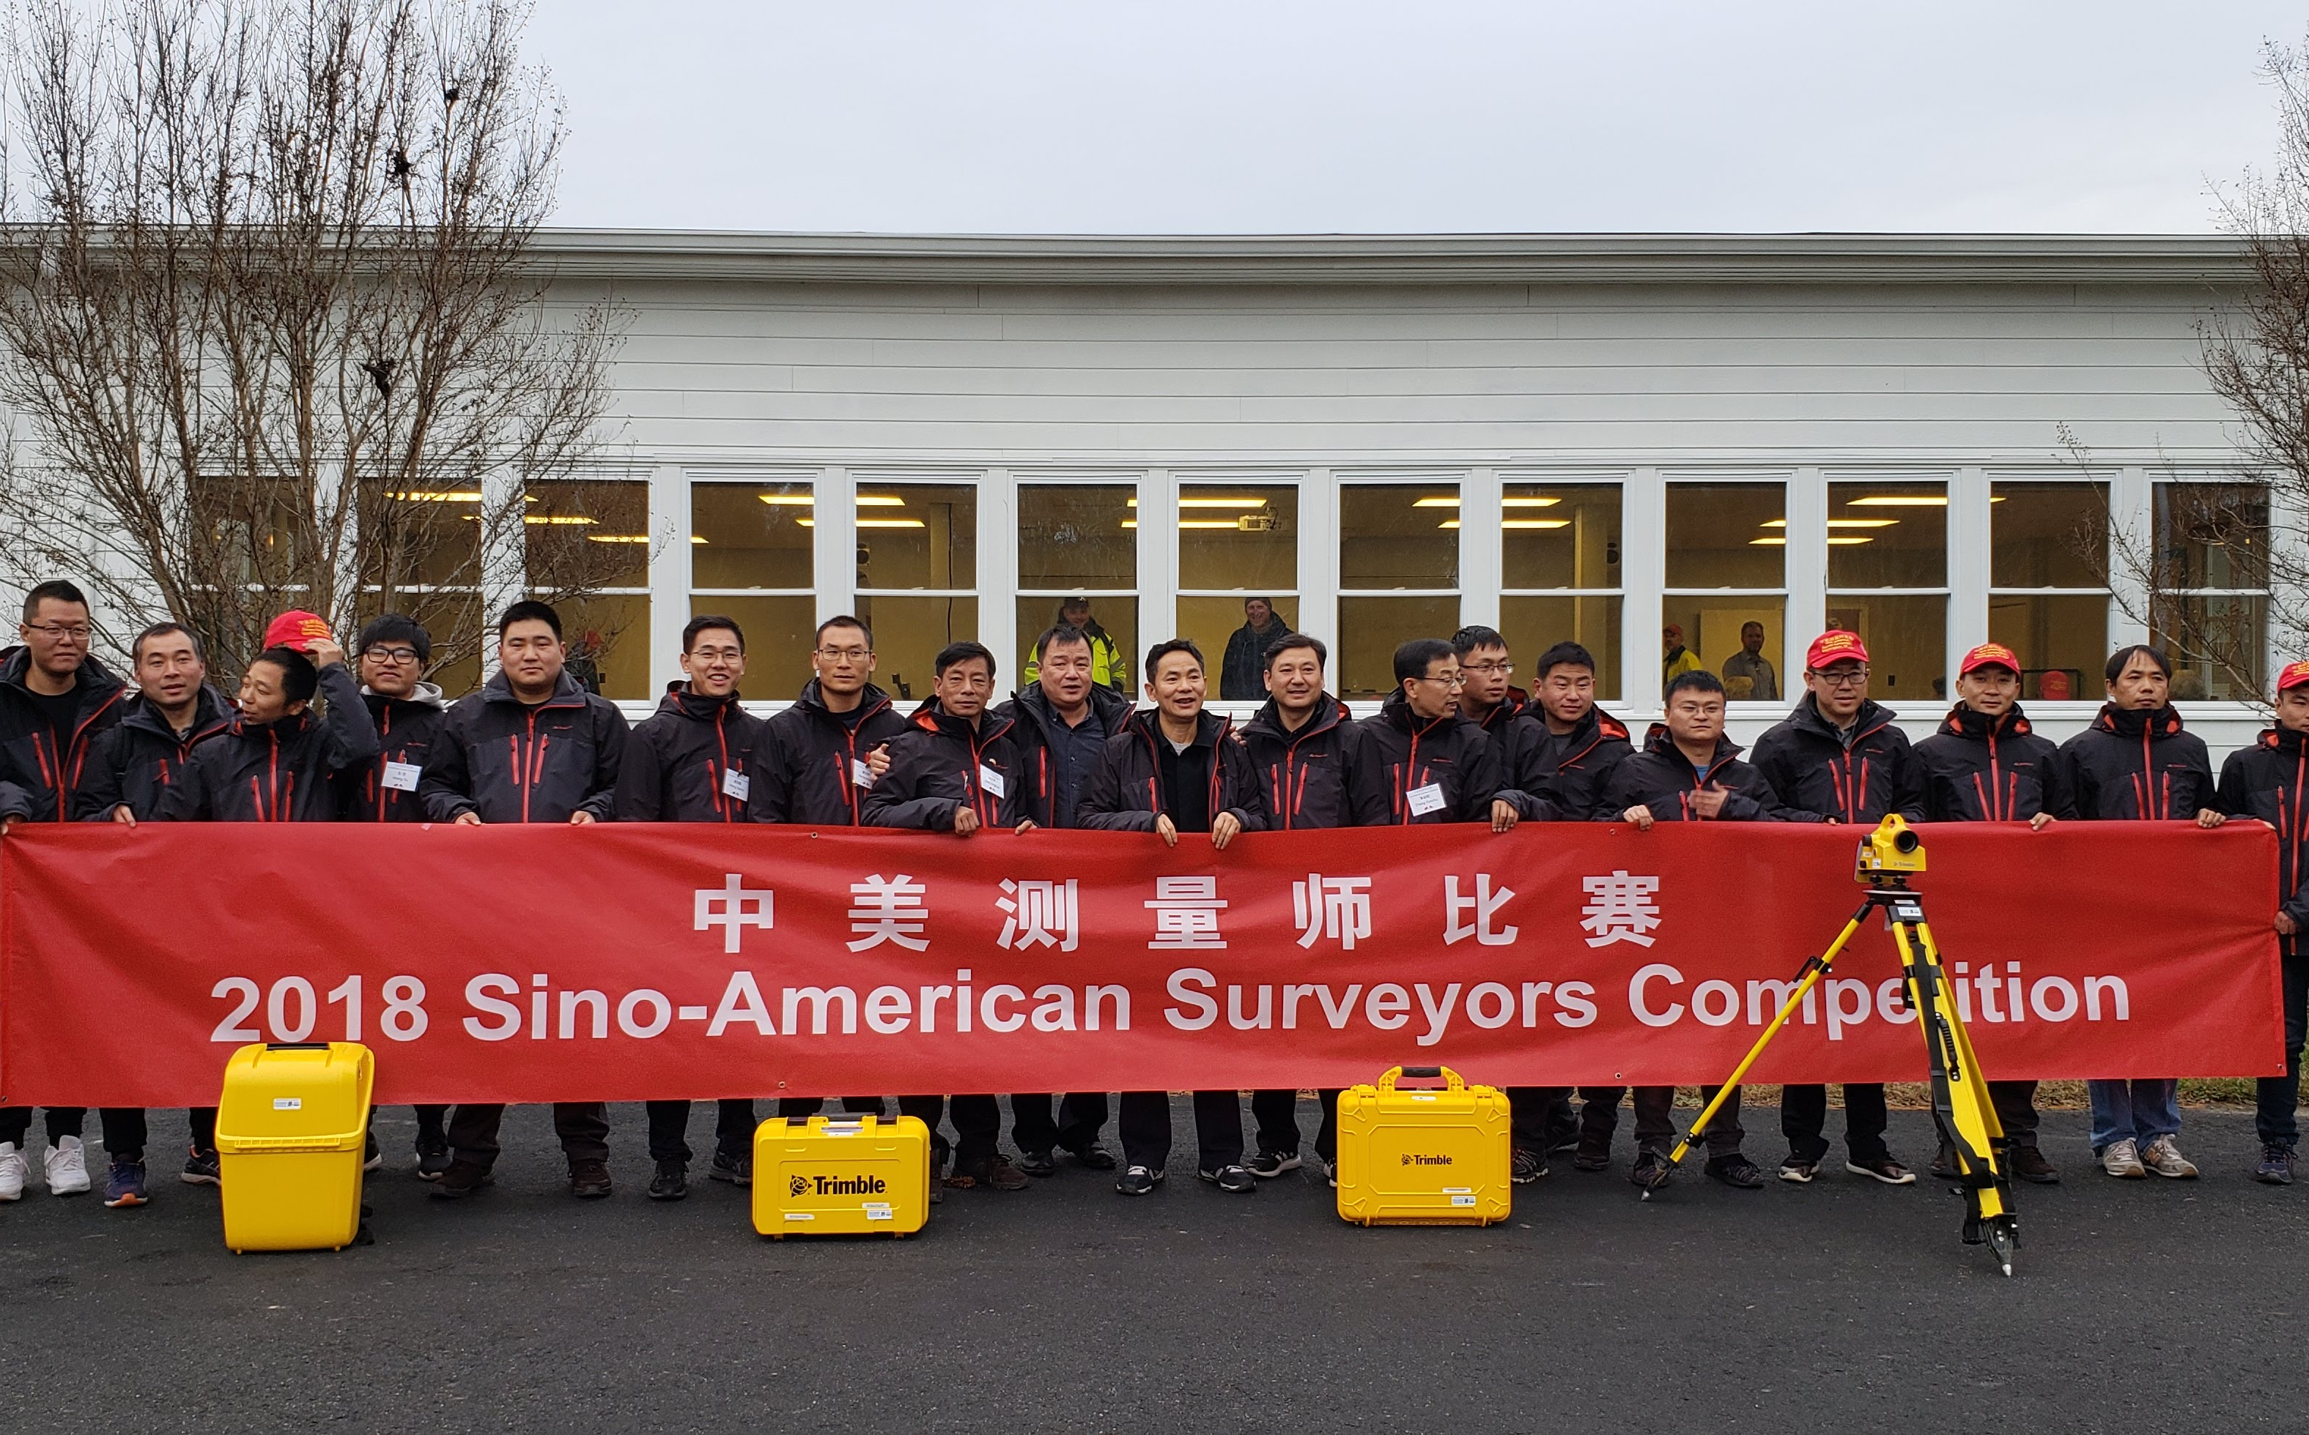
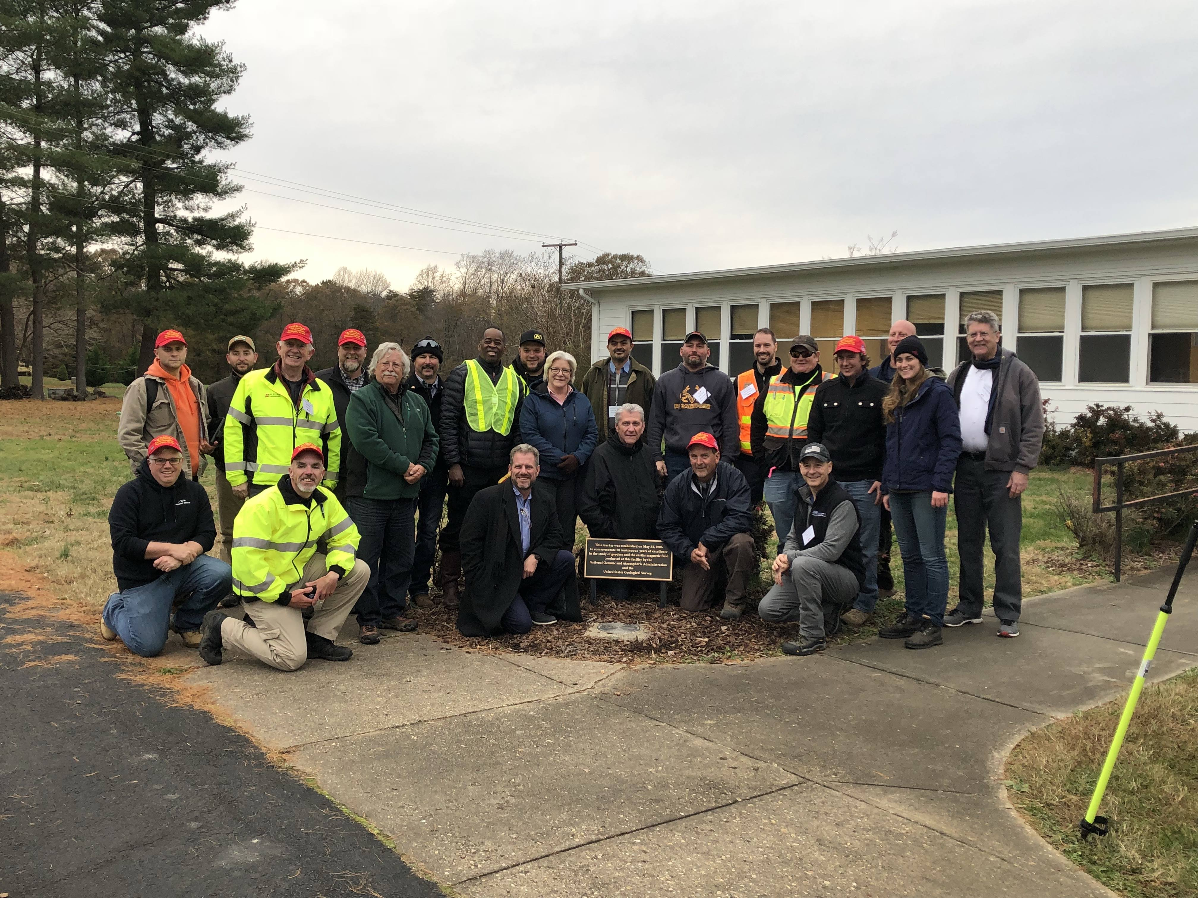
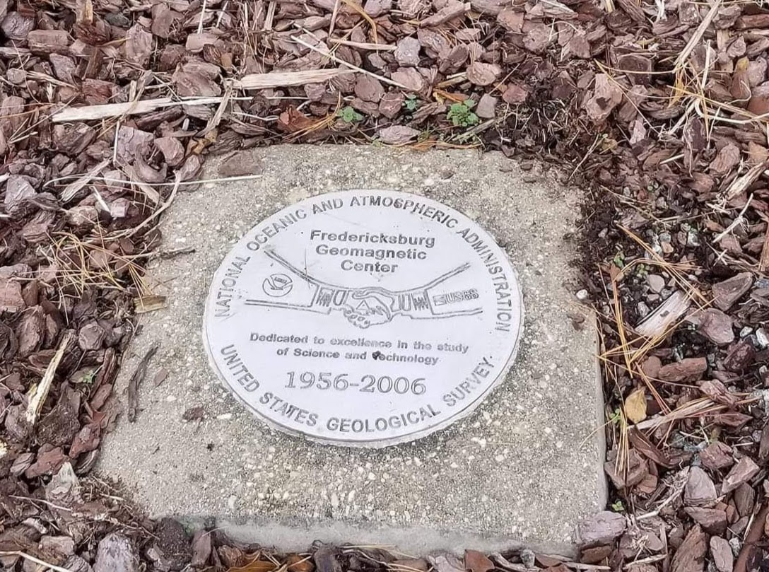
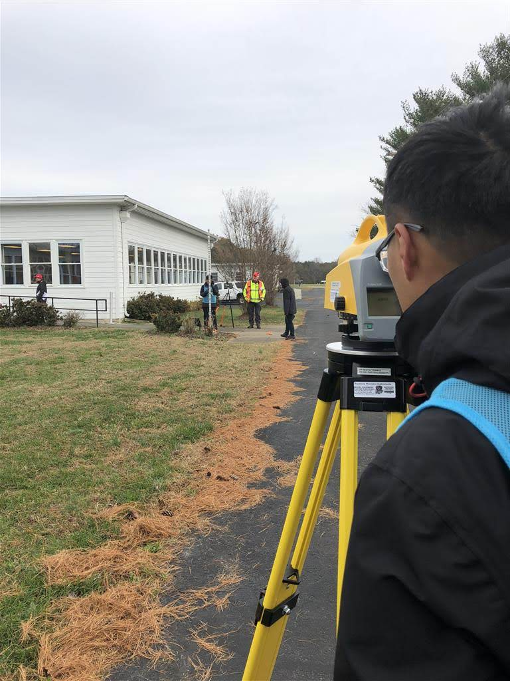
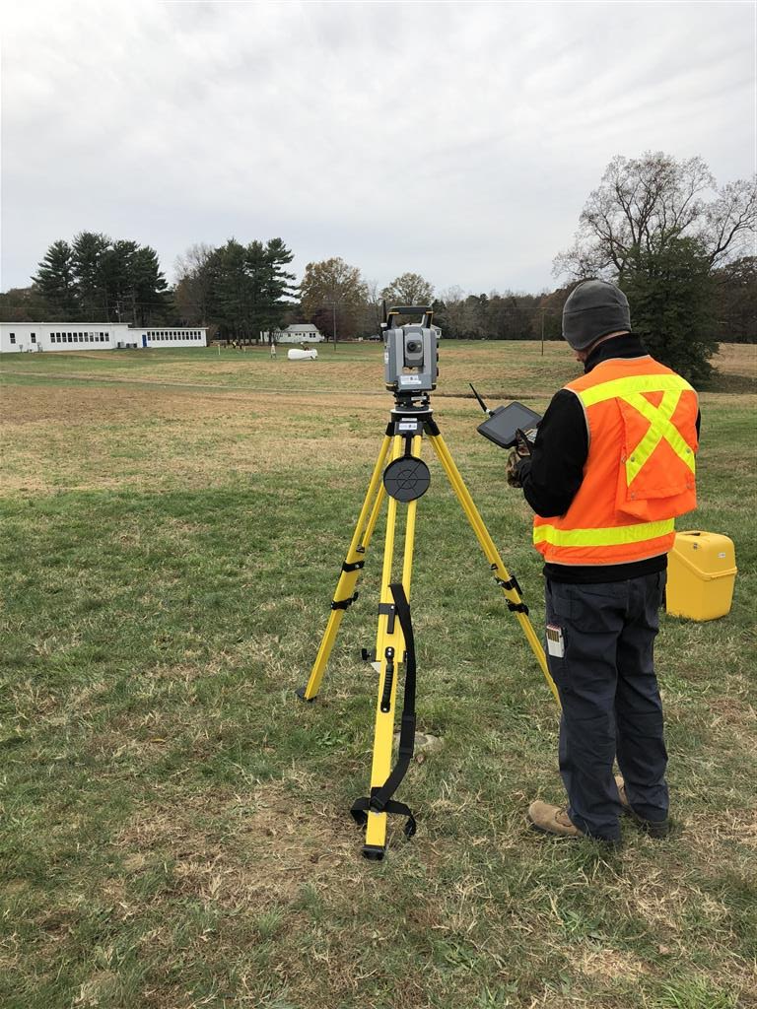
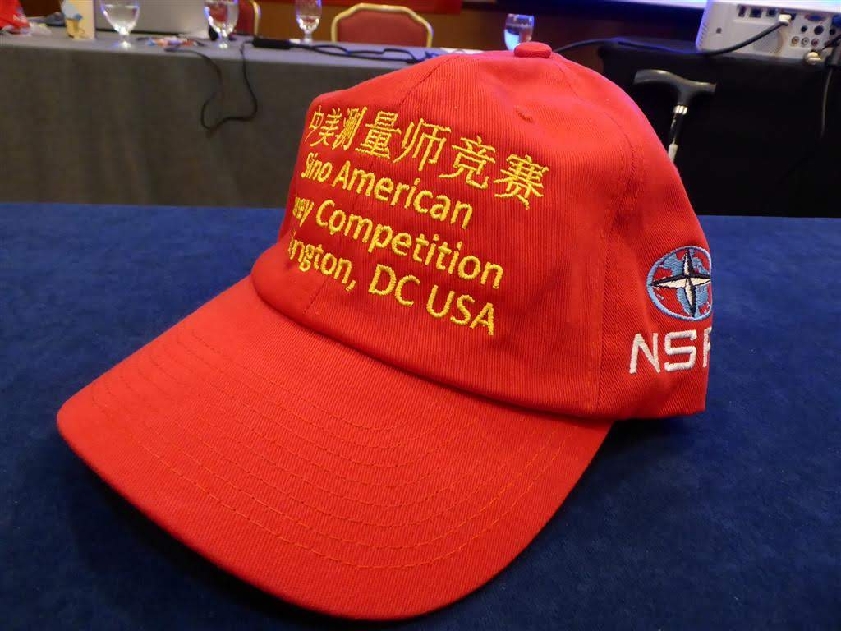
SINO American surveying competition
Washington dc - November 2018

Slide 34
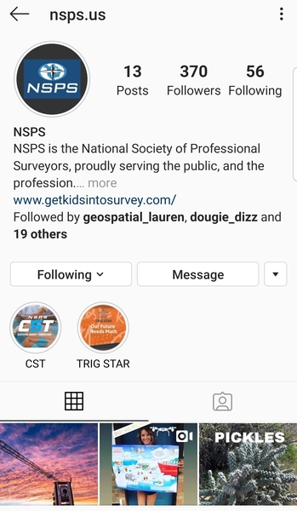
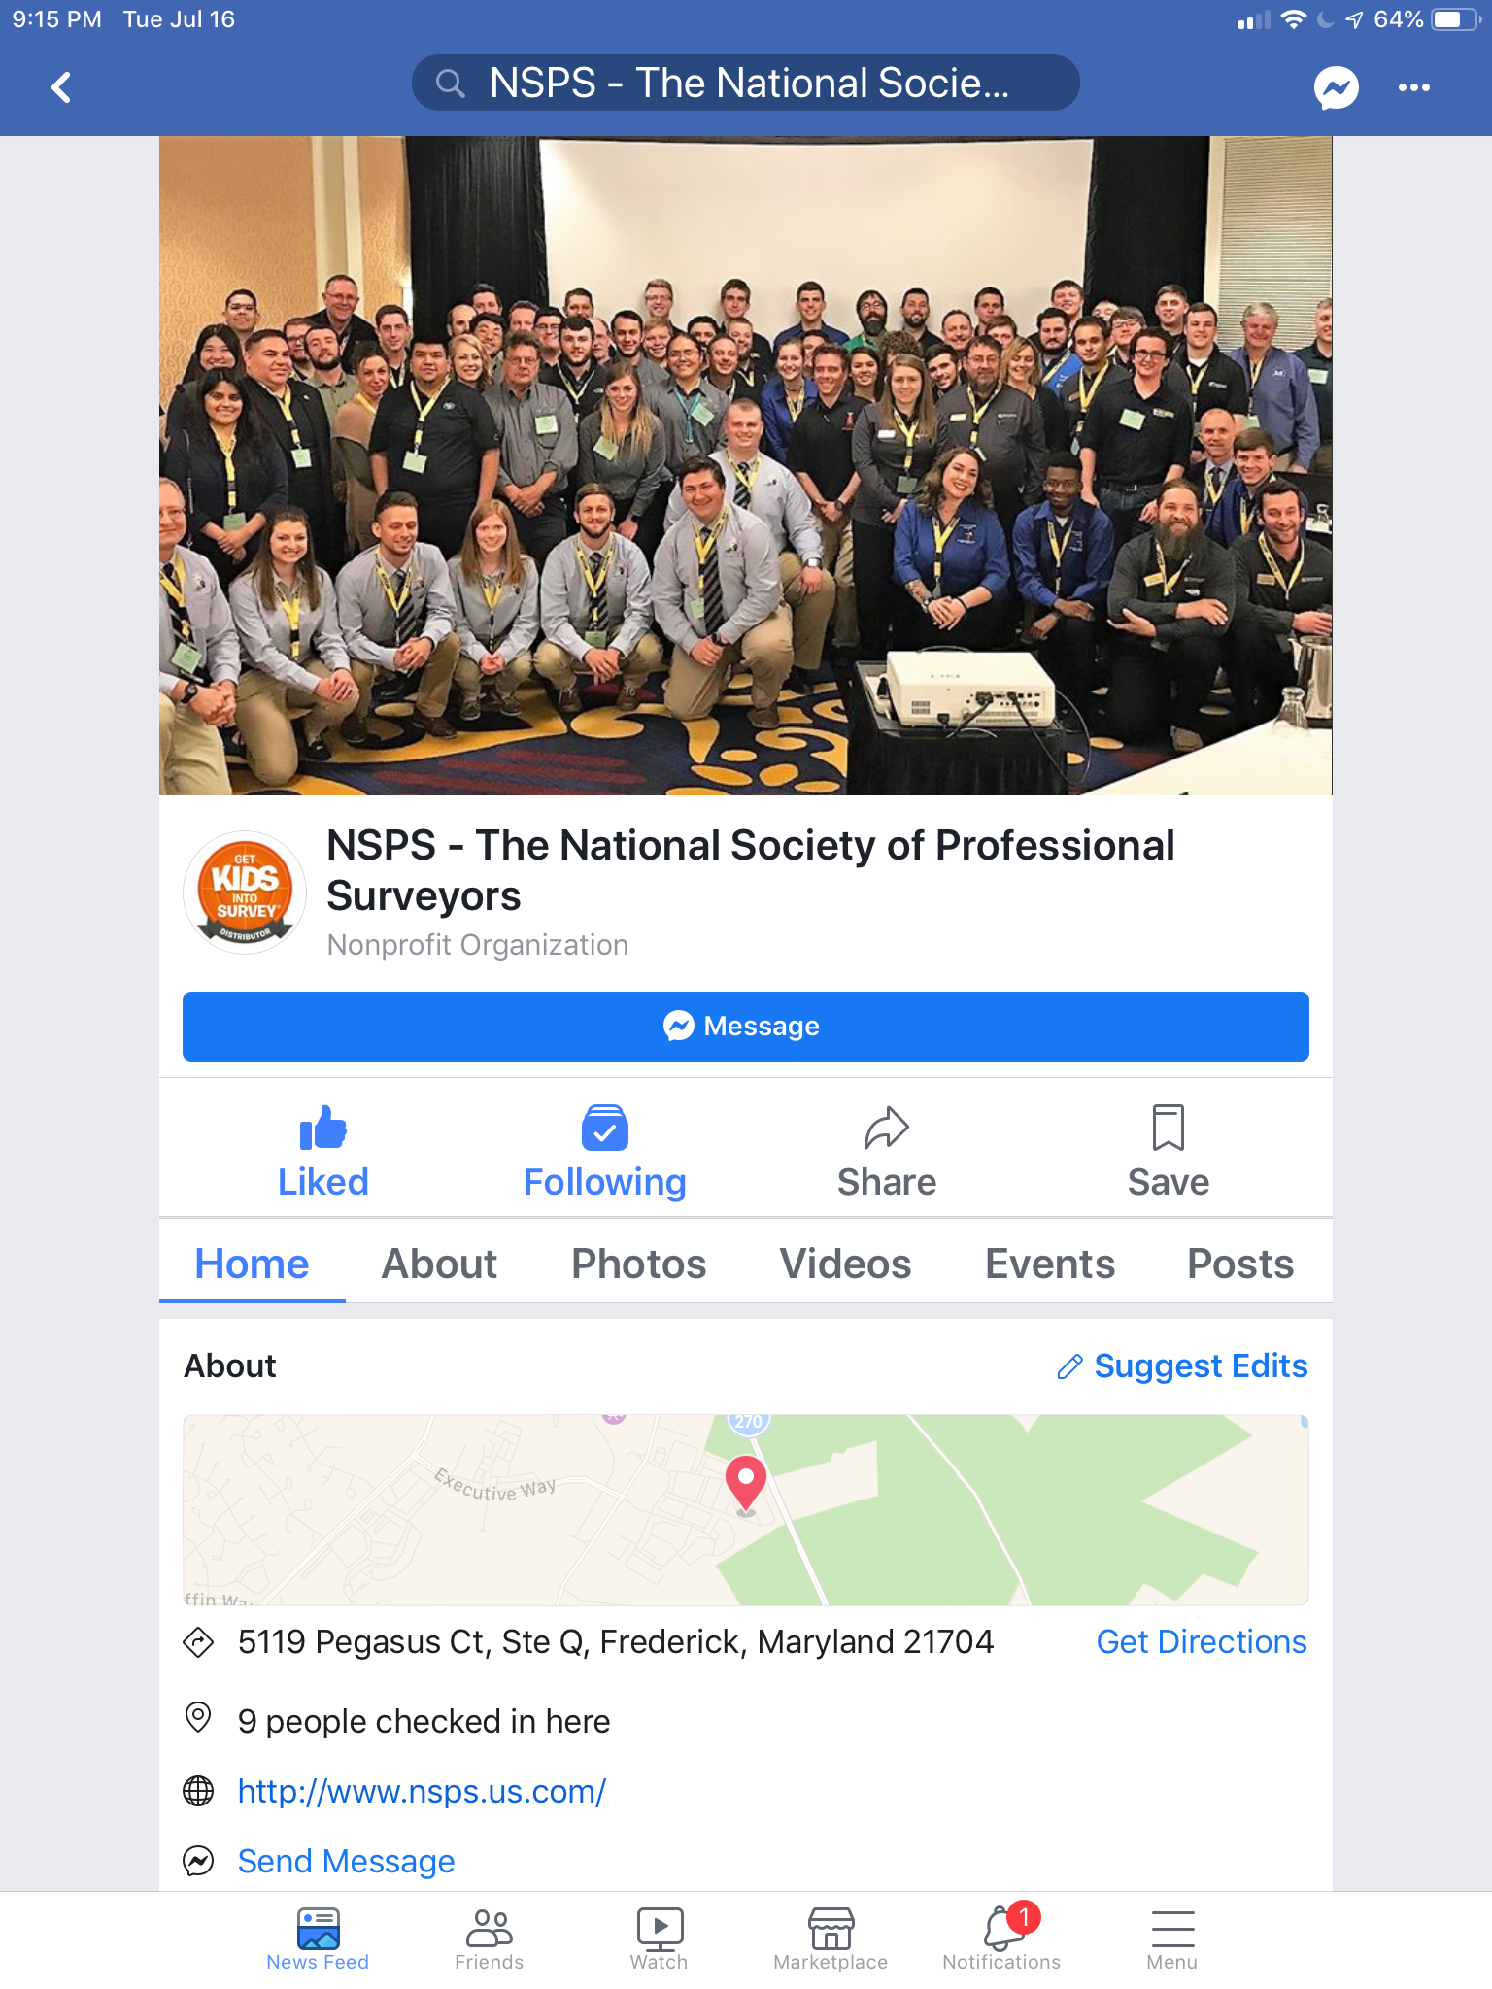
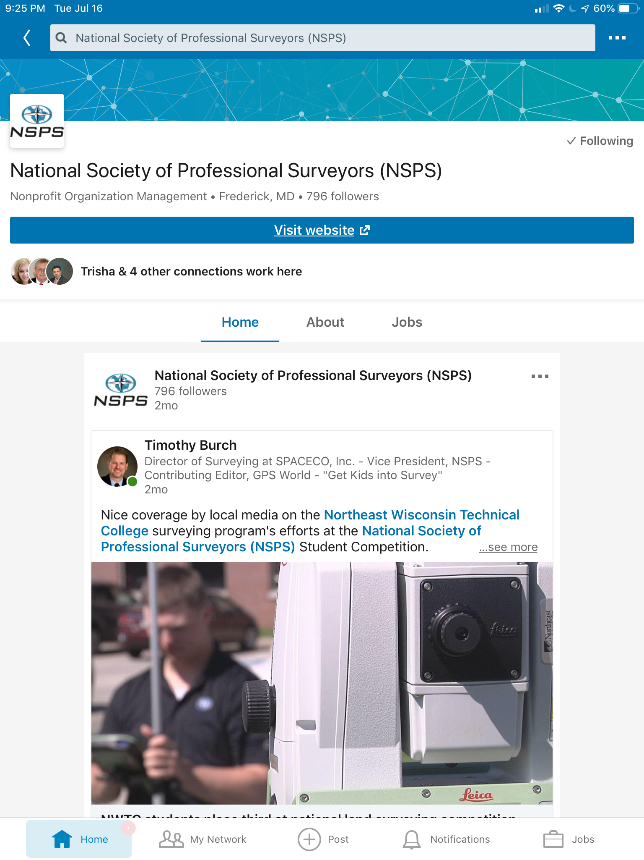
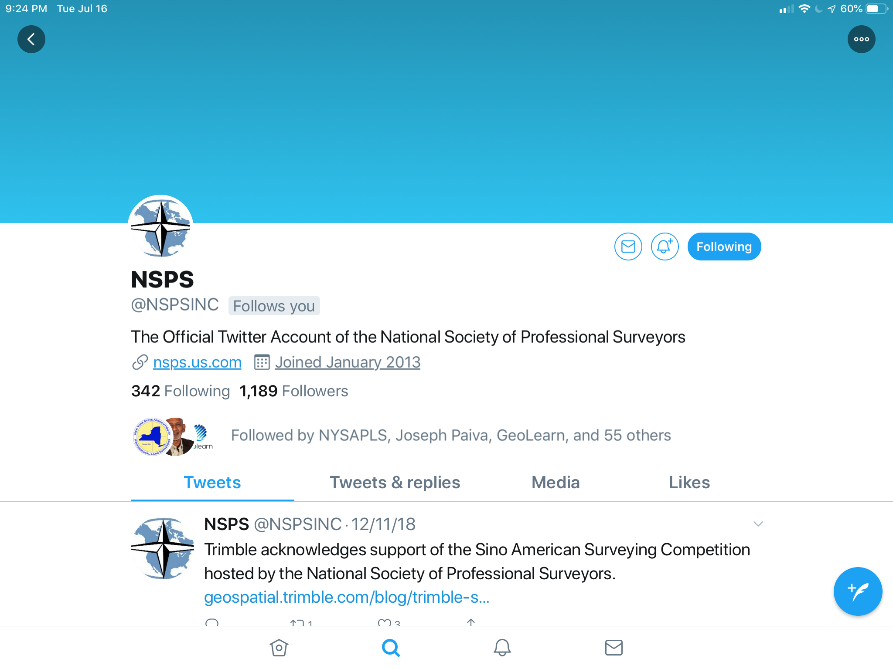
NSPS – Social media style

Slide 35
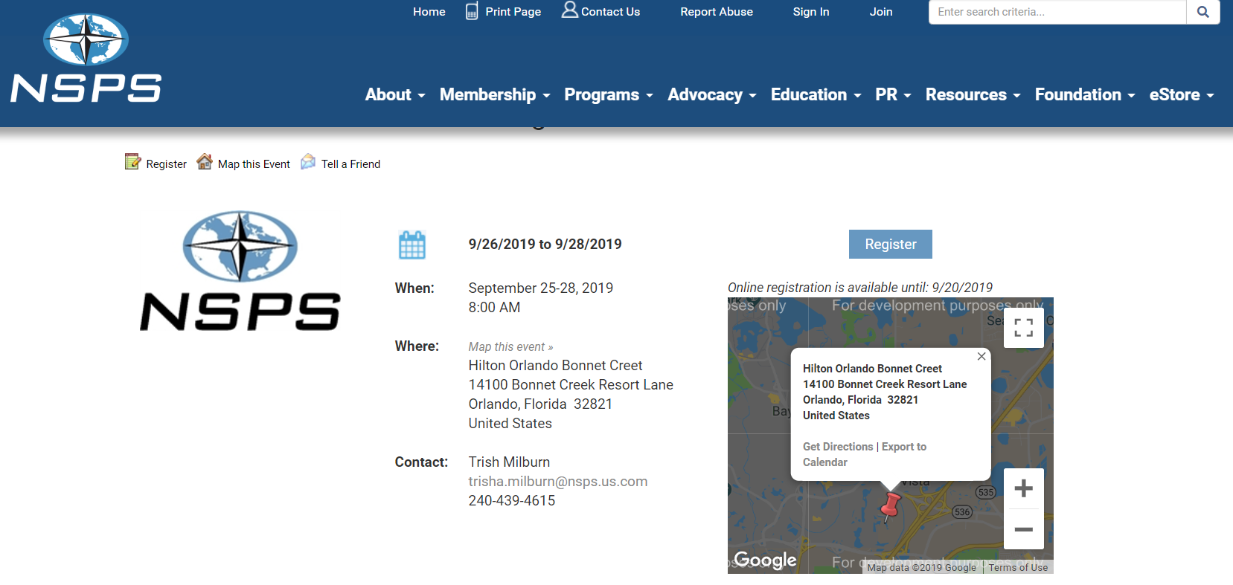
Fall 2019 business meetings

Slide 36

Calling all golfers!!!

Slide 37


National Society of Professional Surveyors (NSPS) to host 2023 FIG Working Week
Preserving Our Heritage – Conquering New Frontiers
Orlando, Florida USA
27 May – 3 June 2023

Slide 38














Supporting Organizations

Slide 39

Ten Commissions lead FIG’s technical work:
COMMISSION 1- Professional Practice
W
COMMISSION 2- Professional Education
W
COMMISSION 3- Spatial Information Management
W
COMMISSION 4- Hydrography
W
COMMISSION 5- Positioning and Measurement
W
COMMISSION 6- Engineering Surveyors
W
COMMISSION 7- Cadastre and Land Management
W
COMMISSION 8- Spatial Planning and Development
W
COMMISSION 9- Valuation and the Management of Real Estate
W
COMMISSION 10- Construction Economics and Management

Slide 40
Mission of FIG Commission 2:
Promote good practices in professional surveying education by: Exploring the needs of society and endorsing universities and other educational organizations to develop mechanisms and processes that will help to meet those needs
Supporting and promoting advances in survey education through identification of core surveying knowledge
Promoting cooperative ventures in surveying education and research
Supporting the building of capacity for surveying education in the developing world
Reinforcing contacts to educational commissions of related professions
Improving dissemination of information on all of the above

Slide 41
2023 FIG Working Week is the ideal venue to hold the 2023 SaGES 29th Biennial Conference
Surveying educators from around the world will attend
and participate in the working week
providing the perfect opportunity
for SaGES members
to participate and network
with peers from around the world

Slide 42

The perfect networking opportunity!
We hope SaGES will join FIG in 2023
Celebrating 60 years as an
FIG Member Association
1959-2019

Slide 43

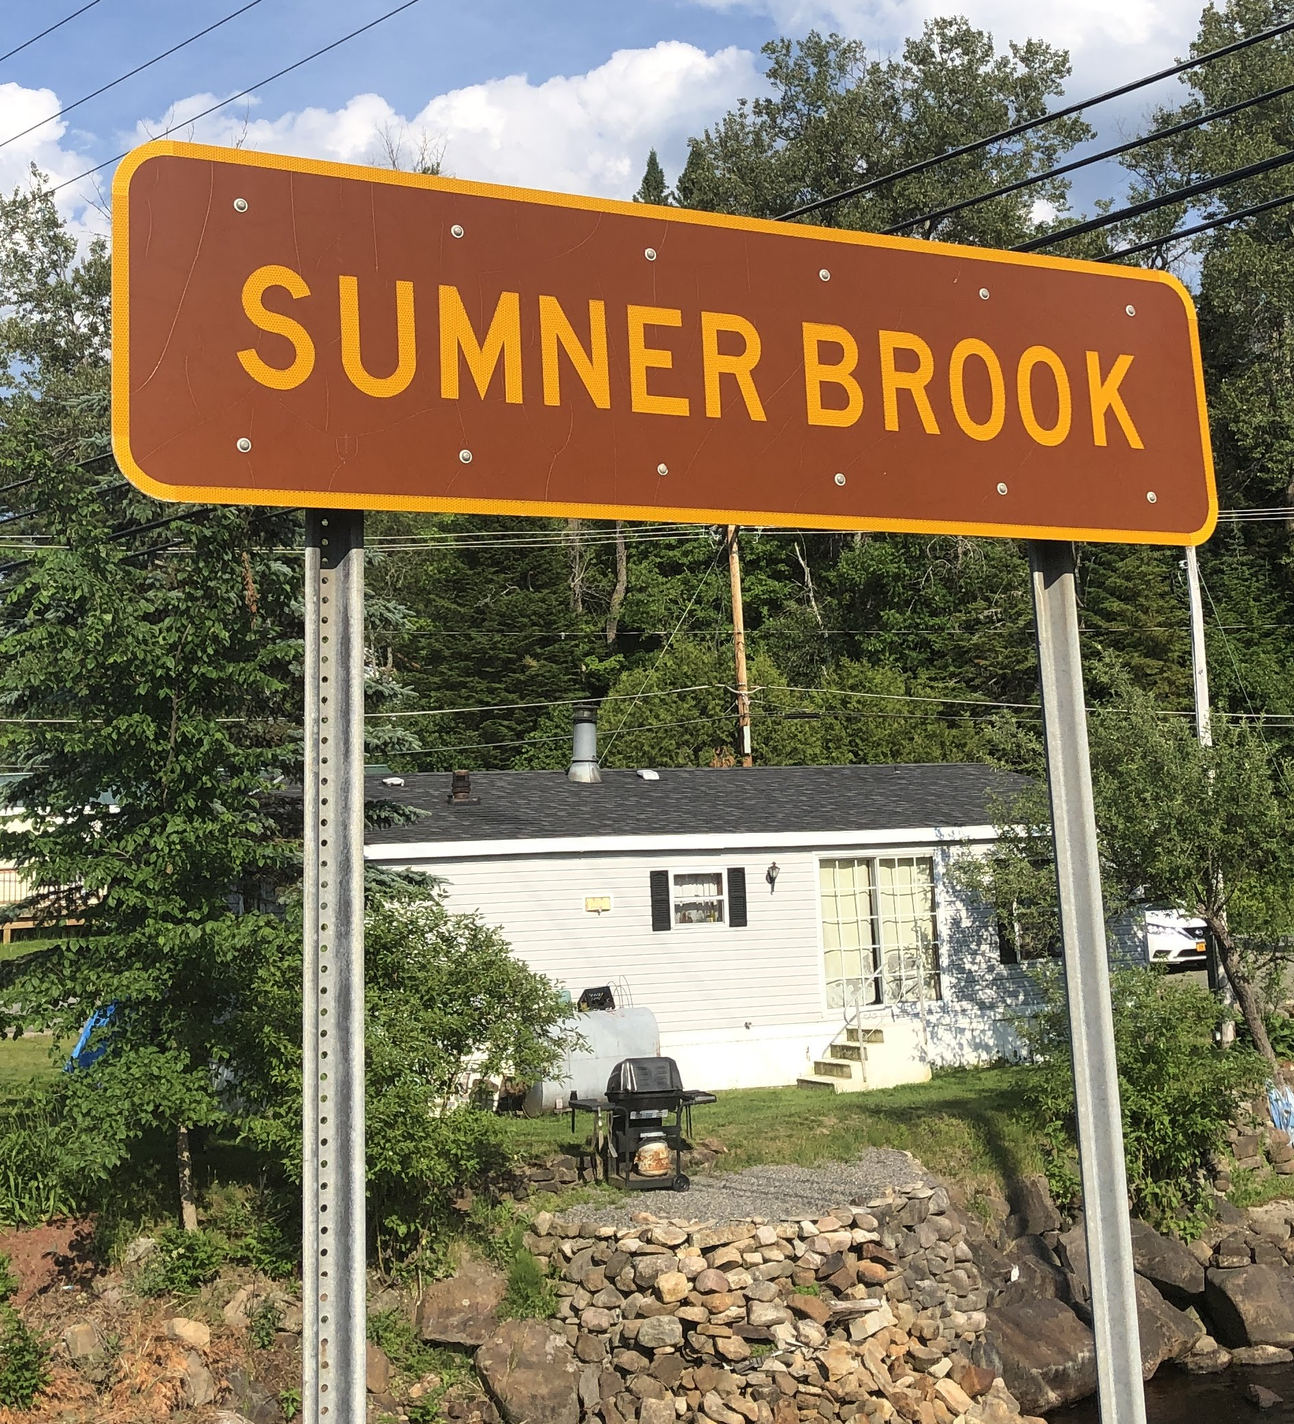

Slide 44



Thank you for attending and participating!

